Slide 1
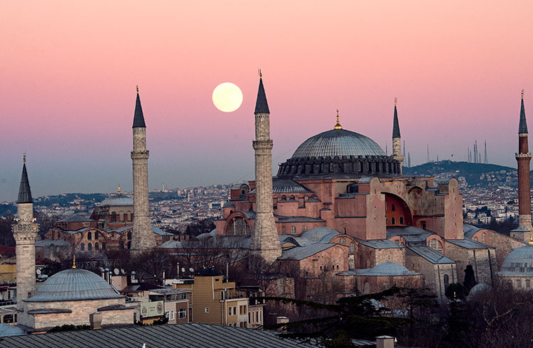
Pick one of the shapes you see in this photo.
Sketch your shape.
Now sketch one that is the SAME in one way and DIFFERENT in another way.
1.G.A2
Notes:
Week of January 3, 2022

Slide 2
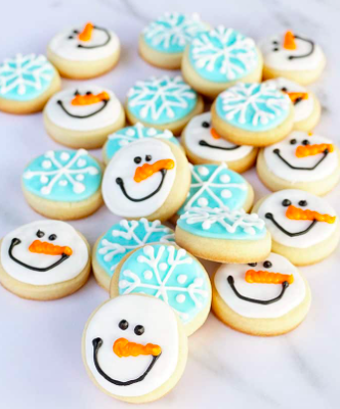
How many snowy-day cookies do you see?
How can you count them?
Write an equation to match your thinking.
1.OA.C6

Slide 3
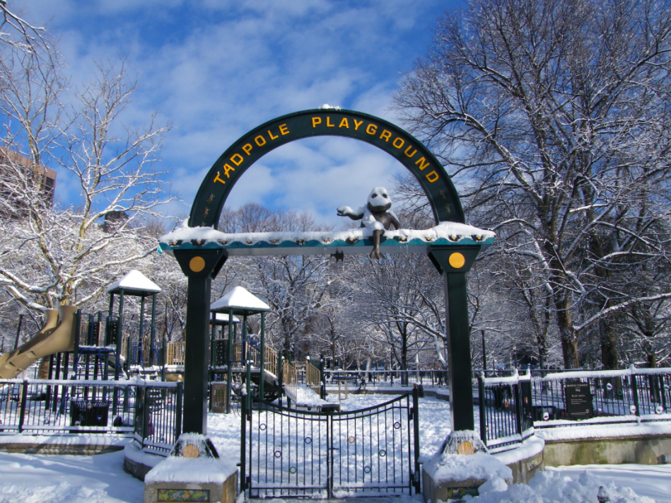
What shapes do you see hiding in this picture?
1.G.A1

Slide 4
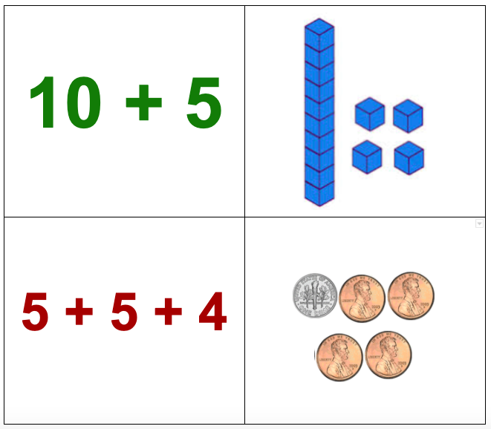
Which one does not belong?
1.NBT.B2

Slide 5
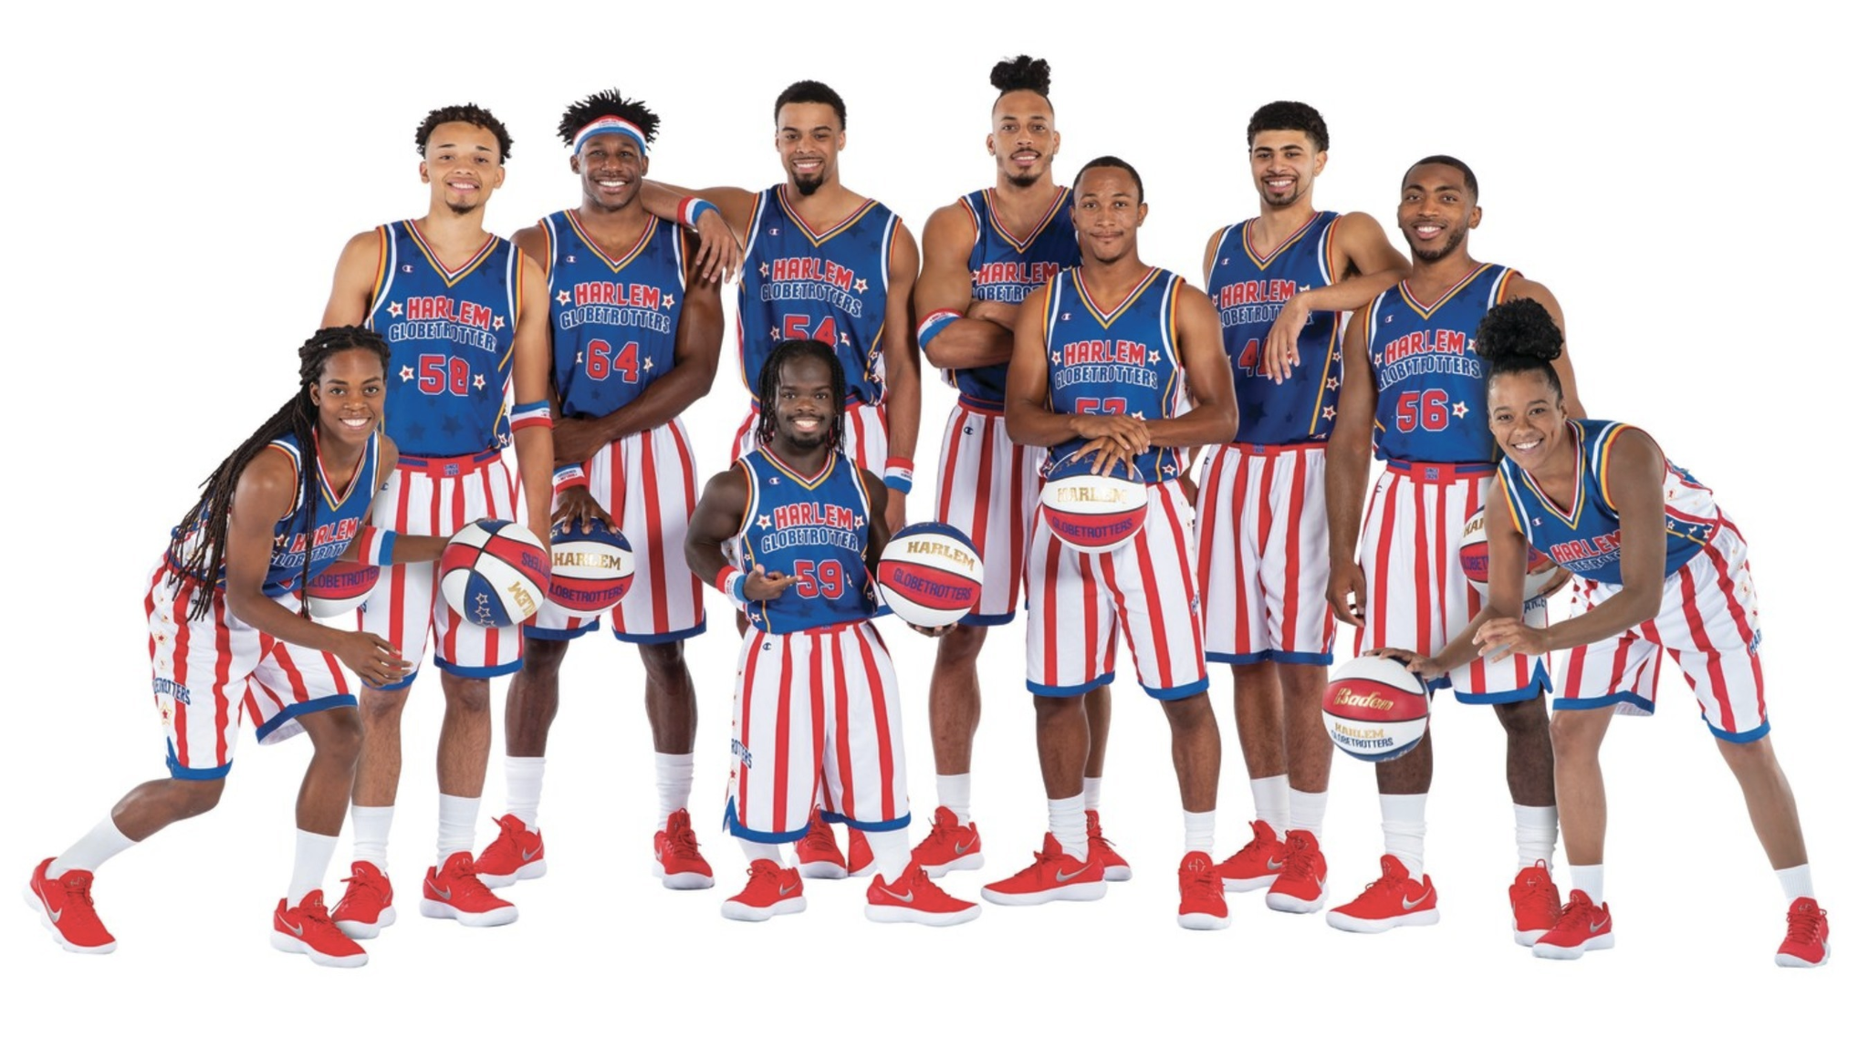
It’s Harlem Globetrotter’s Day!
How many players are on the team?
How many different equations can you create to match this number?
1.OA.C6
Notes:
January 7, 2022
Harlem Globetrotter’s Day

Slide 6
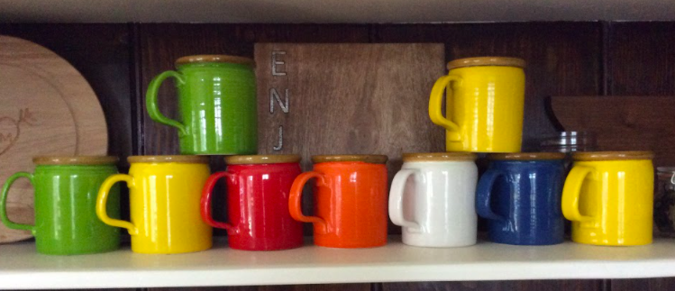
How many mugs do you see?
How many different expressions can you record to match the picture?
1.OA.C6
Notes:
Week of January 10, 2022

Slide 7
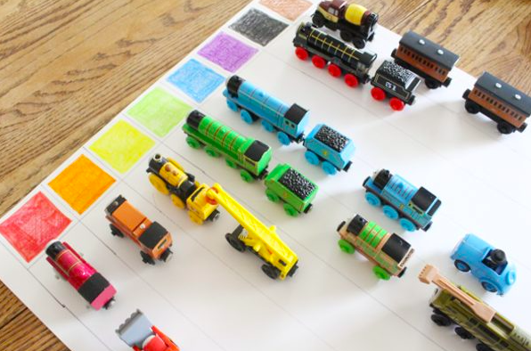
What might be going on here?
1.MD.C4

Slide 8
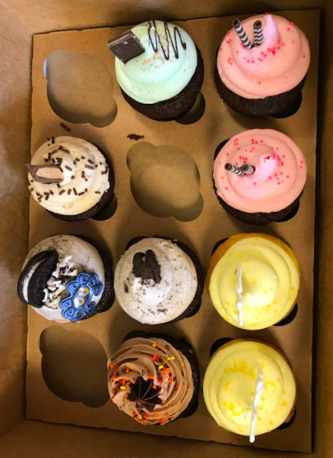
How many cupcakes do you see?
How many don’t you see?
Can you write an equation to match your thinking?
Can you think of any other equations to match the picture?
1.OA.A1

Slide 9
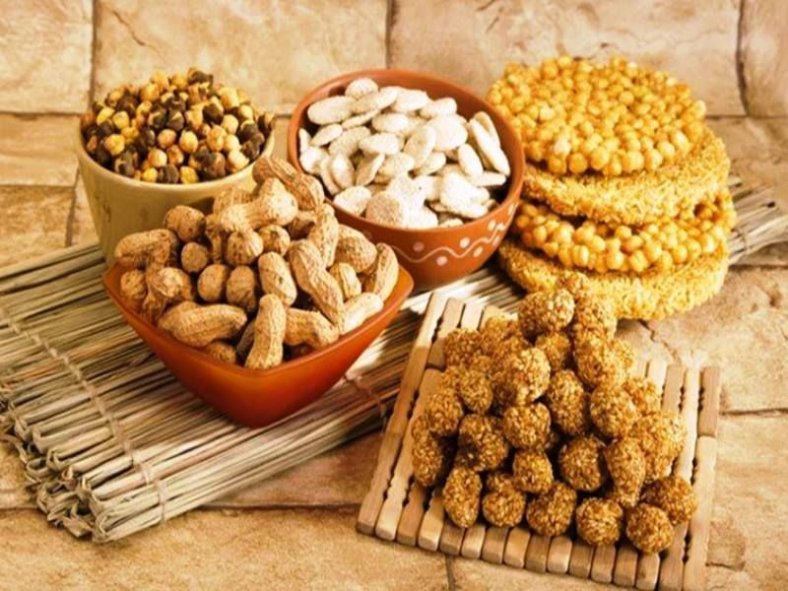
Happy Lohri!
What can be counted in this photo of traditional treats?
What can we estimate?
1.OA.C5
Notes:
January 13, 2022
Lohri (India)

Slide 10
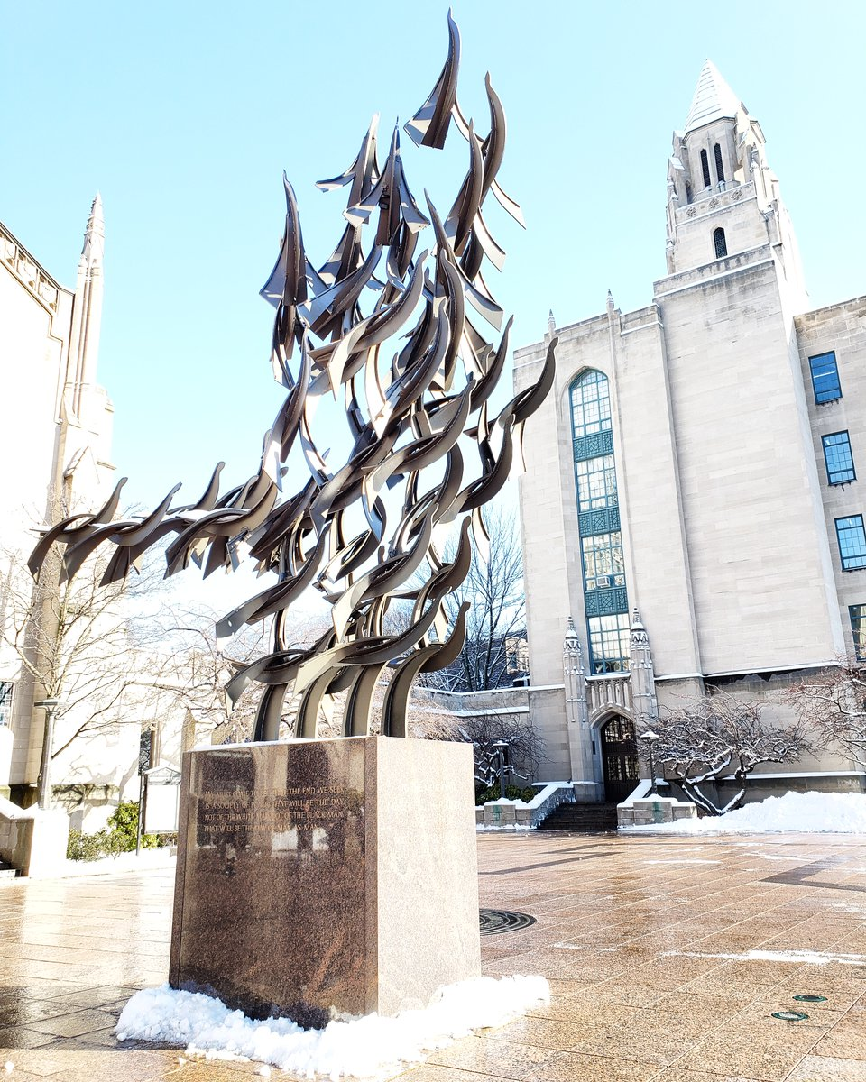
“Free at Last” a sculpture in Boston that honors Martin Luther King Jr.
features 50 doves.
How many different equations can you create that equal 50?
“Free at Last” Boston University, Sergio Castillo
1.NBT.C4
Notes:
Week of January 18, 2022
Martin Luther King Jr. Day

Slide 11
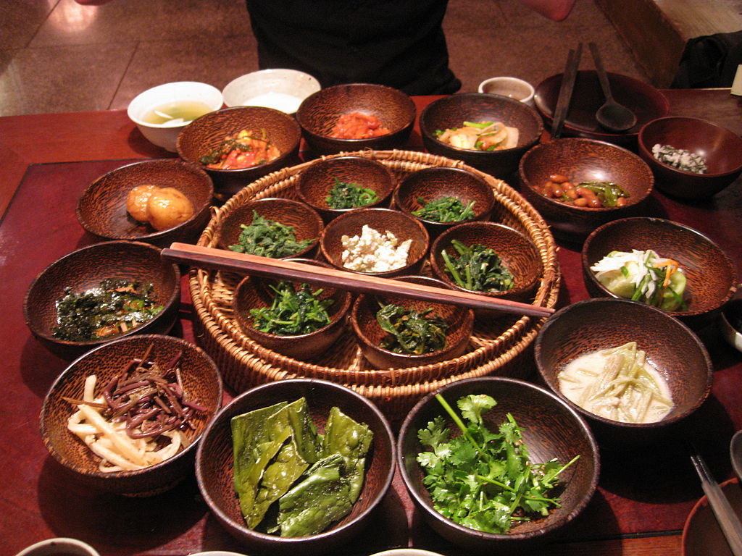
It’s Mahayana New Year in Northeast Asia!
How many bowls do we see here?
How do we see them?
Create an expression to match your thinking?
1.OA.C6
Notes:
January 18, 2022
Mahayana New Year, Northern Asia

Slide 12
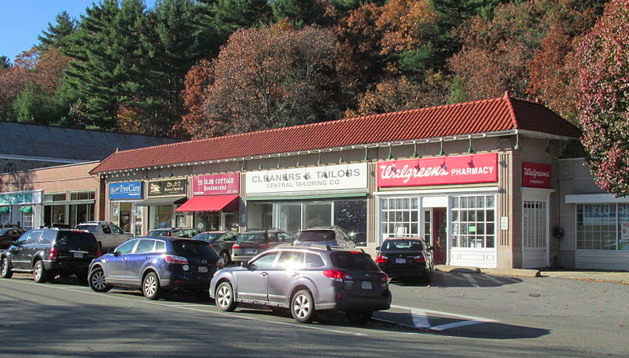
Talk about the different shapes you see here.
1.G.A1

Slide 13
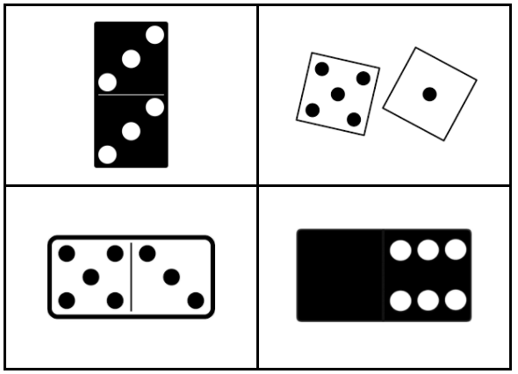
Which one does not belong?
1.OA.C5

Slide 14
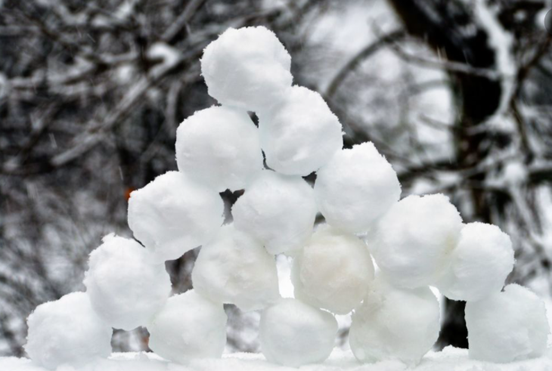
Are there more than 10 snowballs or less?
Write a number sentence to match the picture.
1.OA.A1
Notes:
Week of January 24, 2022

Slide 15
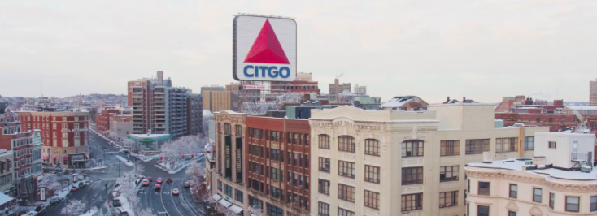
What shapes do you see?
What would happen if you cut some of the shapes in half?
1.G.A3

Slide 16
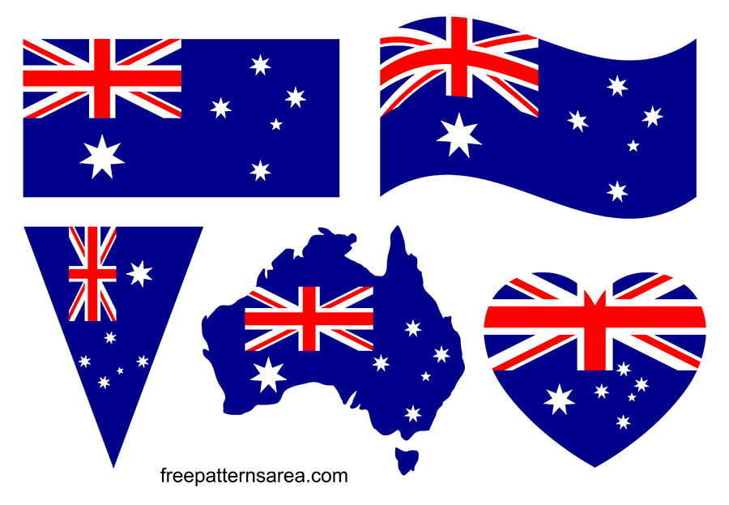
Happy Australia Day!
What’s the Same?
What’s Different?
1.G.A1
freepatternsarea.com
Notes:
January 26, 2022
Australia Day

Slide 17
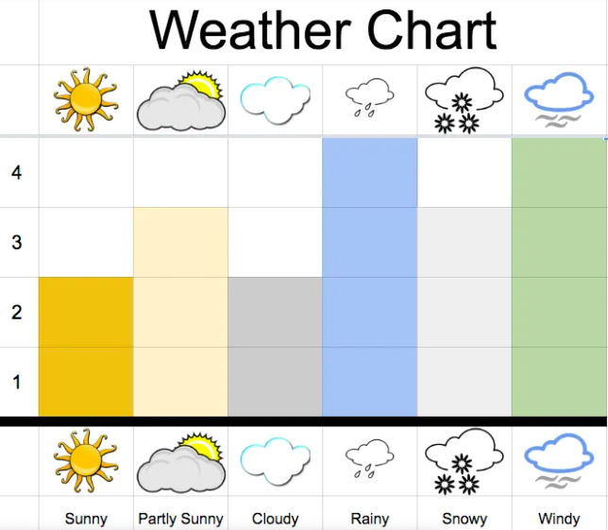
What you notice?
What do you wonder?
What month might this be?
1.MD.C4

Slide 18
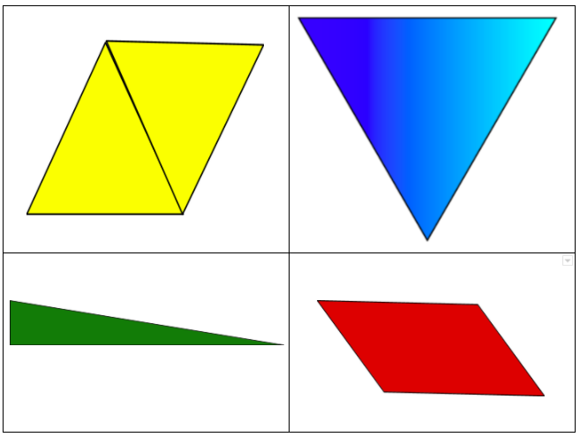
Which one does not belong?
1.G.A2

