Slide 1
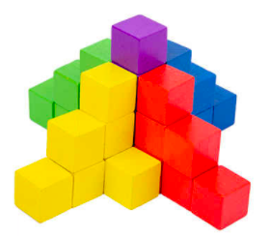
What do we notice? What do we wonder?
How many blocks are here?
How many of each color?
Write a math expression to match your mathematical thinking!
5.MD.C4
Notes:
Week of November 29, 2021

Slide 2
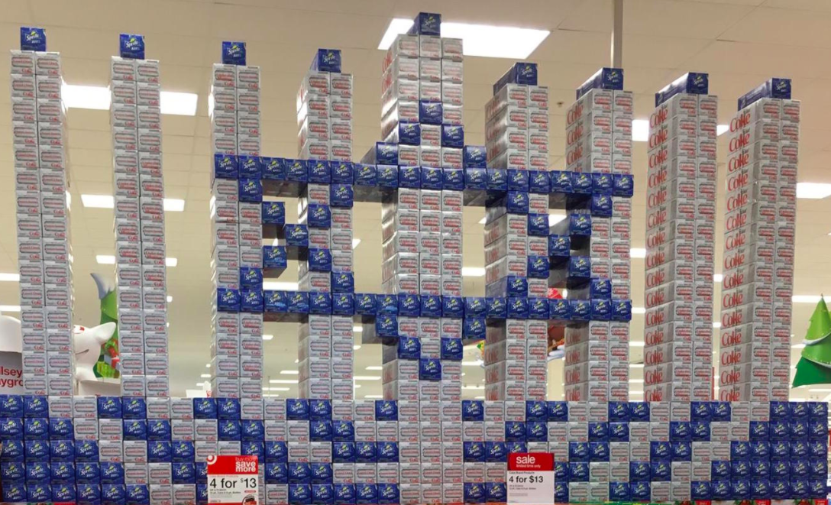
How many cans of soda do you think are here? What is a reasonable estimate?
Talk about strategies you could use to figure it out.
5.NBT.B5

Slide 3
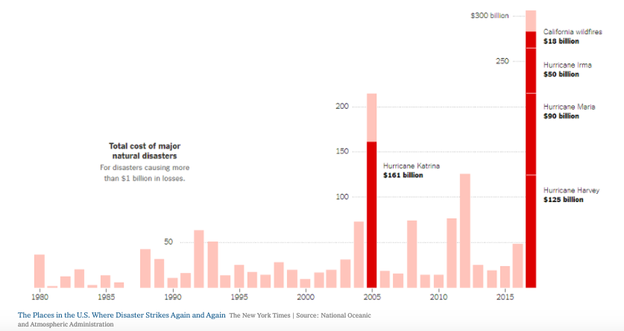
What’s Going On in this Graph?
5.MD.B
5.MD

Slide 4
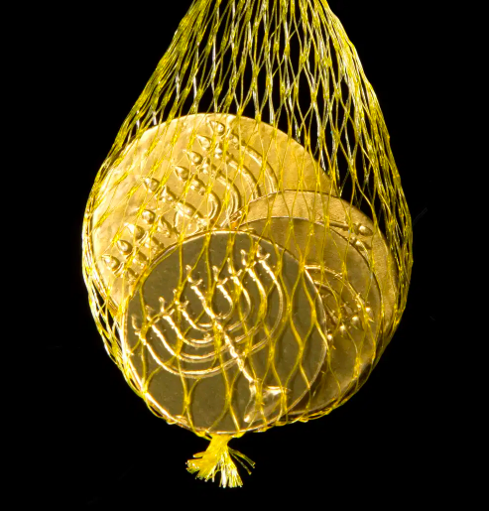
I wonder how much this bag of chocolate gelt would be worth if it was REAL GOLD?
The weight of the gelt is 202.46 grams.
The current price of GOLD is $34.55 per gram.
ESTIMATE!
5.NBT.B7

Slide 5
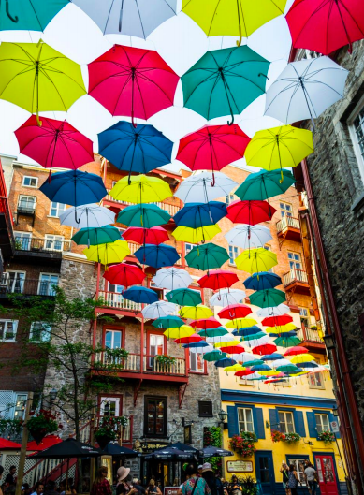
There are 10 streets that have this umbrella pattern.
If there are 18 rows of umbrellas on each street, how many umbrellas are there altogether?
What if there were 100 streets? 1,000 streets? What patterns do you notice in the number of umbrellas?
Illustrative Mathematics
5.NBT.B5

Slide 6
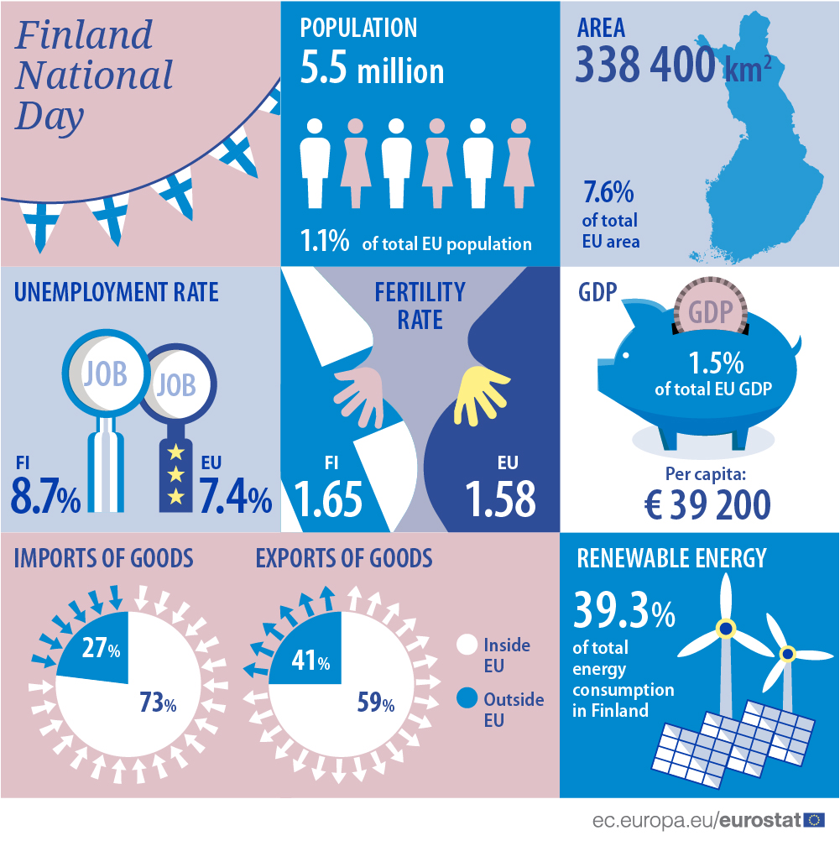
Happy Independence Day in Finland!
What do you notice about this infographic? What do you wonder?
What information can you find?
5.MD
Notes:
Week of December 6, 2021

Slide 7
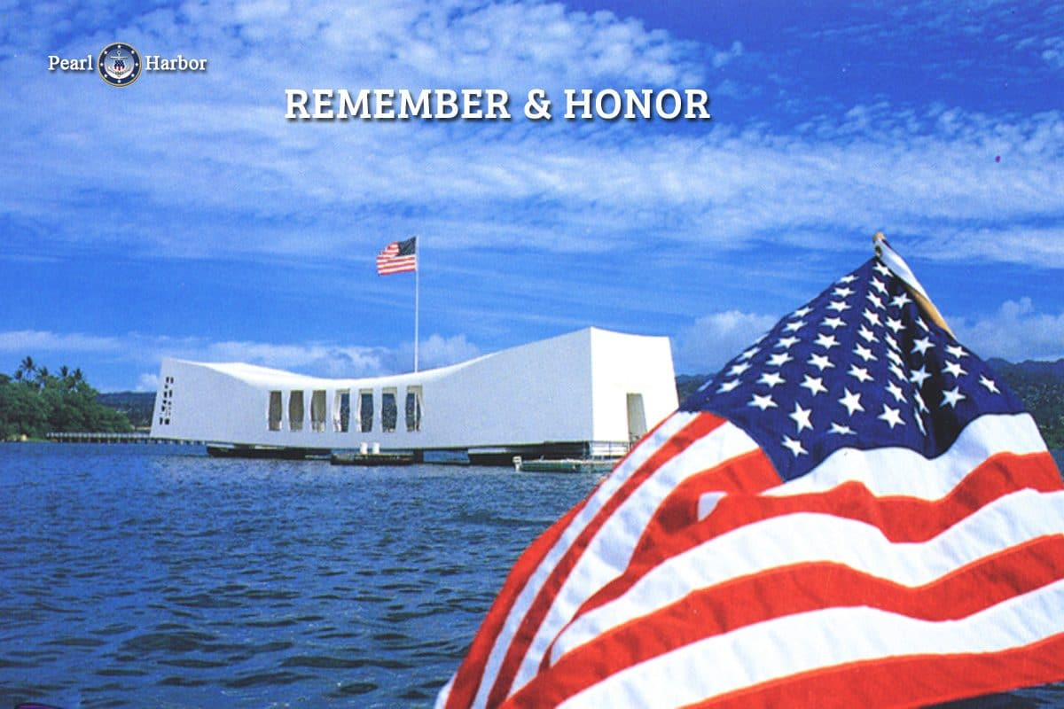
The attack on Pearl Harbor was 12/7/1941.
What can we say about these numbers? Do they have anything in common?
12
7
1,941
What can we do with these numbers?
5.NBT.B
Notes:
December 7… Pearl Harbor Day

Slide 8
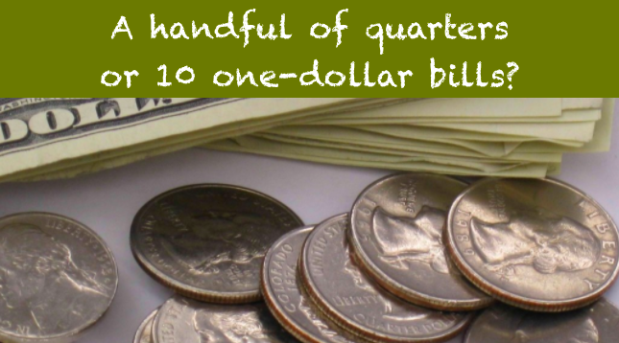
Would you rather …. (and justify your decision with MATH!)
5.SMP
Notes:
Would you rather?

Slide 9
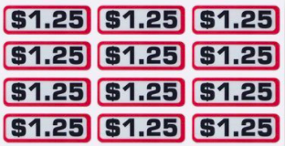
What questions do you have?
How much money?
How many ways can you represent this problem using multiplication?
5.NBT.B7

Slide 10

Human Rights Day is the day the UN adopted and proclaimed the Universal Declaration of Human Rights in 1948. It has inspired all of us to start treating every person with the right to life, liberty, property, and the pursuit of happiness.
It is the most translated document around the world and is available in over 500 languages.
What are some factor pairs of 500? Can you find all of them?
5.NBT.B

Slide 11

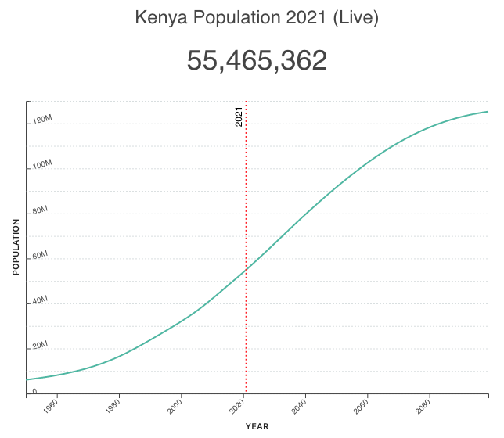
Happy Independence Day in Kenya!
What do you notice about this graph?
What do you wonder?
5.MD
Notes:
Week of December 13, 2021

Slide 12
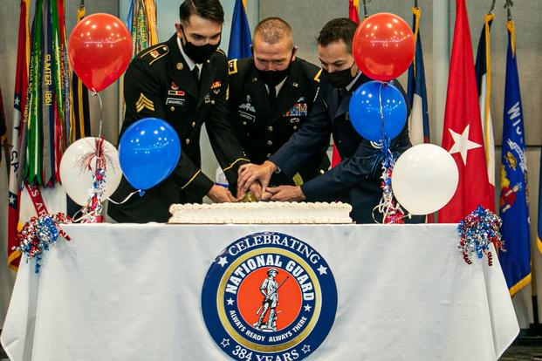
Happy Birthday to the US National Guard
Established in 1636, the National Guard is the oldest military organization in America. Its members serve during times of war and emergency.
How long ago was 1636?
What are some factor pairs of 1,636?
Can you find all of them?
5.NBT.B

Slide 13
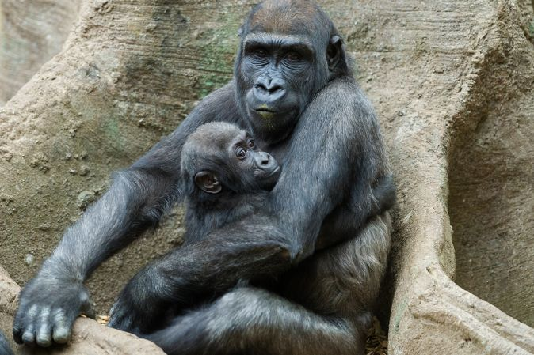
Kiki and Pablo at the Franklin Park Zoo
Pablo weighed 4.5 pounds when he was born. His mom Kiki weighs 400 pounds. About how many times heavier is Kiki than Pablo?
Estimate first!
How close are you to your estimate?
How many times heavier are you than Pablo?
5.NBT.A2

Slide 14
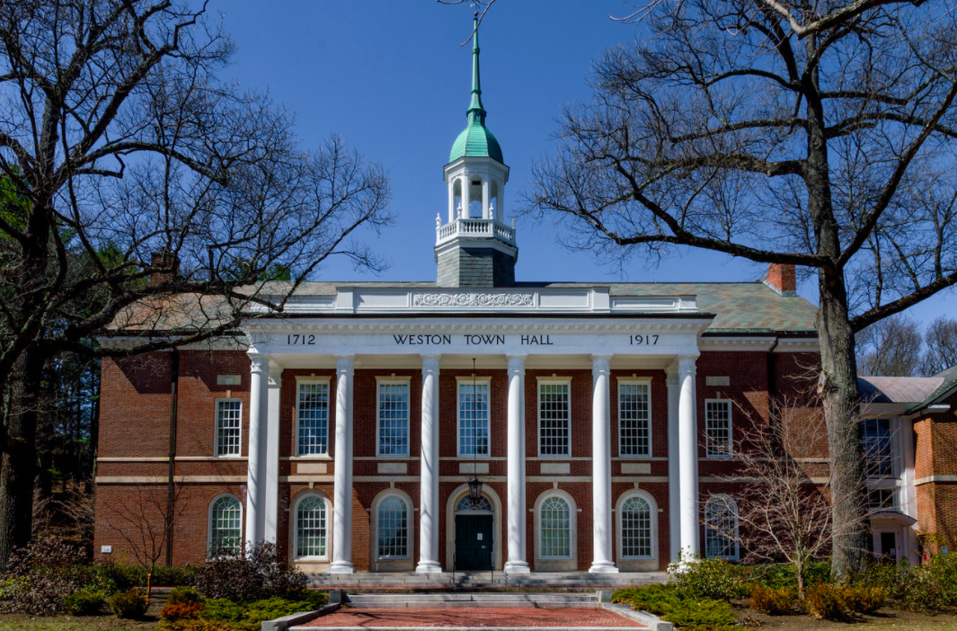
What do the numbers mean?
How old is the Weston Town Hall?
Where do you see arrays?
How can you use arrays to figure out how many window panes are here?
What would that equation look like?
5.NBT.B5

Slide 15
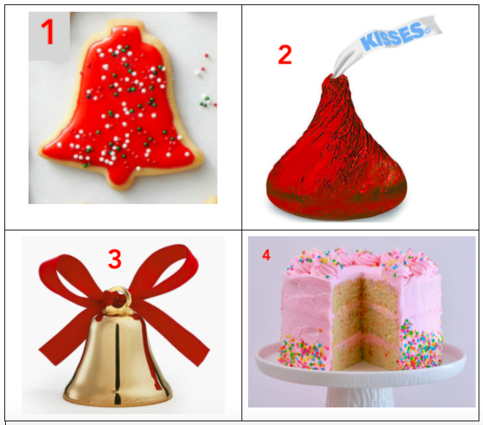
Which one doesn’t belong?
5.SMP.3
Notes:
Bell (not food)
Kiss (wrapped)
Cake (not red/holiday)
Cookie (not 4-letters)

Slide 16
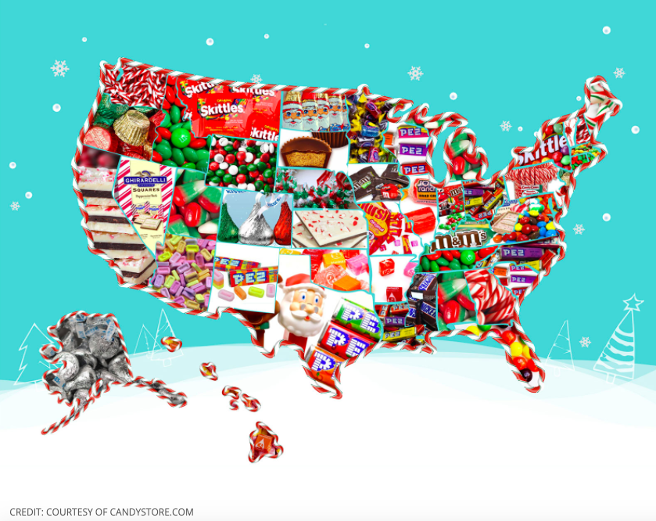
What do you notice?
What do you wonder?
What is this infographic telling us?
Create a catchy title!
5.MD

Slide 17
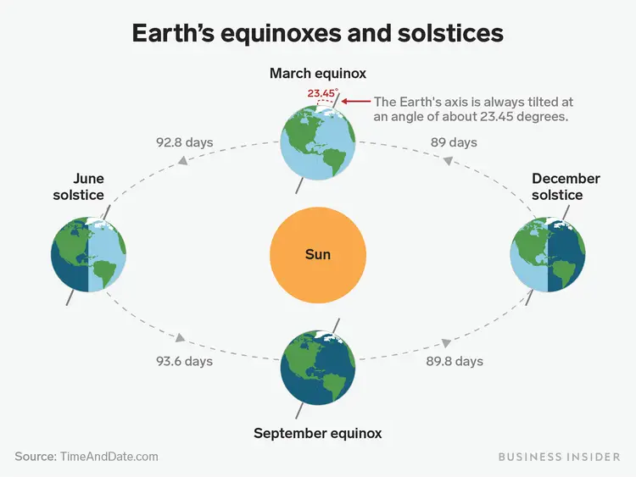
What do you notice?
What do you wonder?
According to the astronomical definition winter began with the winter solstice at 5:13 am.
How many hours ago was that?
It’s the SHORTEST day of the year!
The sun rises at 7:12 am and sets at 4:18.
How many hours of daylight do we get today?
5.MD.A
Notes:
December 21, the winter solstice!

Slide 18
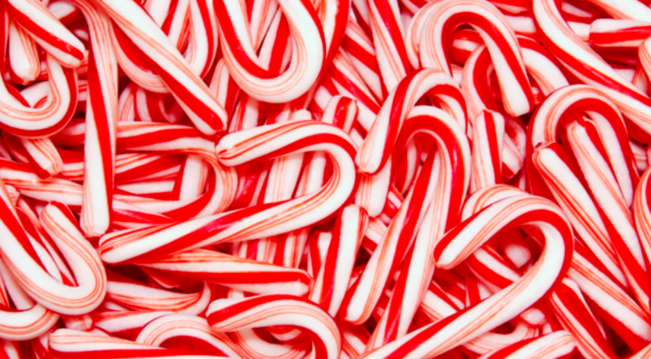
According to the National Confectioners Association, about 1.2 billion candy canes are made annually, and 90 percent of those are sold between Thanksgiving and Christmas.
What do those numbers mean?
5.NBT.A2
Notes:
Week of December 21, 2020

Slide 19
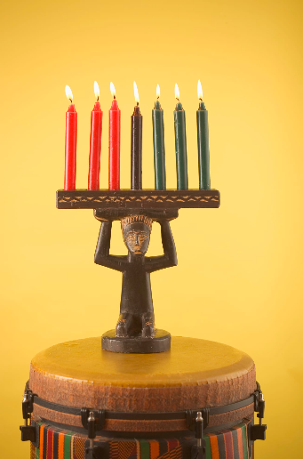
Kwanzaa, celebrated from December 26 to January 1, is an African American and pan-African seven-day cultural holiday that celebrates family and community.
If we had a Kinara for every student at Field School (286 students), how many red candles we would need. Estimate first!
How many green candles?
How many black candles?
How many candles altogether?
5.NBT.B5

