Slide 1
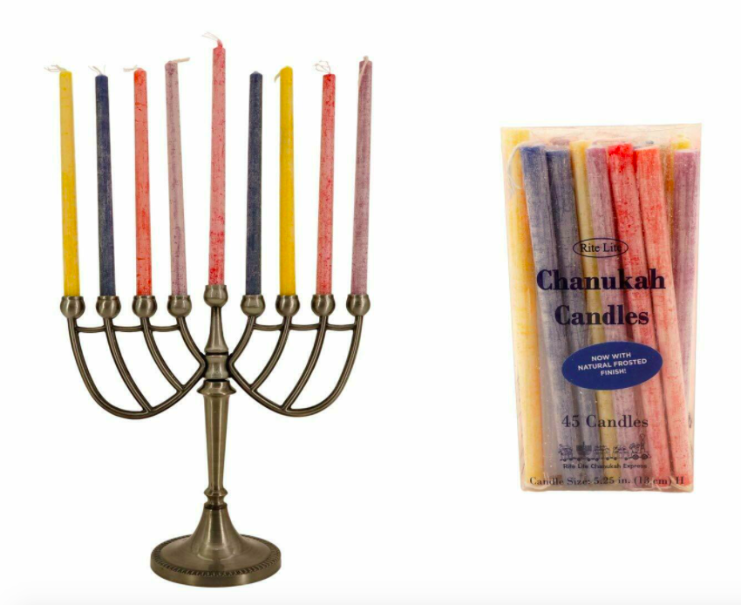
Happy Chanukah!
The first night we light 2 candles, the second night 3 candles, the third night 4 candles… all the way to eight nights!
What can you say about this pattern?
How many candles will we use altogether?
3.OA.D9
Notes:
Week of November 29, 2021

Slide 2
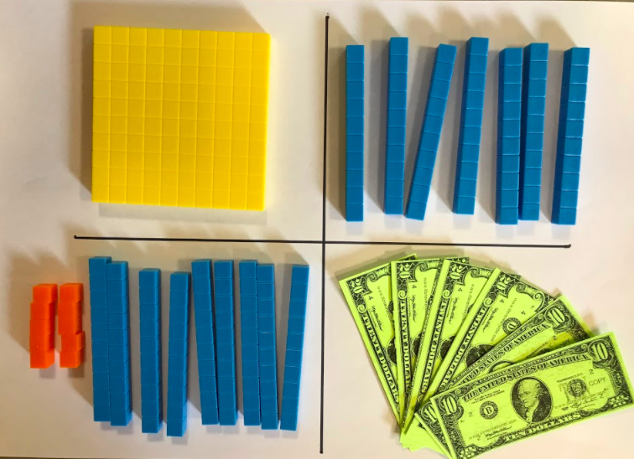
Which one DOES NOT belong?
3.SMP

Slide 3
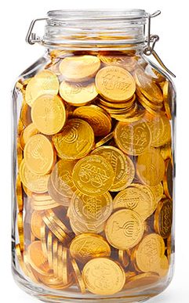
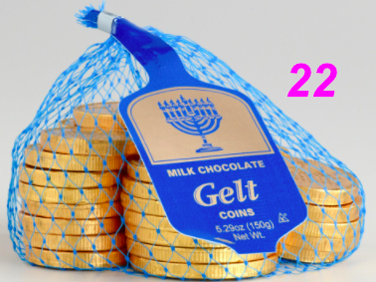
How many chocolate coins do you think are in the jar?
Estimate!
3.OA.D8

Slide 4
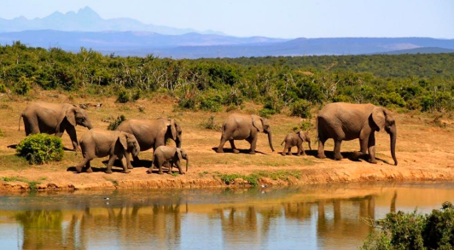
A baby elephant typically weighs about 200 pounds.
What are three possible weights for an elephant whose weight would round to 200?
3.NBT.A1

Slide 5
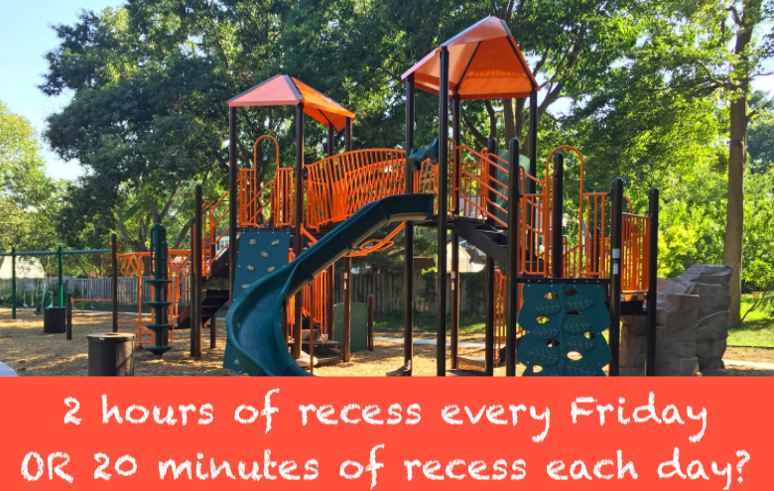
Would you rather …. (and justify your decision with MATH!)
3.MD.A1

Slide 6
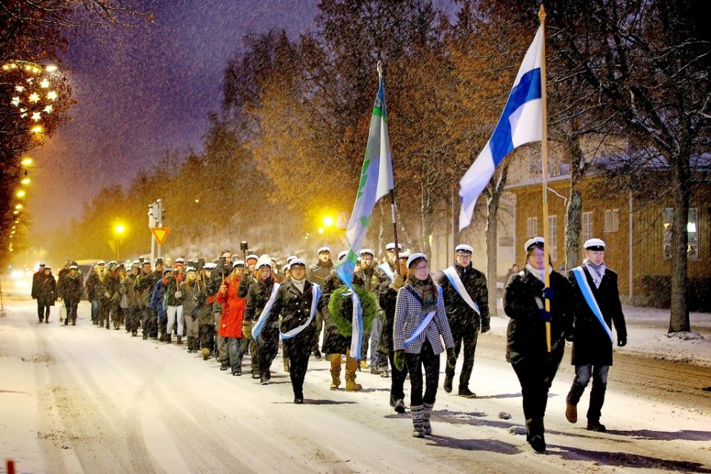
Happy Independence Day in Finland!
Russia ruled over Finland from 1809 to 1917.
How many years was that?
How long has Finland been an independent nation?
3.NBT.A2
Notes:
Week of December 6, 2021

Slide 7
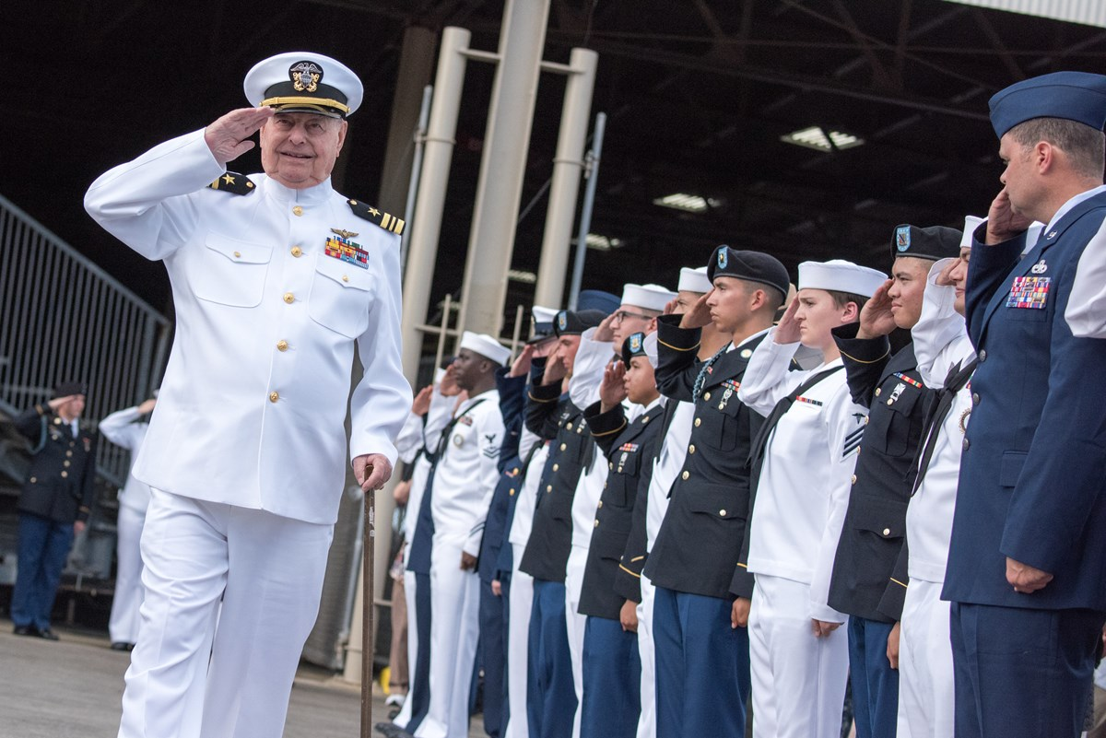
National Pearl Harbor Remembrance Day
The attack on Pearl Harbor was in 1941.
What can we say about the number 1,941?
How long ago was 1941?
3.NBT.A2
Notes:
December 7… Pearl Harbor Day

Slide 8
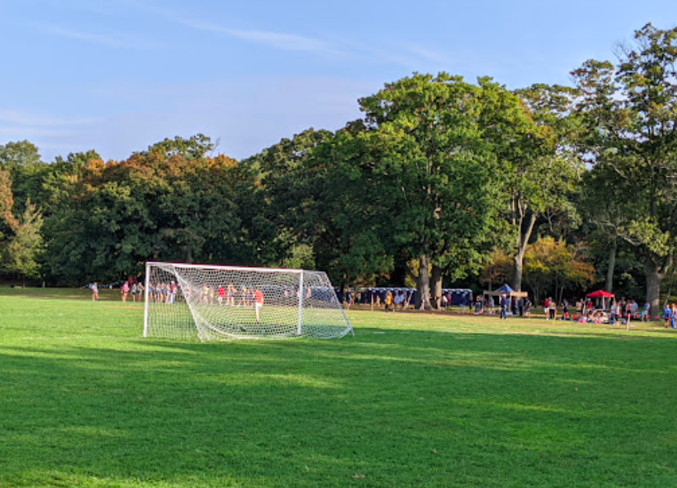
The soccer field at the Franklin Park Playstead is 110 yards long and 70 yards wide.
According to FIFA regulations, the dimensions of a soccer field are between 120 yards long and 80 yards wide, and 110 yards long and 70 yards wide.
What can we say about the AREA of a soccer field?
3.MD.C7

Slide 9
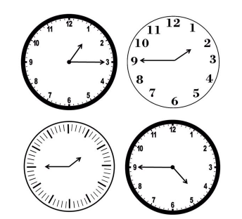
Which one DOES NOT belong?
3.MD.A1

Slide 10

Human Rights Day is the day the UN adopted and proclaimed the Universal Declaration of Human Rights in 1948.
It is the most translated document around the world and is available in over 500 languages.
It has inspired all of us to start treating every person with the right to life, liberty, property, and the pursuit of happiness.
How can we use multiplication to get to 500?
3.NBT.A3

Slide 11
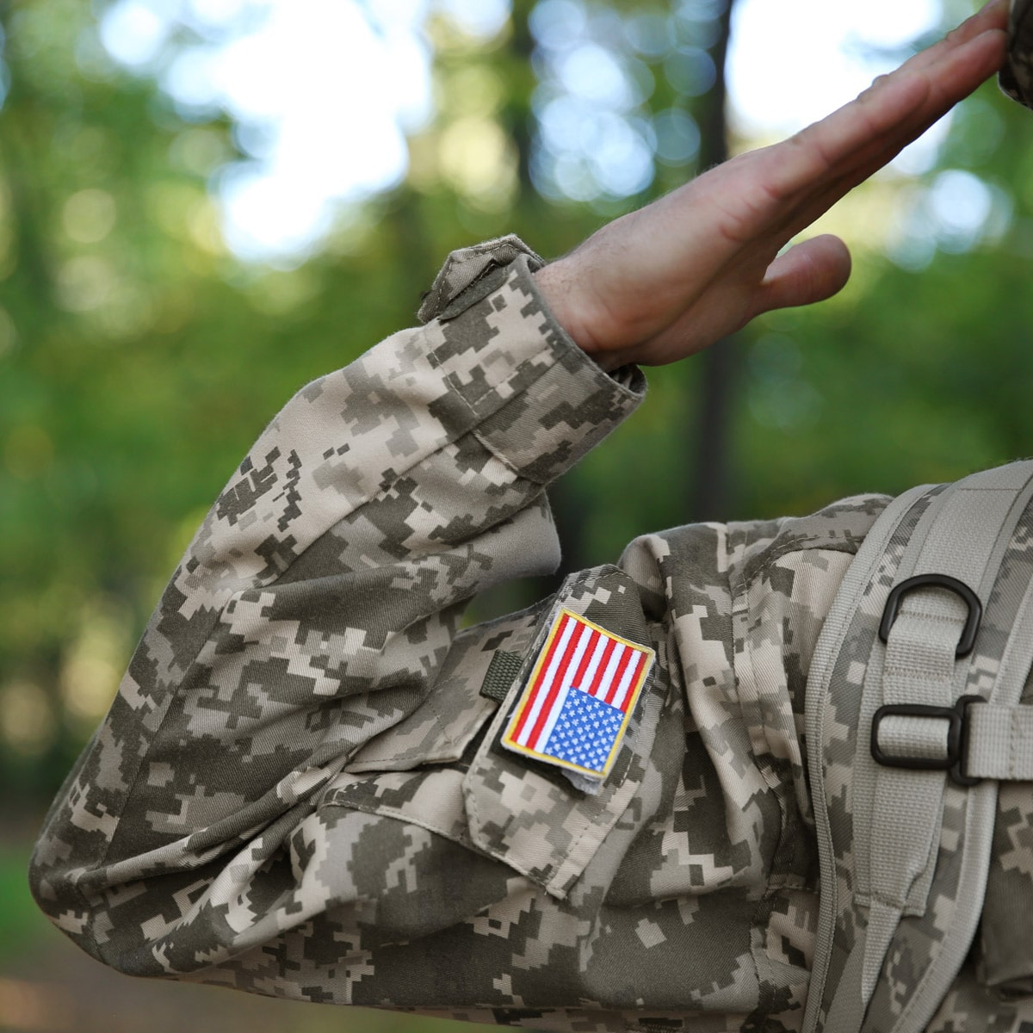
Happy Birthday to the US National Guard
Established in 1636, the National Guard is the oldest military organization in America. Its members serve during times of war and emergency.
How long ago was 1636?
3.NBT.A2
Notes:
Week of December 13, 2021

Slide 12
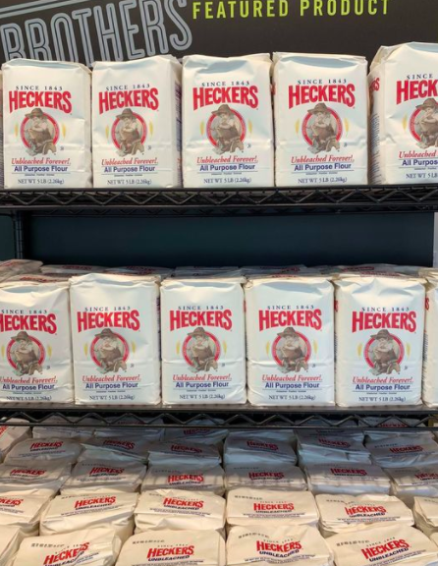
What do you notice?
Estimate how many bags of flour are here.
How could you figure it out?
How can arrays help you?
3.OA.A3

Slide 13
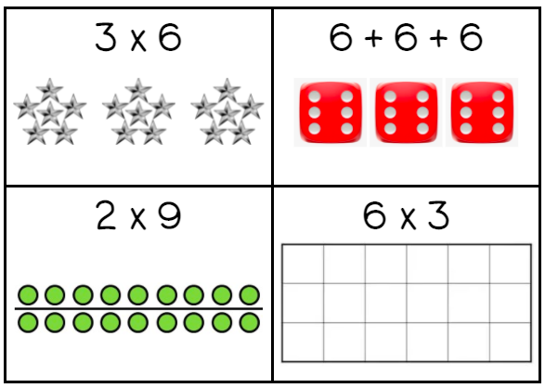
Which one does not belong?
3.OA.A

Slide 14
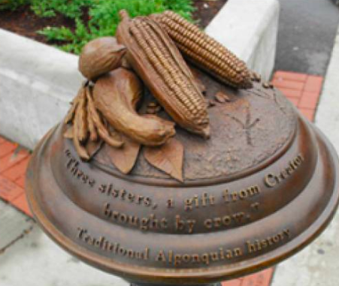
This sculpture in Andrew Everett Square is a tribute to the local Native Americans.
The Algonquin have been in this neighborhood for 10,000 years!
What can we say about the number 10,000?
How many ways can you get to 10,000?
3.NBT.A

Slide 15
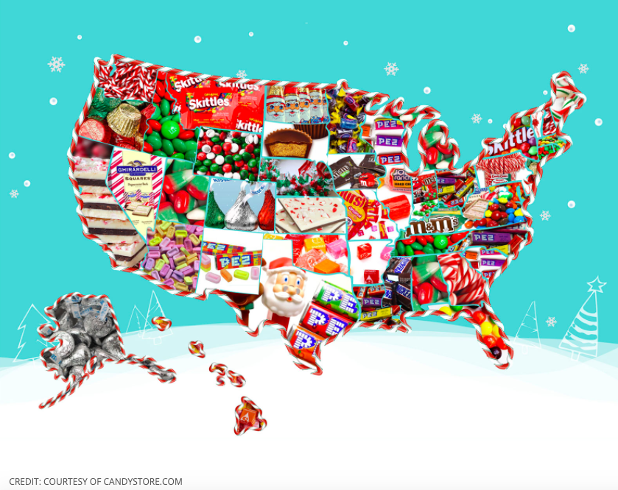
What do you notice?
What do you wonder?
What is this infographic telling us?
Create a catchy title!
3.MD.3

Slide 16
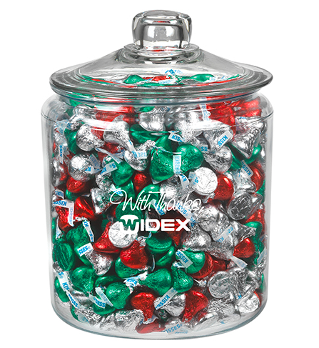
This is a 1 gallon jar FULL of Hershey Kisses.
How many do you think are in here?
How can you use your math skills to make a reasonable estimate?
3.OA.D
Notes:
Week of December 20, 2021

Slide 17
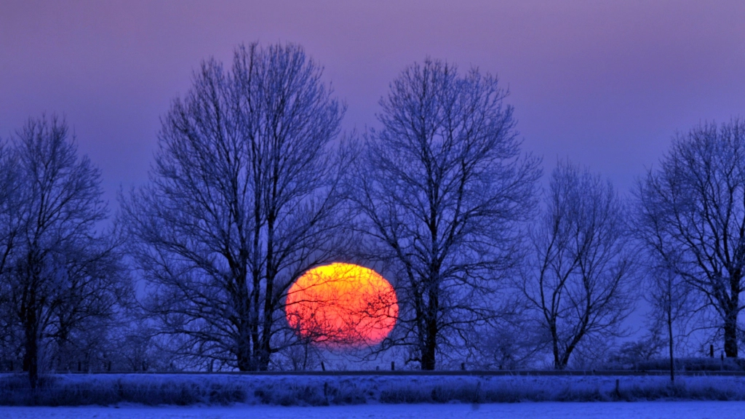
According to the astronomical definition winter began with the winter solstice at 5:13 am.
How many hours ago was that?
It’s the SHORTEST day of the year! The sun rises at 7:12 am and sets at 4:18 pm.
How many hours of daylight do we get today?
3.MD.A1
Notes:
December 21, the winter solstice!

Slide 18
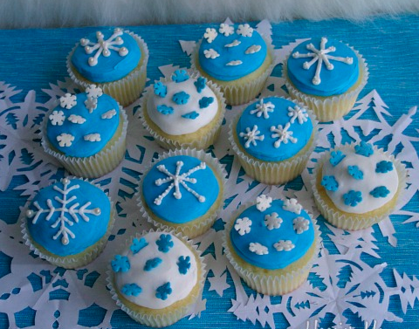
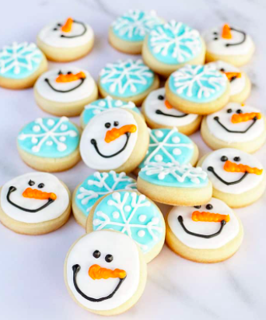
Would you rather ….
Share the cupcakes EQUALLY with your family or the cookies?
3.SMP.3

Slide 19
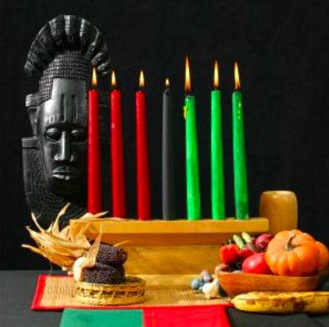
Kwanzaa, celebrated from December 26 to January 1, is an African American and pan-African seven-day cultural holiday that celebrates family and community.
Kwanzaa began here in the United States in 1966.
How long ago was that?
3.NBT.A2

