Slide 1
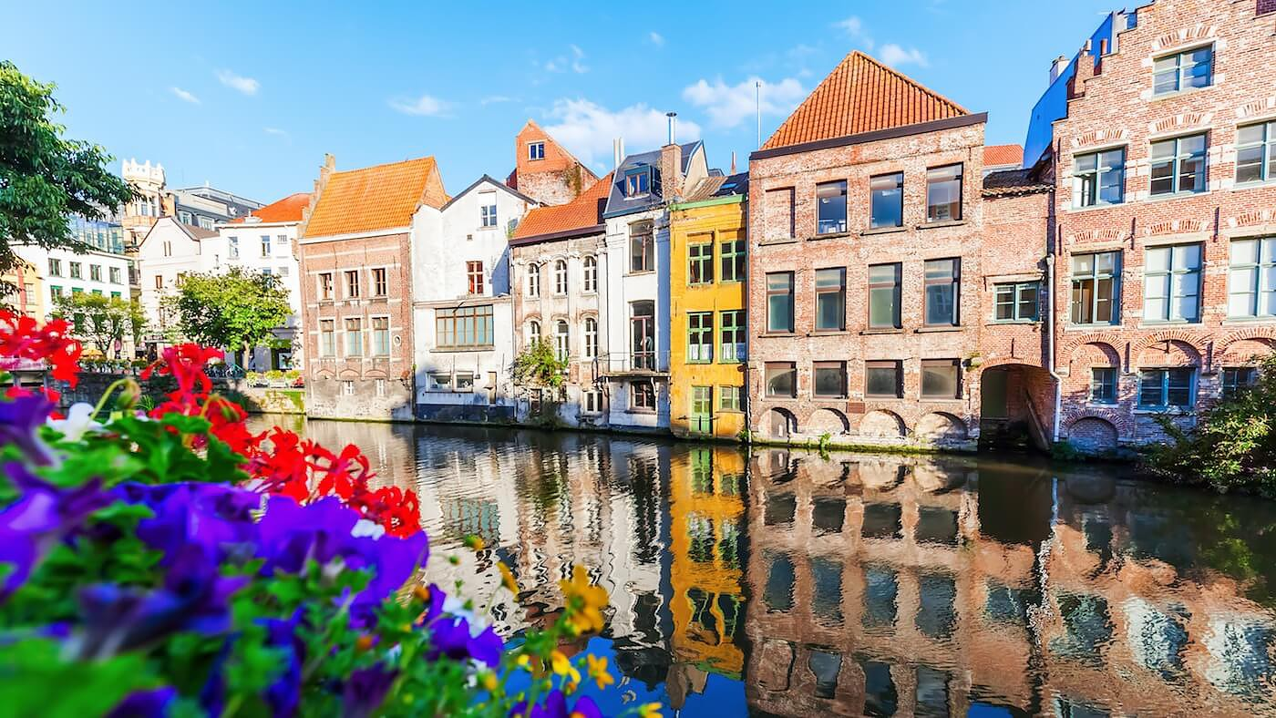
What interesting shapes do we see here? Estimate how many windows we see.
1.G.A1
Notes:
Week of November 29, 2021

Slide 2
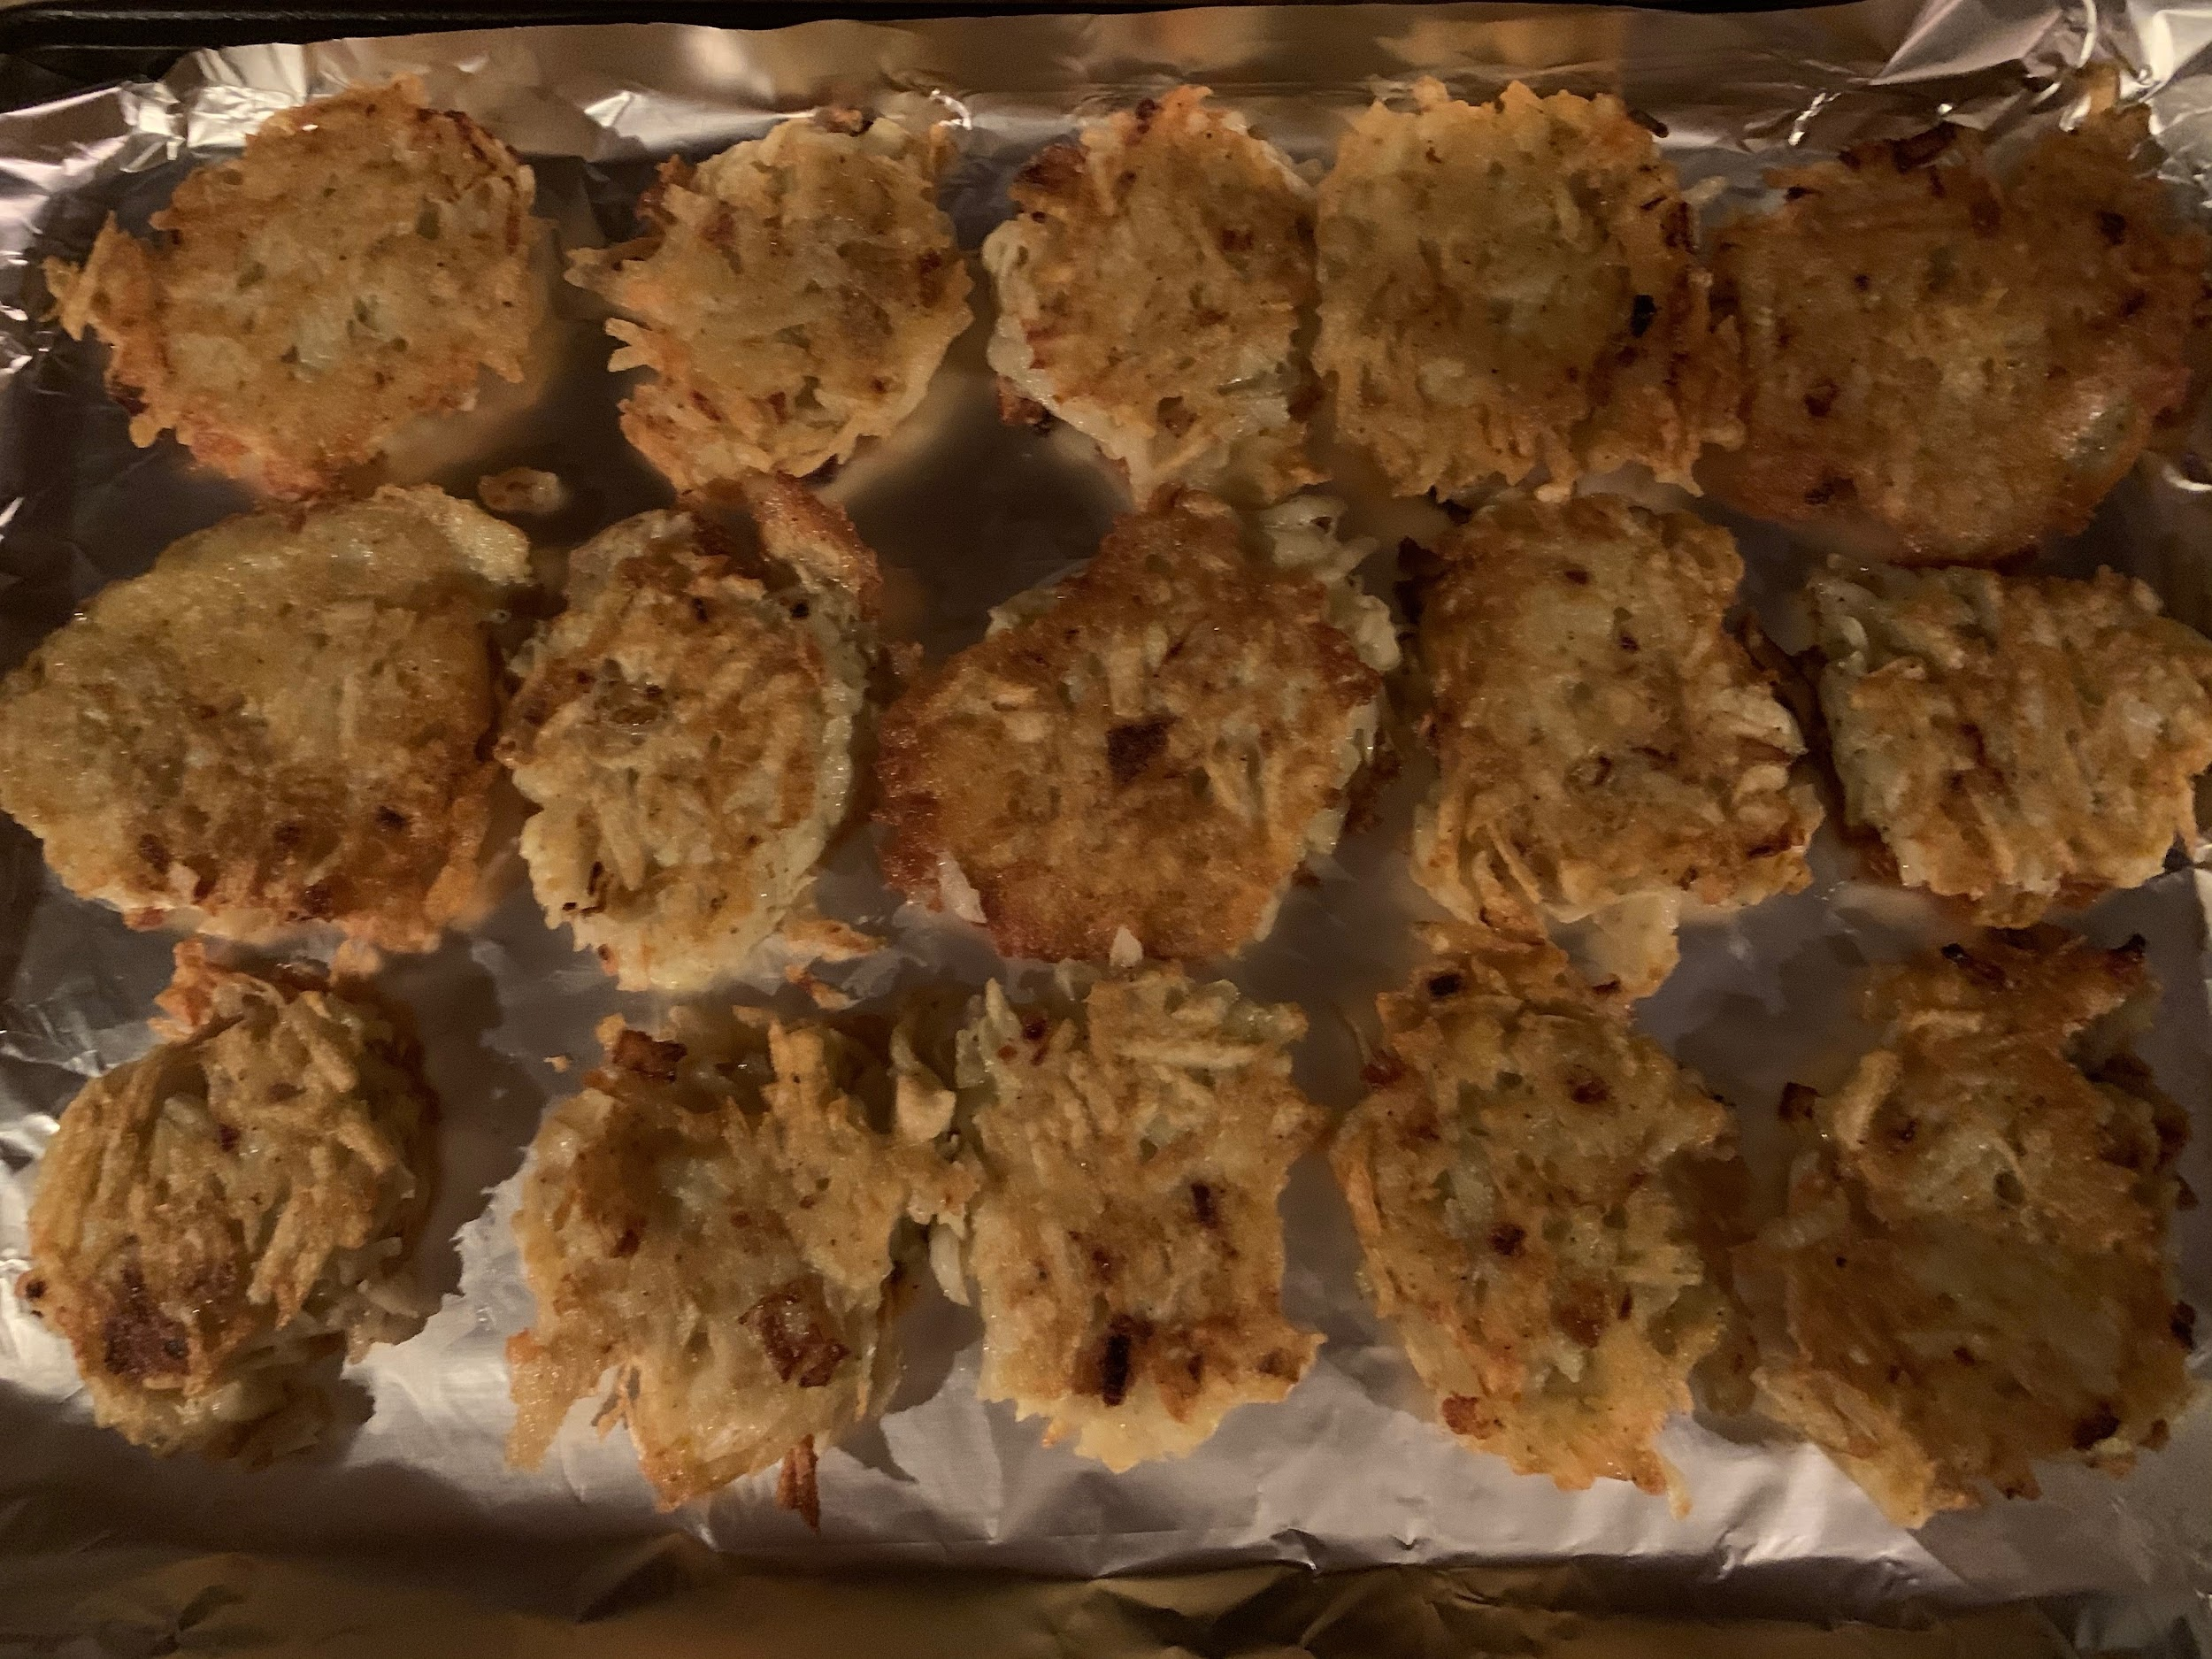
Happy Hanukkah!
How many potato pancakes do you see?
How do you see them?
1.OA.A2

Slide 3
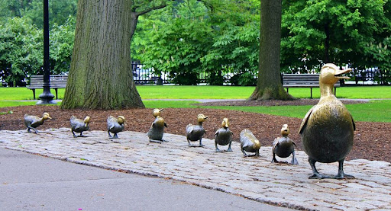
If 10 more ducks joined the group, how many would there be altogether?
What if 20 more ducks joined them?
1.NBT.C5

Slide 4
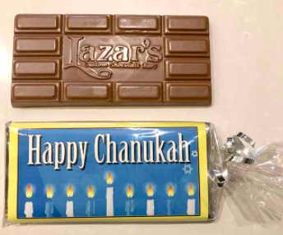
How many pieces of chocolate do you see?
How many might be in the middle?
Can you write a number sentence to match your thinking?
1.OA.C5

Slide 5
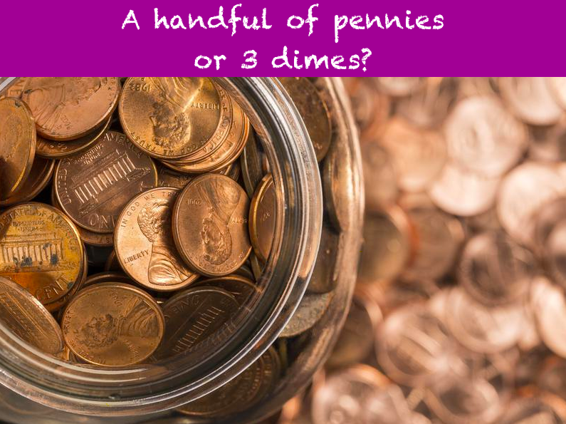
Would you rather have...
1.MD.D5

Slide 6

Independence Day is celebrated on December 6th, or 12 / 6
What do you notice about the date?
Does this happen any other day of the year?
1.NBT
Notes:
Week of December 6, 2021

Slide 7
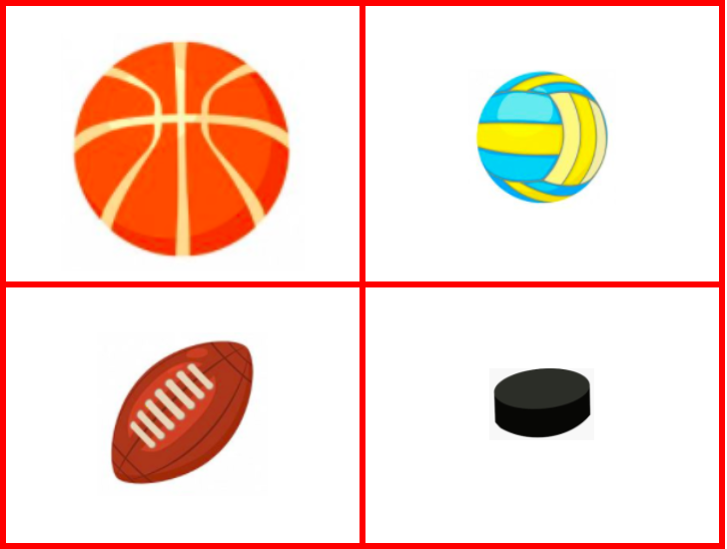
Which one DOES NOT belong?
1.G.A1

Slide 8
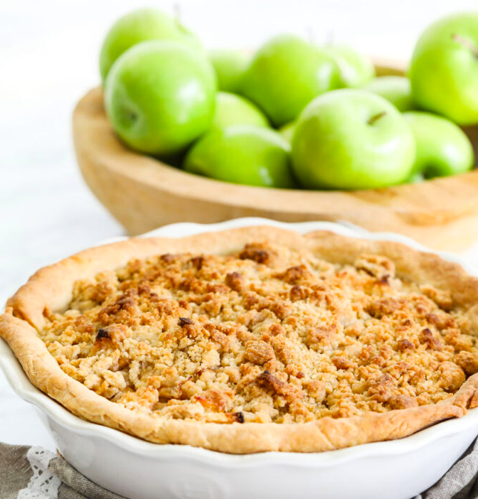
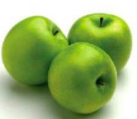

How many apples are in the pie?
Estimate!
1.NBT.A1

Slide 9
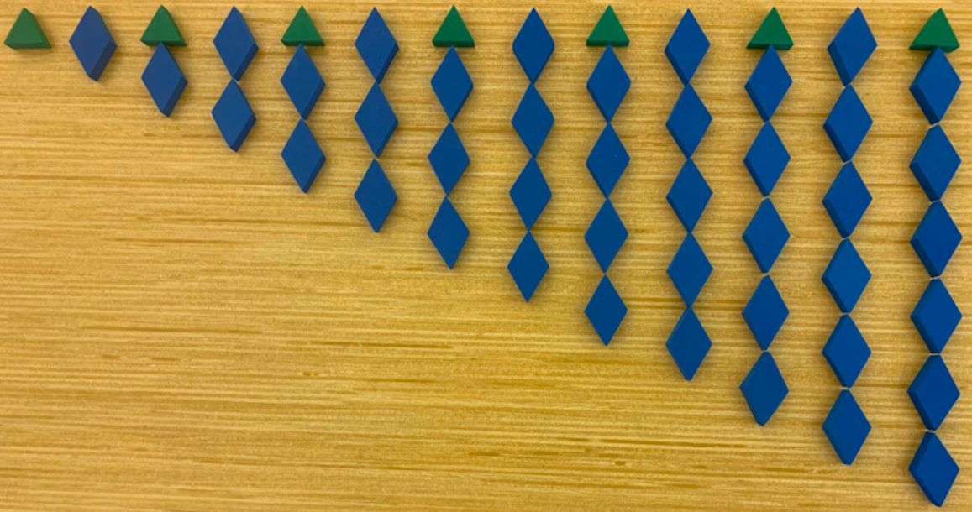
What do you notice?
What do you wonder?
1.OA.C5

Slide 10
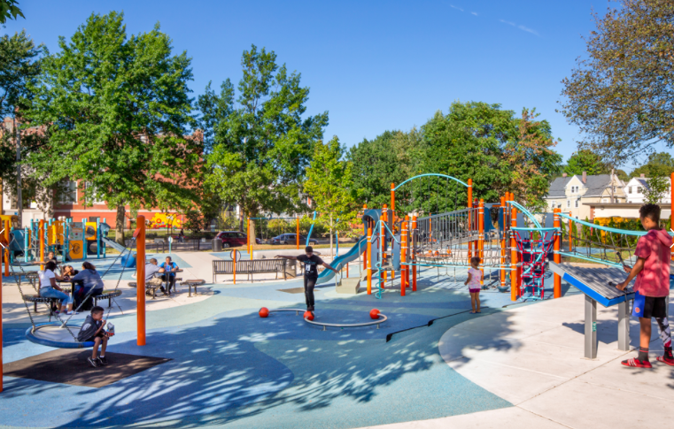
Describe the shapes you see in the playground
Can you put some of them together to make other shapes?
1.G.A2

Slide 11
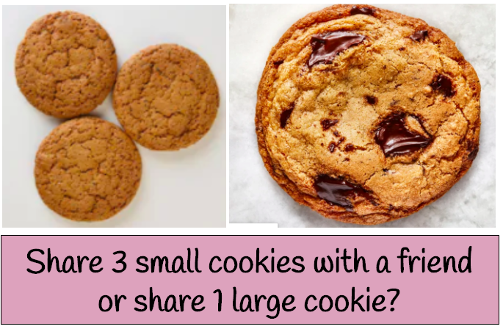
Would you rather ….
1.SMP.3
Notes:
Week of December 13, 2021

Slide 12
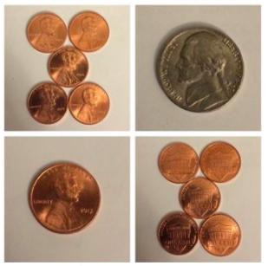
Which one DOES NOT belong?
1.MD.D5

Slide 13
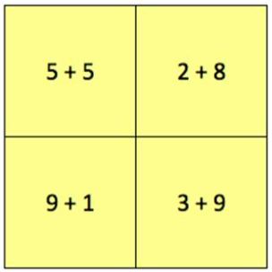
Which one doesn’t belong?
1.OA.B3

Slide 14

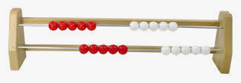
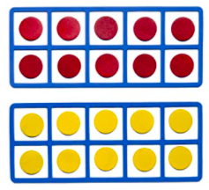
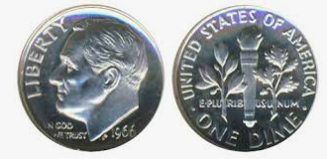
What do you notice?
Can you think of another way to show 20?
1.NBT.2A

Slide 15
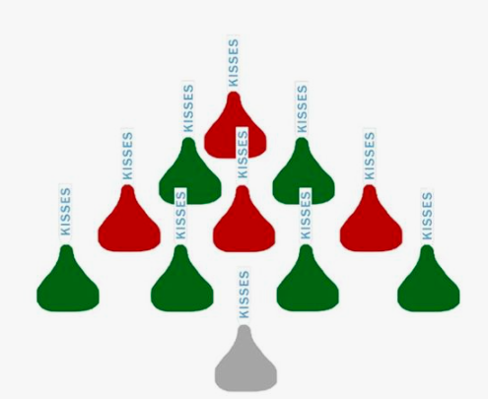
How many kisses do you see?
How do you see them?
How many different ways can you count them?
Can you write a number sentence to match your thinking?
1.OA.A2

Slide 16
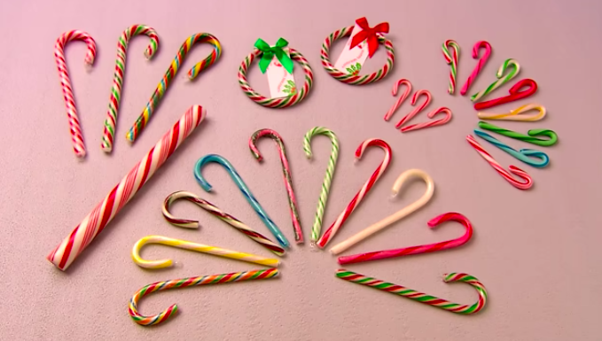
How can you count the candy canes?
Is there another way?
1.MD.C4
Notes:
Week of December 20, 2021

Slide 17
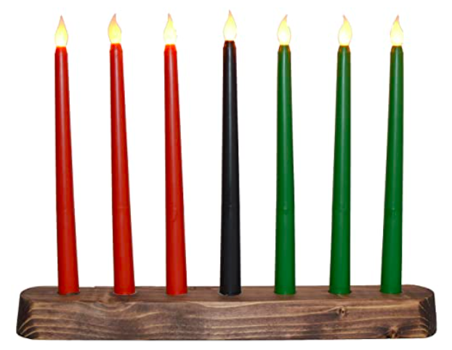
What do you notice about the candles in this Kinara?
Write a number sentence to match your thinking.
Now there are 2 Kinaras.
How does your number sentence change?
1.OA.C6

Slide 18
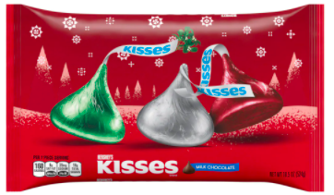
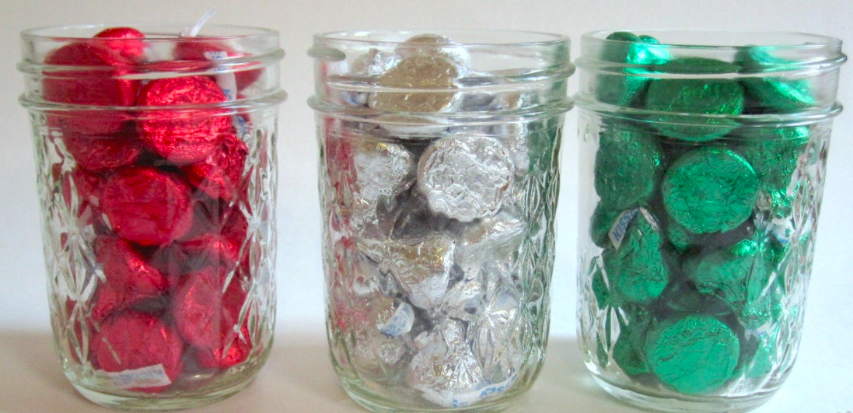
How many kisses do you think are in all 3 jars?
Use your math skills to ESTIMATE!
40
40
1.NBT.C5

Slide 19


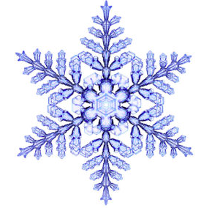

Which one does not belong?
1.SMP.3

