Slide 1
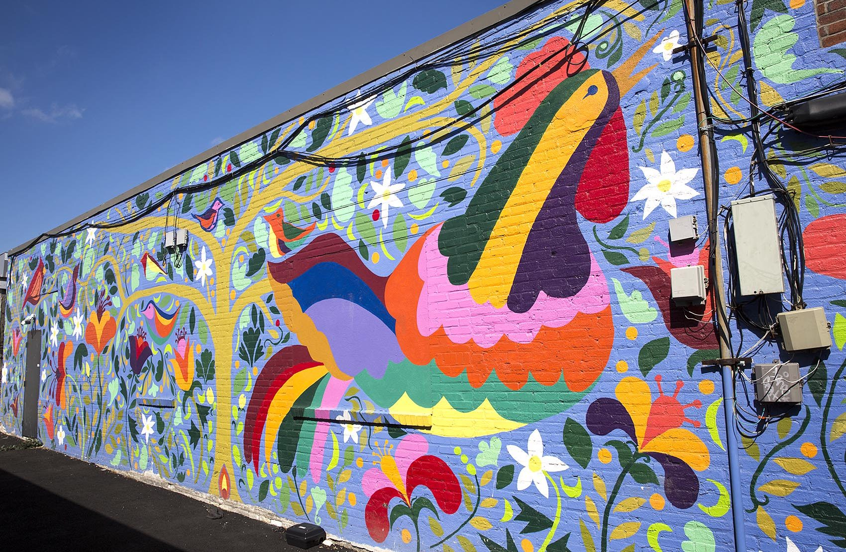
What shapes do we see?
How many do we see?
What can we count?
How can we count?
K.CC.B5
Notes:
Week of November 1, 2021

Slide 2
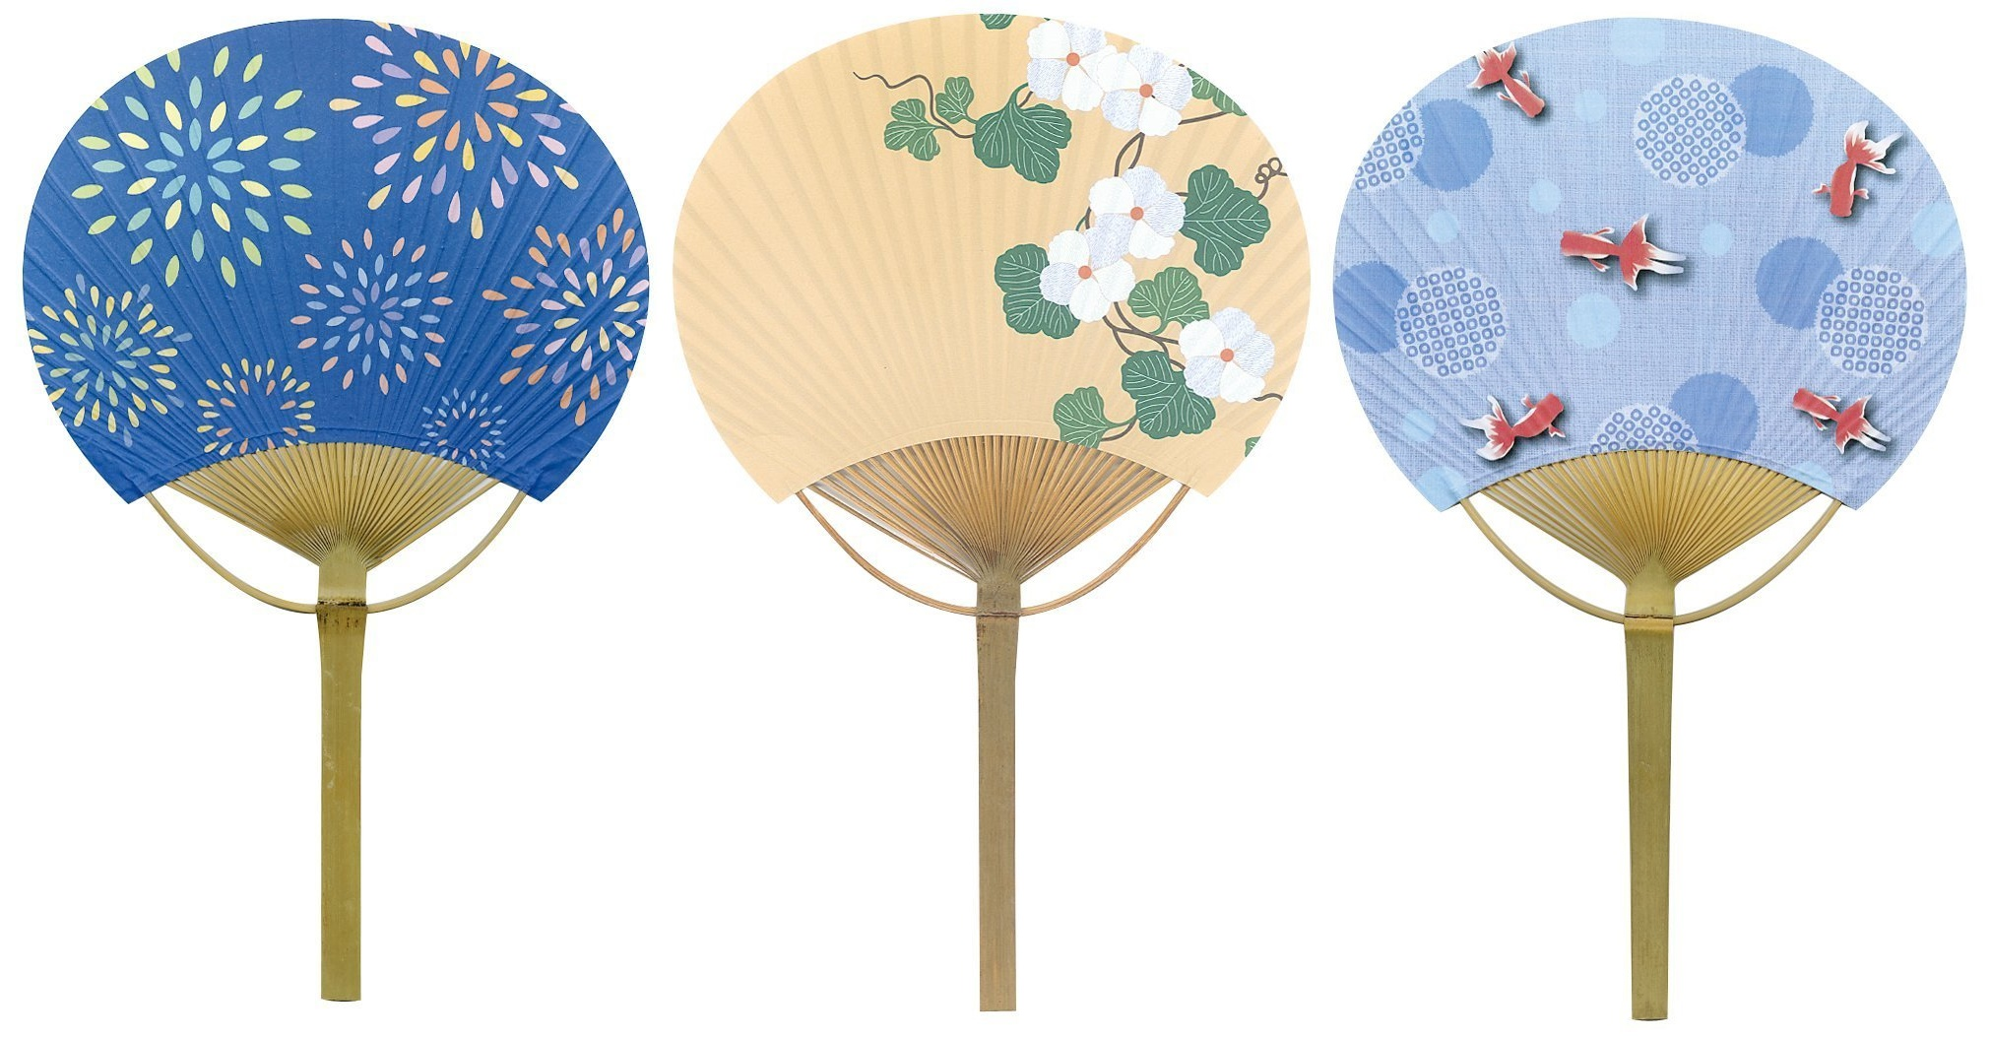
Happy Japanese Culture Day!
What can we count? How can we count them?
K.CC.B4

Slide 3
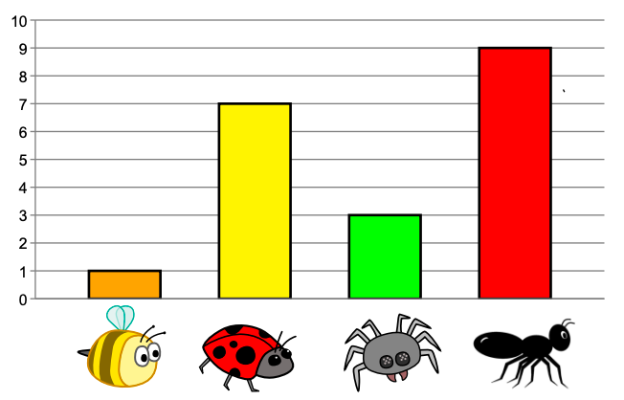
If this graph could talk what would it say?
What is a good title for this graph?
K.MD.B3

Slide 4

What can we count?
How can we count them?
K.CC.B4

Slide 5
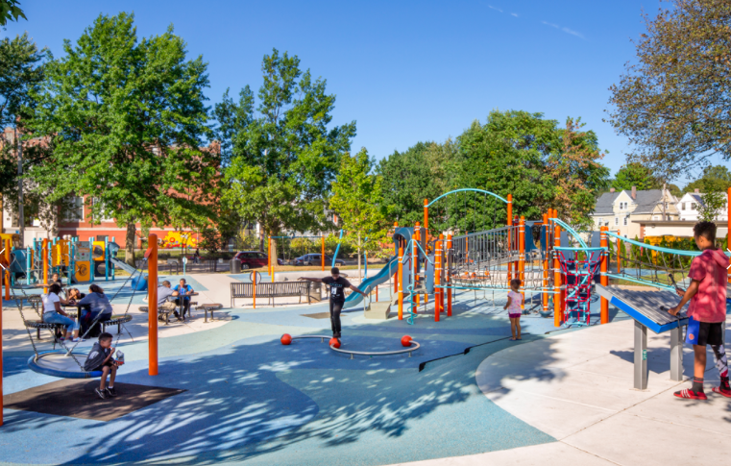
Describe the shapes you see in the playground.
K.G.A2

Slide 6
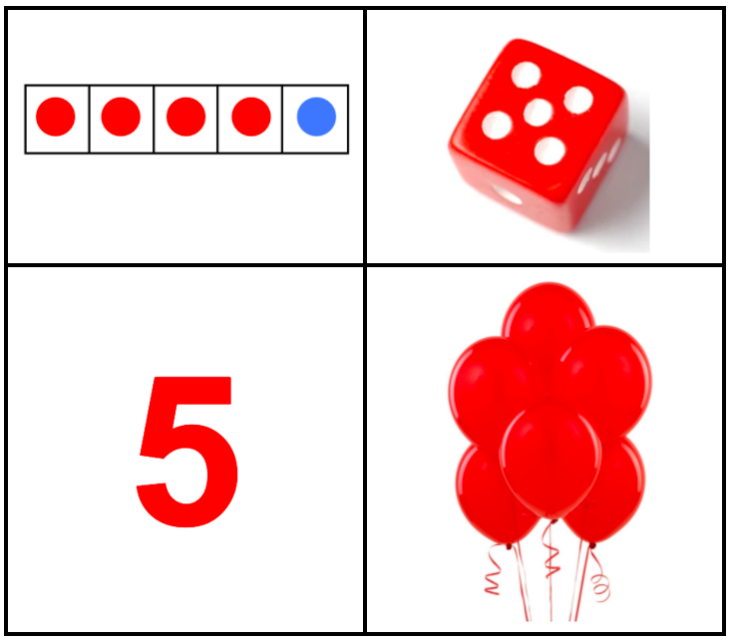
Which one doesn’t belong?
K.CC.B4
Notes:
Week of November 8, 2021

Slide 7
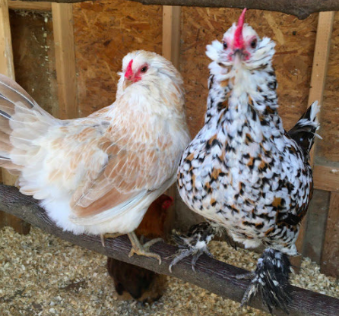
Meet Hawk and Princess from Land’s Sake Farm
They have 5 chickens in their family!
How many are missing from this photo?
K.OA.A5

Slide 8
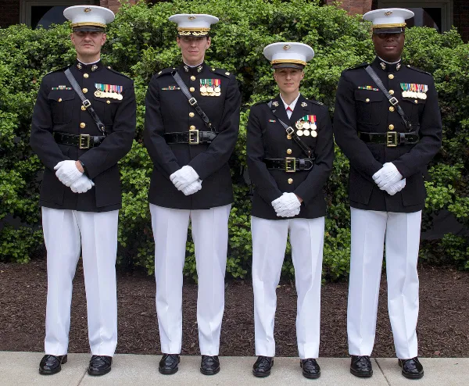
Happy Birthday to the US Marine Corps
What can we count in this picture?
How can we count them?
K.CC.B4

Slide 9
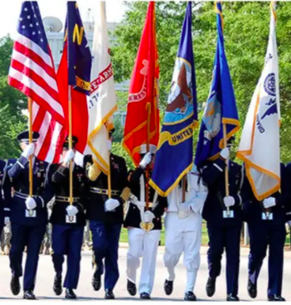
Happy Veterans Day
What can we count in this picture?
How can we we count them?
K.CC.B4
Notes:
Veterans Day

Slide 10
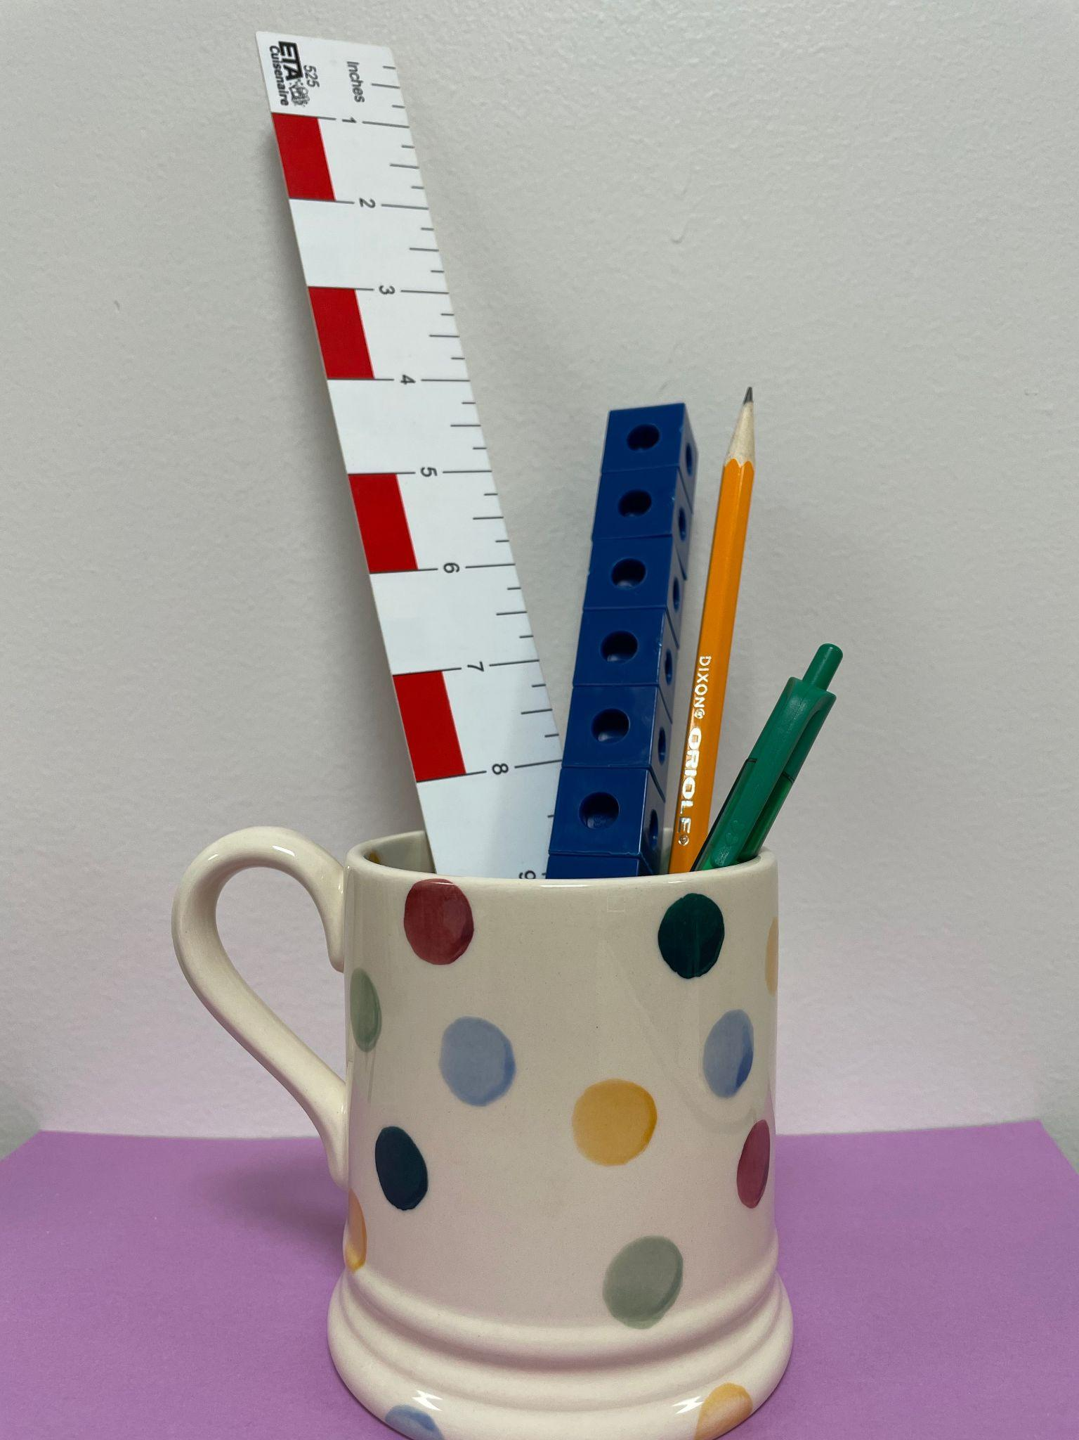
What do we notice?
The ______ is taller than the _______
The ______ is shorter than the ______
K.MD.A2
Notes:
Week of November 15, 2021

Slide 11
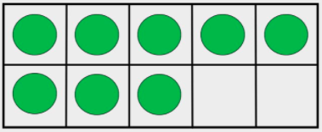
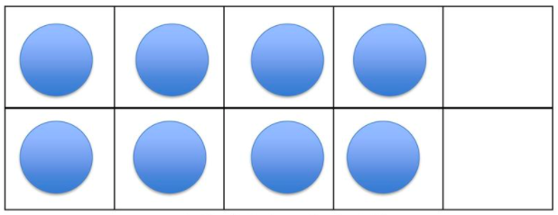
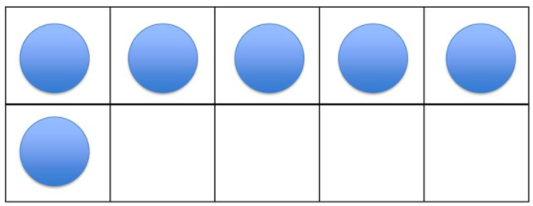
Which one does not belong?
 | 8
K.CC.B5

Slide 12
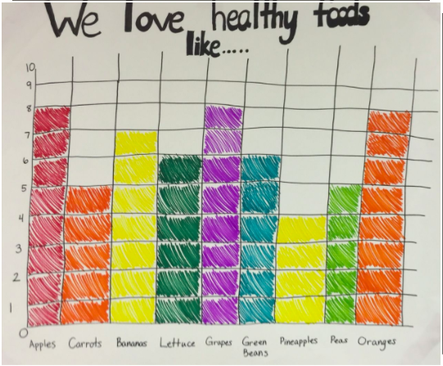
If this graph could talk what would it say?
K.MD.B3

Slide 13
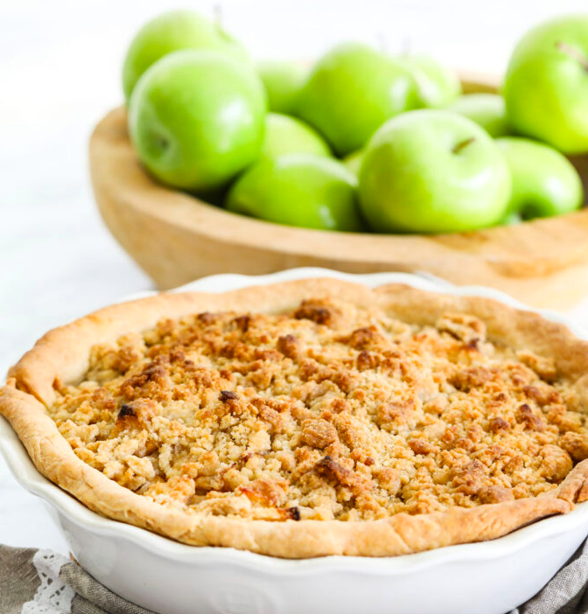
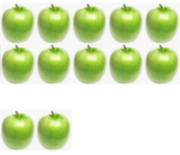
How many apples are in the pie?
Estimate!
K.CC.B5

Slide 14
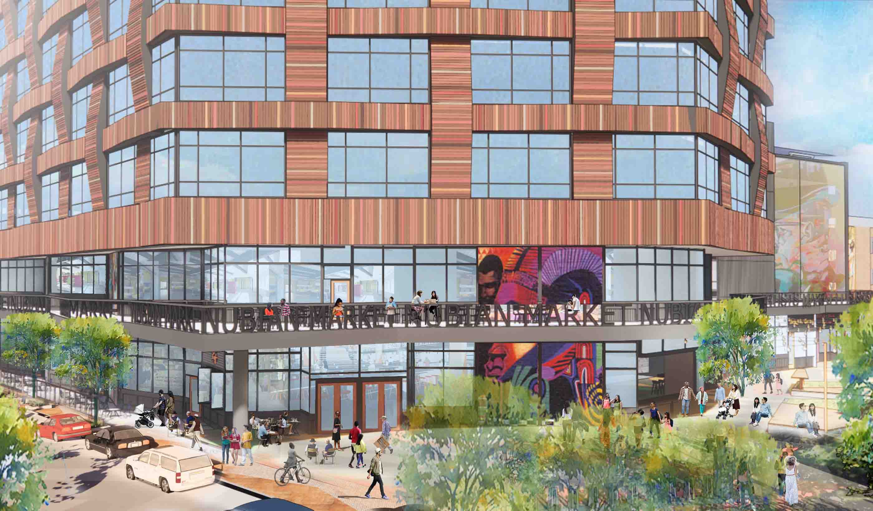
What can we say about the shapes in this picture?
K.G.A2

Slide 15
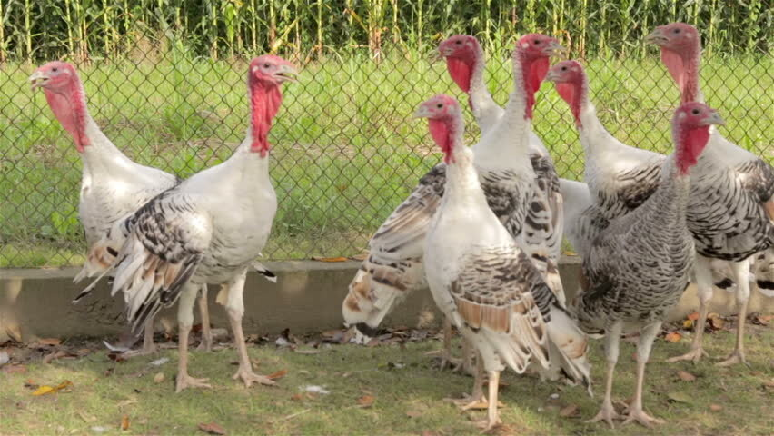
What do we notice? What do we wonder?
Are there more or less than 10 turkeys? How do you know?
K.CC.C6
Notes:
Week of November 22, 2021

Slide 16
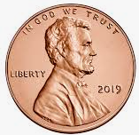
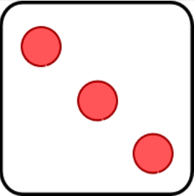
Which one does not belong?
Can you find a reason why all of them may not belong?
 | 3
K.CC.B4

Slide 17
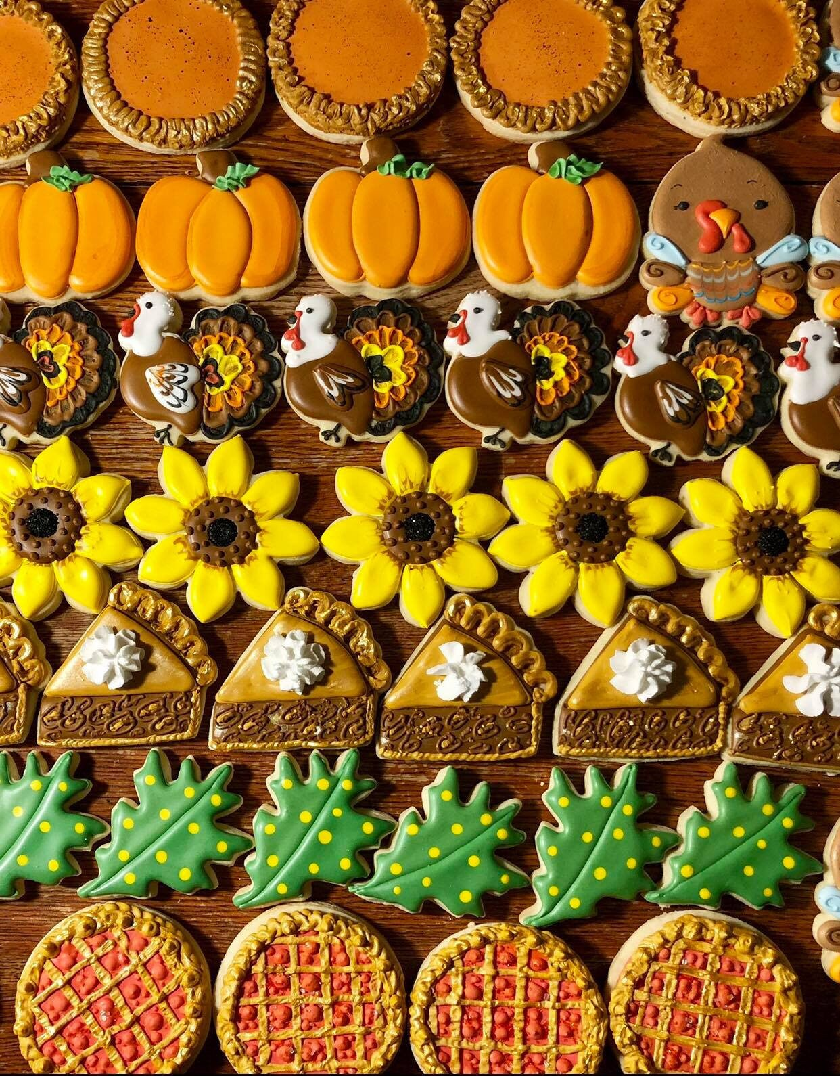
Describe these yummy cookies using the words above, below, beside, in front of, behind, and next to.
K.G.A1

