Slide 1
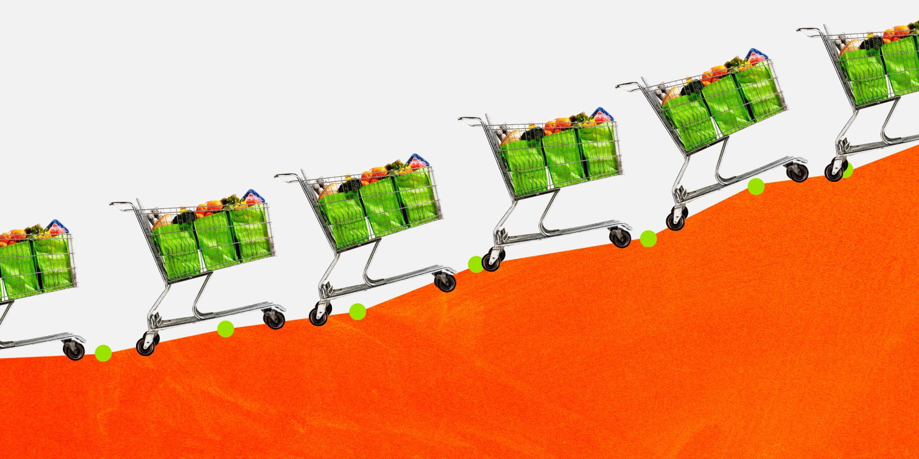
What’s Going on in this Graph?
What interesting MATH PROBLEMS can we create with this visual?
5.MD
Notes:
Week of November 1, 2021

Slide 2
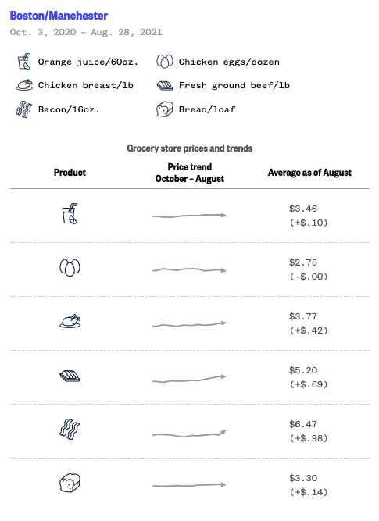
What’s going on in this graph of Average Grocery Store Prices?
What do you notice?
What do you wonder?
Why does it matter?
Source: NielsenIQ
Graphic: Robin Muccari / NBC News
5.MD
Notes:
Link to interactive graph

Slide 3
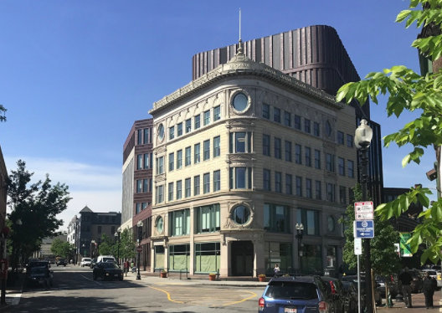
The original Bolling Municipal building was built in 1901?
How long ago was that?
How many MONTHS ago was that?
How can you efficiently figure that out?
5.NBT.B7

Slide 4
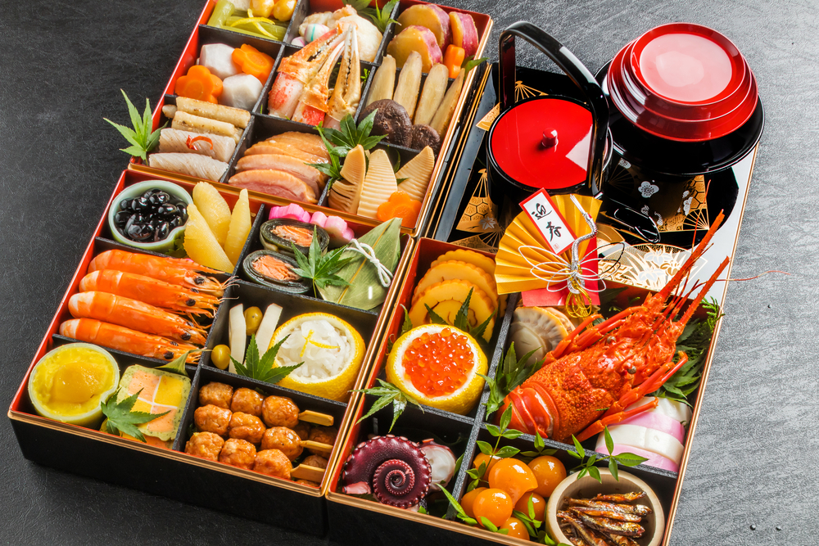
Happy Japanese Culture Day!
What are some interesting math expressions we can create to match this photo?
5.OA.A2
Notes:
Japanese Culture Day

Slide 5
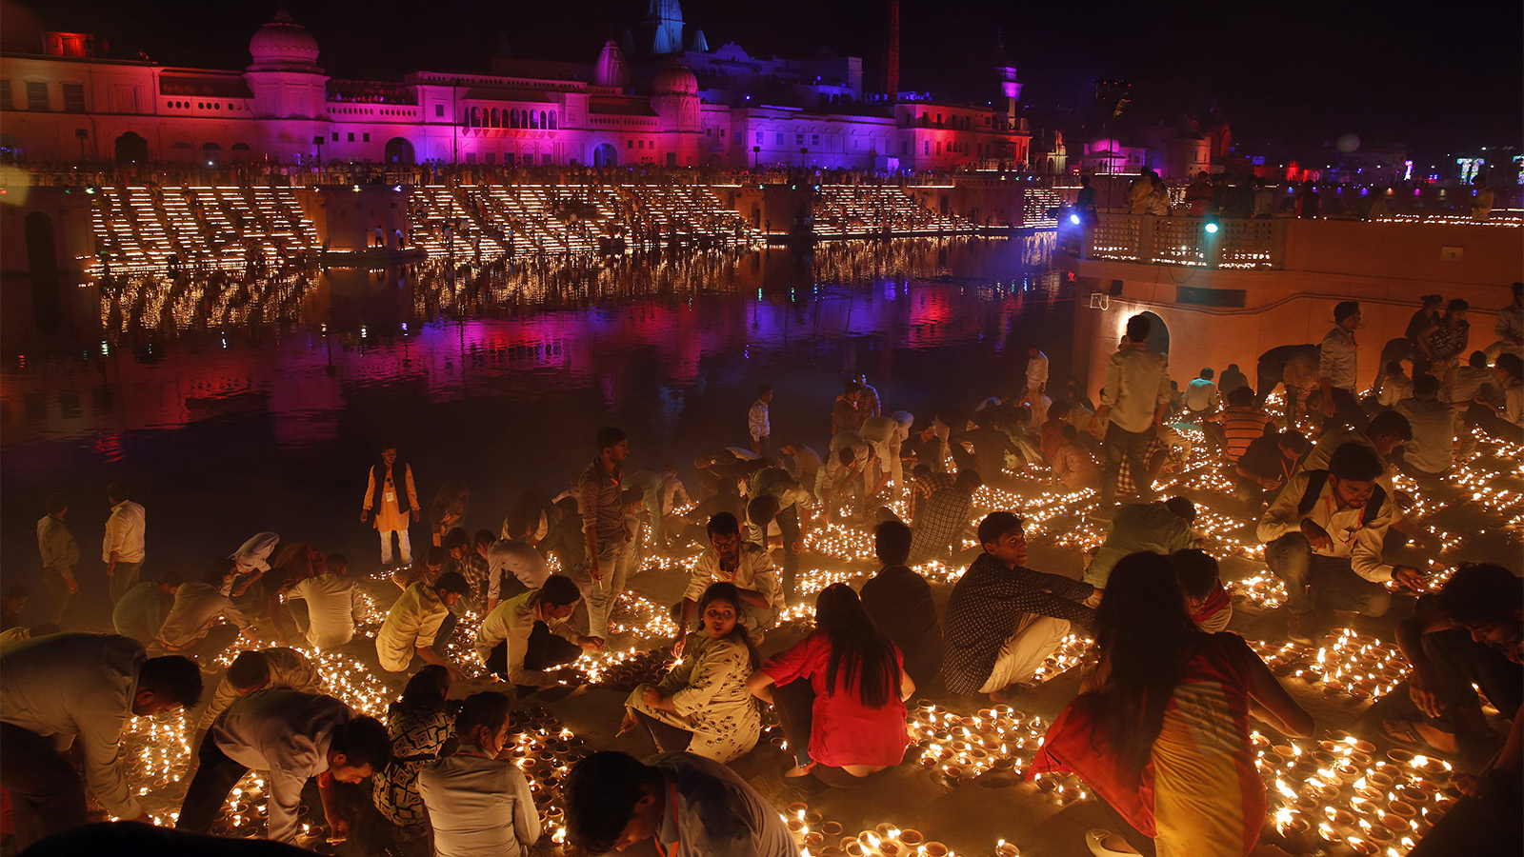
More than a billion people from a variety of faiths across India and its diaspora celebrate Diwali. The five days of Diwali are marked by prayer, feasts, fireworks, family gatherings, and charitable giving.
What can we say about the number
“a billion”
Write an equation that equals one billion.
5.NBT.B5
Notes:
Diwali

Slide 6
Which one does not belong?
Can you find a reason why all four may not belong?
50 x 20 | 10,000➗10
40 x 50 | 125 x 8
5.NBT.A1
Notes:
Week of November 8, 2021

Slide 7
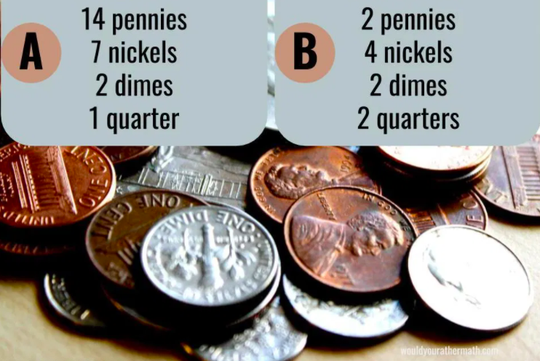
Would You Rather
have a pocket full of ...
5.MD
Would you rather math

Slide 8
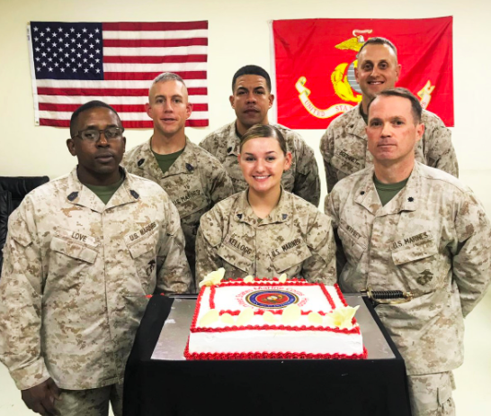
Happy Birthday to the United States Marine Corps!
This traditional cake has a VOLUME of 6,400 cubic centimeters.
What’s possible?
5.MD.C5
Notes:
US Marine Corps Birthday

Slide 9
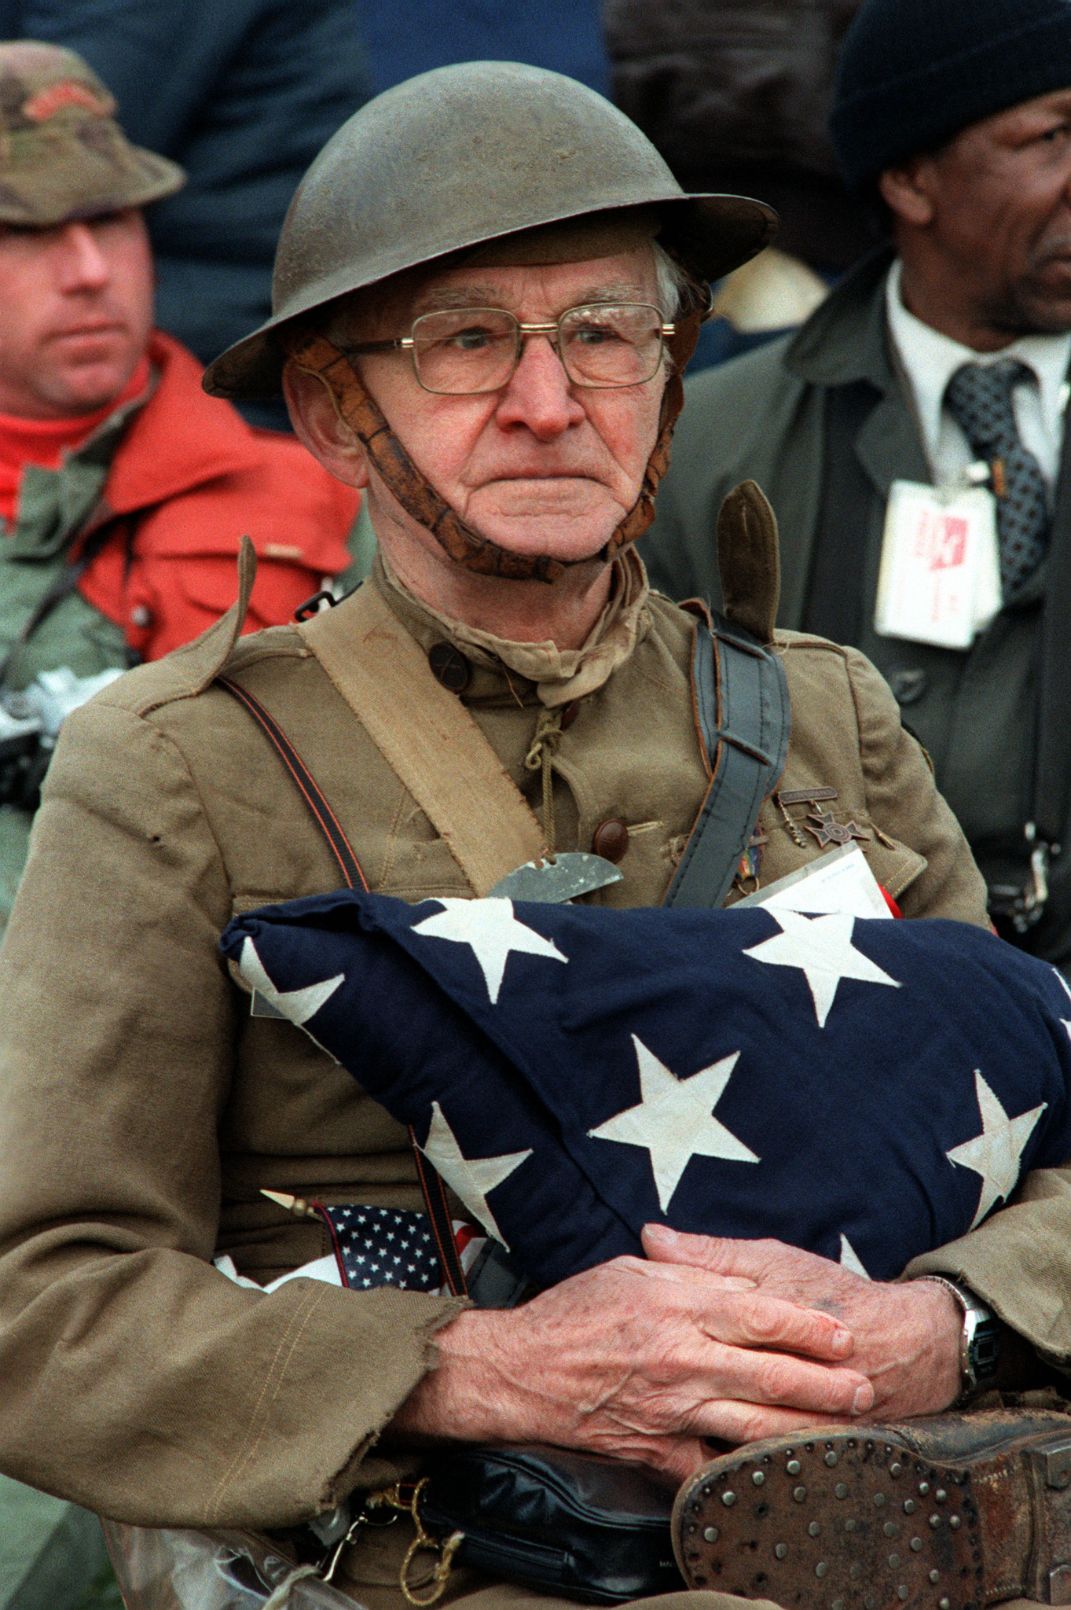
Happy Veterans Day
In 1954 President Dwight D. Eisenhower issued the first "Veterans Day Proclamation" which stated: "In order to insure proper and widespread observance of this anniversary, all veterans, all veterans' organizations, and the entire citizenry will wish to join hands in the common purpose.”
How many years ago was that?
How many months?
How can we figure this out?
5.NBT.B5
Joseph Ambrose
Notes:
Veterans Day

Slide 10
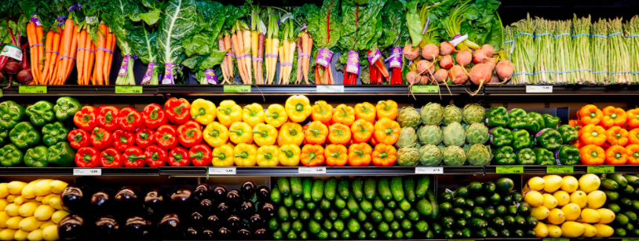
What math expressions can you create?
5.NBT.B5
Notes:
Week of November 15, 2021

Slide 11
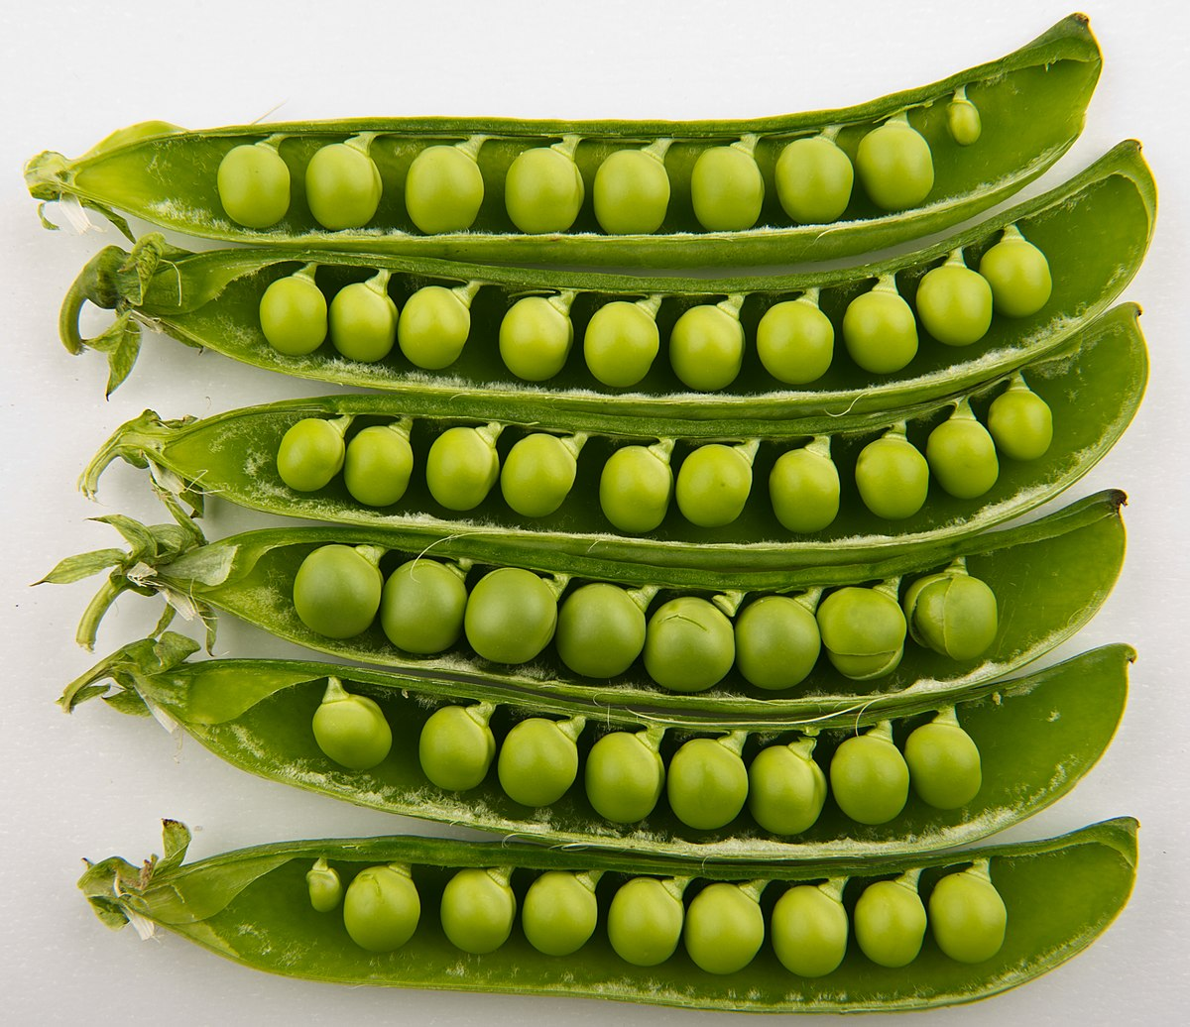
Fun Fact:
In 1984 Janet Harris of Sussex, UK set the world record for eating 7,175 peas!
About how many pods would that be? How do you know?
5.NBT.B6

Slide 12
Which one does not belong?
1.5 x 5 | 2.5 x 3
10 x 7.5 | 10 - 2.5
5.NBT.B7

Slide 13
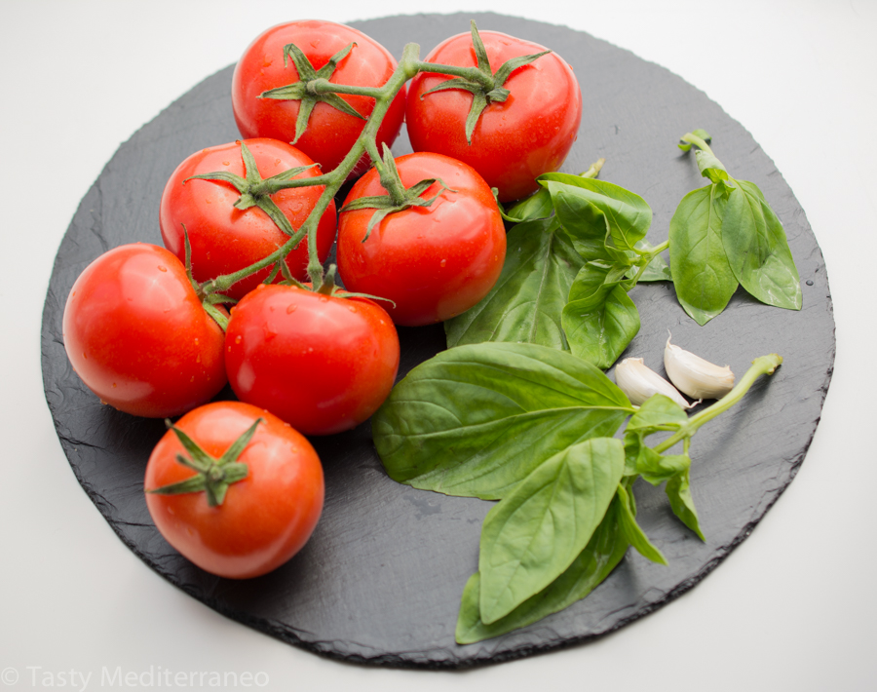
The green basil leaves are about 3.5 cm long.
About how long would a line of 7 leaves be?
5.NBT.B7

Slide 14
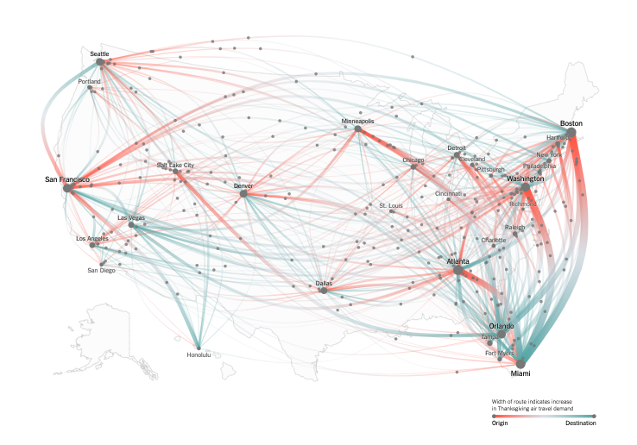
What do you notice?
What do you wonder?
Name the graph!
5.MD
Notes:
https://www.nytimes.com/2018/11/08/learning/whats-going-on-in-this-graph-nov-14-2018.html

Slide 15
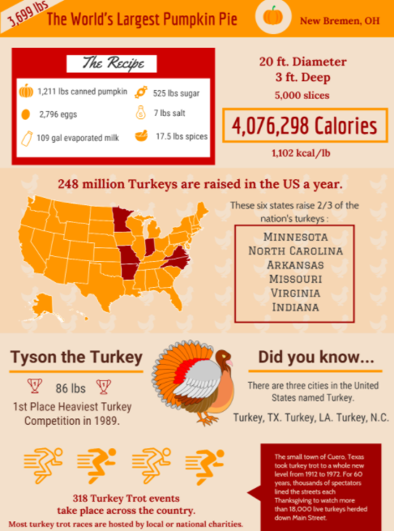
If this INFOGRAPHIC could talk, what would it say?
Think of a fun name for this INFOGRAPHIC!
5.MD
Notes:
Week of November 22, 2021

Slide 16
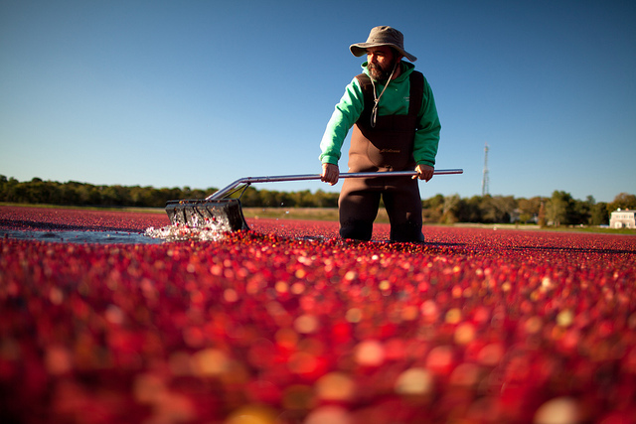
400 million pounds of cranberries are consumed by Americans each year. What are some numbers that ROUND to 400 million?
5,062,500 gallons of cranberry sauce are consumed by Americans every holiday season.
How many different ways can you express 5,062,500?
How many different ways can you show the number 400 million?
Cranberry Bog Plympton, MA
Cranberry Bog Carver, MA
5.OA.A2

Slide 17
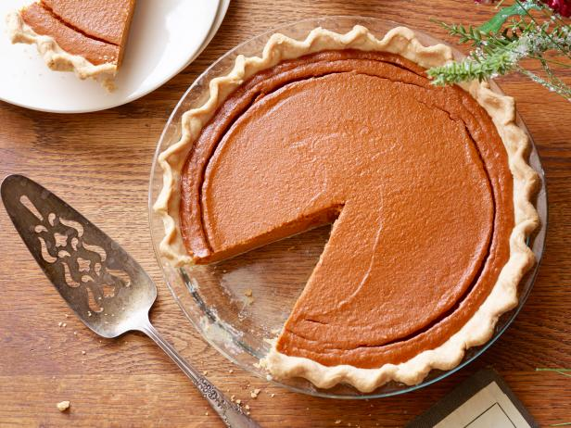
Happy Thanksgiving
About what fraction of the pie is missing?
How much is still in the pie dish?
5.NF.A1

