Slide 1
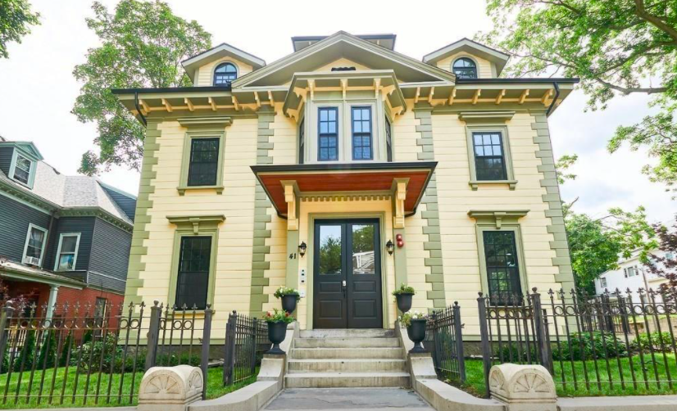
The footprint of this historic home is a square.
It is 39 feet wide.
What is the perimeter of this home?
4.MD.A3
Notes:
Week of November 1, 2021

Slide 2
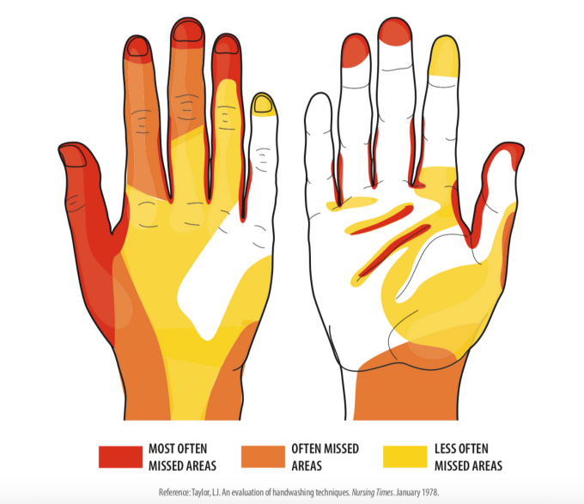
What do you notice?
What do you wonder?
What is going on in this data visualization?
4.MD

Slide 3
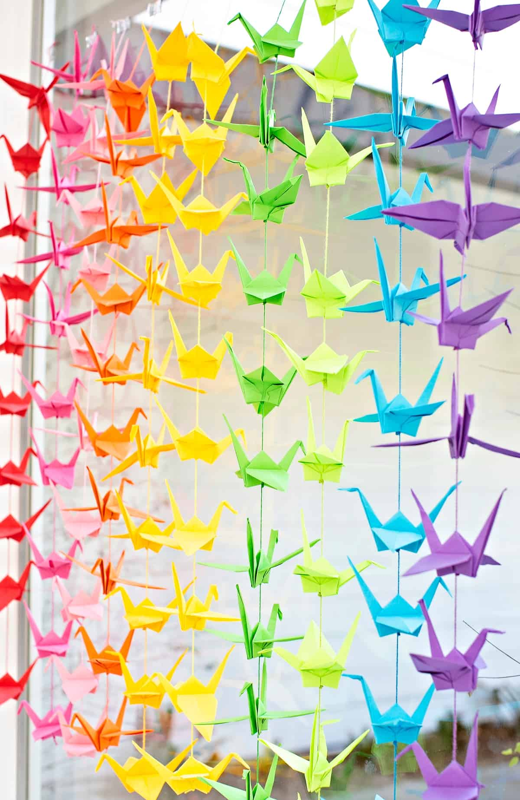
Happy Japanese Culture Day
1,000 paper cranes!
There are 9 different colors.
Each color DOES NOT have the same number of paper cranes.
What is possible?
4.OA.A3
Notes:
Japanese Culture Day

Slide 4
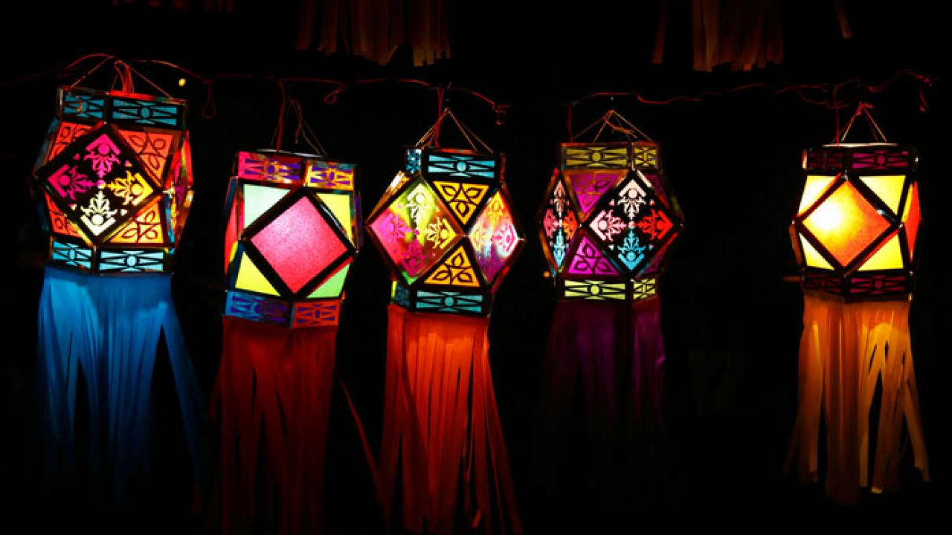
Let’s talk about some of the amazing shapes and angles
we see in these Diwali Lanterns.
44.G.A2
Notes:
Diwali

Slide 5
Which one does not belong?
Can you find a reason why all four may not belong?
10 x 4 | 5 x 8
10 + 30 | 6 x 10
4.NBT.B4

Slide 6
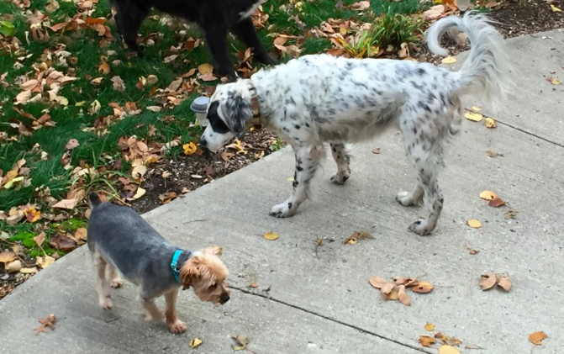
Lucy weighs ten times more than Theo.
Theo weighs about 11 pounds.
So how much does Lucy weigh?
Lucy and Theo
4.NBT.A1
Notes:
Week of November 8, 2020

Slide 7
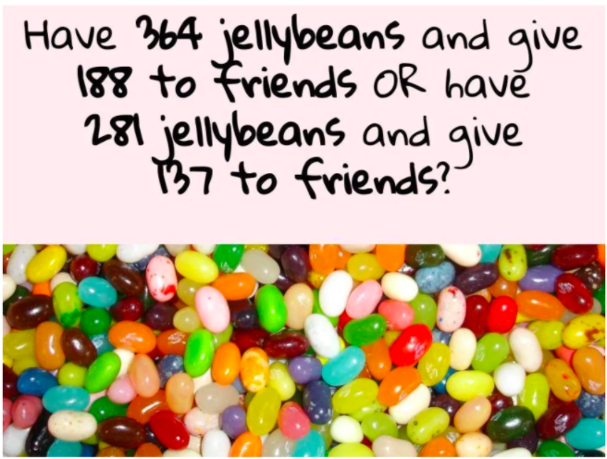
Would You Rather...
4.NBT.B4

Slide 8
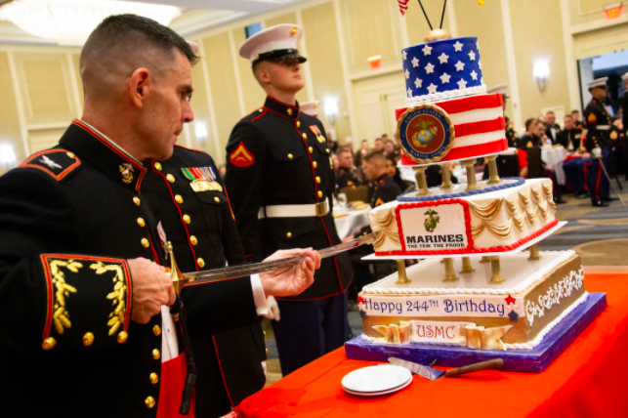
It is tradition to celebrate the birthday of the US Marine Corps with a Huge Birthday cake!
The bottom layer of this cake has an area of 240 sq. in.
What’s possible?
4.MD.A3
Notes:
Marine Corps Birthday

Slide 9
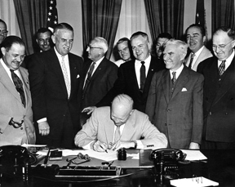
In 1954 President Dwight D. Eisenhower issued the first "Veterans Day Proclamation" which stated: "In order to insure proper and widespread observance of this anniversary, all veterans, all veterans' organizations, and the entire citizenry will wish to join hands in the common purpose.”
How many years ago was that?
4.NBT.B4
Notes:
Veterans Day

Slide 10
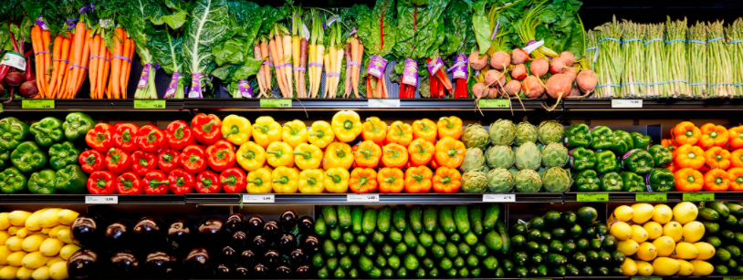
What math expressions can you create?
4.OA.A3
Notes:
Week of November 15, 2021

Slide 11
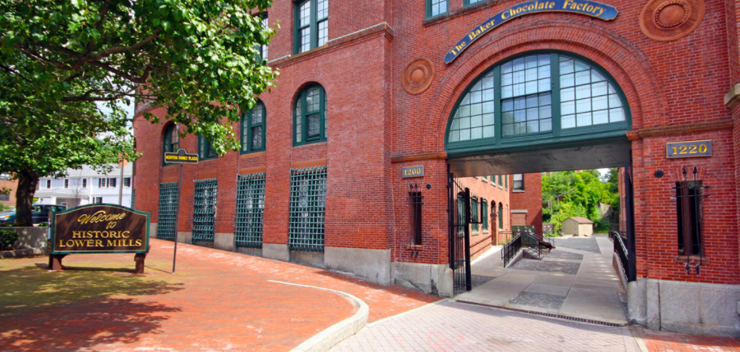
What MATH do you see in this picture?
How many window panes are in the arch entrance?
Estimate how many are on the whole building!
How can you count them?
What about the ones that are not wholes?
4.NBT.B5

Slide 12
Which one does not belong?
6 x 4 | 48 ÷ 2
8 x 4 | 2 x 3 x 4
4.OA.A1

Slide 13
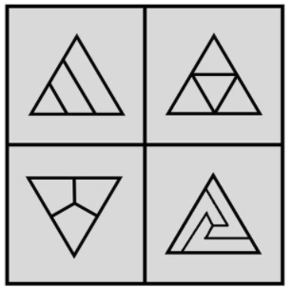
Which one DOES NOT belong?
4.G.A2

Slide 14
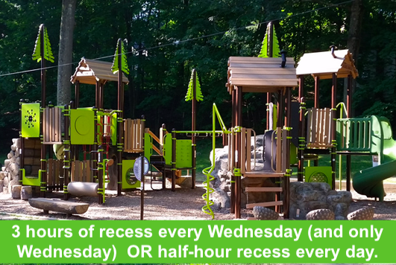
Would you rather …. (and justify your decision with MATH!)
4.MD.A1

Slide 15
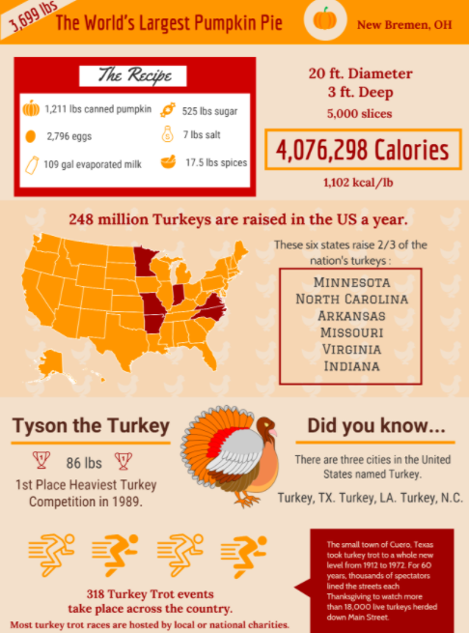
If this INFOGRAPHIC could talk, what would it say?
Think of a fun name for this INFOGRAPHIC!
4.MD
Notes:
Week of November 22, 2021

Slide 16
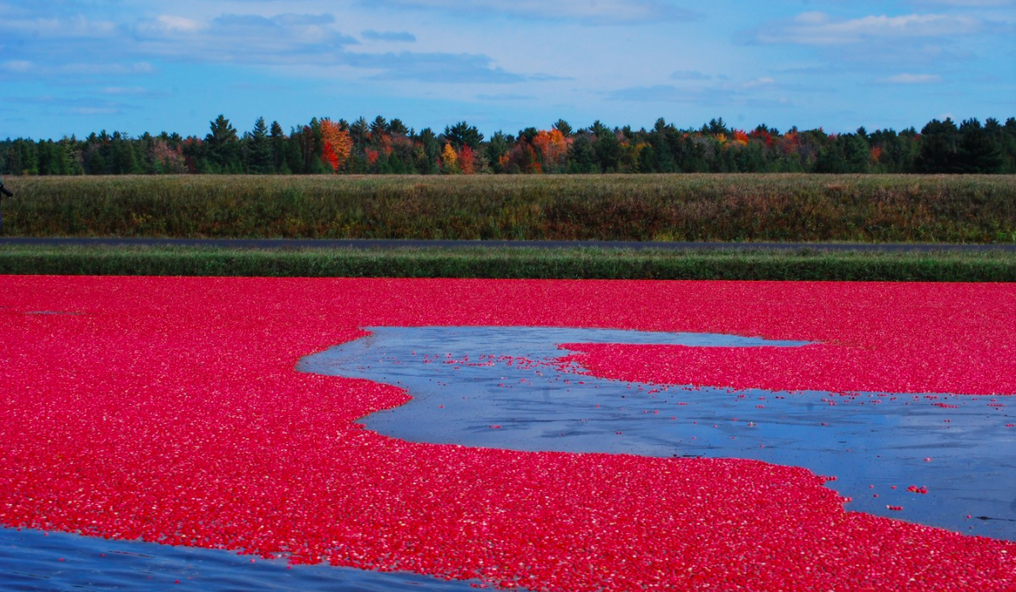
400 million pounds of cranberries are consumed by Americans each year.
What are some numbers that ROUND to 400 million?
Cranberry Bog Carver, MA
4.NBT.A3

Slide 17
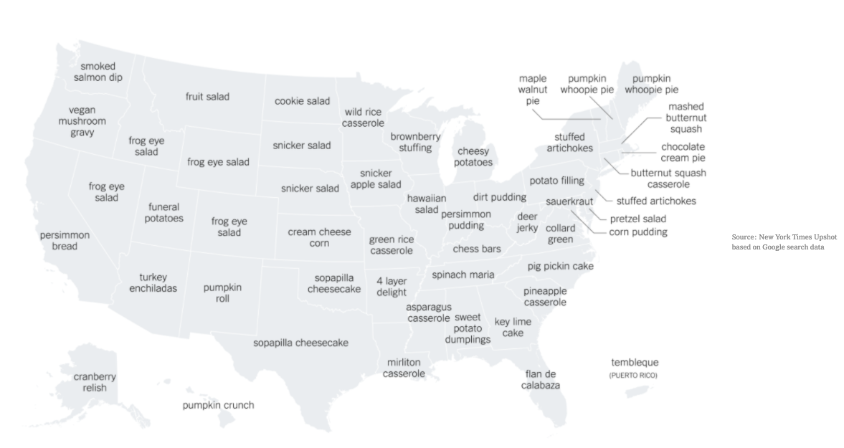
Which foods are unusually popular in each state on Thanksgiving?
What do you notice?
What do you wonder?
What’s a good name for this graph?
4.MD
Notes:
https://www.nytimes.com/2020/11/12/learning/whats-going-on-in-this-graph-thanksgiving-side-dishes.html

