Slide 1
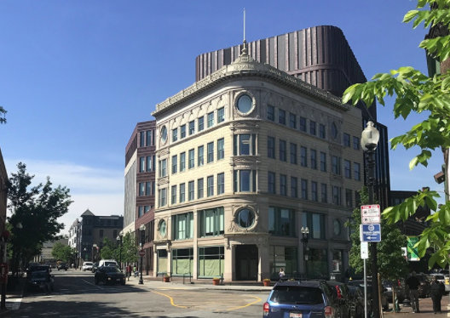
This building was built in 1901.
About how old is it?
What strategies can you think of to find out precisely how old it is?
3.NBT.A2
Notes:
Week of November 1, 2021

Slide 2
Which one does not belong?
Can you find a reason why all four may not belong?
20 | 92
19 | 192
3.OA.D9

Slide 3
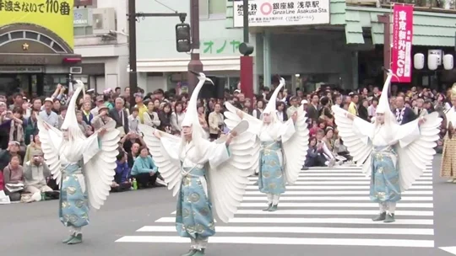
Happy Bunka No Hi ~ Japanese Culture Day!
Japanese Culture Day is celebrated on the birthdate of the late Emperor Meiji.
Emperor Meiji ruled Japan from 1867 to 1912.
How long was that?
How can we figure it out?
3.NBT.A2

Slide 4
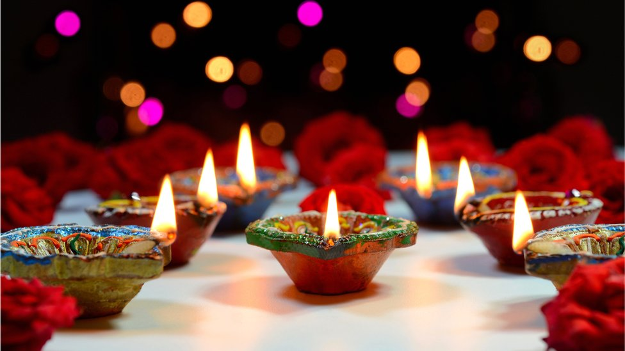
Happy Diwali ~ Festival of Lights
Diwali is celebrated for five days!
How many hours is that?
3.MD.A1

Slide 5
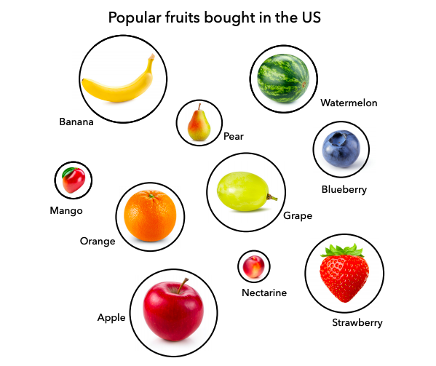
What do you notice?
What do you wonder?
What is going on in this data visualization?
You Cubed, Stanford University
3.MD.B3

Slide 6
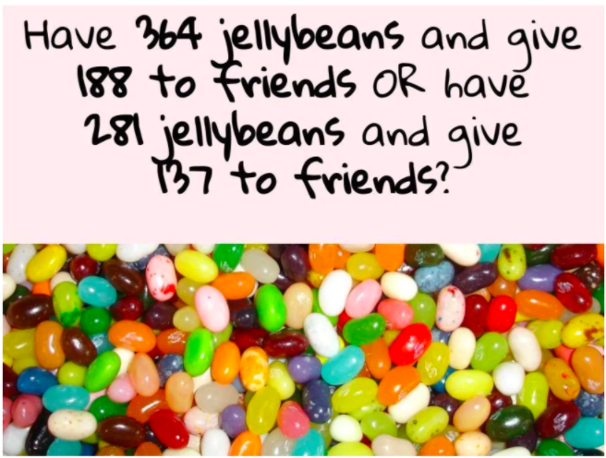
Would You Rather...
3.NBT.A2
Would You Rather
Notes:
Week of November 8, 2021

Slide 7
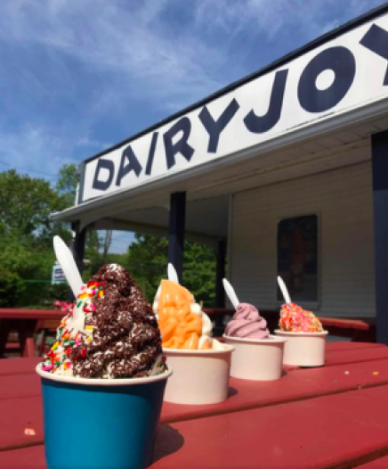
Ice cream, yum!
If each ice cream is $4, and you have $15, do you have enough money?
How much more do you need?
What if you have $20, how much change will you get back?
3.MD

Slide 8
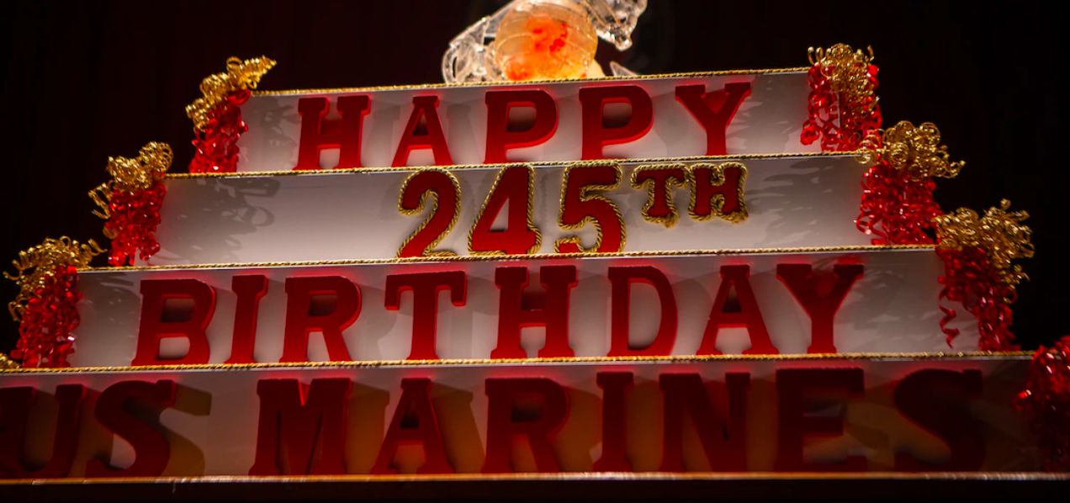
It is tradition to celebrate the US Marine Corps birthday with a huge cake.
This giant cake is made up of 4 rectangular cakes. The top cake is 14 inches long and 12 inches wide.
What might the other 3 cakes be?
3.MD.A2

Slide 9
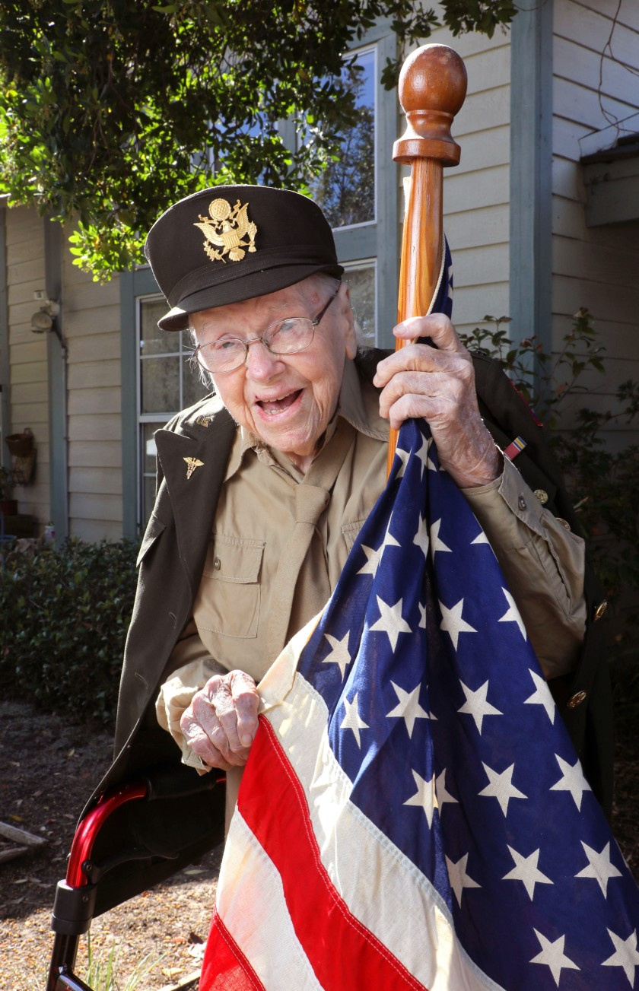
Lt. Betty Gilby
Happy Veterans Day!
In November 1919, President Wilson proclaimed November 11th as the first commemoration of Armistice Day, today known as VETERANS DAY
How long ago was that?
How can we figure that out using mental math?
3.NBT.A2

Slide 10
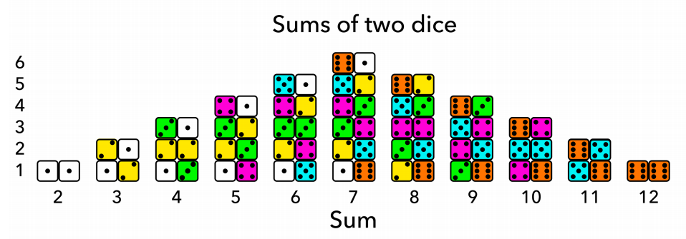
What do you notice?
What do you wonder?
What is this data saying?
3.MD.B3
Notes:
Week of November 15, 2021

Slide 11
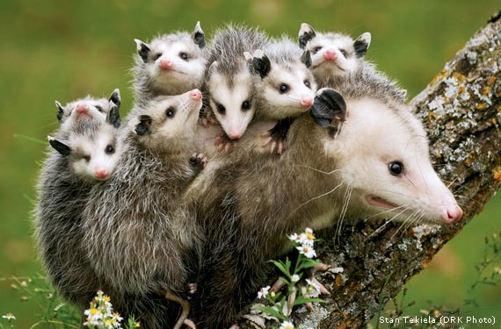
These baby Opossums can eat up to 6 ounces of food each day.
How many ounces of food does Mama Opossum need to gather each day?
3.OA.C7

Slide 12
Which one DOES NOT belong?
50 + 50 | 38 + 62
44 + 66 | 132 - 32
3.OA.D9

Slide 13
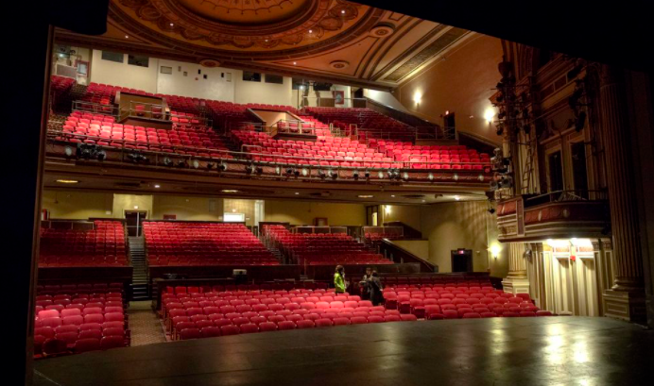
This is the view from the stage of the Strand Theater in Dorchester. Are there more than 100 seats or less? Estimate how many seats.
3.NBT.A1
Notes:
There are 1400 seats!

Slide 14
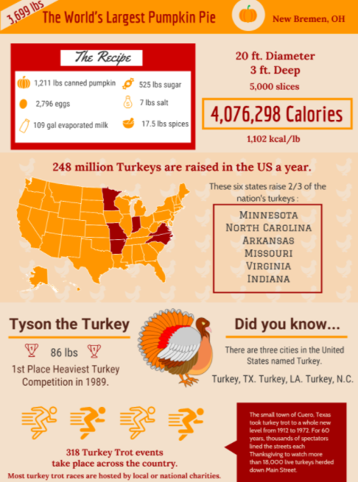
If this INFOGRAPHIC could talk, what would it say?
Think of a fun name for this INFOGRAPHIC!
3.MD

Slide 15
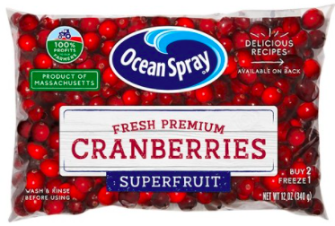
There are about 330 cranberries in this bag.
How many different equations can we create to equal 330?
3.OA.D8
Notes:
Week of November 22, 2021

Slide 16
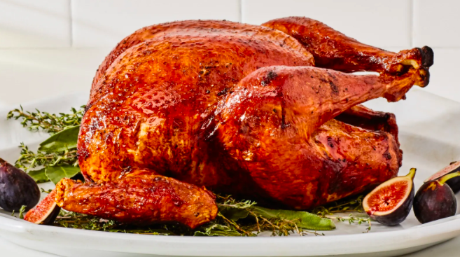
We are cooking turkeys for the Miracle Kitchen. These are 15 pound turkeys!
We get about 12 servings per turkey.
How many guests can we serve?
How many turkeys would we need to serve 200 guests?
3.OA.D8

Slide 17
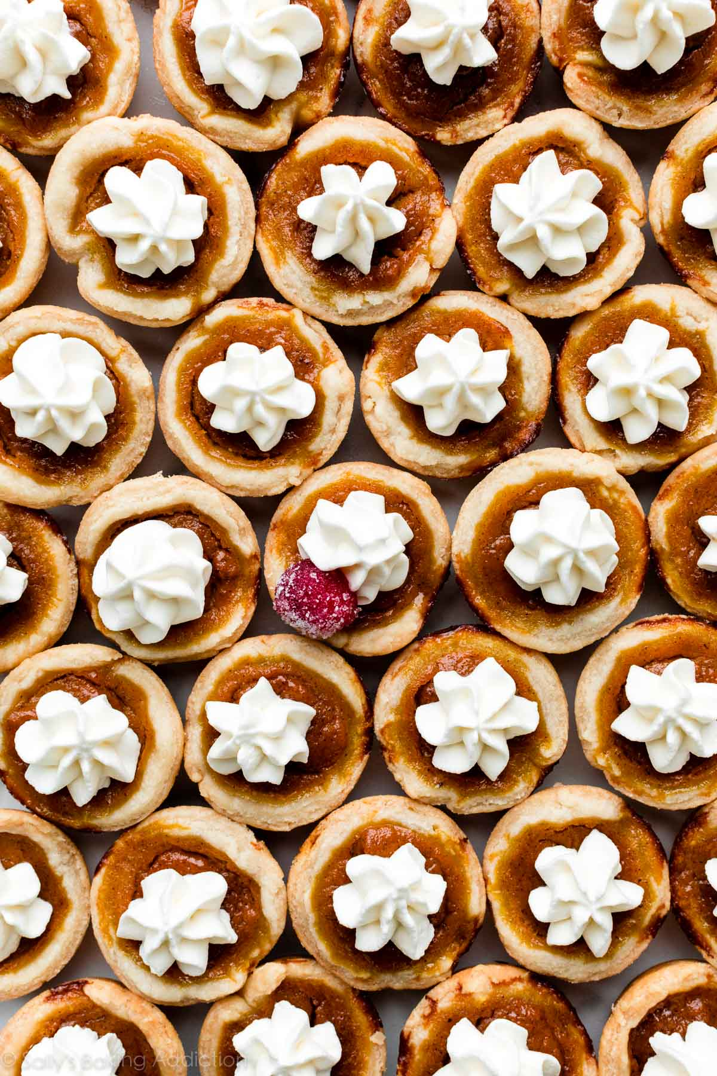
Happy Thanksgiving!
How many mini pumpkin pies might be here?
How can we use arrays to help us?
3.OA.A3

