Slide 1
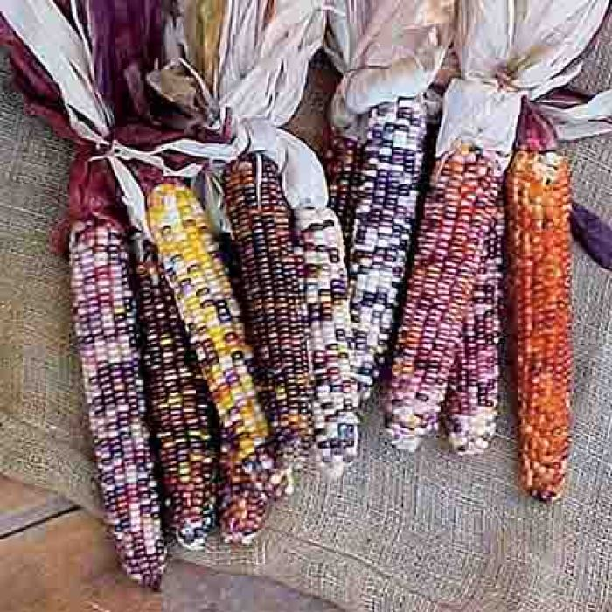
Wow! Look at all of this Indian corn!
How many ears are here?
How can we count them?
Let’s write a number sentence to match our mathematical thinking.
1.NBT.C6
Notes:
Week of November 1, 2021

Slide 2
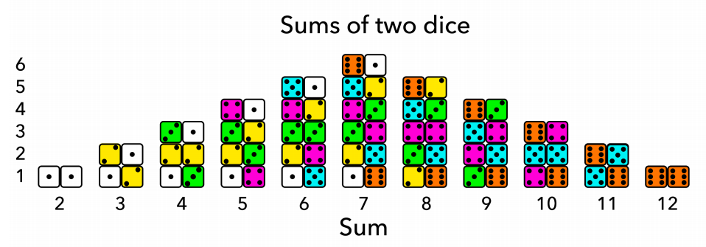
What do you notice?
What do you wonder?
What is this data saying?
You Cubed, Stanford University
1.MD.C4

Slide 3
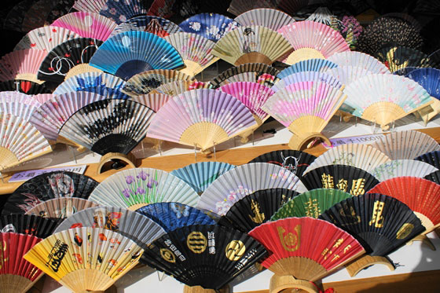
There are about 55 Japanese fans.
How many TENS are in 55?
What is 10 MORE than 55?
What is 10 LESS than 55?
Draw a picture to represent the number 55.
1.NBT.B2
Notes:
Japanese Culture Day

Slide 4
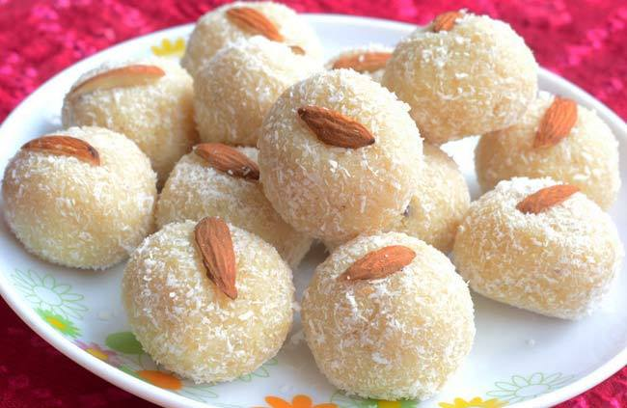
How many Diwali treats do we see?
There are 14!
How many more would we need to make 20?
30? 50? 100?
1.OA.D8
Notes:
Happy Diwali

Slide 5
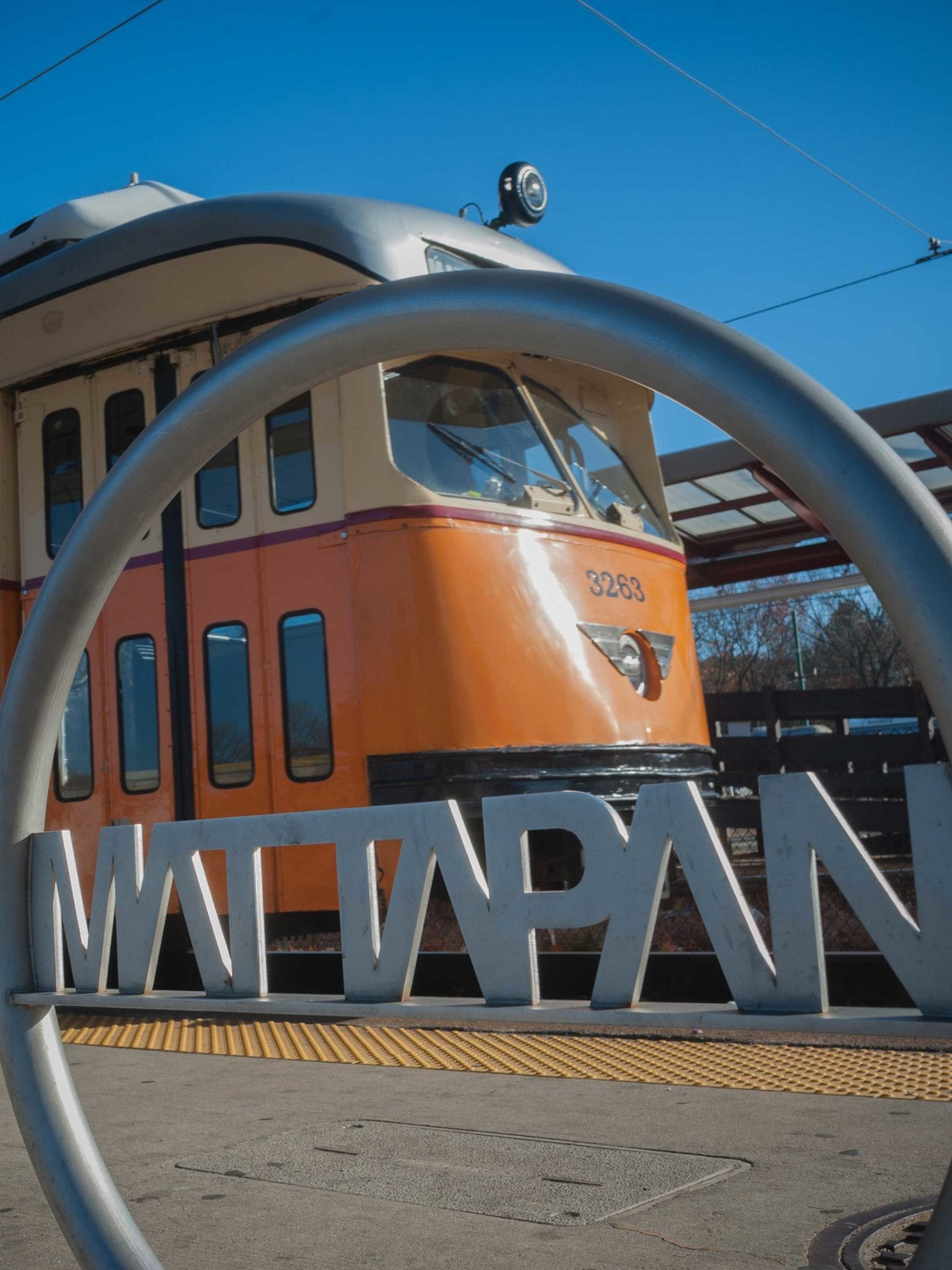
What interesting shapes do we see in this photo?
What shapes are hiding in the letters?
Sketch some of the shapes, what are they?
1.G.A1

Slide 6
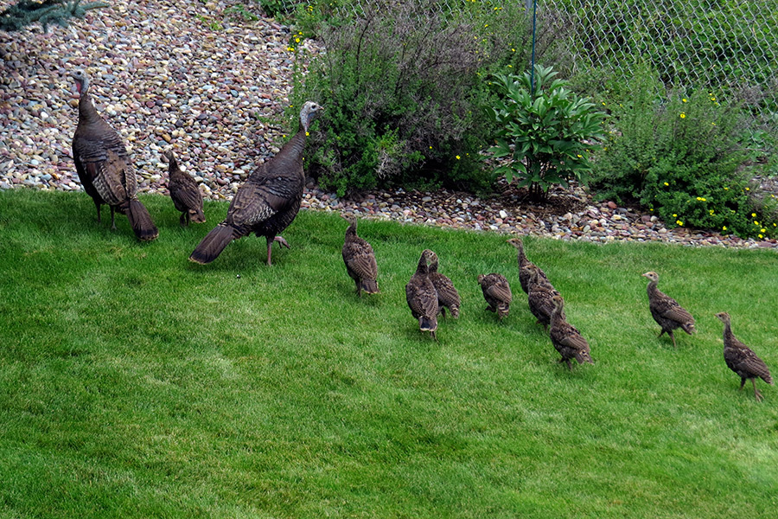
How many turkeys do we see?
What if HALF of them walked away?
What if the number of turkeys DOUBLED?
1.OA.A1
Notes:
Week of November 8, 2021

Slide 7
Which one does not belong?
5 + 5 | 12 - 2
8 + 1 | 7 + 2 + 1
1.OA.C6

Slide 8
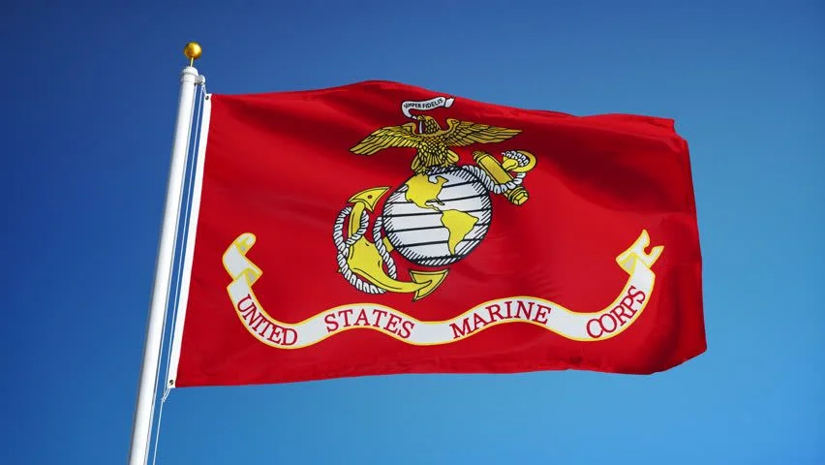
Happy Birthday to the US Marine Corps.
This flag is 5 feet long, how high might it be? Is that taller or shorter than you?
1.MD.A2

Slide 9
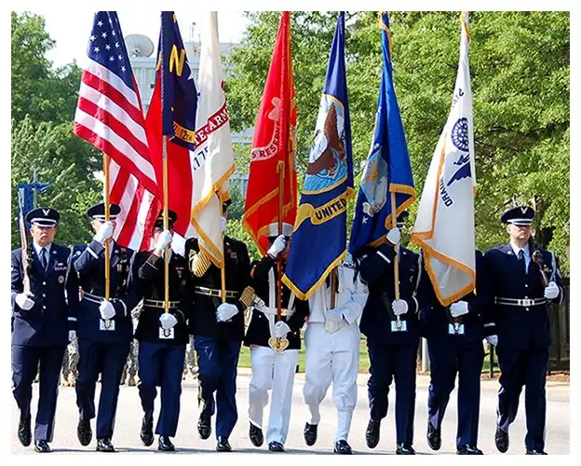
Happy Veterans Day
What can we count in this picture?
How can we count?
What patterns do we notice?
1.NBT.A1
Notes:
Veterans Day

Slide 10
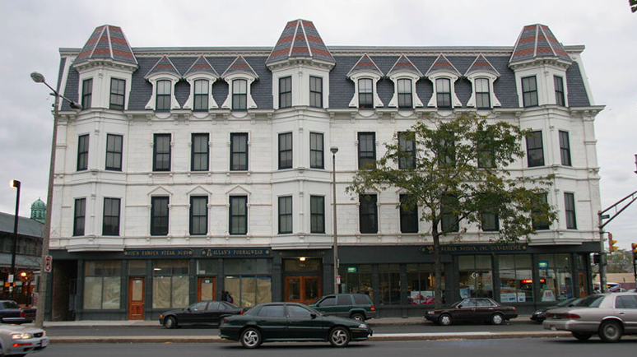
What shapes do we see?
How many different rectangles do we see?
Can we put shapes together to make new shapes?
1.G.A2
Notes:
Week of November 15, 2021

Slide 11
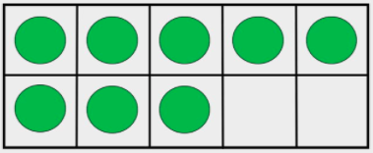
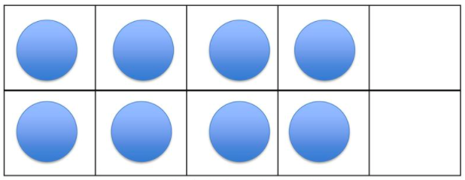
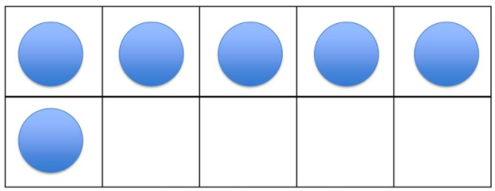
Which one does not belong?
 | 8
1.OA.C5

Slide 12
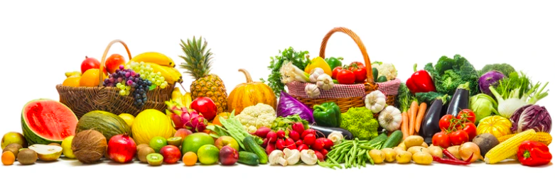
How would you sort these fruits and vegetables?
What might that graph look like?
1.MD.C4

Slide 13
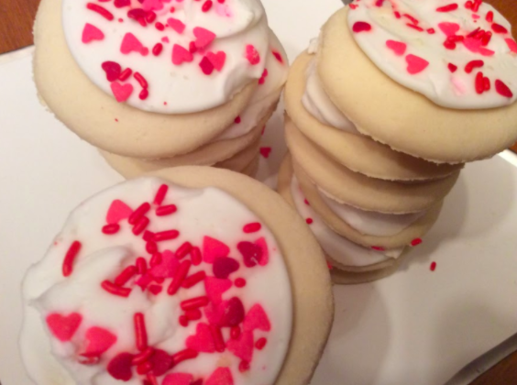
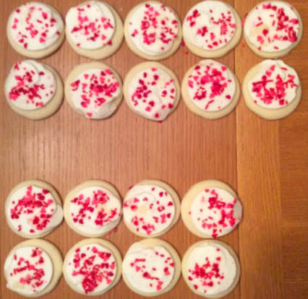
How many yummy cookies do you see?
Write an expression to match the picture.
1.NBT.B2

Slide 14
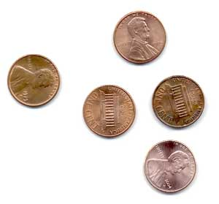
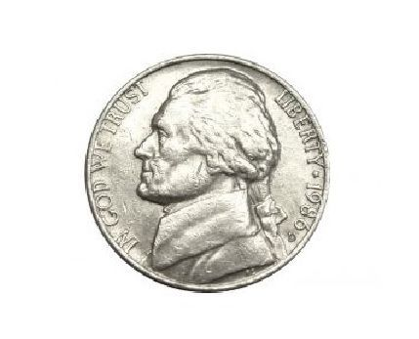
What’s the same? What’s different?
1.MD.D5

Slide 15
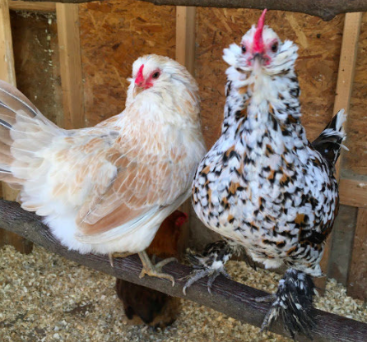
Meet Hawk and Princess from Land’s Sake Farm
They have 21 chickens in their family!
How many are missing from this photo?
1.OA.C6
Notes:
Week of November 22, 2021

Slide 16
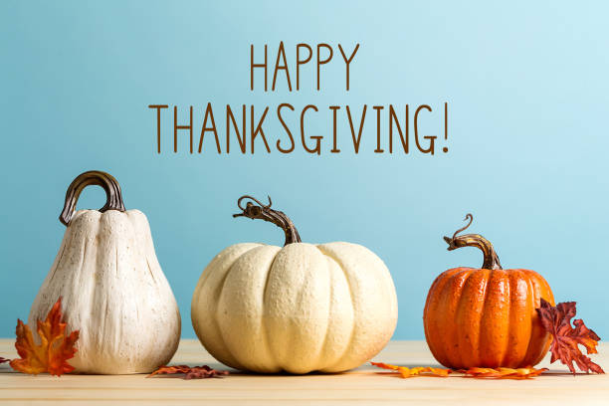
How can we compare these three pumpkins?
How might we order them?
What can we say if the pumpkin in the middle weighs 25 ounces?
1.MD.A1

Slide 17
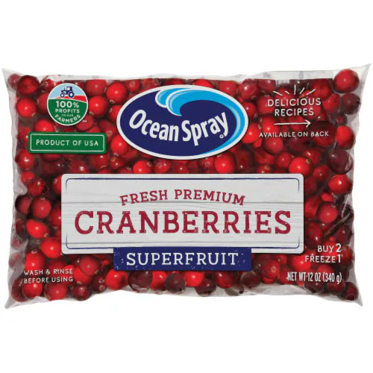
There are about 350 cranberries in this bag.
How many hundreds?
How many tens?
How many different ways can we MODEL this number?
1.NBT.B2

