Slide 1
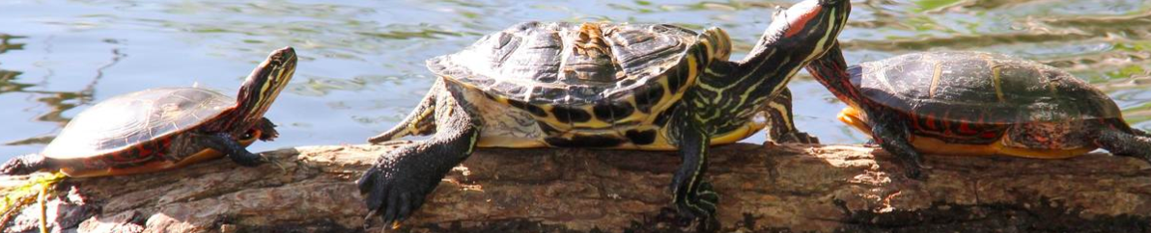
These turtles are basking in the sun at
Jamaica Pond in Jamaica Plain
How many are there?
What if one jumped into the pond?
What if 2 more turtles joined them?
K.CC.B4
Notes:
Week of October 4, 2021

Slide 2
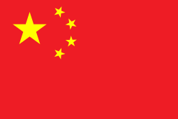
Happy Chinese National Day!
Let’s talk about the interesting shapes we see in the Flag of China.
How many points?
How many sides?
K.CC.B4

Slide 3
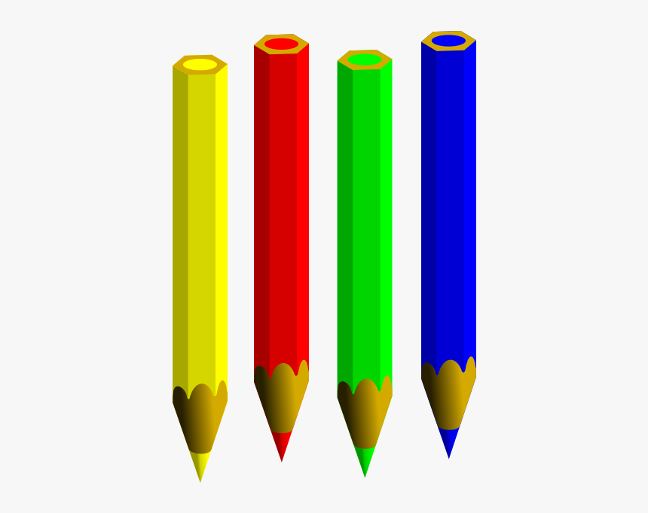
How many pencils?
What if we added 2 more?
What if we took 2 away?
K.OA.A1

Slide 4
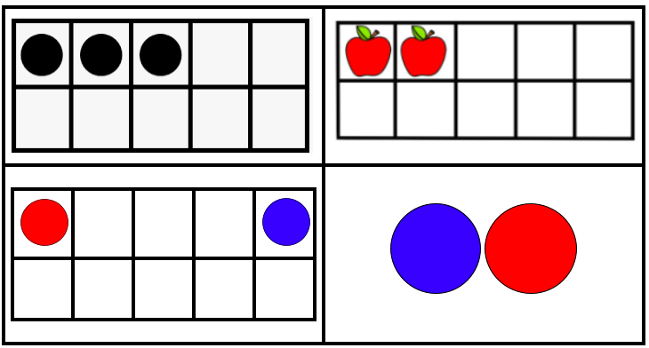
Which one doesn’t belong?
K.CC.C6

Slide 5
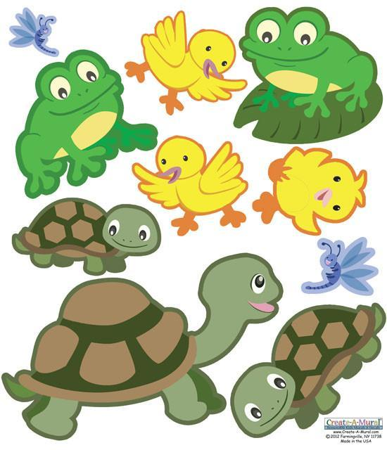
Froggy Friday!
What can we say about the animals in this picture?
K.CC.C6

Slide 6
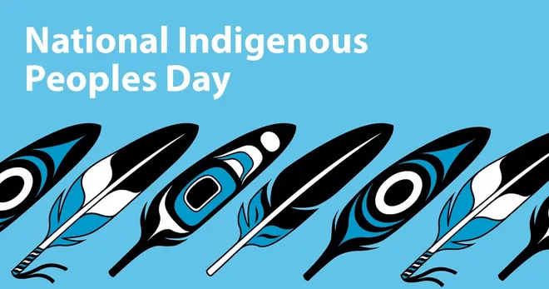
What do these feathers have in COMMON? What is different about them?
K.G.A1
Notes:
Week of October 12, 2021

Slide 7
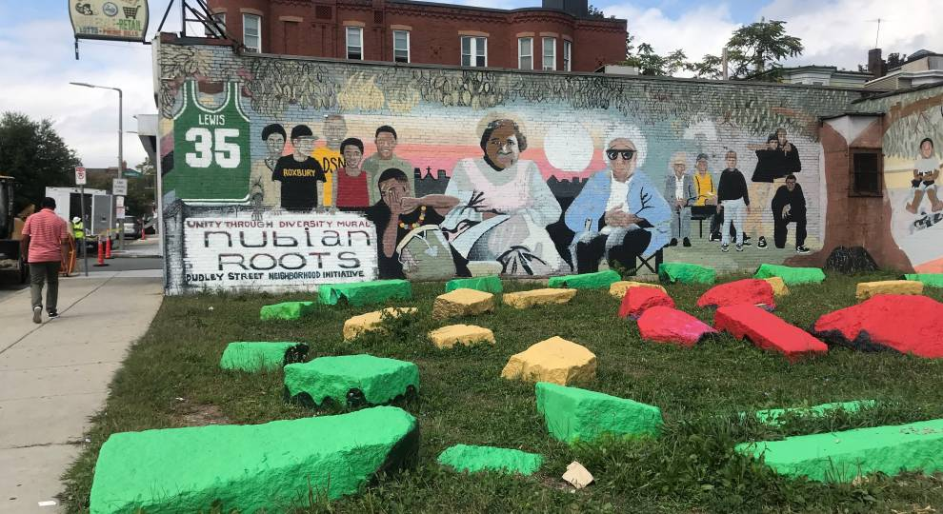
How many rocks are here? Which color has the MOST?
K.CC.B5

Slide 8
What’s the SAME, what’s DIFFERENT?
K.G.B4

Slide 9
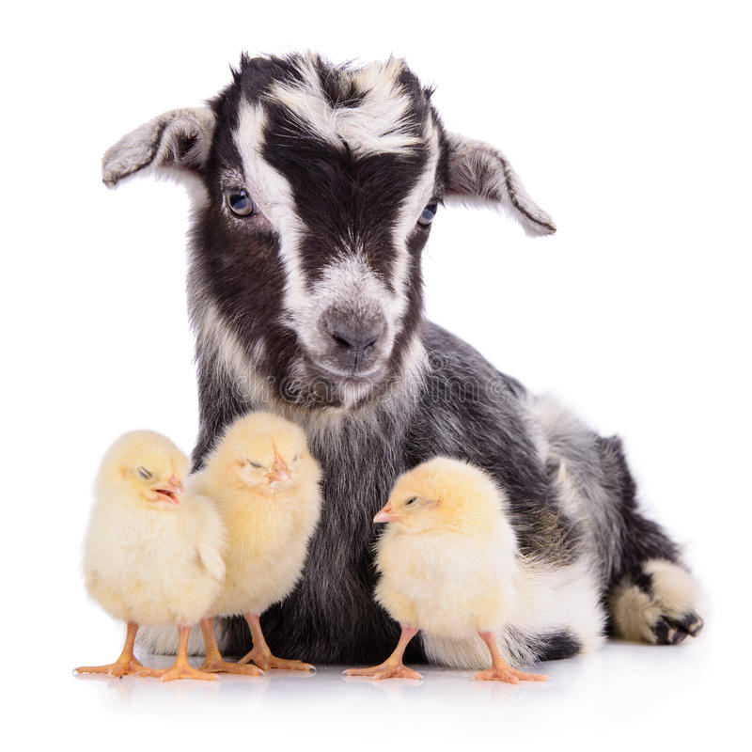
How can we compare these animals?
Which one is bigger?
Which one is lighter?
K.MD.A2

Slide 10
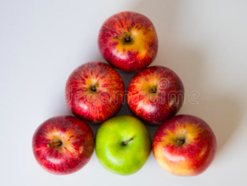
How do we see these apples?
K.OA.A3
Notes:
Week of October 18, 2021

Slide 11
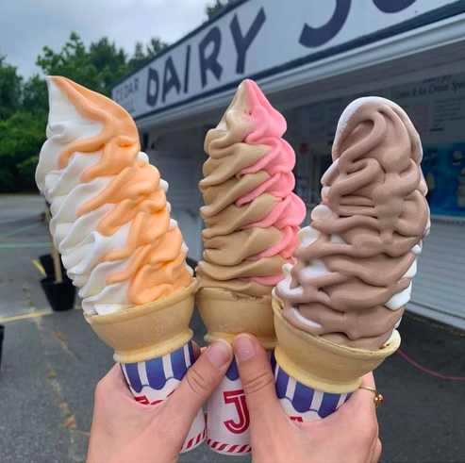
How many ice cream cones do you see?
How many FLAVORS do you see?
What number sentences can you make?
K.CC.B4

Slide 12
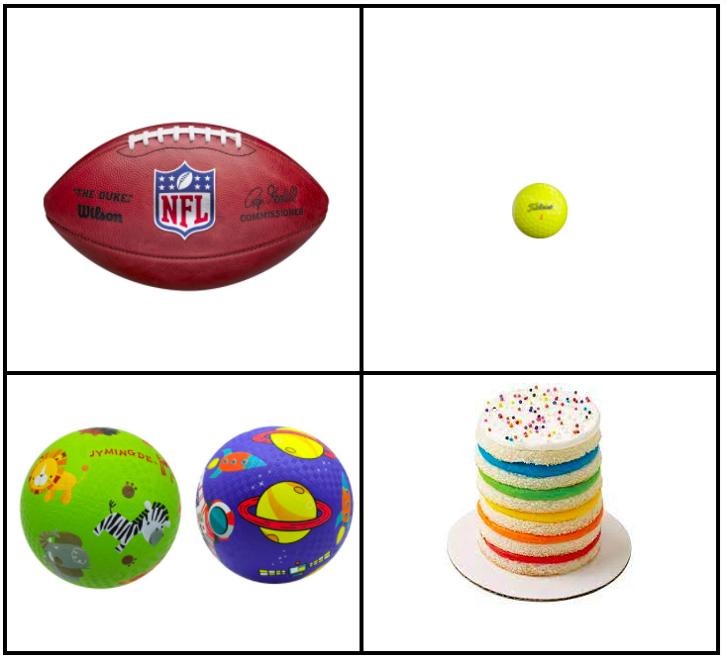
Which one doesn’t belong?
K.MD.A2

Slide 13
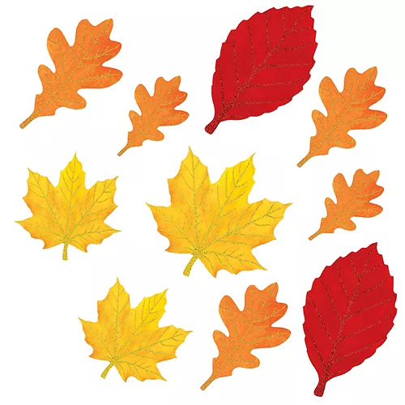
How many leaves?
How might we sort them?
K.MD.B3

Slide 14
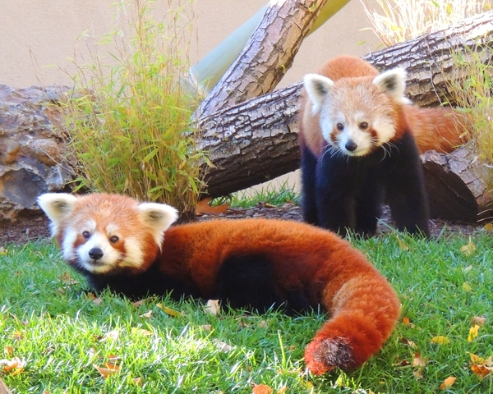
Red Pandas at the Franklin Park Zoo!
The one on the log weighs LESS that the one on the grass.
What is possible?
K.MD.A1

Slide 15
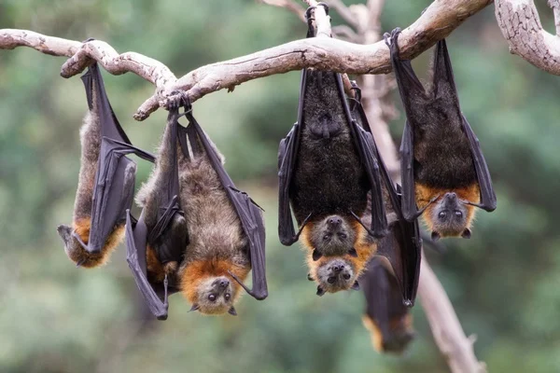
BATS!
How many do we see here?
How do we see them?
What if ONE flies away?
K.OA.A1
Notes:
Week of October 25, 2021

Slide 16
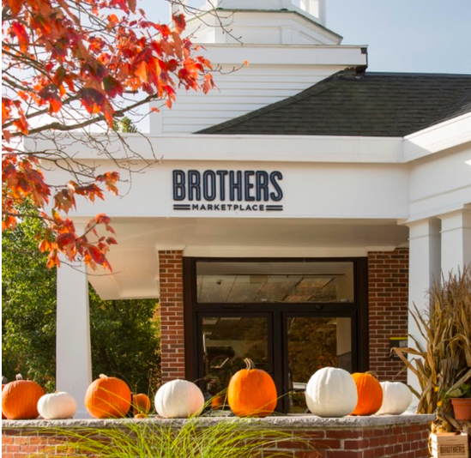
How many pumpkins do you see?
What if we took
1 away?
What if we took
2 away?
K.OA.A1

Slide 17
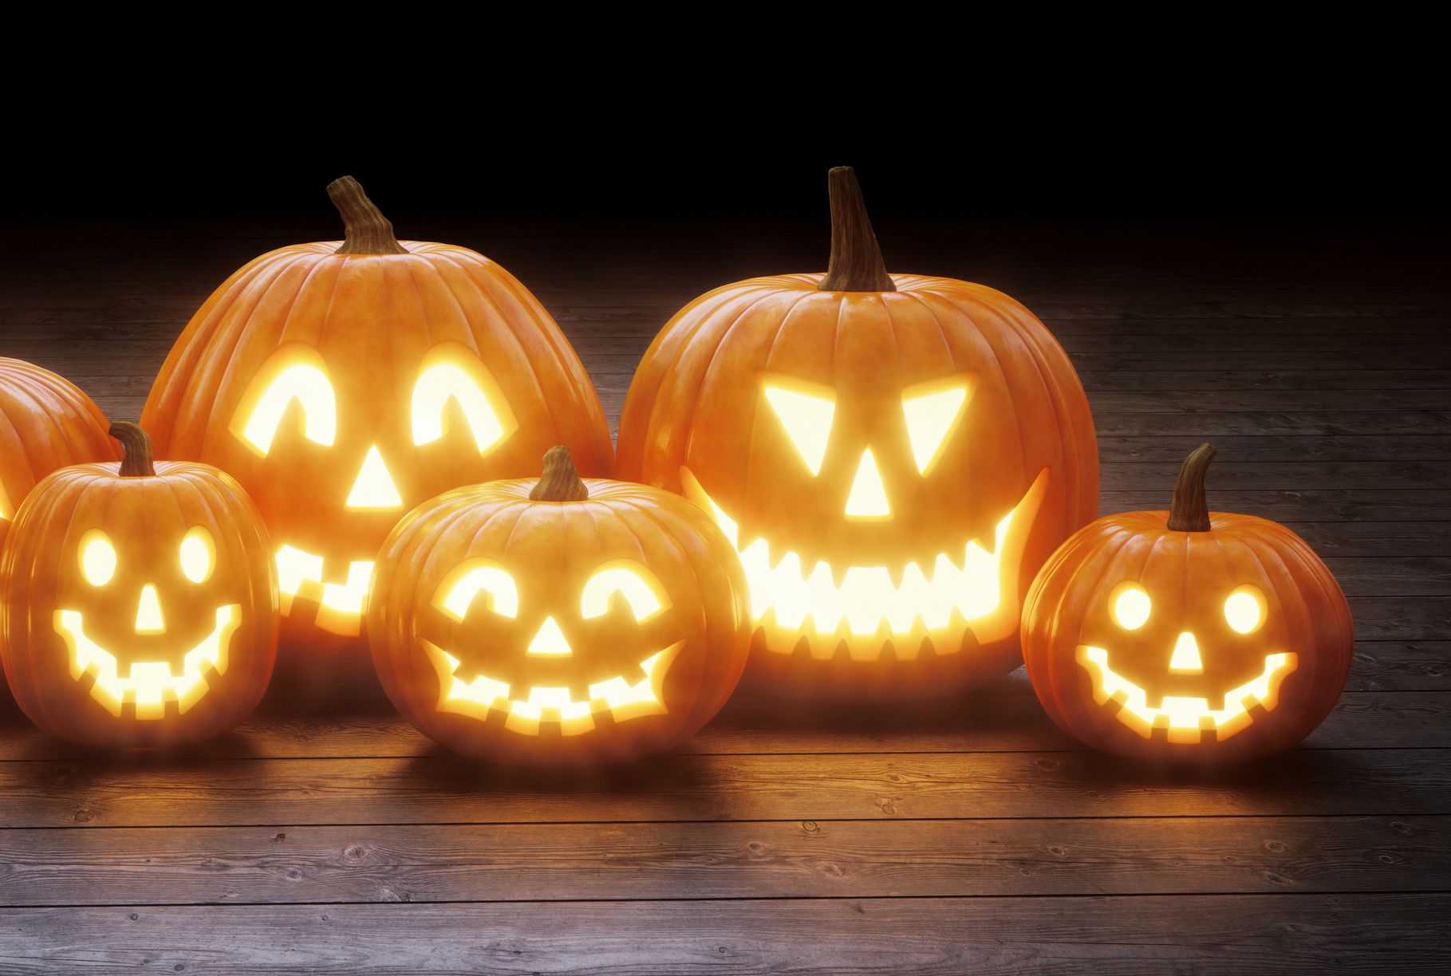
What interesting shapes do we see in these pumpkins?
K.G.A2

Slide 18
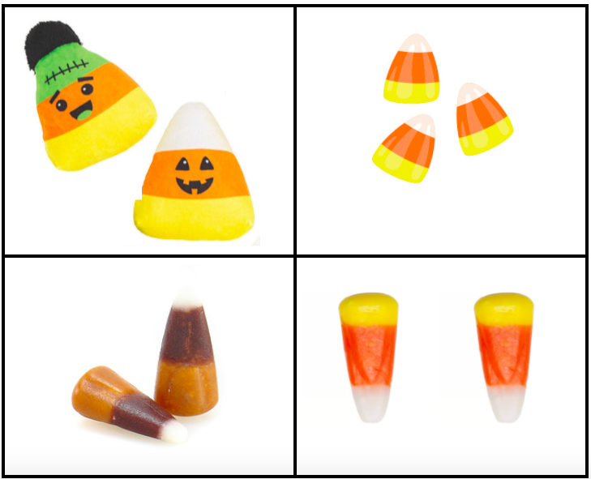
Which one doesn’t belong?
K.MD.B3

Slide 19
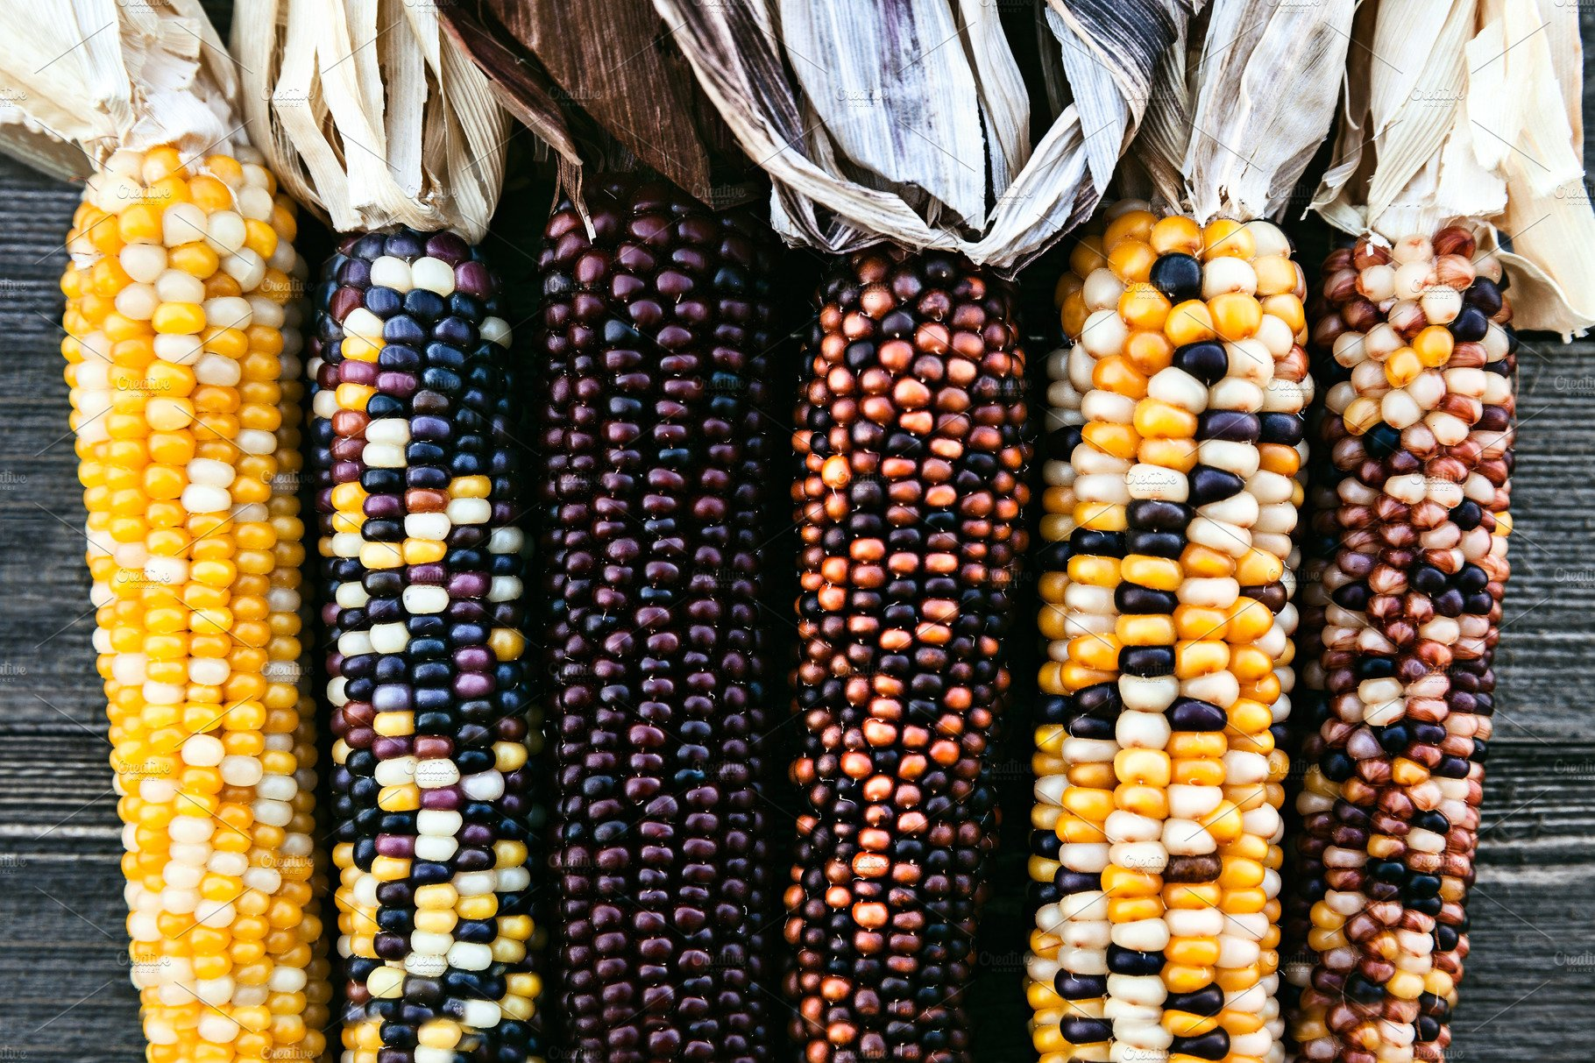
How many ears of Indian corn do we see?
How many more would we need to have 10?
K.OA.A2

