Slide 1
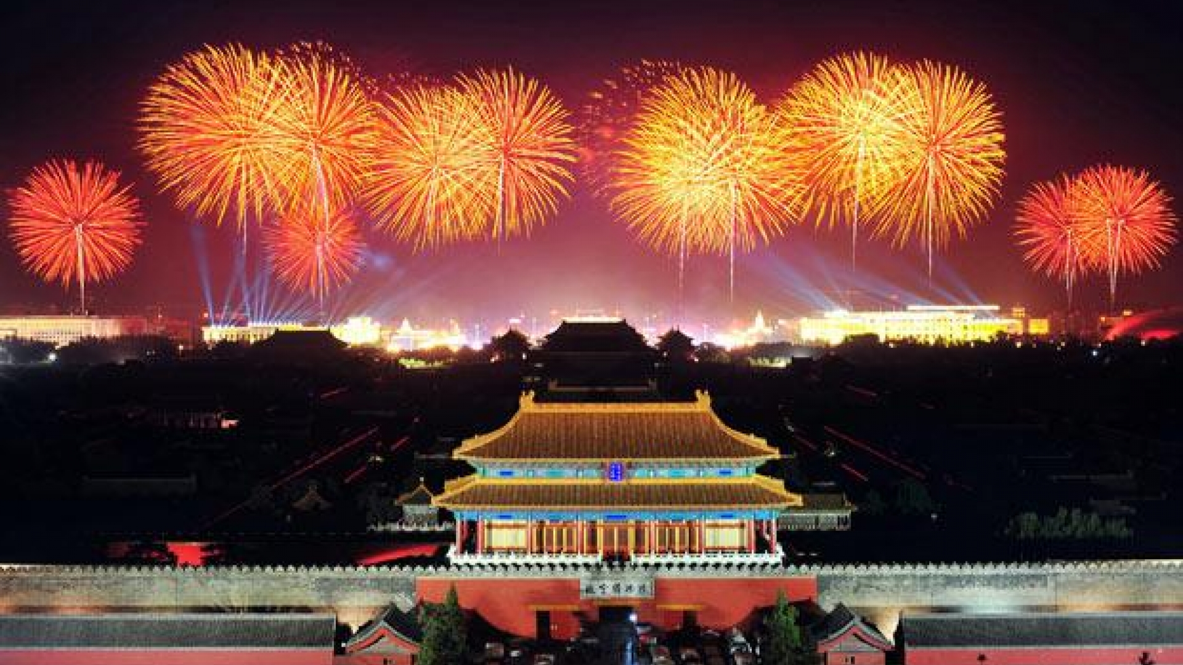
The holiday is actually celebrated for a whole week!
About how many hours would that be?
How could we figure it out?
It’s National Day in China!
4.MD.A1
Notes:
Week of October 4, 2021

Slide 2
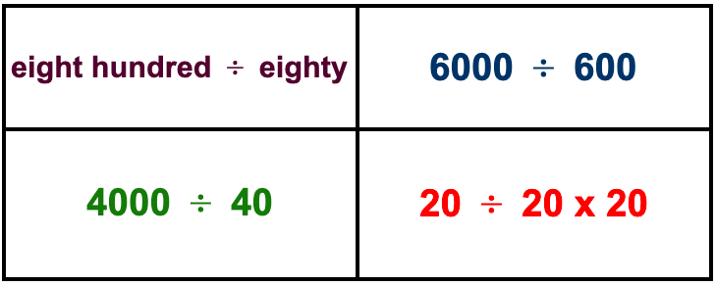
Which one doesn’t belong?
4.NBT.A1

Slide 3
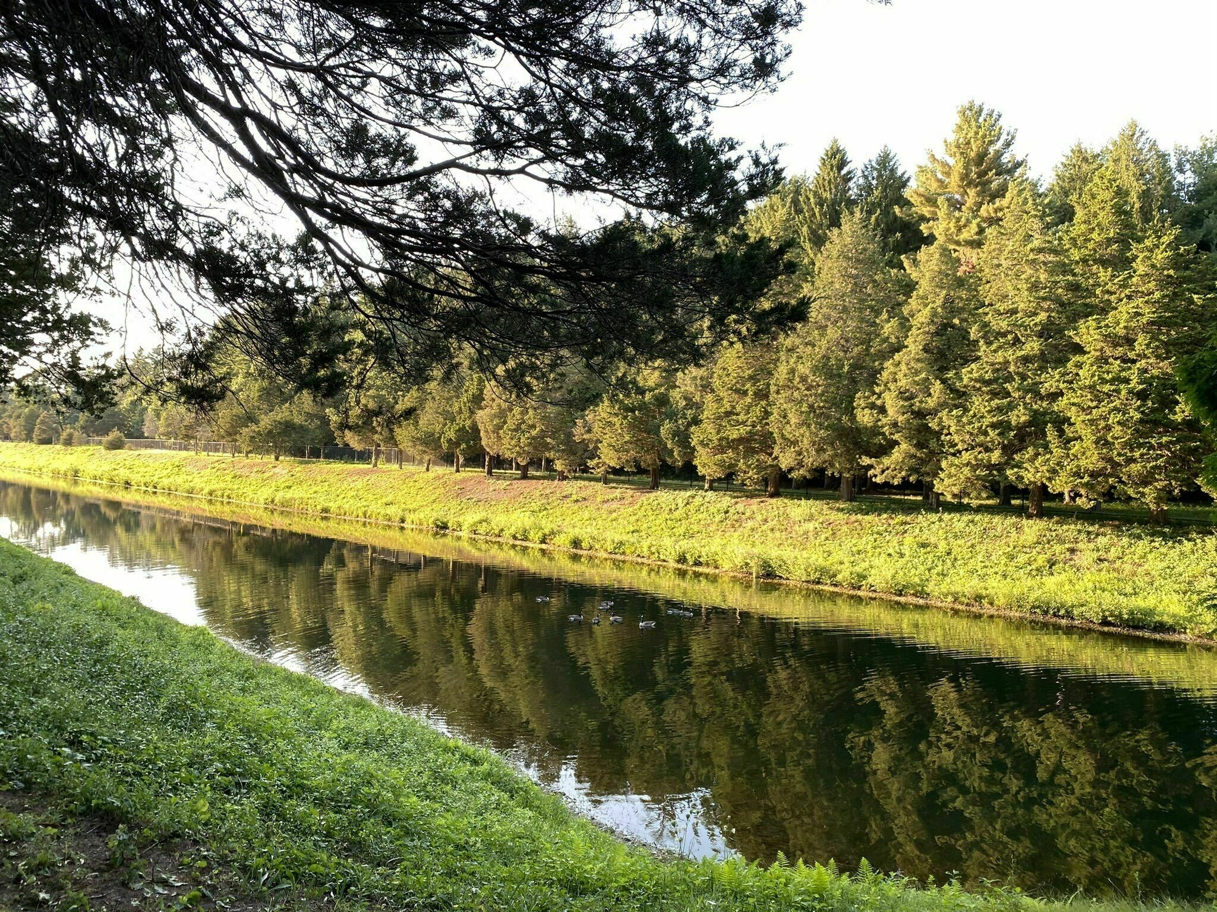
The Weston Reservoir Loop is about 2 miles around.
We can walk an 18 minute mile, and we always do the loop twice!
How long does it take us?
What if we did the loop three times?
Do you see a pattern?
4.MD.A1

Slide 4

Happy Sharada Navratri!
Where’s the math?
Do we see any symmetry in these traditional Indian sweets?
4.G.A3

Slide 5
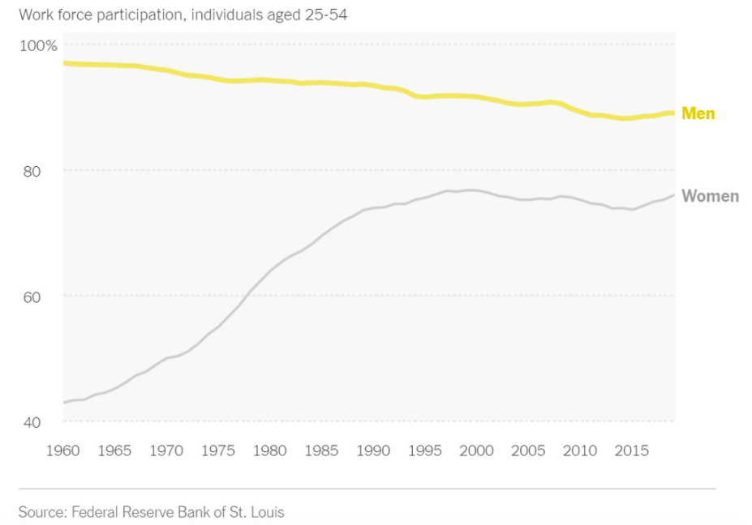
What do we notice?
What do we wonder?
What’s going on in this graph?
Why does it matter?
4.MD.B

Slide 6

This beautiful makerjake print spotlights the accomplished Aquinnah harpoonist, Tashtego, from the Moby-Dick story!
Look closely, what interesting shapes do we see here?
Do we see any patterns?
Describe them.
“Tashtego” by Jake Yellow Eagle Ginga
4.G.A
Notes:
Week of October 12, 2021
INDIGENOUS PEOPLE DAY

Slide 7

THE USS ZUMWALT This ship is designed to be stealthy. All of its sharp angles are meant to deflect radar beams sent out by anyone trying to find it.
Estimate the size of the angles we see here.
Happy Birthday to the US Navy!
4.MD.C5

Slide 8
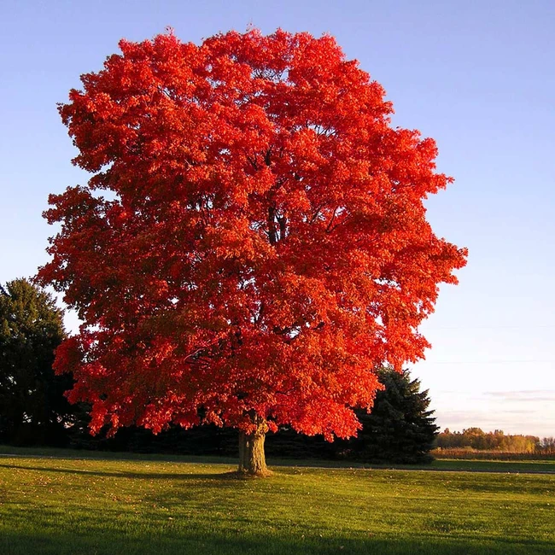
An average Maple tree has up to 250,000 leaves!
What’s possible?
4.NBT.A3

Slide 9
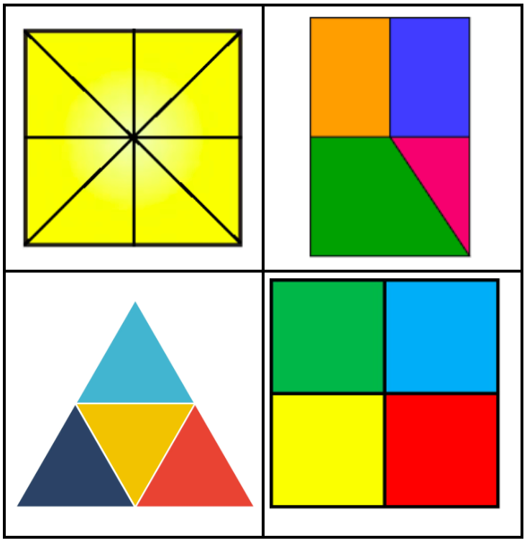
Which one doesn’t belong?
4.NF.B3

Slide 10
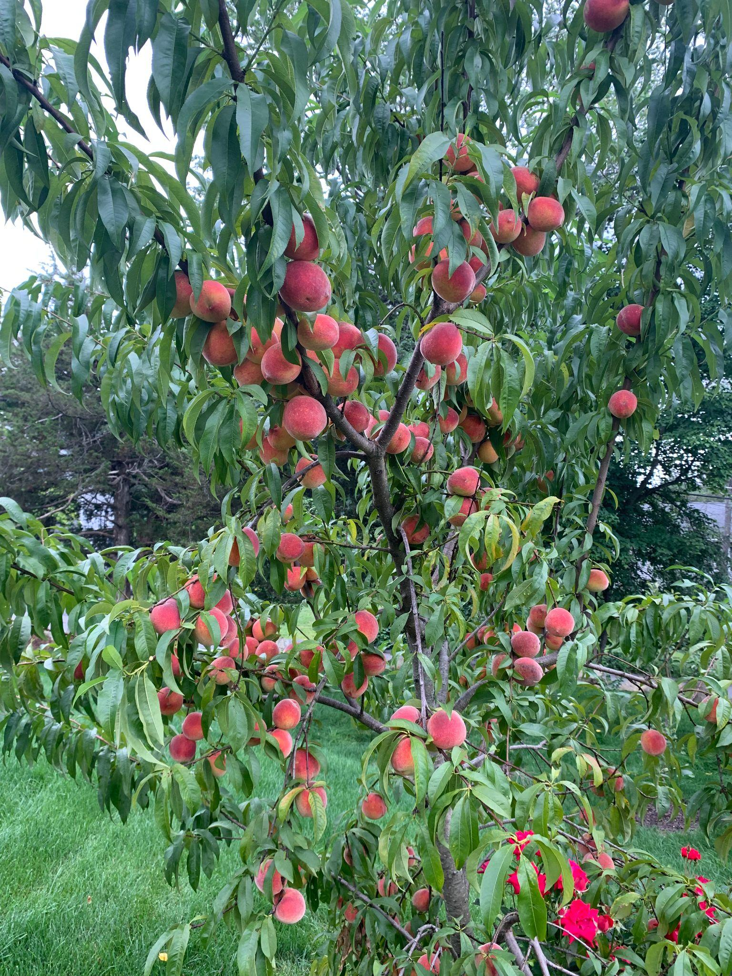
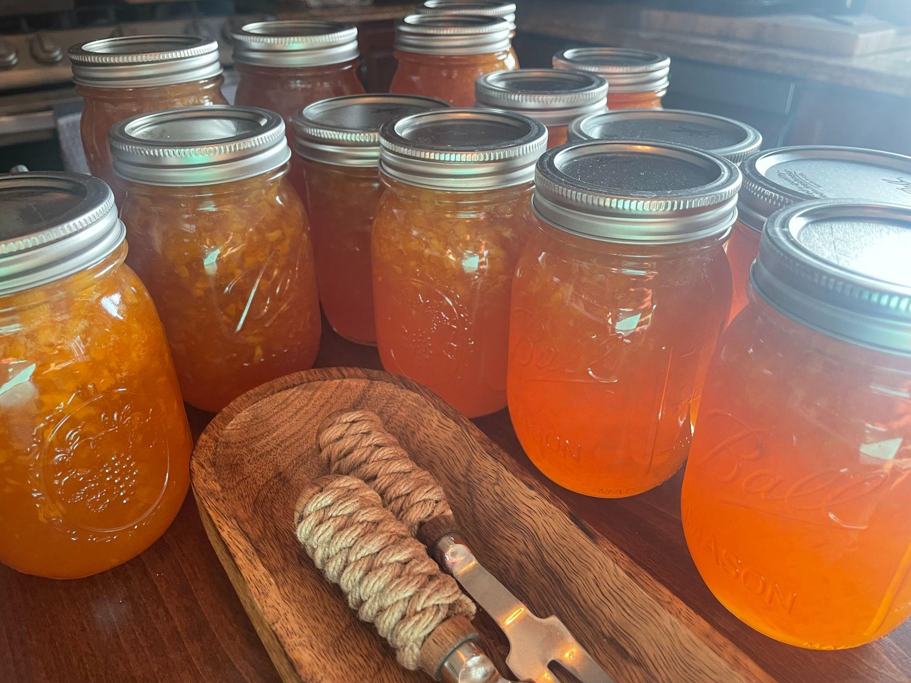
This is our peach tree!
Lots of peaches make lots of jam!
It takes 18 peaches to make 1 batch of jam which yields 3 jars!
We made 15 jars of jam!
4.OA.A3
Notes:
Week of October 18, 2021

Slide 11

120 square feet of carpet was installed in this room.
What might the length and width of the room be?
4.MD.A3

Slide 12
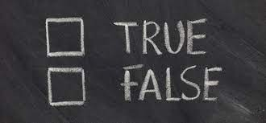
4 feet = 48 inches
20 inches = 2 feet
200 minutes = 2 hours
150 minutes > one and a half hours
4.MD.A1

Slide 13
What’s the same, what’s different?
4.G.A1

Slide 14
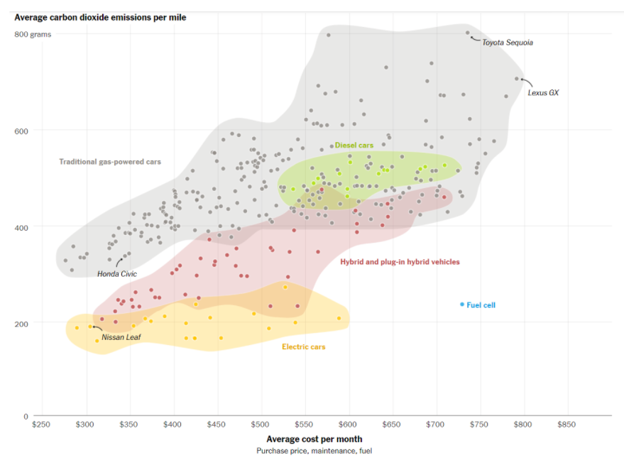
What do we notice?
What do we wonder?
What’s going on in this graph?
Why does it matter?
Source: carboncounter.com by the MIT Trancik Lab
4.MD.B

Slide 15
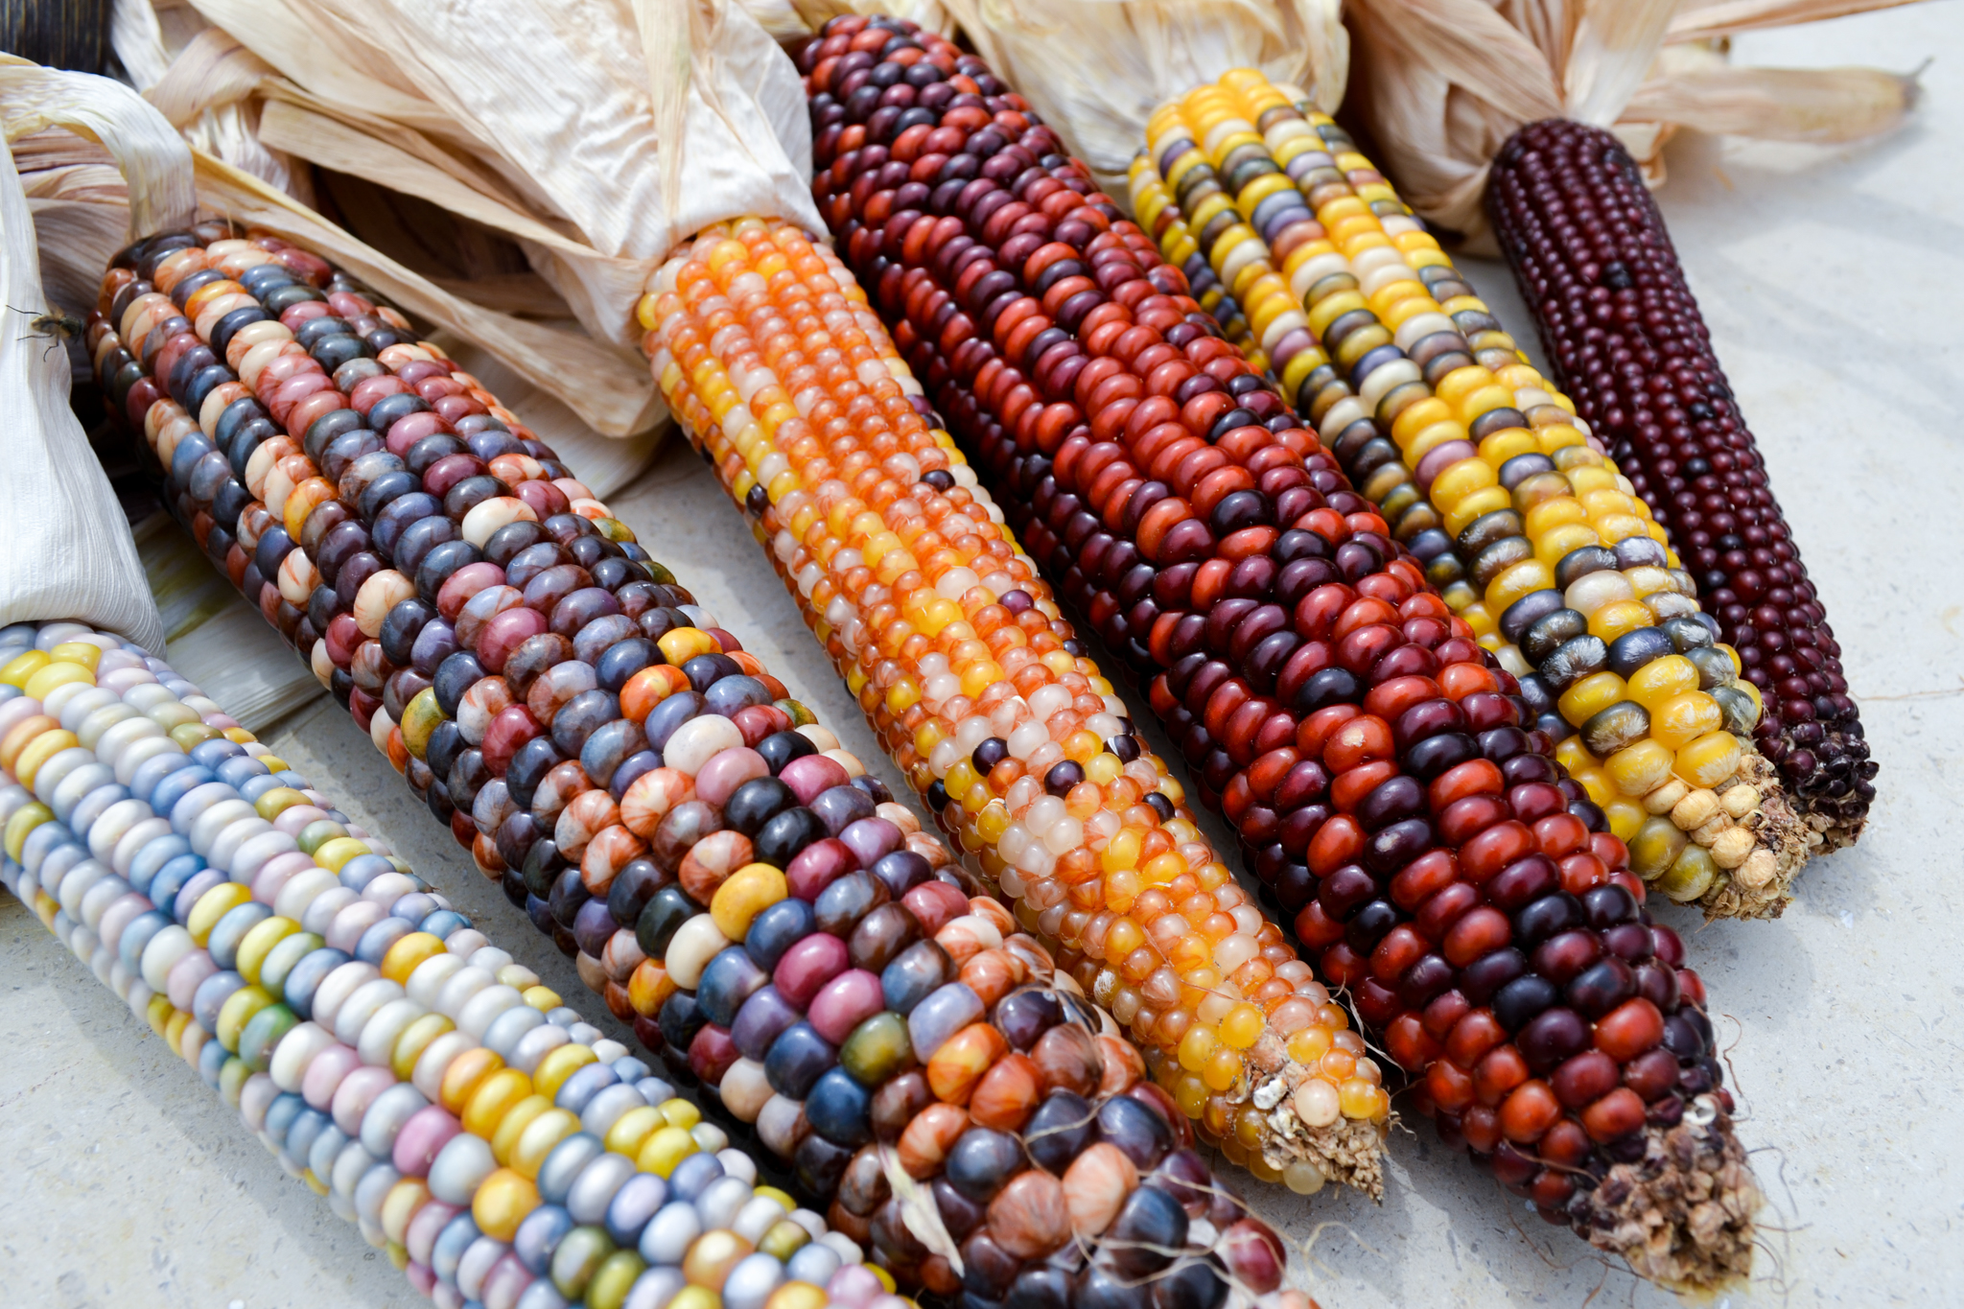
The number of kernels per ear can vary from 500 to about 1,200.
How many kernels might be here?
4.NBT.B5
Notes:
Week of October 25, 2021

Slide 16
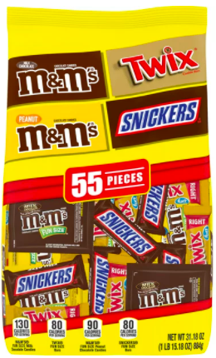
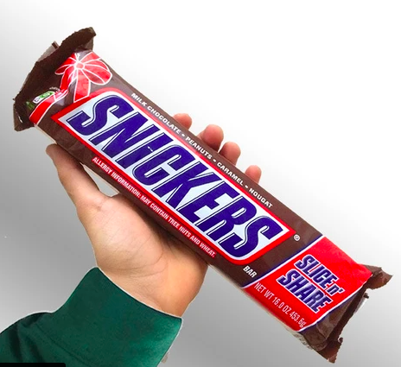
453 grams
884 grams
WOULD YOU RATHER have the mixed candy
or 2 giant bars?
4.MD.A1

Slide 17
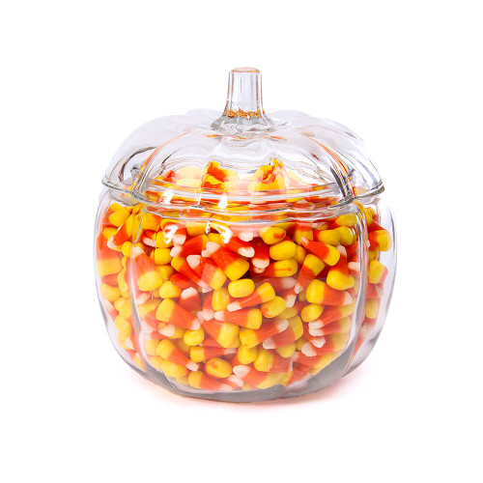
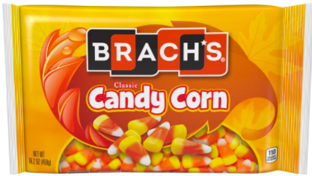
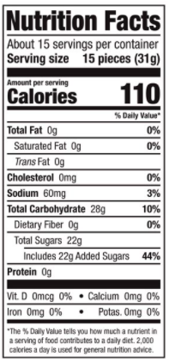
4.NBT.B5

Slide 18
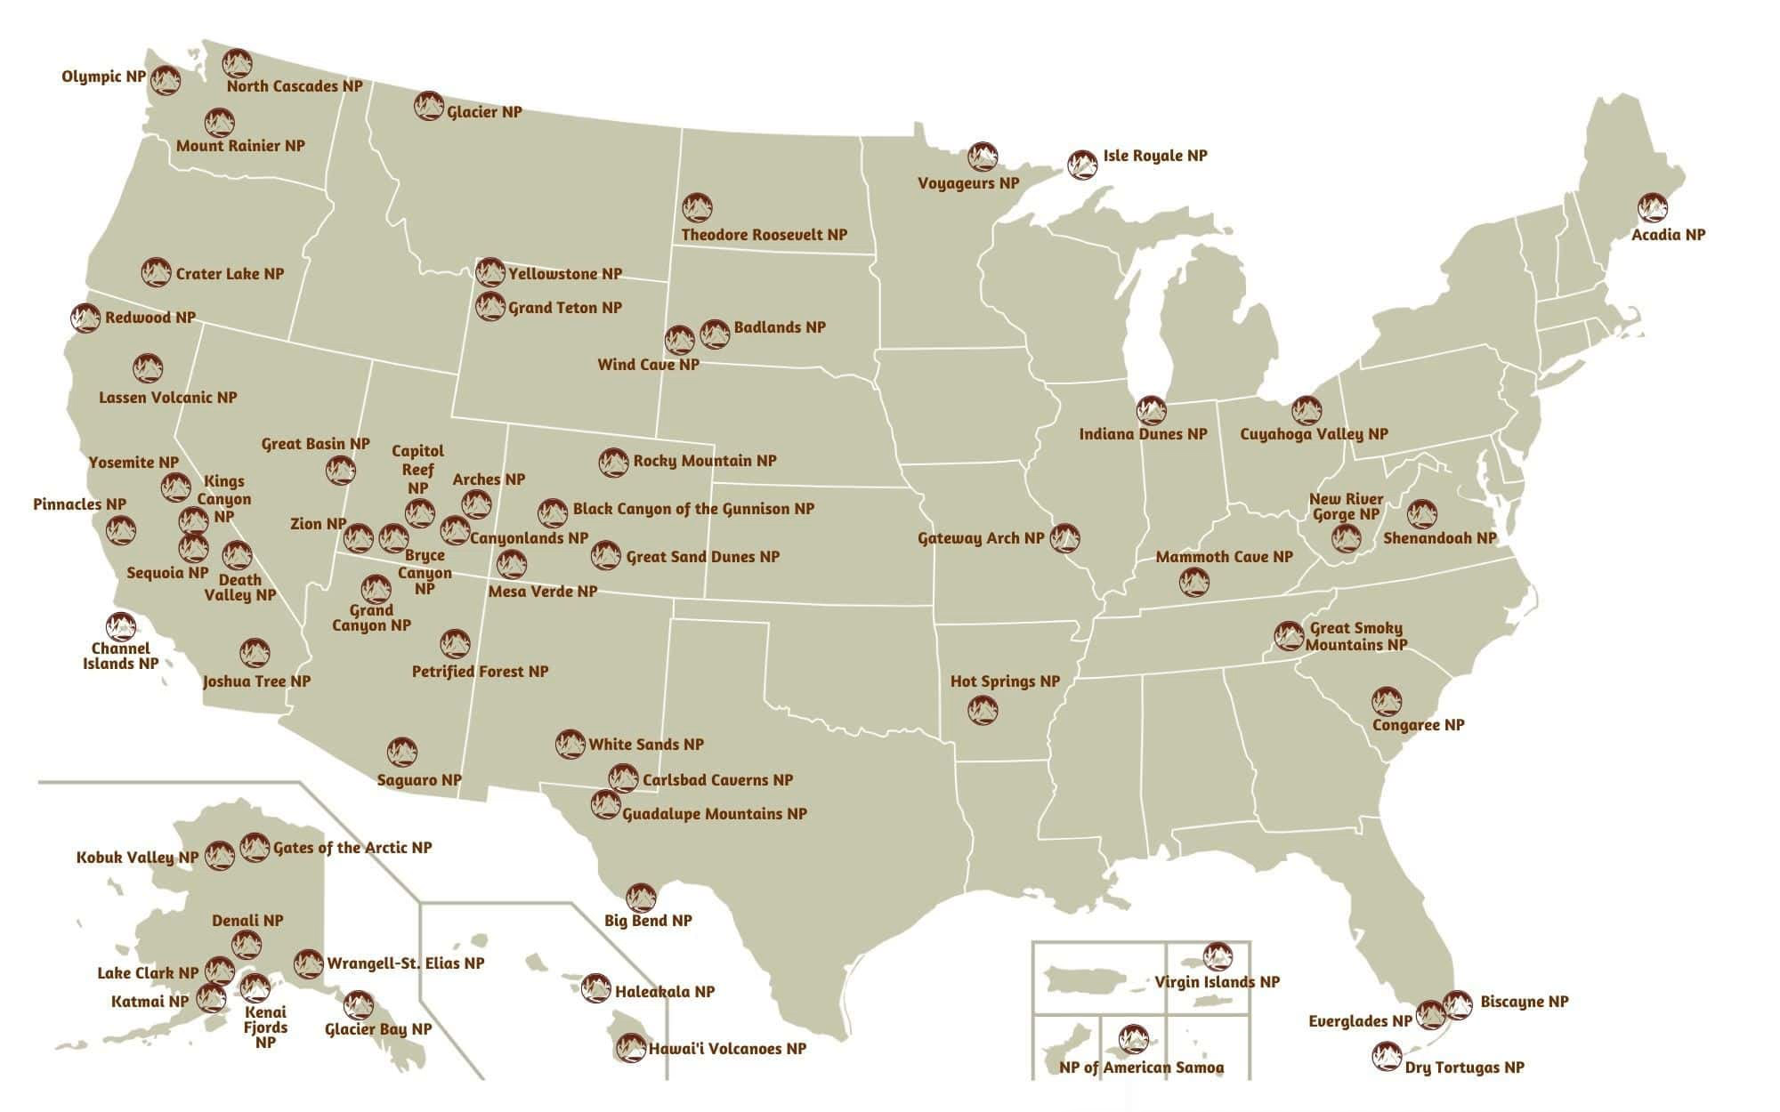
If this map could talk, what would it say?
4.MD.B

Slide 19
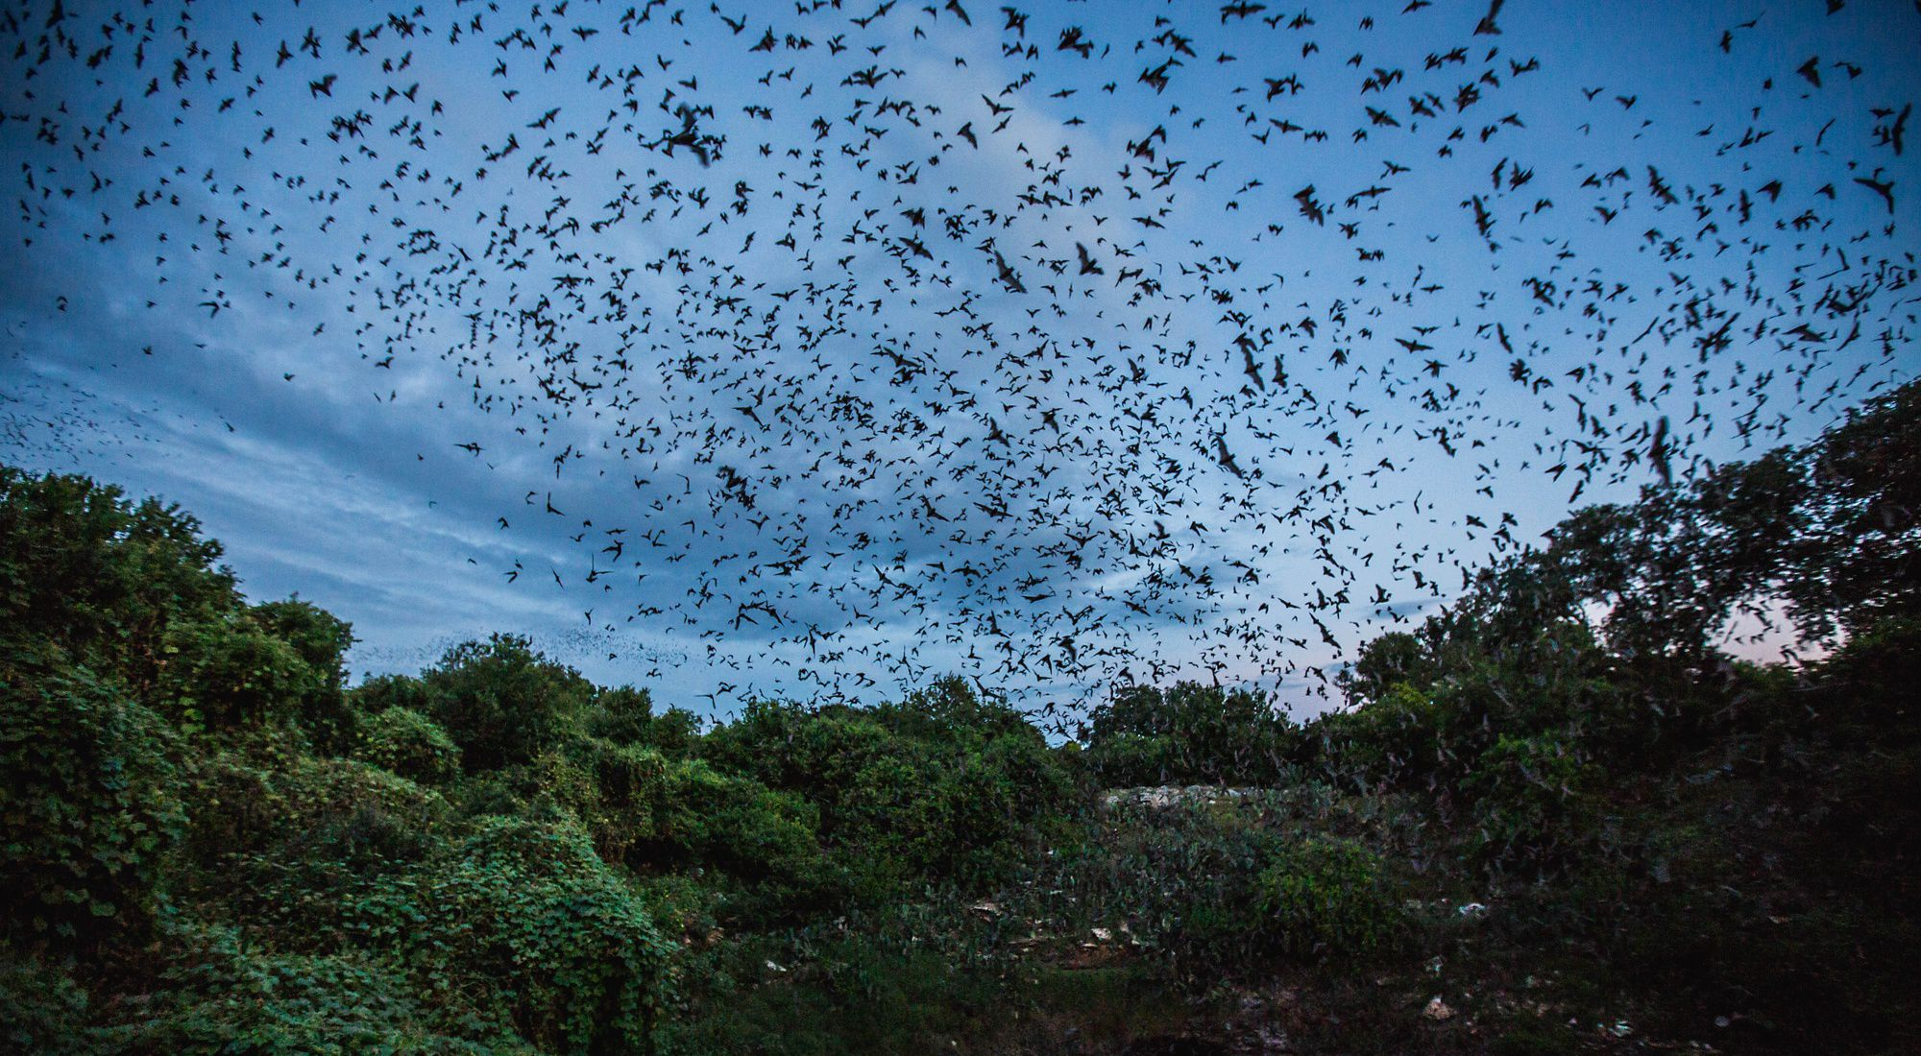
Bats will eat up to 1,200 mosquitoes per hour!
They can consume their body weight in insects every night!
An average summer night is 9 hours, how many bugs would that be?
4.NBT.A5

