Slide 1
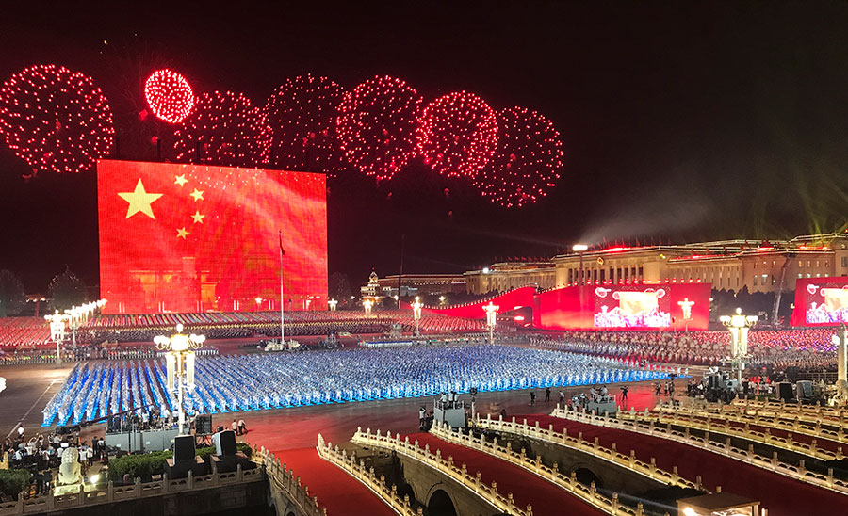
The People’s Republic of China was founded in 1949!
How long ago was that?
How many years until The People’s Republic of China celebrates its 100th anniversary?
It’s National Day in China!
3.NBT.A2
Notes:
Week of October 4, 2021

Slide 2
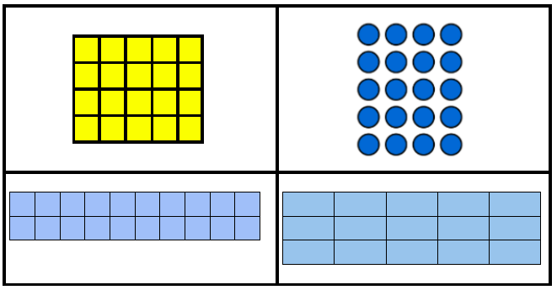
Which one doesn’t belong?
3.OA.A3

Slide 3
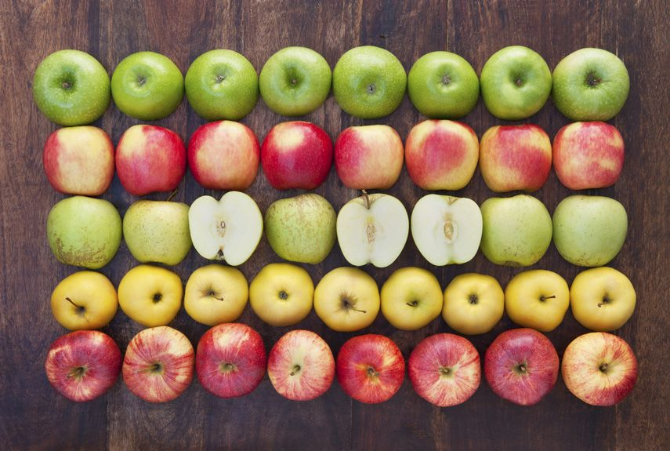
Where’s the Math?
Create a fun number sentence to match your mathematical thinking!
3.OA.A3

Slide 4
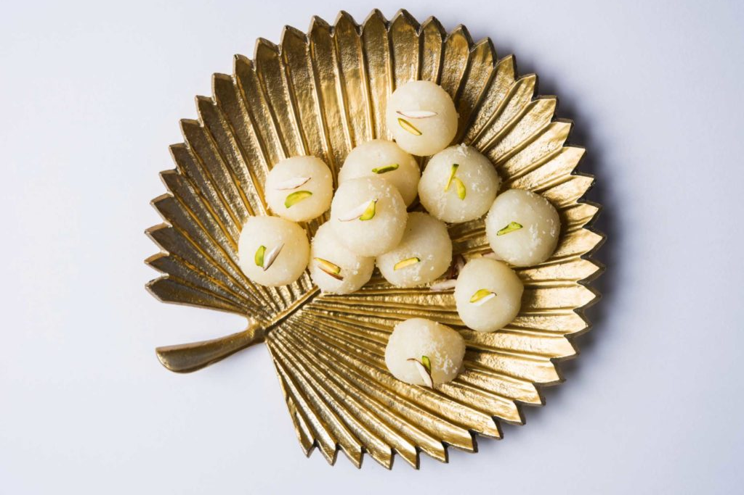
These traditional Indian sweets weigh about 60 grams each.
About how much do all of these sweets weigh?
Happy Sharada Navratri!
3.NBT.A3

Slide 5
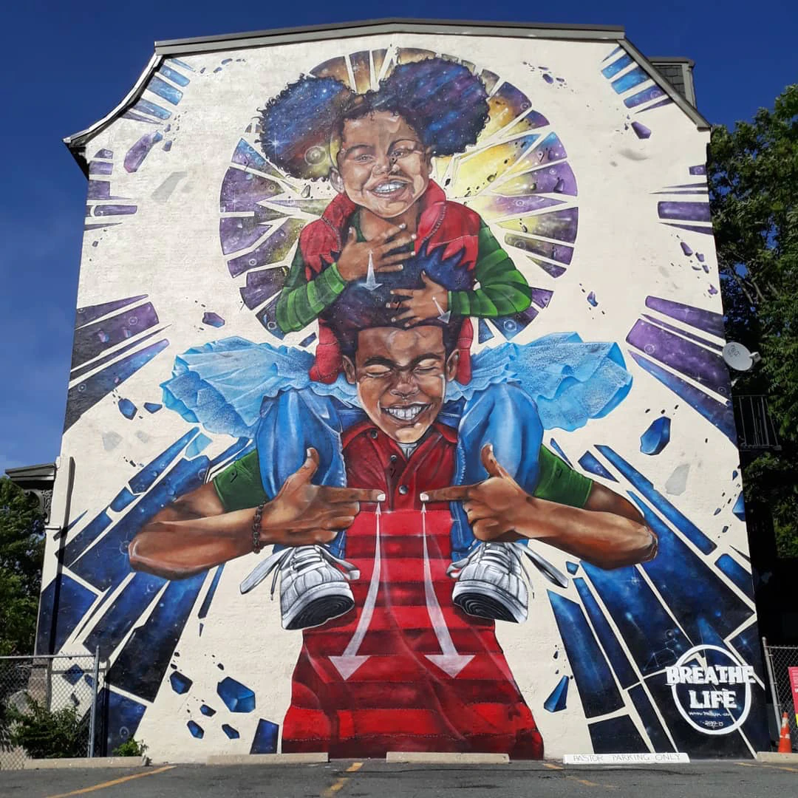
This mural is on the side of a 2-story building.
How high (in feet) do you think it is?
HINT: The young man’s hand is about 4 feet (from pinky to thumb)
What is a too low estimate?
What is a too high estimate?
What is your JUST RIGHT estimate?
“Breathe Life” Rob Gibbs, Tremont Street, Boston
3.OA.A4

Slide 6
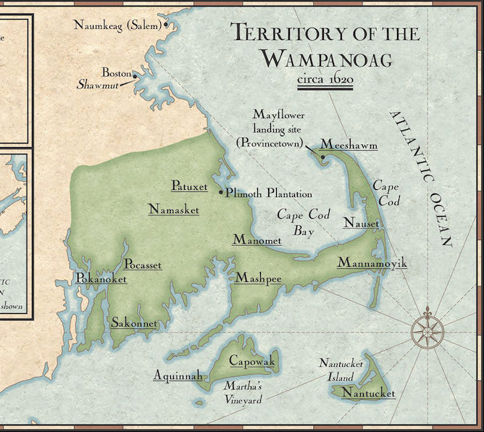
What do we notice?
What do we wonder?
If this map could talk, what would it say?
3.MD
Notes:
Week of October 12, 2021
INDIGENOUS PEOPLE DAY

Slide 7
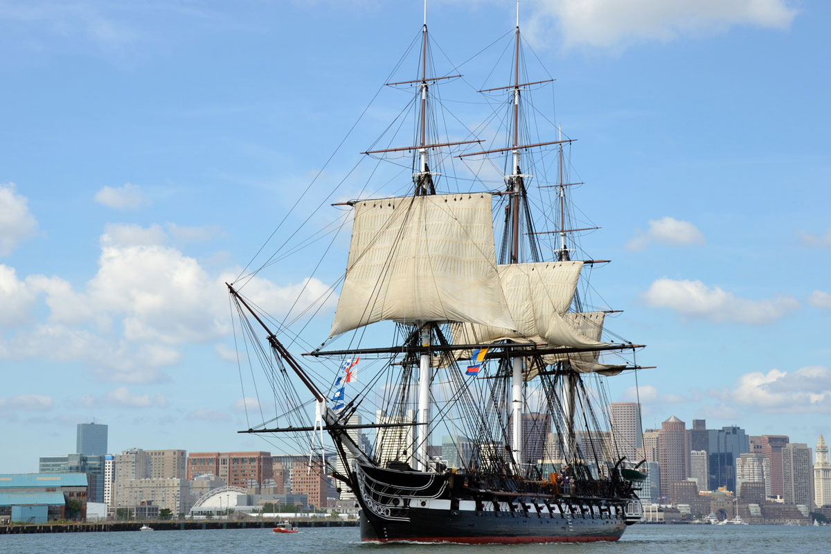
HAPPY BIRTHDAY TO THE US NAVY!!!
The Constitution was built in Boston of live oak with planks up to 7 inches thick. Paul Revere forged the copper spikes and bolts that held the planks in place and the copper sheathing that protected the hull.
She was first put to sea in July 1798!
How long ago was that?
Is she closer to 200 or 250 years old? How close?
The USS Constitution is the oldest U.S. warship still in commission
3.NBT.A1

Slide 8
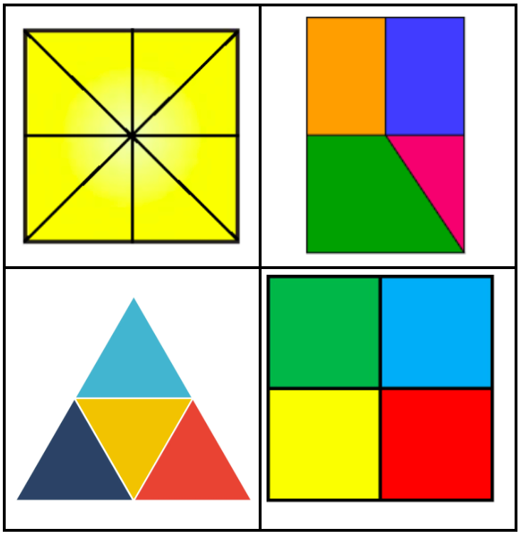
Which one doesn’t belong?
3.G.A2

Slide 9
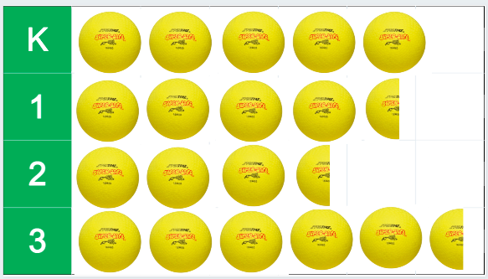
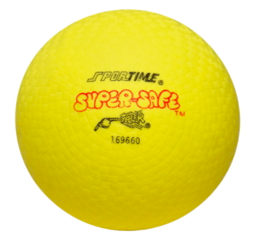
= 6
If this graph could talk, what would it say?
3.MD.B3

Slide 10
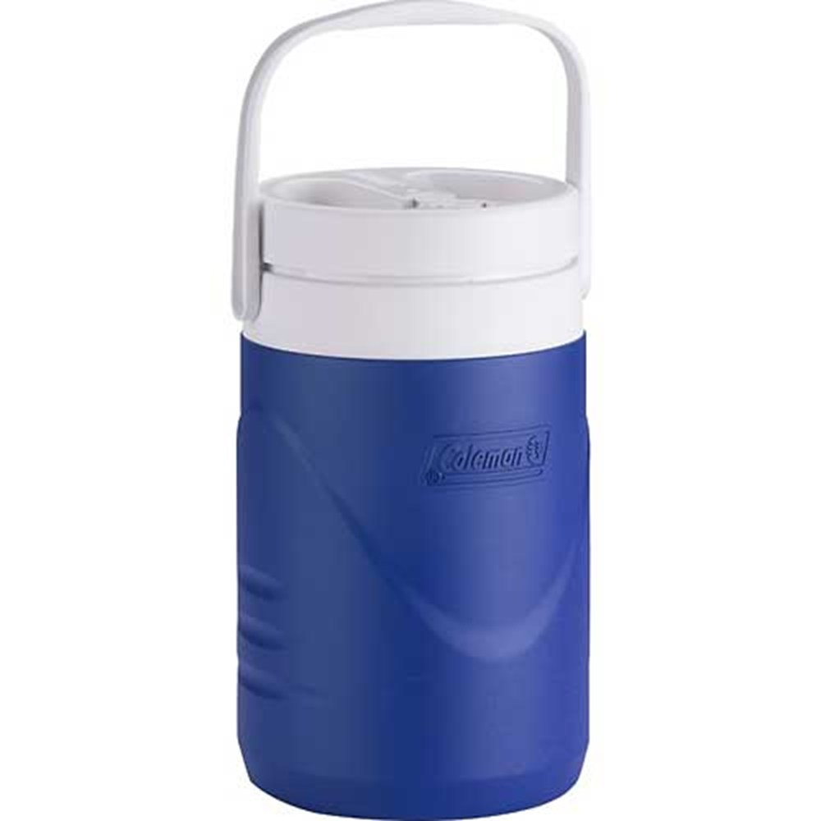
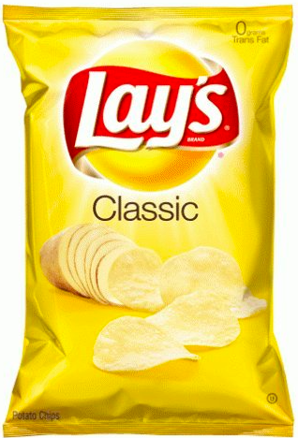
WOULD YOU RATHER…
carry the thermos of lemonade or
7 jumbo bags of chips to the football game?
3.SMP.3
Notes:
Week of October 18, 2021

Slide 11
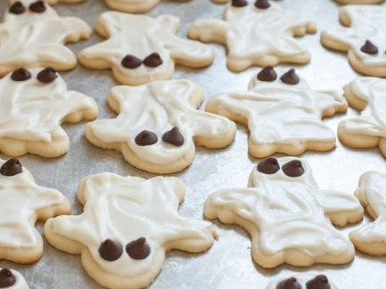
Fresh baked cookies!
I need to share these EQUALLY with my friends.
I baked 24 cookies.
3.OA.A2

Slide 12
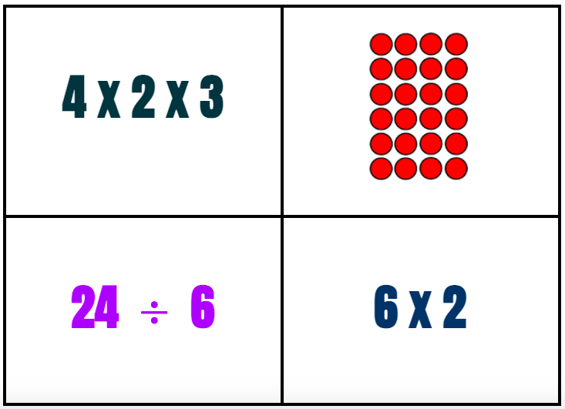
Which one doesn’t belong?
3.OA.C7

Slide 13

3 x 5 x 2 = 5 x 2 x 3
7 x 10 < 10 x 7
7 x 10 x 1 = 10 x 7
3.OA.B5

Slide 14
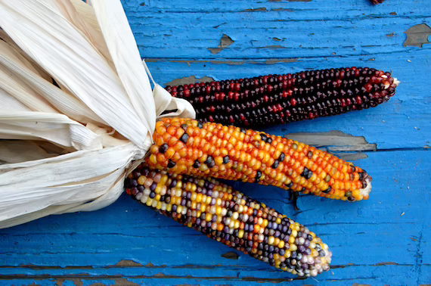
The number of kernels per ear can vary from 500 to about 1,200.
How many kernels might be here?
3.NBT.A3
Notes:
Week of October 25, 2021

Slide 15
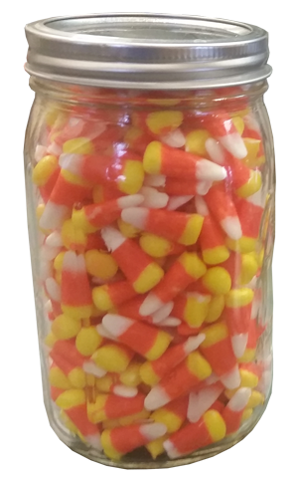
What do we notice?
What do we wonder?
Make an estimate!
There are 263 in the jar!
What TEN is this closest to?
What HUNDRED is this closest to?
3.NBT.A1

Slide 16
Prove it!
127 + 5 = 127 + 2 + 3
137 + 5 = 140 + 2
147 + 5 = 150 + 2
3.OA.D9

Slide 17
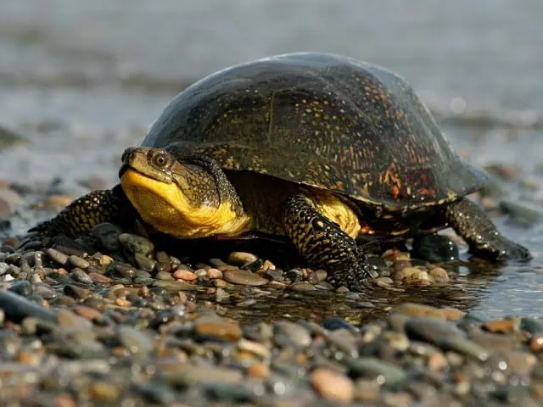
Did you know that the Blanding’s Turtle can live to be 80 years old!
Starting at age 18 she lays 10 eggs per year!
What math sentences can you create?
3.OA.D8

Slide 18
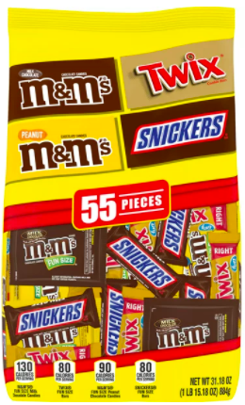
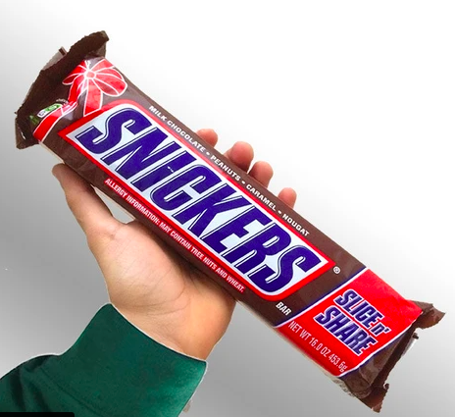
453 grams
884 grams
WOULD YOU RATHER have the mixed candy
or 2 giant bars?
3.MD.A2

