Slide 1
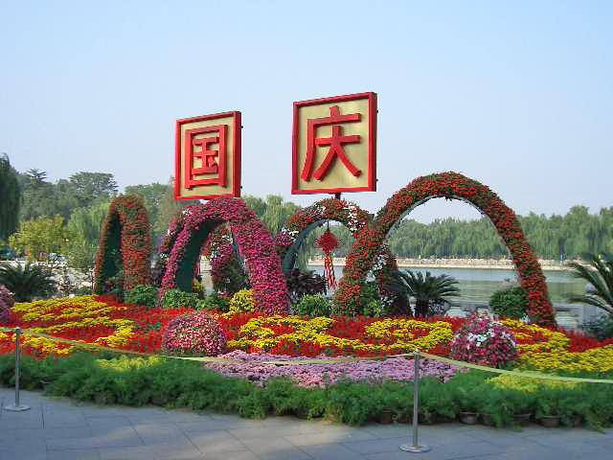
It’s National Day in China!
Wow! Look at all of the flowers!
Do you wonder how many there are?
2.NBT.A
Notes:
Week of October 4, 2021

Slide 2
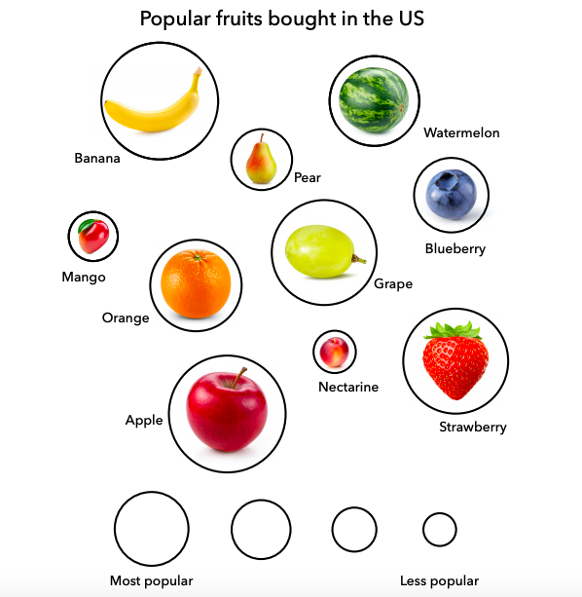
What do you notice?
What do you wonder?
If this info-graph could talk, what would it say?
YouCubed.org The Packer’s 2019 Fresh Trends
2.MD.D10

Slide 3
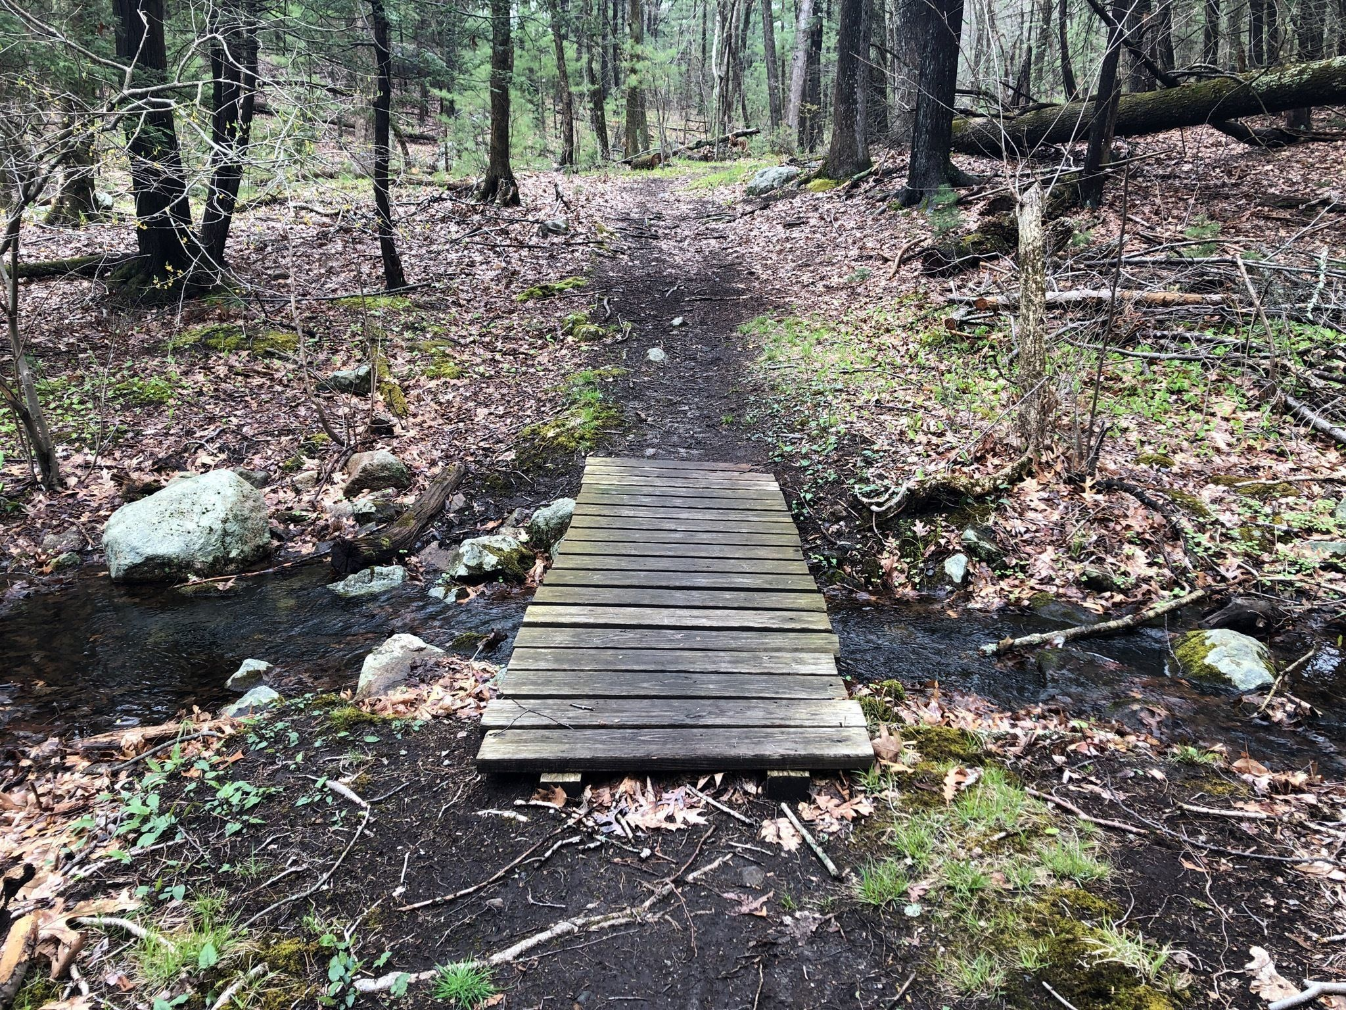
The Doublet Hill Loop is a 2 mile trail in Weston.
Have you ever hiked it?
How long did it take?
If you can hike 1 mile in 20 minutes, how long would it take?
How close is that to 1 hour?
2.MD.C7

Slide 4
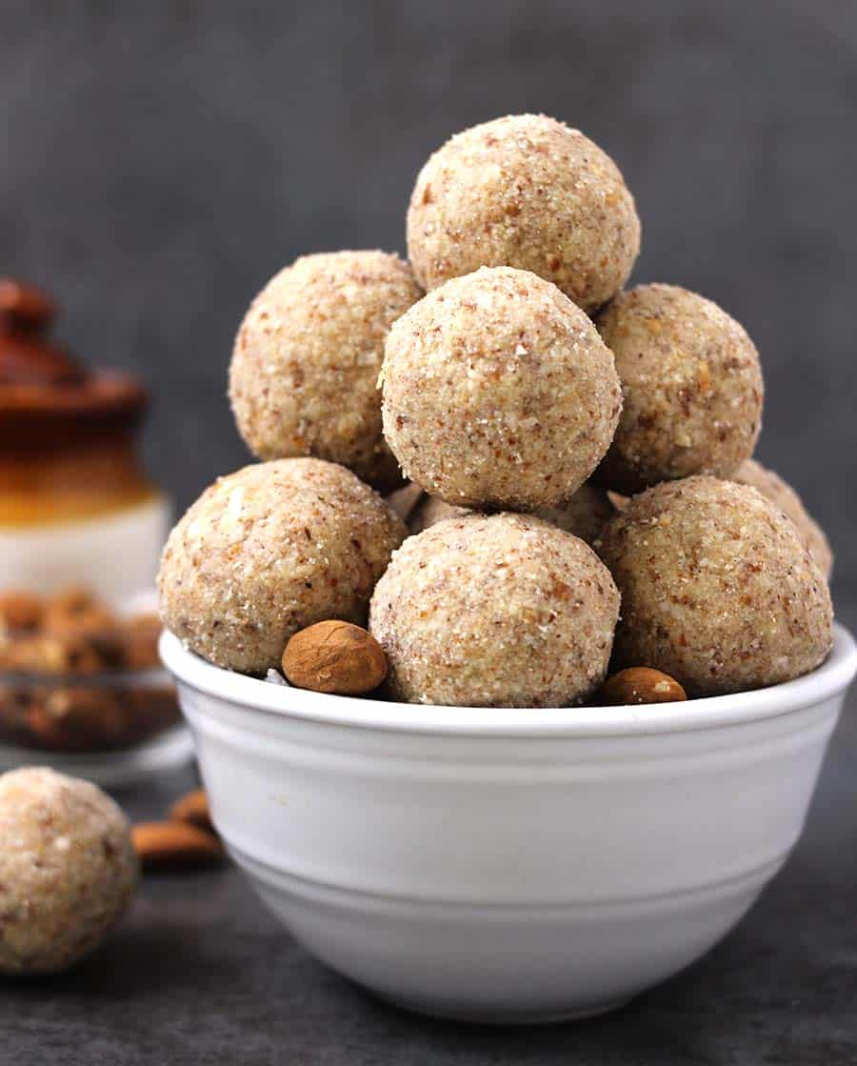
Sharada Navratri Celebration
in India
How many Baddam Laduu or Almond Bites do we see?
How many don’t we see?
Write some number sentences to match your mathematical thinking!
2.OA.B2

Slide 5
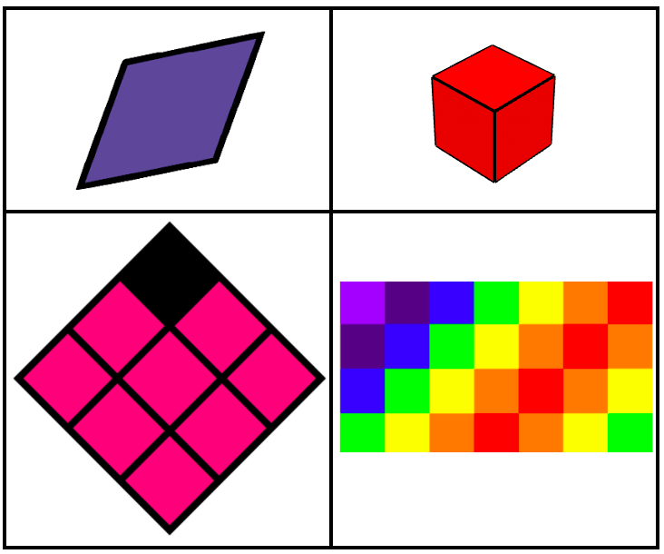
Which one doesn’t belong?
2.G.A1

Slide 6

“Soar above the sails”
by our amazing Art Teacher
Jacob Yellow Eagle Ginga
What interesting shapes do we see in this mural?
Sketch one of the shapes, and describe it using lots of rich math language!
2.G.A1
Notes:
Week of October 12, 2021
INDIGENOUS PEOPLE DAY

Slide 7
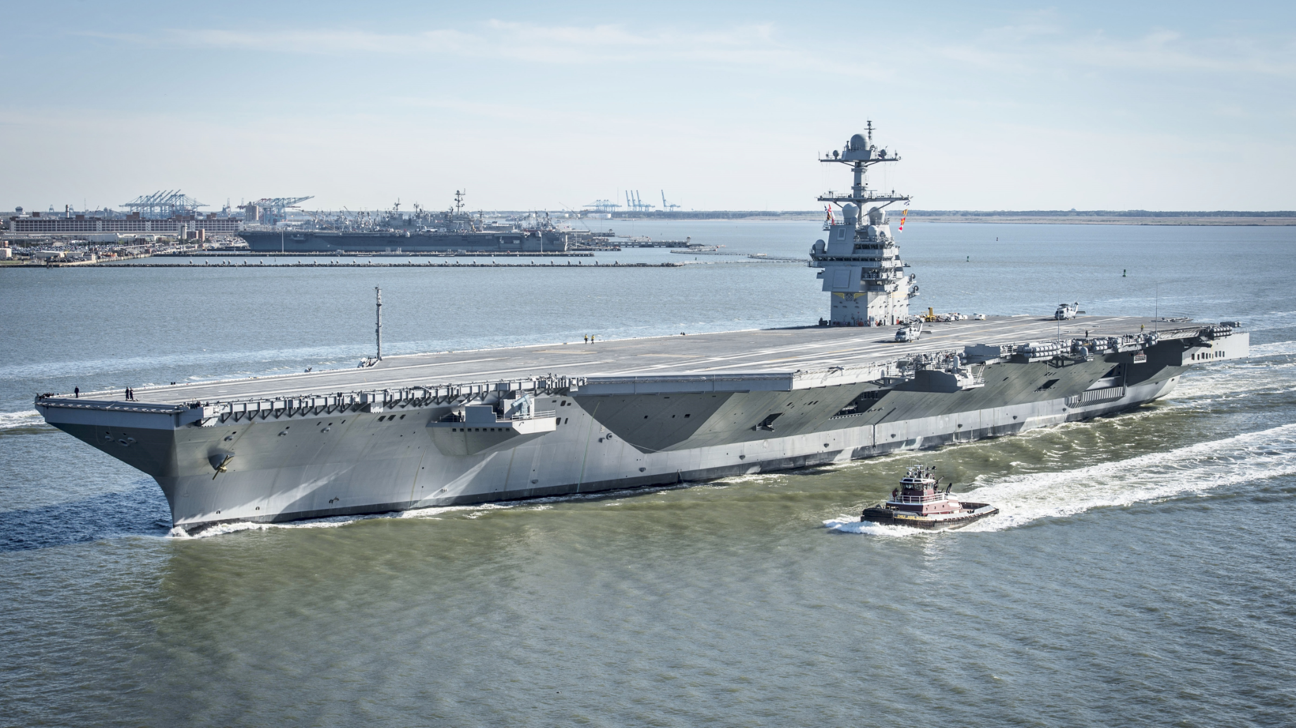
THE USS GERALD FORD
This amazing class of Aircraft Carrier is 1,092 feet long
What can we say about that number?
How long is that?
Happy Birthday to the US Navy!
2.OA.A3

Slide 8

34 + 10 > 24 + 10
20 - 5 < 15 - 5
30 - 10 = 20 + 10
2.OA.A4

Slide 9
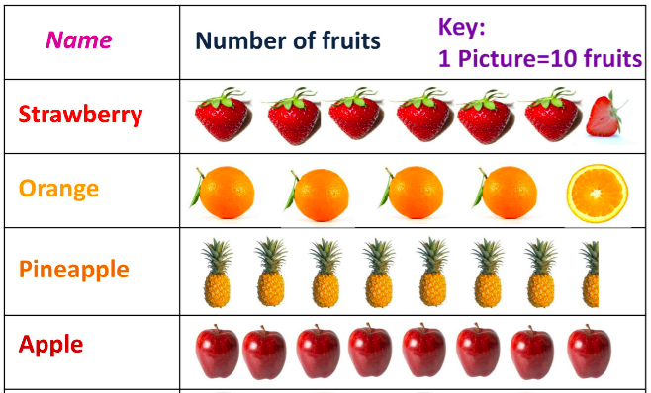
What do we notice?
What do we wonder?
What’s going on in this graph?
2.MD.D

Slide 10
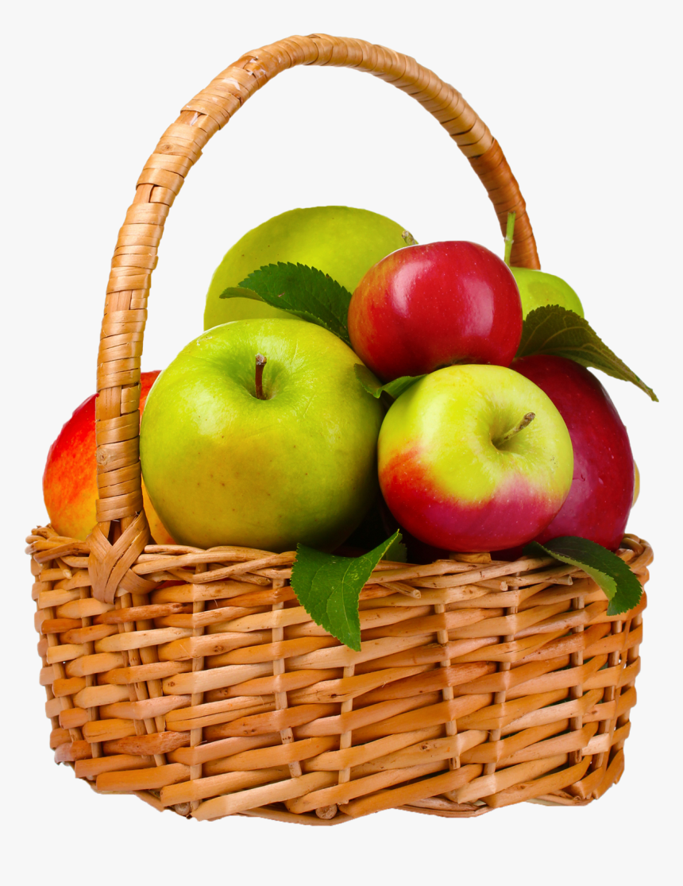
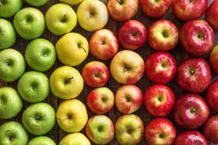
WOULD YOU RATHER carry 2 baskets of 10 apples
or
30 apples without a basket?
2.SMP.3
Notes:
Week of October 18, 2021

Slide 11
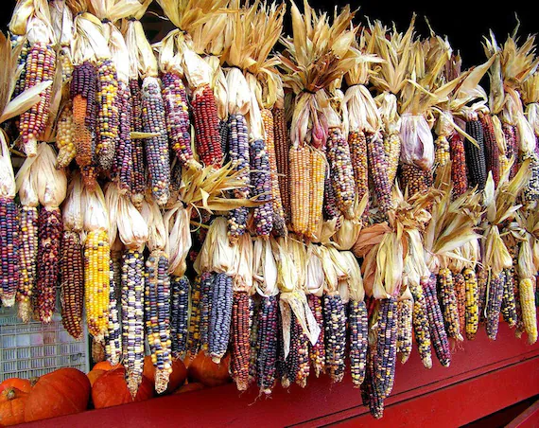
Wow! Look at all of this Indian corn!
How many ears are here?
What is an estimate that is too low?
Too high?
Just right?
2.NBT.A

Slide 12
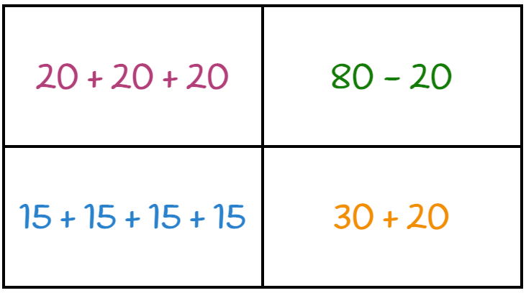
Which one doesn’t belong?
2.OA.B8

Slide 13
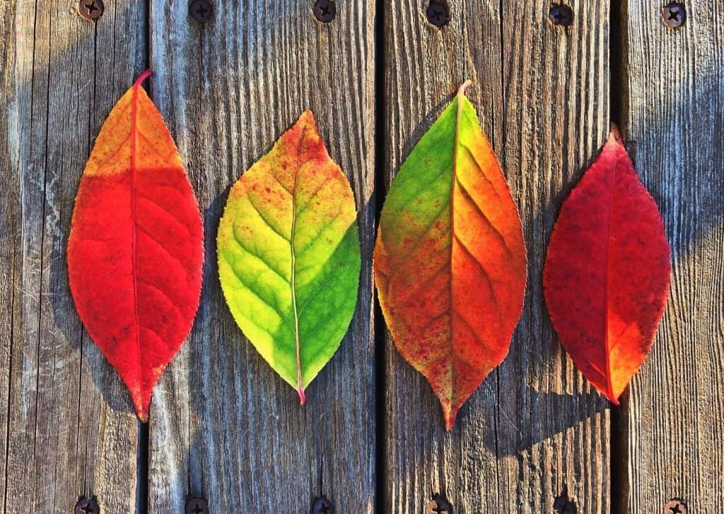
If the length of the first leaf is 9 centimeters,
what might the other three leaves be?
2.MD.A3

Slide 14
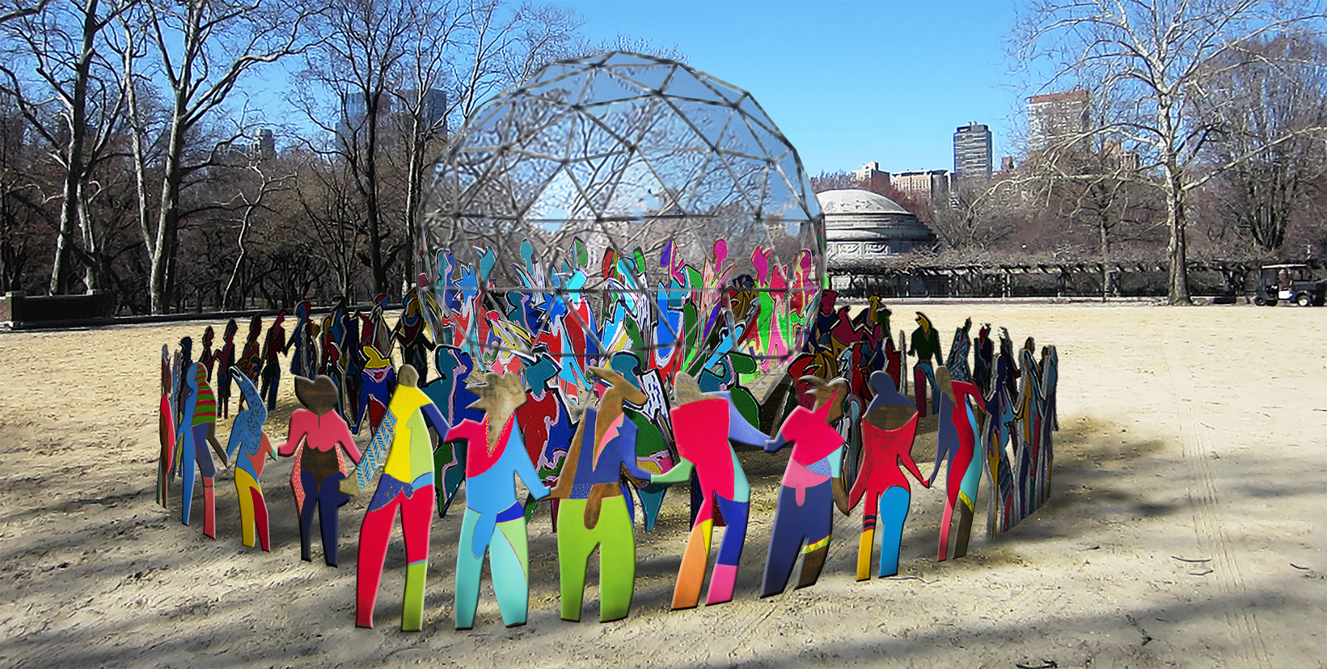
IT’S UNITED NATIONS DAY!
What shapes do we see in this geodesic dome? How many do we think are here?
“Enlightened Universe” by Cristobal Gabarron
2.G.A1

Slide 15
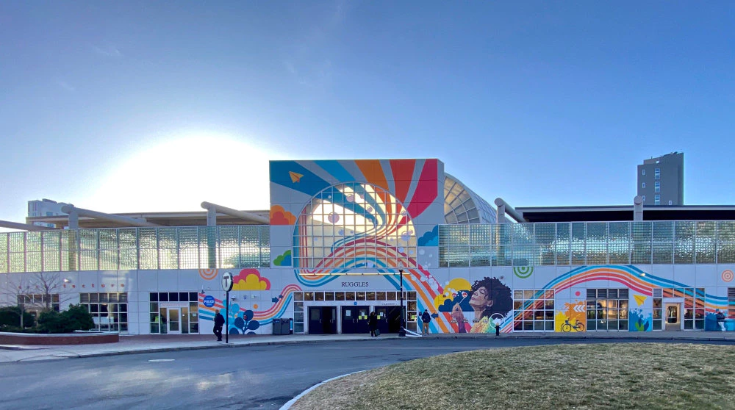
This mural in Boston is more than 50 feet high.
How does that compare to your height?
2.OA.A1
Notes:
Week of October 25, 2021

Slide 16
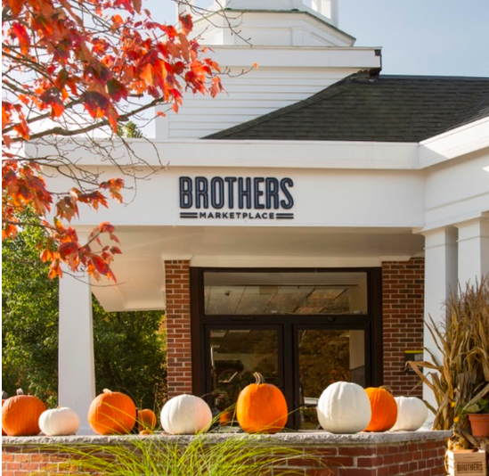
How many pumpkins do we see?
How many more would we need to make 10?
How about 20? 30? 50?
Do we see a pattern in our answers?
Describe the pattern.
2.OA.B5

Slide 17
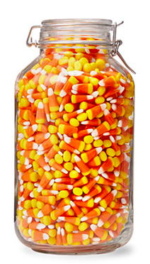
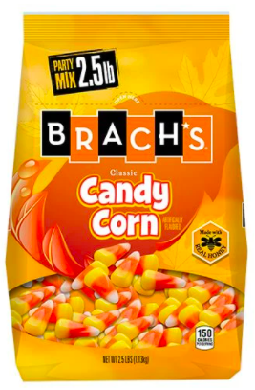
What do we notice?
What do we wonder?
What math question can we ask?
There are between 500 and 600 in each bag!
2.NBT.B8

Slide 18
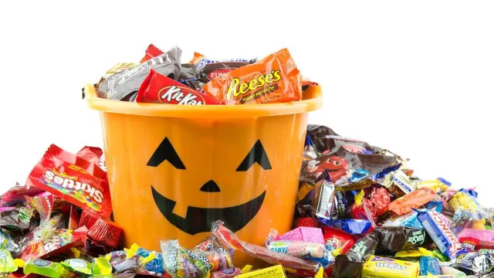
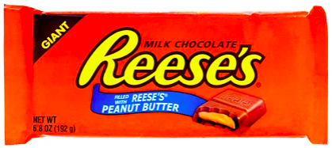
WOULD YOU RATHER have a bucket of small candy
OR 3 giant (of your favorite) candy bars?
2.SMP.3

Slide 19
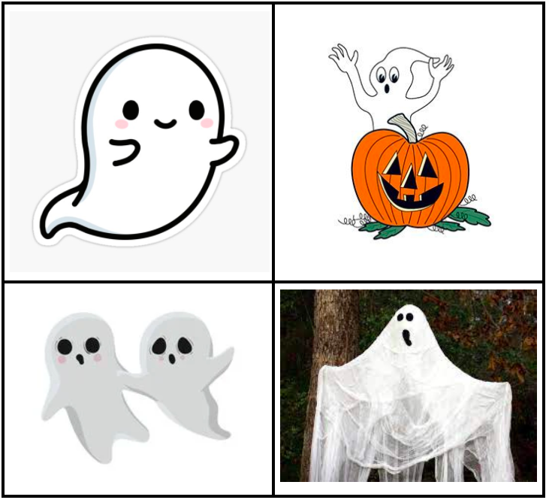
Which one doesn’t belong?
2.G.A

