Slide 1
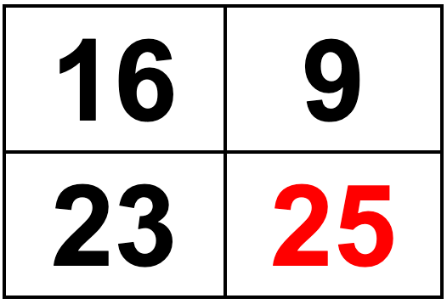
Which one doesn’t belong?
5.OA.B
Notes:
Week of September 1, 2021

Slide 2
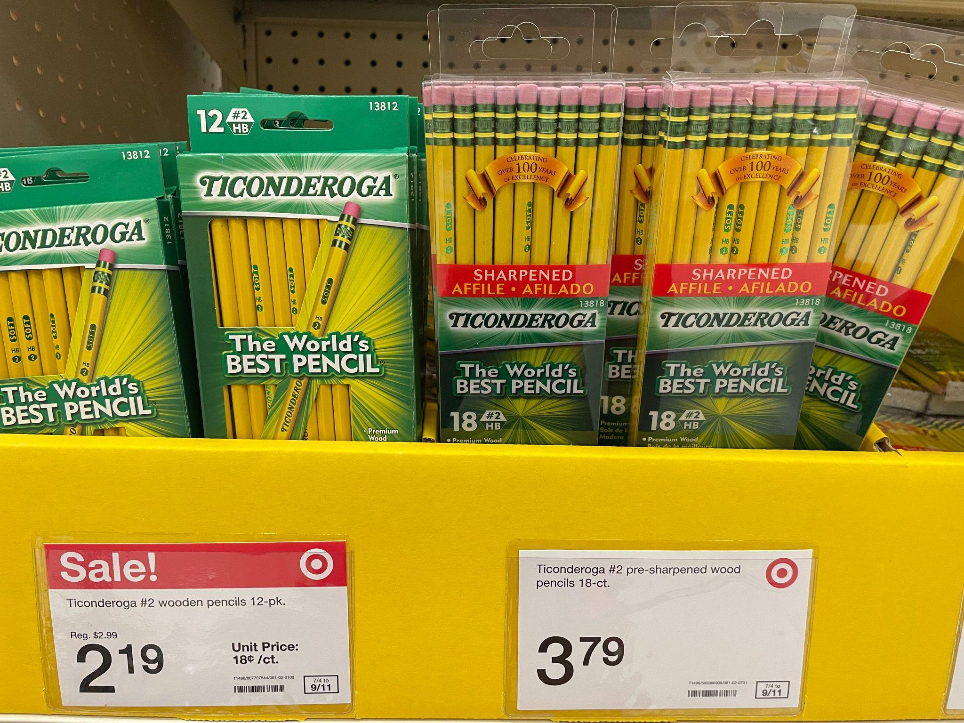
Would you rather buy . . .
5.NBT.B7

Slide 3
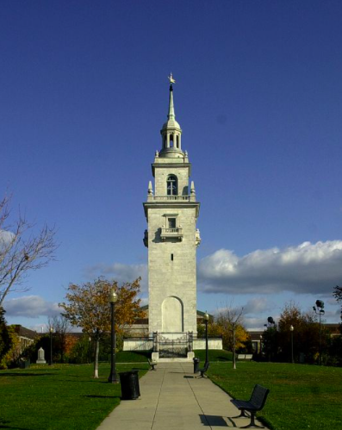
The Dorchester Heights Monument is 115 ft high.
If you are 4 ft. tall, how many of YOU would it take to reach the top?
5.NBT.B6

Slide 4
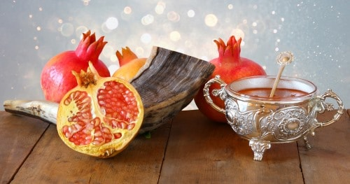
The number of seeds in a pomegranate can vary from 200 to about 1,400.
How many seeds MIGHT be in the pomegranates in this picture?
Happy Rosh Hashanah!
5.NBT.B5
Notes:
Week of September 8, 2021

Slide 5
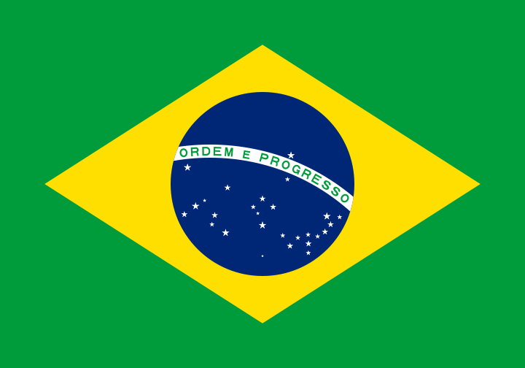
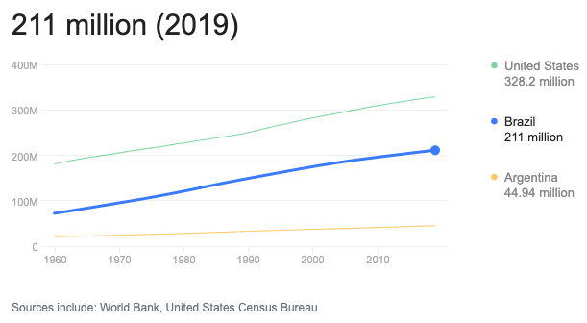
Happy Independence Day in Brazil!
If this graph could talk, what would it say?
5.MD.B

Slide 6
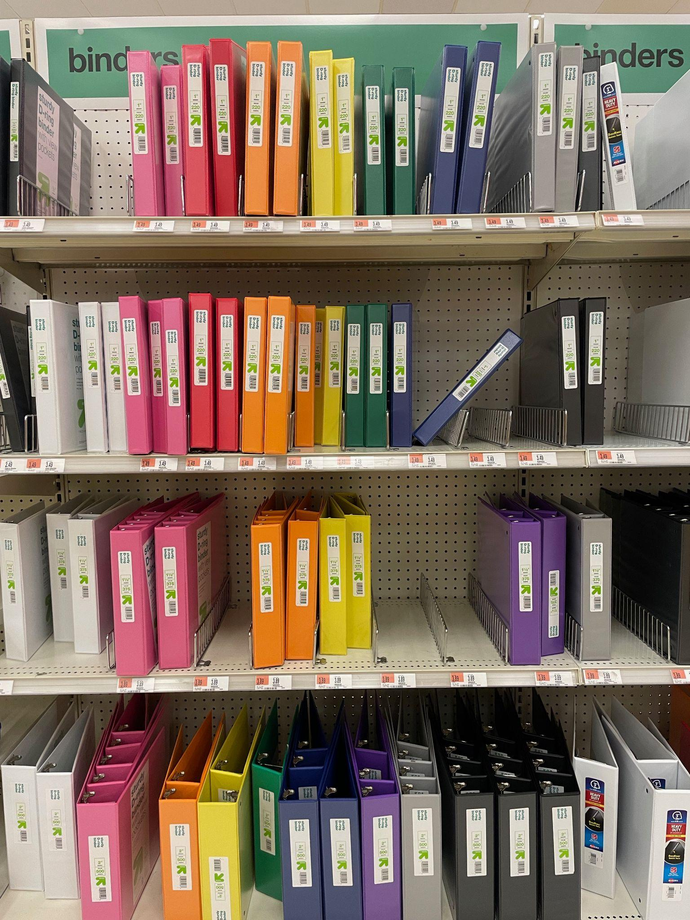
Binders!
How many are here?
Can we make a reasonable estimate?
How many of each color?
What fraction statements can we make?
5.NF.A

Slide 7
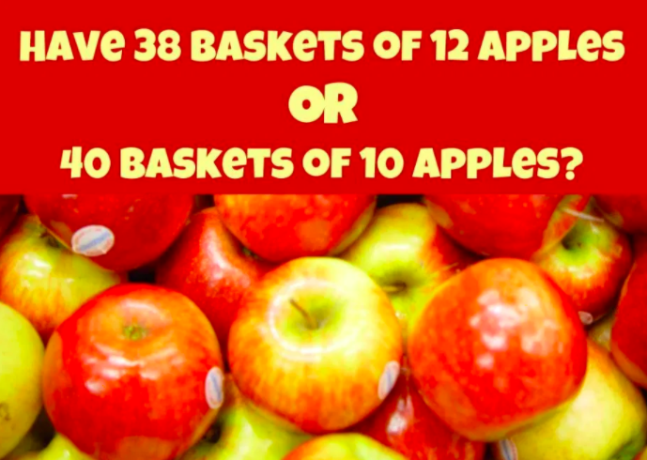
Would you rather ...
5.NBT.B5
Wouldyourathermath.com
Notes:
Week of September 13, 2021

Slide 8
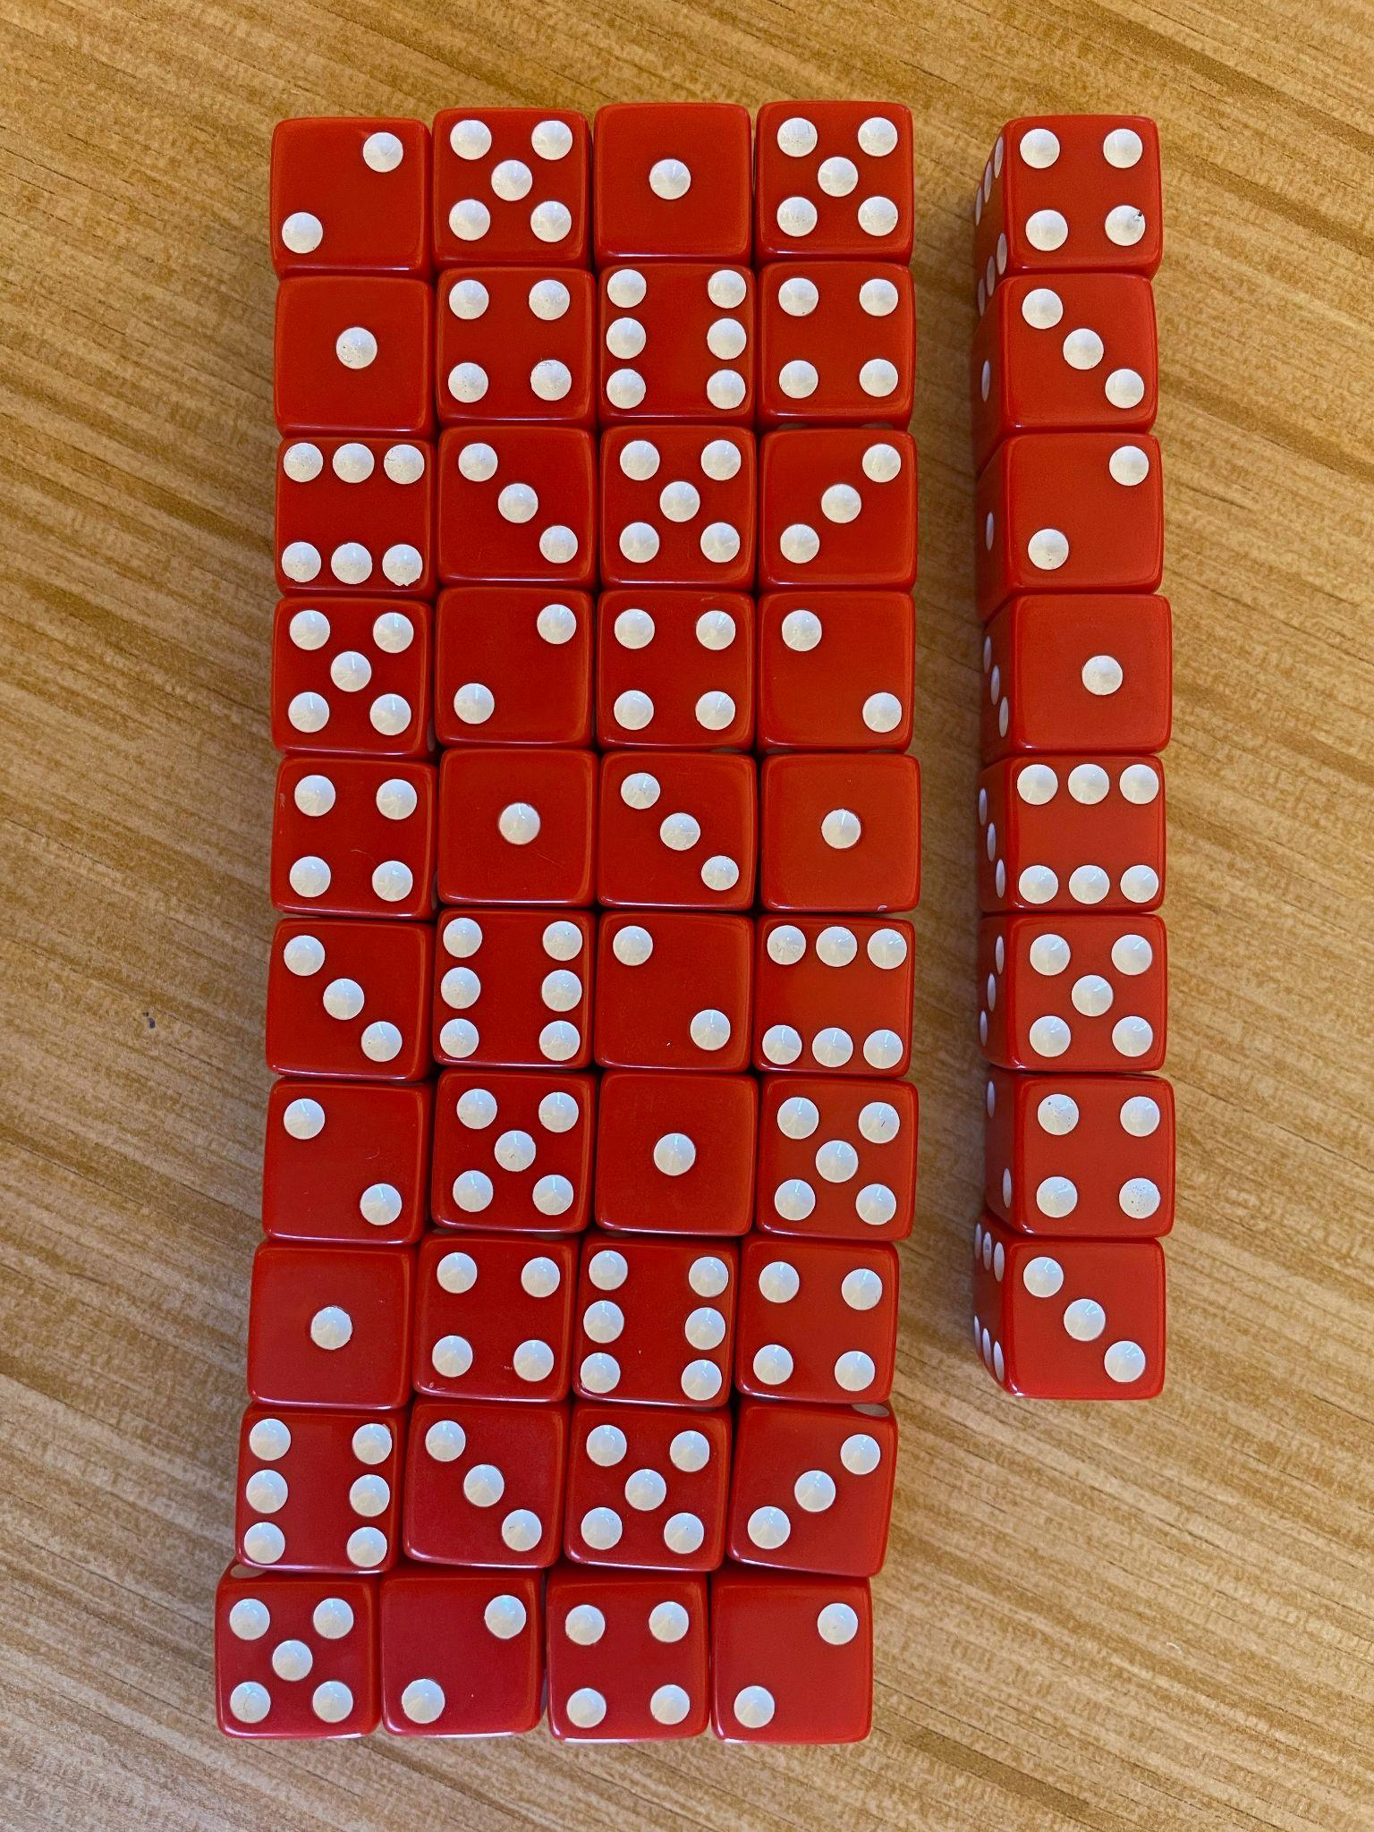
Look closely
at the dice.
Do you see a pattern?
How many dice?
How many dots?
5.OA.B

Slide 9
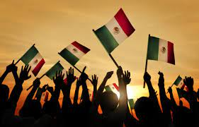
Mexico declared independence from Spain in 1810
How many different ways can we get to 1,810 using THREE operations?
Create a number sentence to match your mathematical thinking.
Happy Independence Day in Mexico!
5.NBT.B7

Slide 10
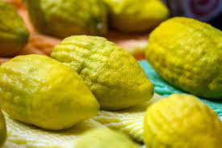

This is an ETROG, it grows in Israel!
Moshav Yishresh Orchard grows 300,00 of these lemon-like fruits every season.
They export
of them to the US.
What does that mean?
How many is that?
Courtesy Andy Alpern
Chag Sukkot Sameah! Happy Sukkot!
5.NF.B4
Notes:
Week of September 20, 2021

Slide 11
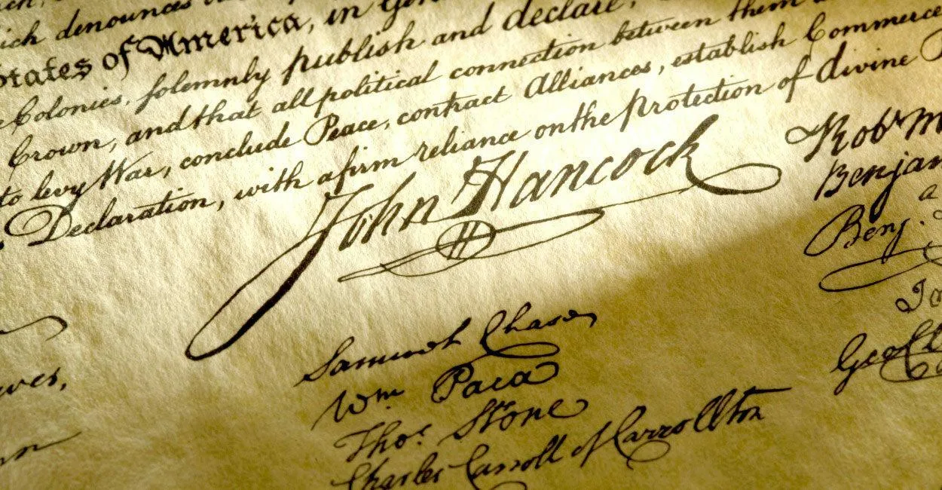
Written in 1787 the United States Constitution is the world’s longest surviving written charter of government.
55 delegates attended the Constitutional Convention sessions, but only 39 actually signed the Constitution.
How many did not sign?
What mathematical statements can we make about the number 55? What is it a multiple of?
What about the number 39?
How many different ways can we get to 39?
5.OA.B
Notes:
SEPTEMBER 17, 2021 CONSTITUTION DAY!

Slide 12
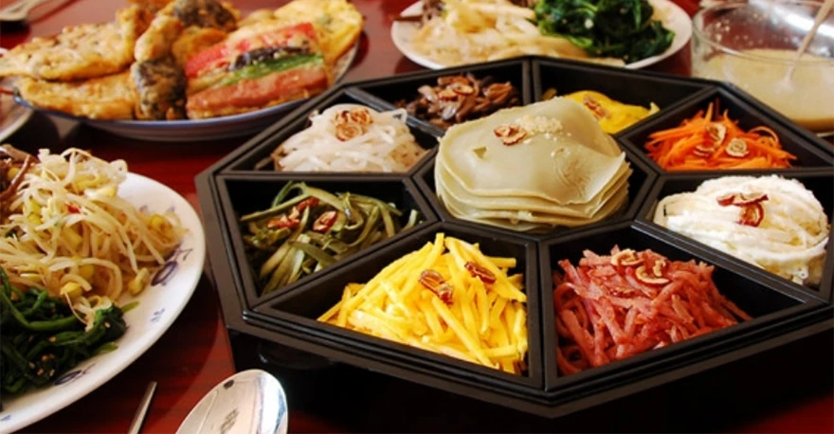
What shapes do we see here?
What kinds of lines make up these shapes?
Can we combine the shapes to make new shapes?
Sketch some of them.
Happy Chuseok! Korean Thanksgiving!
4.G.B3

Slide 13
1,945,350
2,149,700
What is the SAME? What is DIFFERENT?
5.NBT.A

Slide 14
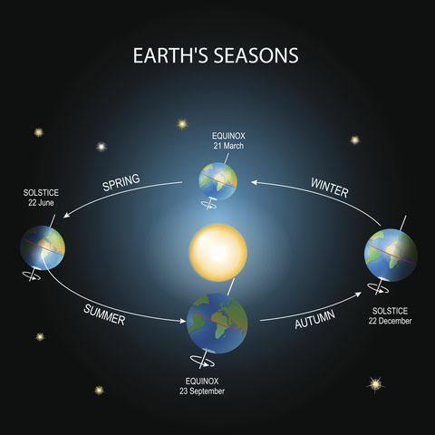
It’s the Autumnal (Fall) Equinox!
Today we have 12 hour of daylight and 12 hours of night.
What fraction of the day
is the sun out?
The Winter Solstice is in December.
The sun will rise around 7:00 AM
and set around 4:00 PM.
How many hours of daylight will that be? What fraction of the day is that?
Create a number sentence to match your mathematical thinking.
Oprah Daily
5.NF.A

Slide 15
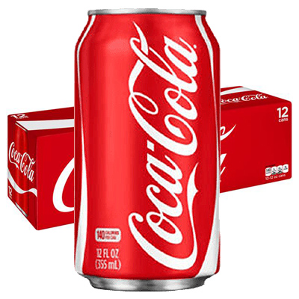
Did you know that ONE can of Coke has about one-fourth cups of sugar?
Here is a 12-pack.
How many cups of sugar are in the 12 cans?
Why does it matter?
5.NF.B4

Slide 16
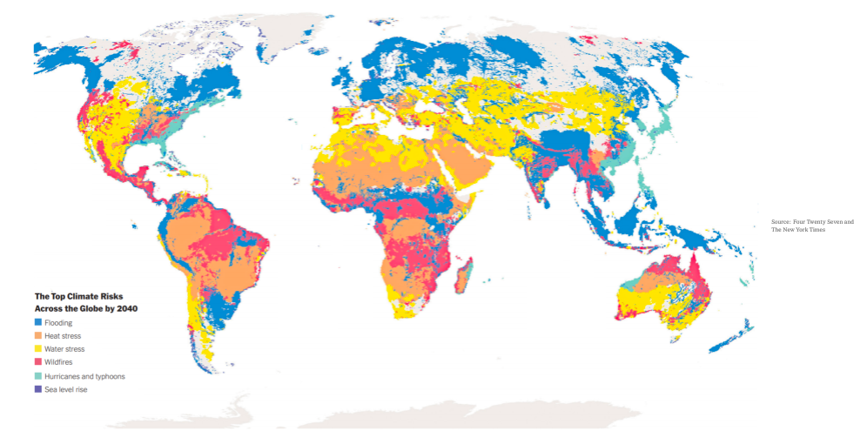
What do we notice? What do we wonder?
Why does it matter? Write a catchy title for this graph!
5.MD.B
Notes:
Week of September 27, 2021

Slide 17
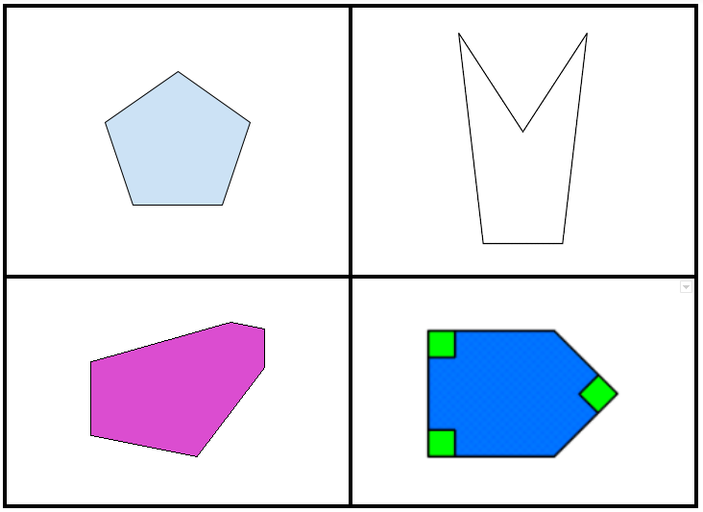
Which one doesn’t belong?
5.G.B3

Slide 18
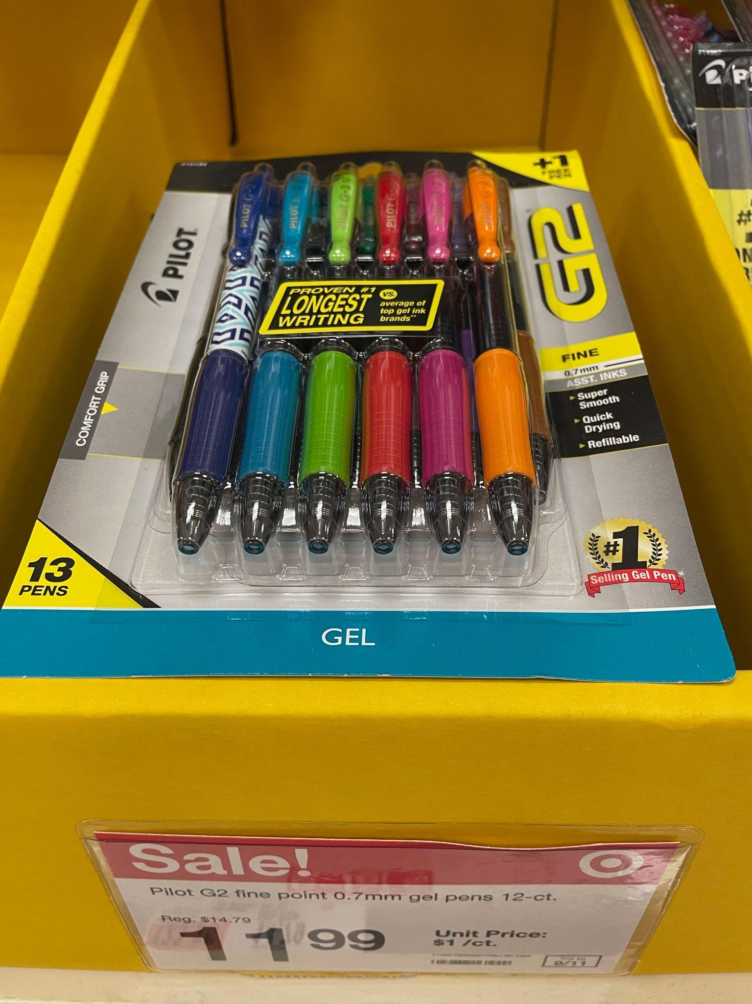
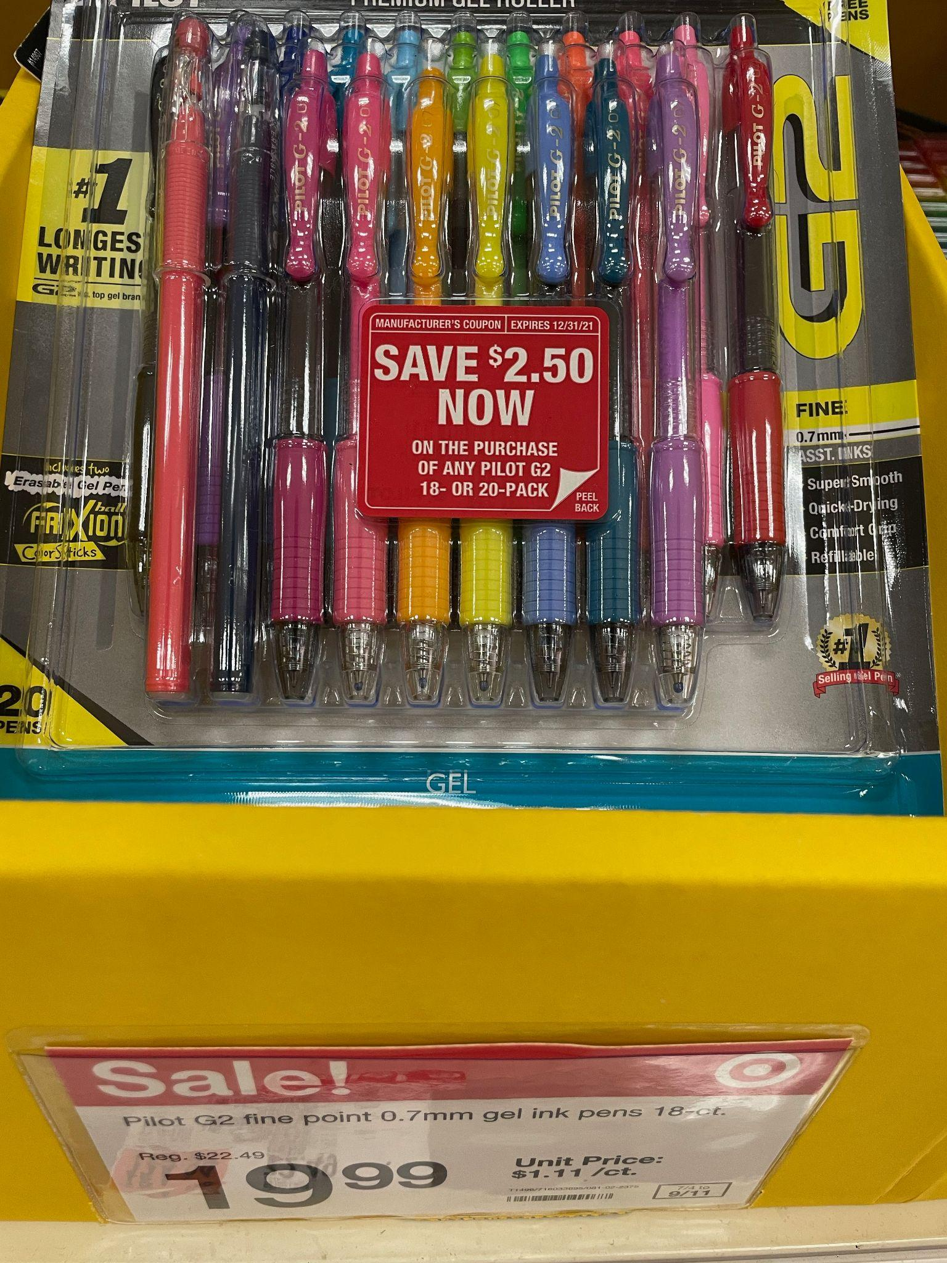
Would you rather ….
13 pens for $11.99
or
20 pens for $19.99
5.NBT.B7

Slide 19
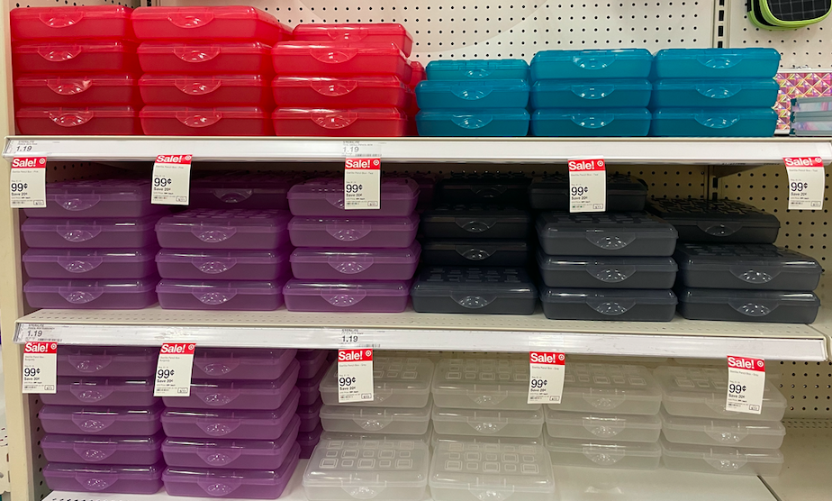
How many different math expressions can you create to match this photo?
5.OA.A1

Slide 20
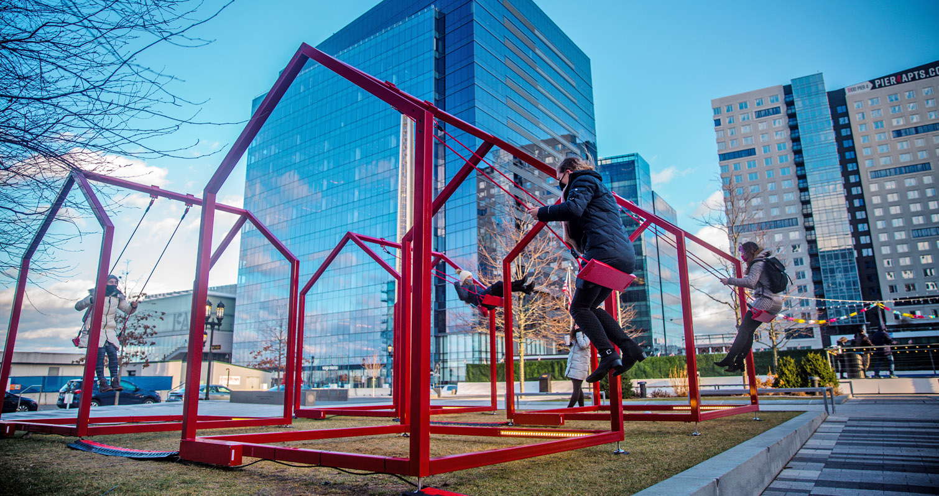
Mi Casa, Your Casa comprises of 16 homes, spaced 6 feet apart
and standing at nearly 10 feet tall!
Each “home” is 10 feet long and 8 feet wide. What math statements can you make?
5.MD.C

