Slide 1
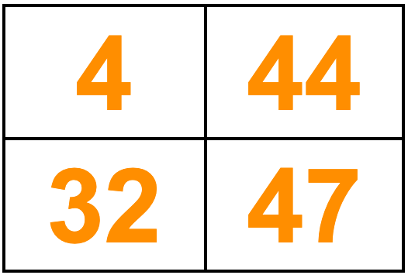
Which one doesn’t belong?
3.NBT.A
Notes:
Week of September 1, 2021

Slide 2
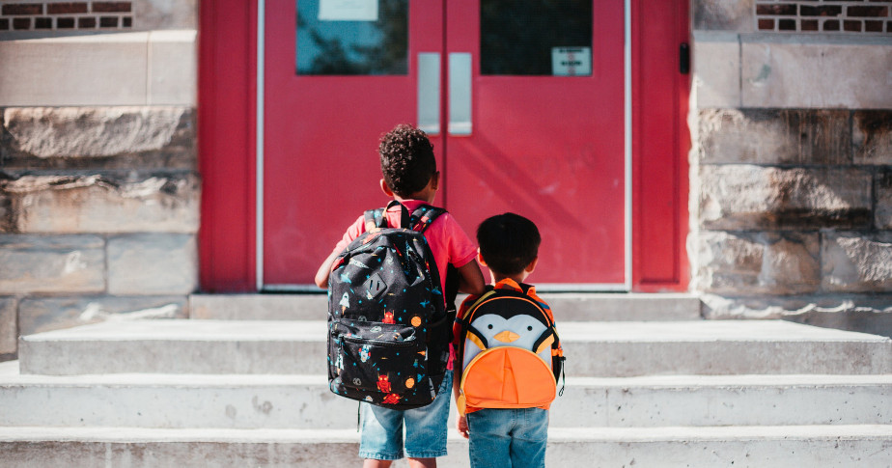
The backpack on the left weighs TWICE as much as the one on the right.
What’s possible?
Can you write a number sentence to match your mathematical thinking?
3.MD.A2

Slide 3
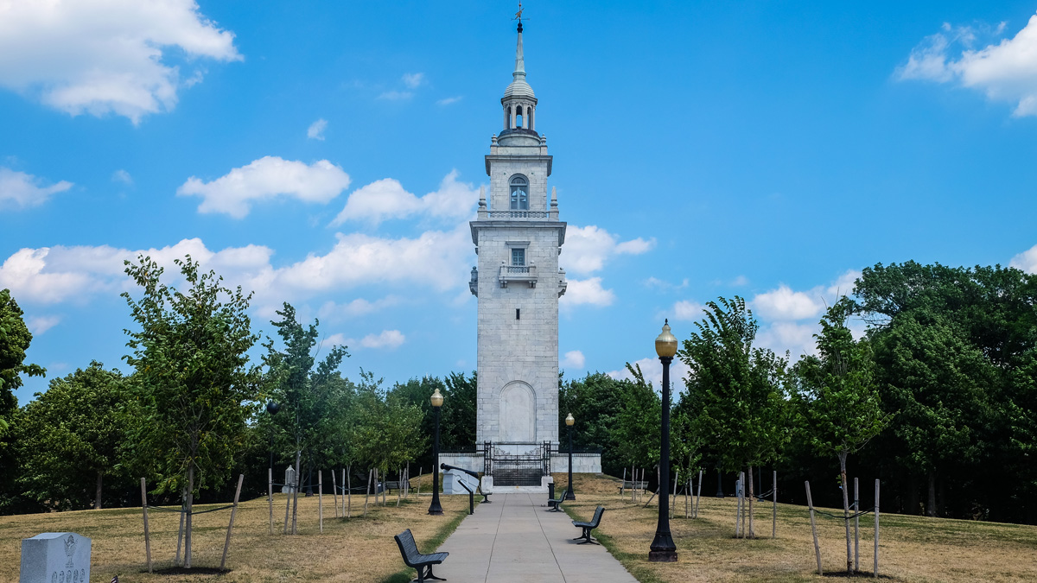
The Dorchester Heights Monument is 119 years old!
What can we say about the number 119?
3.NBT.A

Slide 4
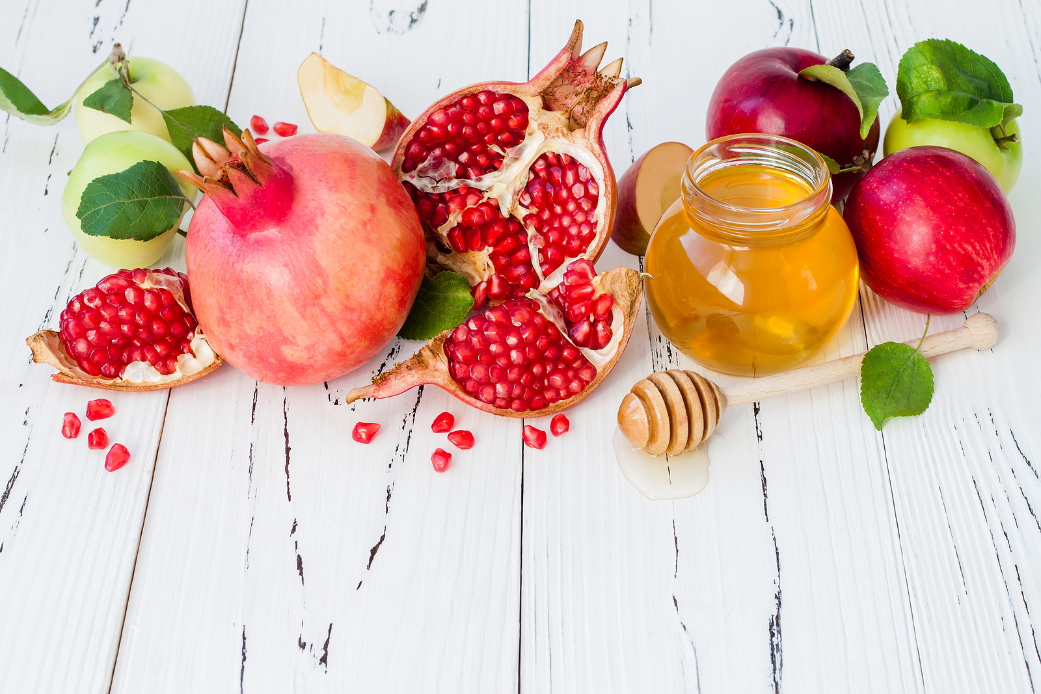
Happy New Year!
5782
What THOUSAND is this year closest to?
How far away
is it?
Happy Rosh Hashanah!
3.NBT.A1
Notes:
Week of September 8, 2021

Slide 5

What different shapes do we see in this Mexican cloth?
What can we say about the shapes and the angles?
Do we see any that are similar in one way, and different in another?
3.G.A1

Slide 6
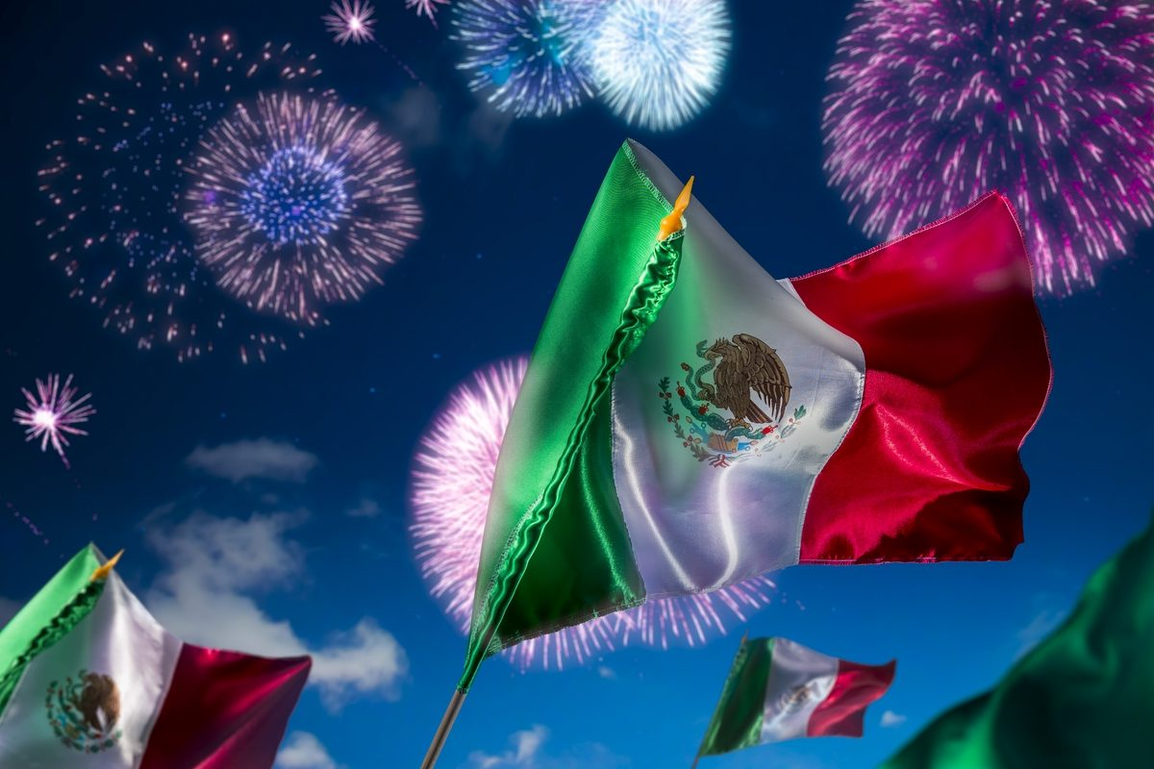
Mexico declared independence from Spain in 1810
How long ago was that?
What strategies can we use to figure it out?
Happy Independence Day in Mexico!
3.NBT.A2

Slide 7
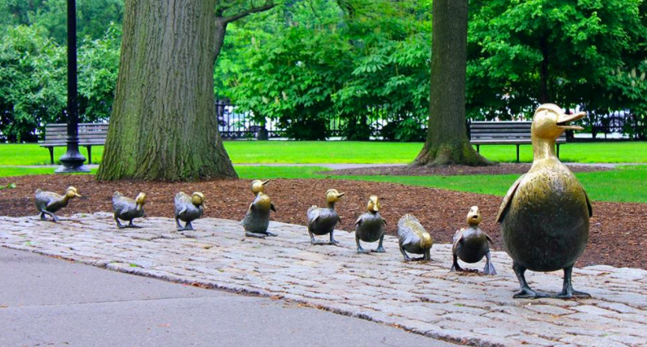
What can we say about the number of ducks here in the Boston Public Garden?
Create NUMBER SENTENCES using subtraction to match this number.
3.OA.D9
Notes:
Week of September 13, 2021

Slide 8
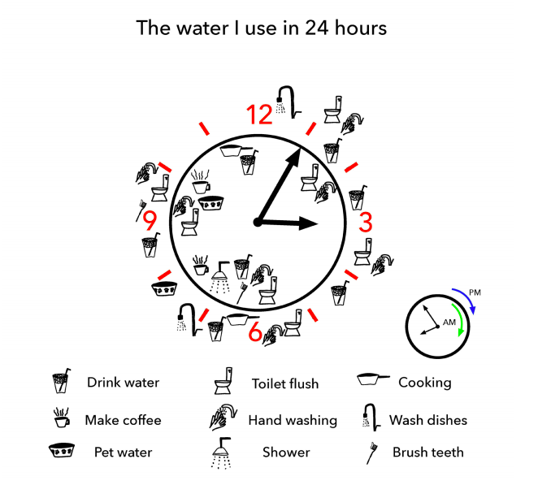
What is going on in this
DATA VISUALIZATION?
3.MD.B
YouCubed .org

Slide 9
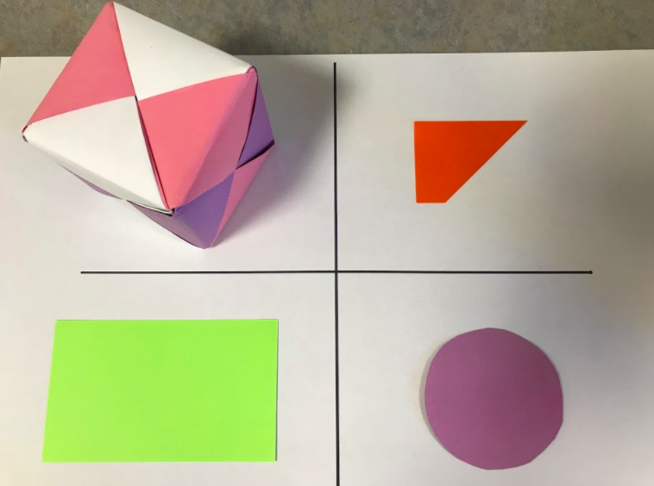
Which one doesn’t belong?
3.G.A1

Slide 10
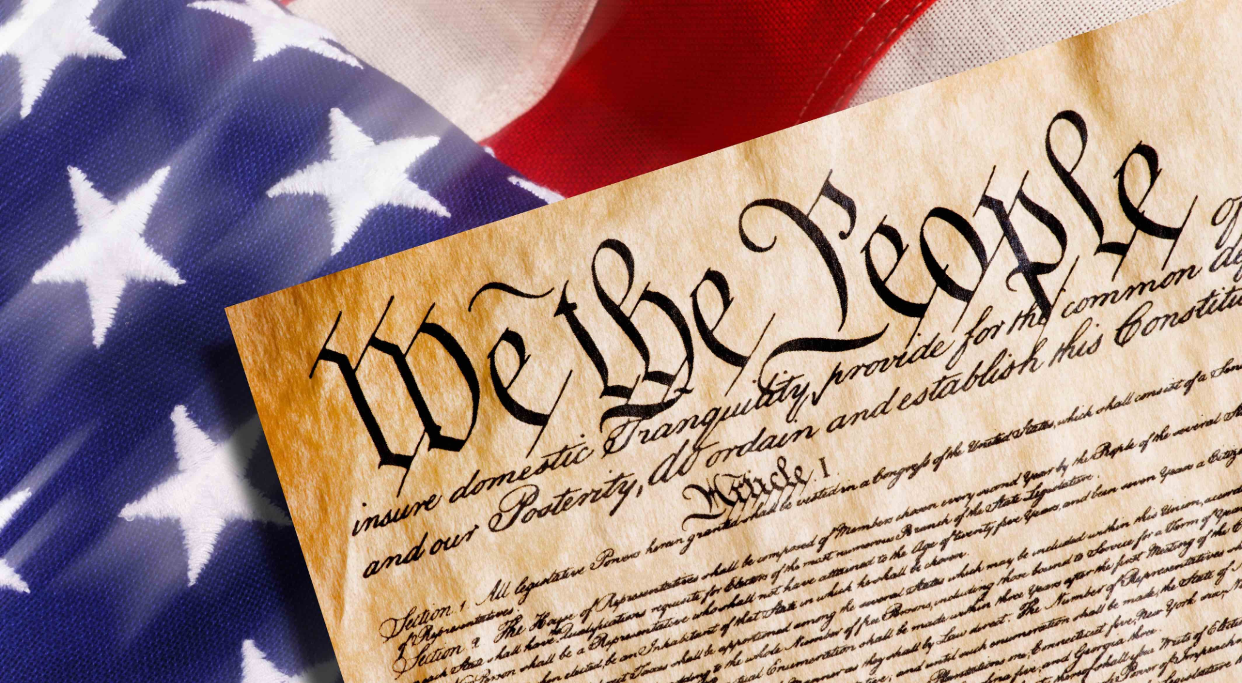
How long ago was 1787?
Is that closer to 200 years ago or 300 years ago?
When will be celebrating the 300th birthday of the Constitution?
Written in 1787 the United States Constitution is the world’s longest surviving written charter of government.
3.NBT.A1

Slide 11
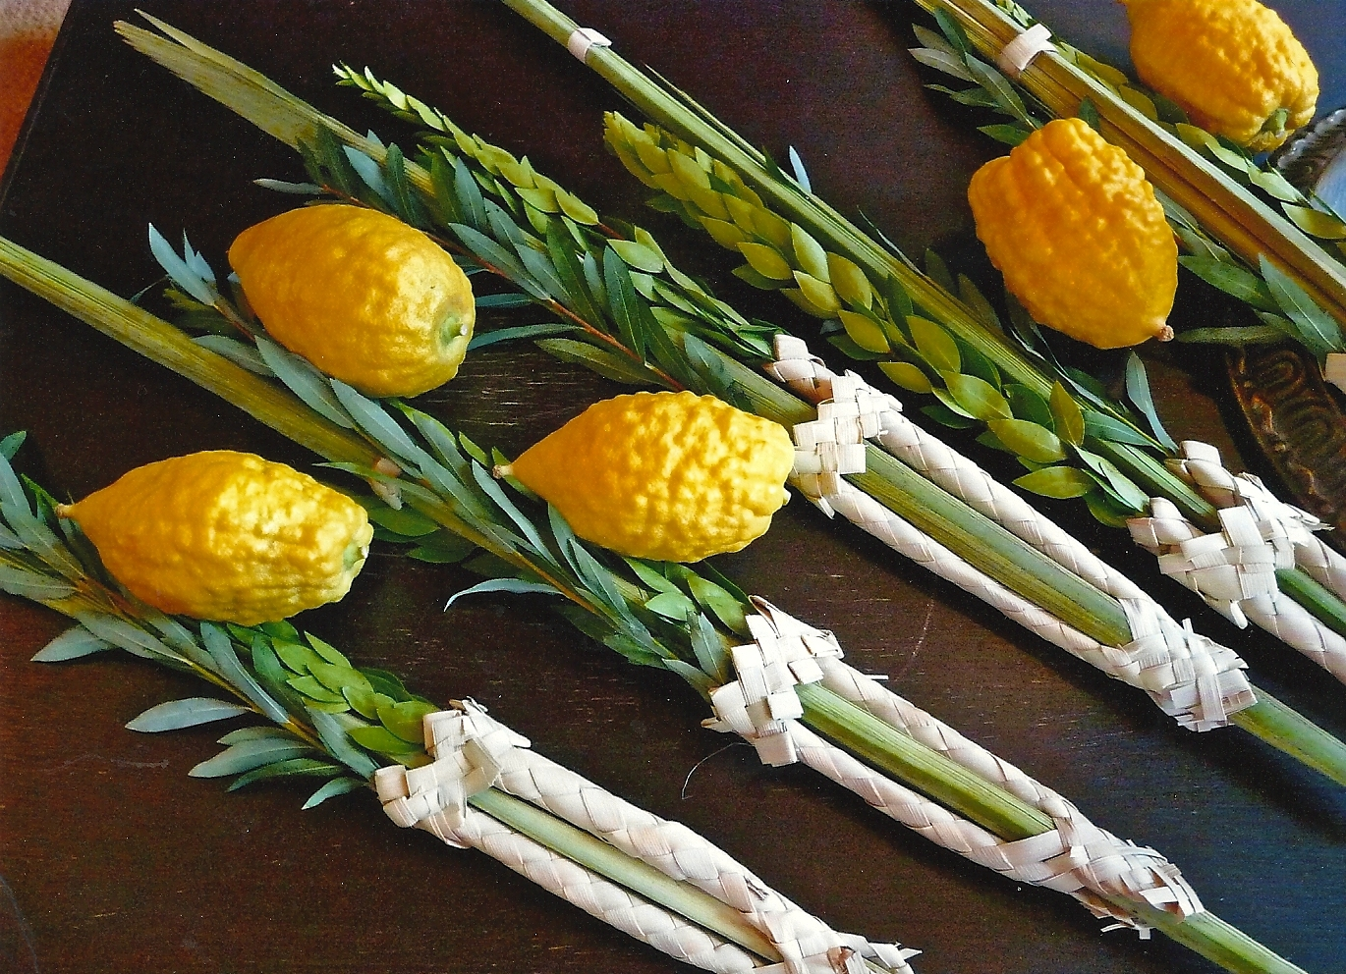
This lemon-like fruit is called an etrog.
An average etrog weighs around 56-85 grams.
How many grams might these 5 etrogim weigh?
Happy Sukkot!
3.OA.A3
Notes:
Week of September 20, 2021

Slide 12
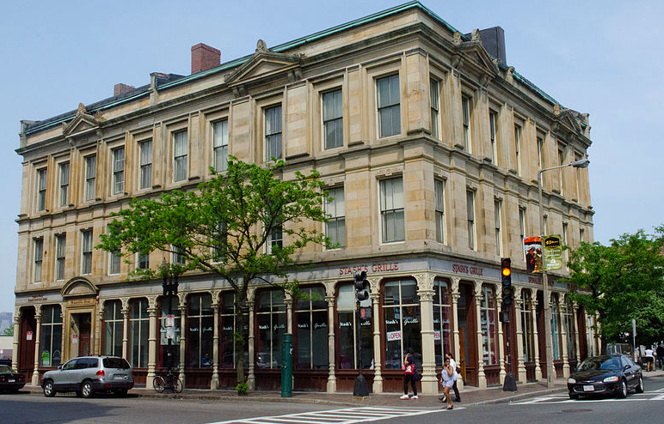
The Palladio Building is about 710 feet on one side and is a perfect square.
What can you say about that?
3.MD.D8

Slide 13
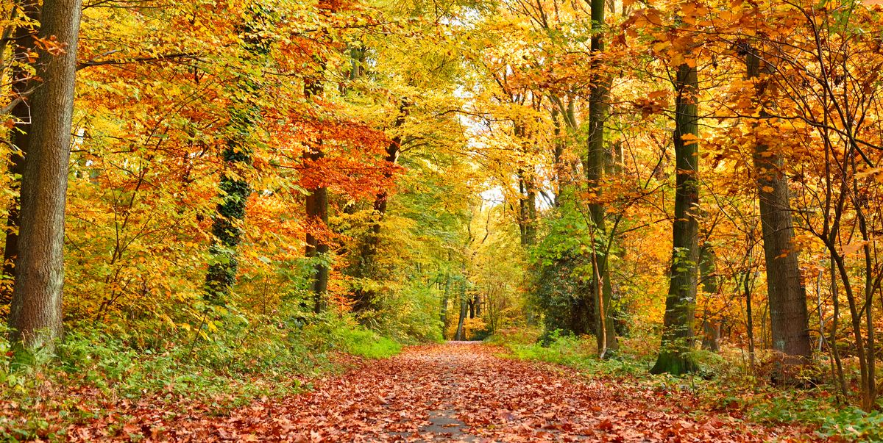
The Fall (Autumnal) Equinox is at 3:20 PM today,
when the sun is sitting directly above the earth’s equator.
How many hours and minutes away is that?
3.MD.A1
Notes:
WEDNESDAY, SEPTEMBER 22, 2021

Slide 14
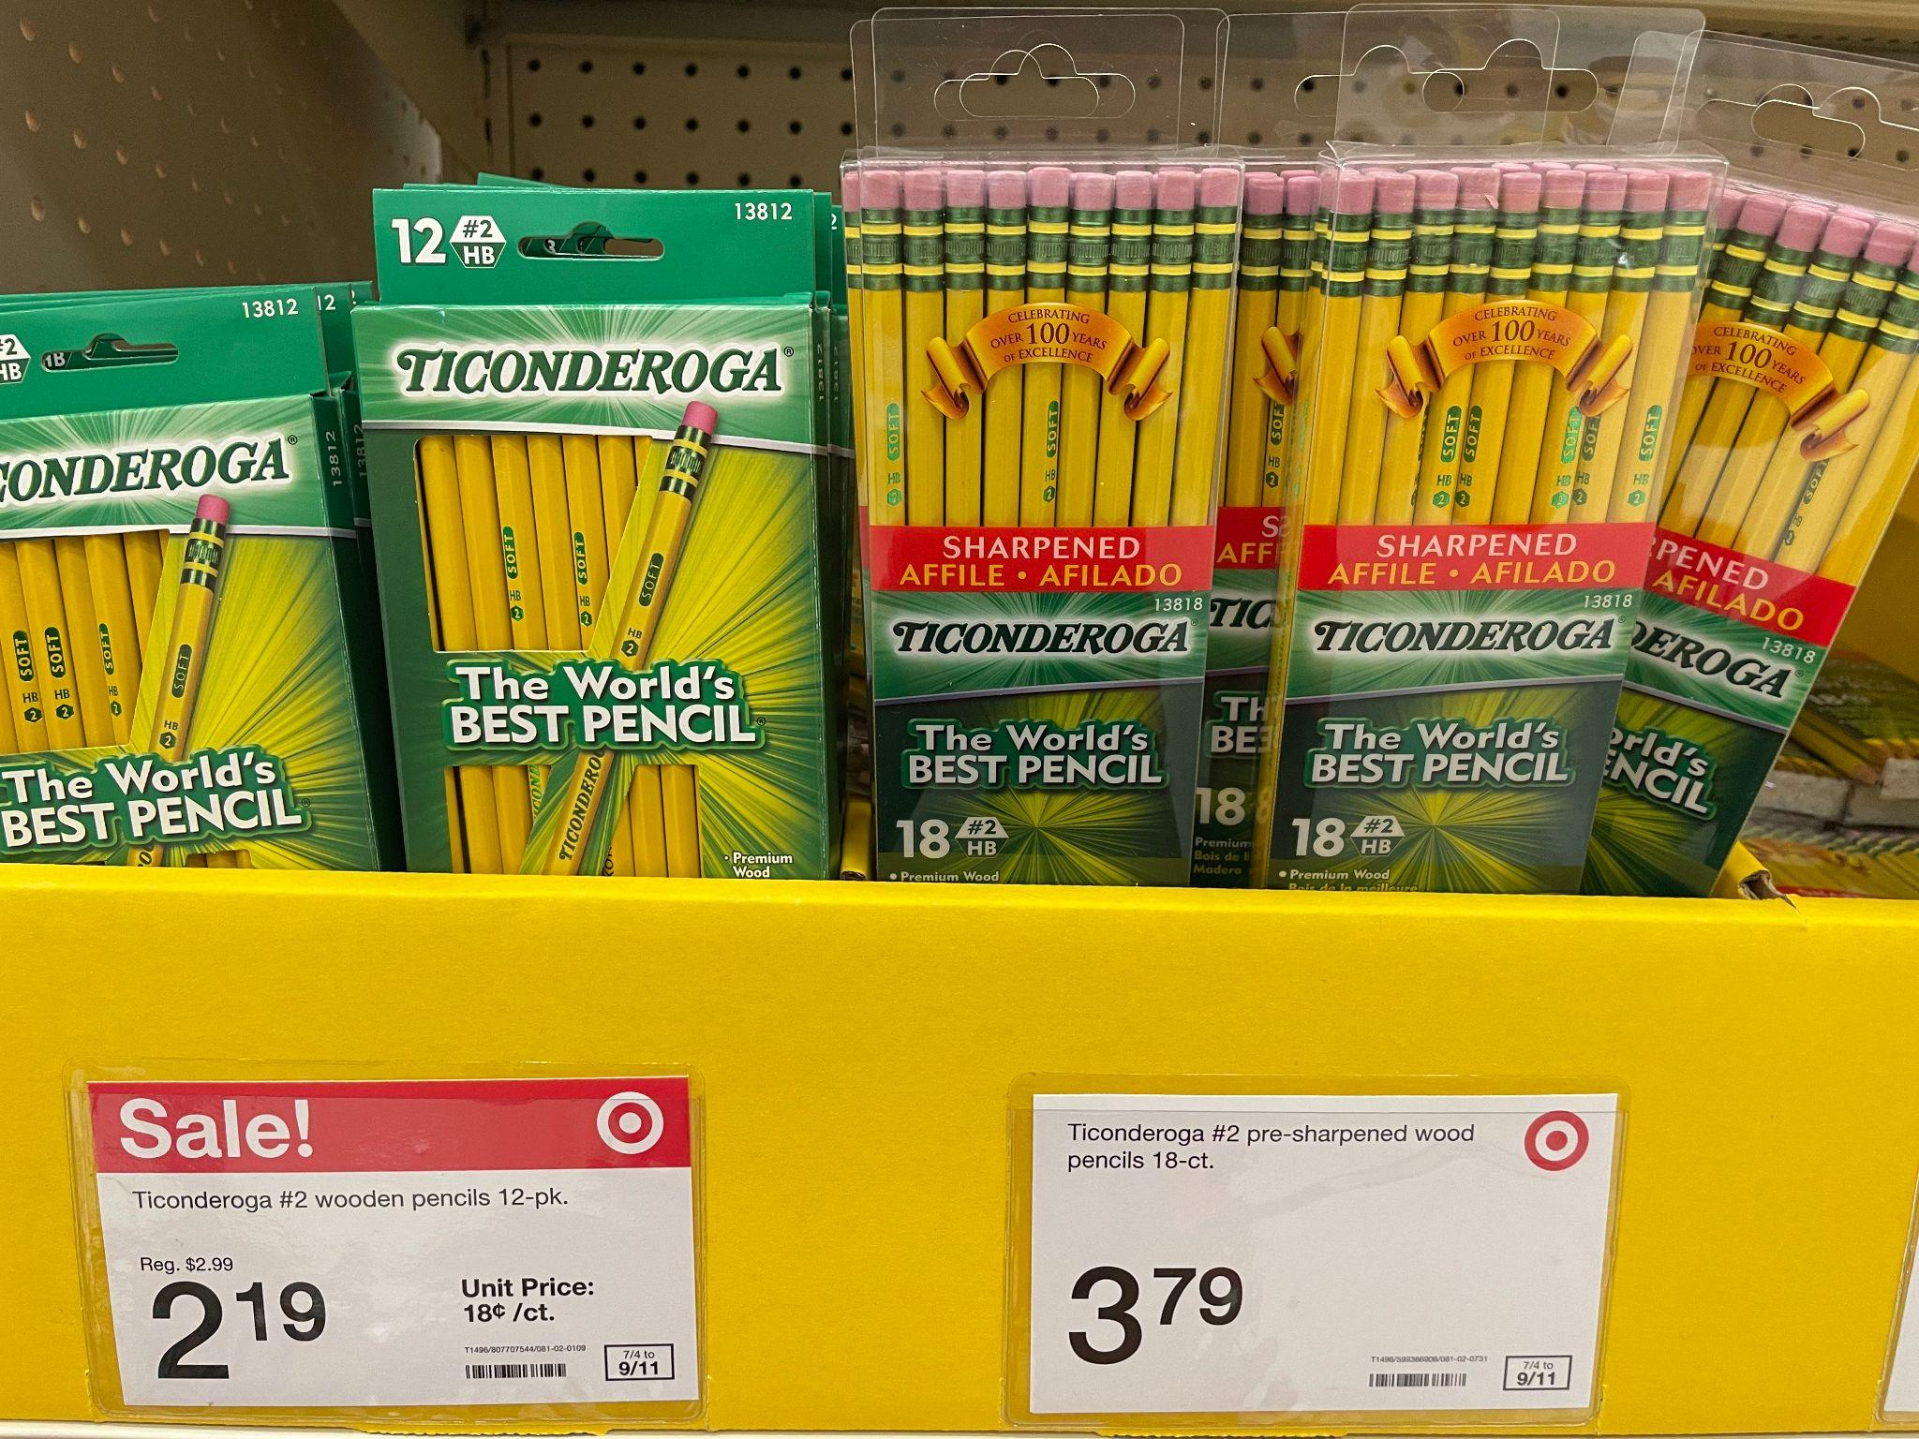
Would you rather have
12 pencils for $2.19
or
18 pencils for $3.79?
3.OA.A3

Slide 15
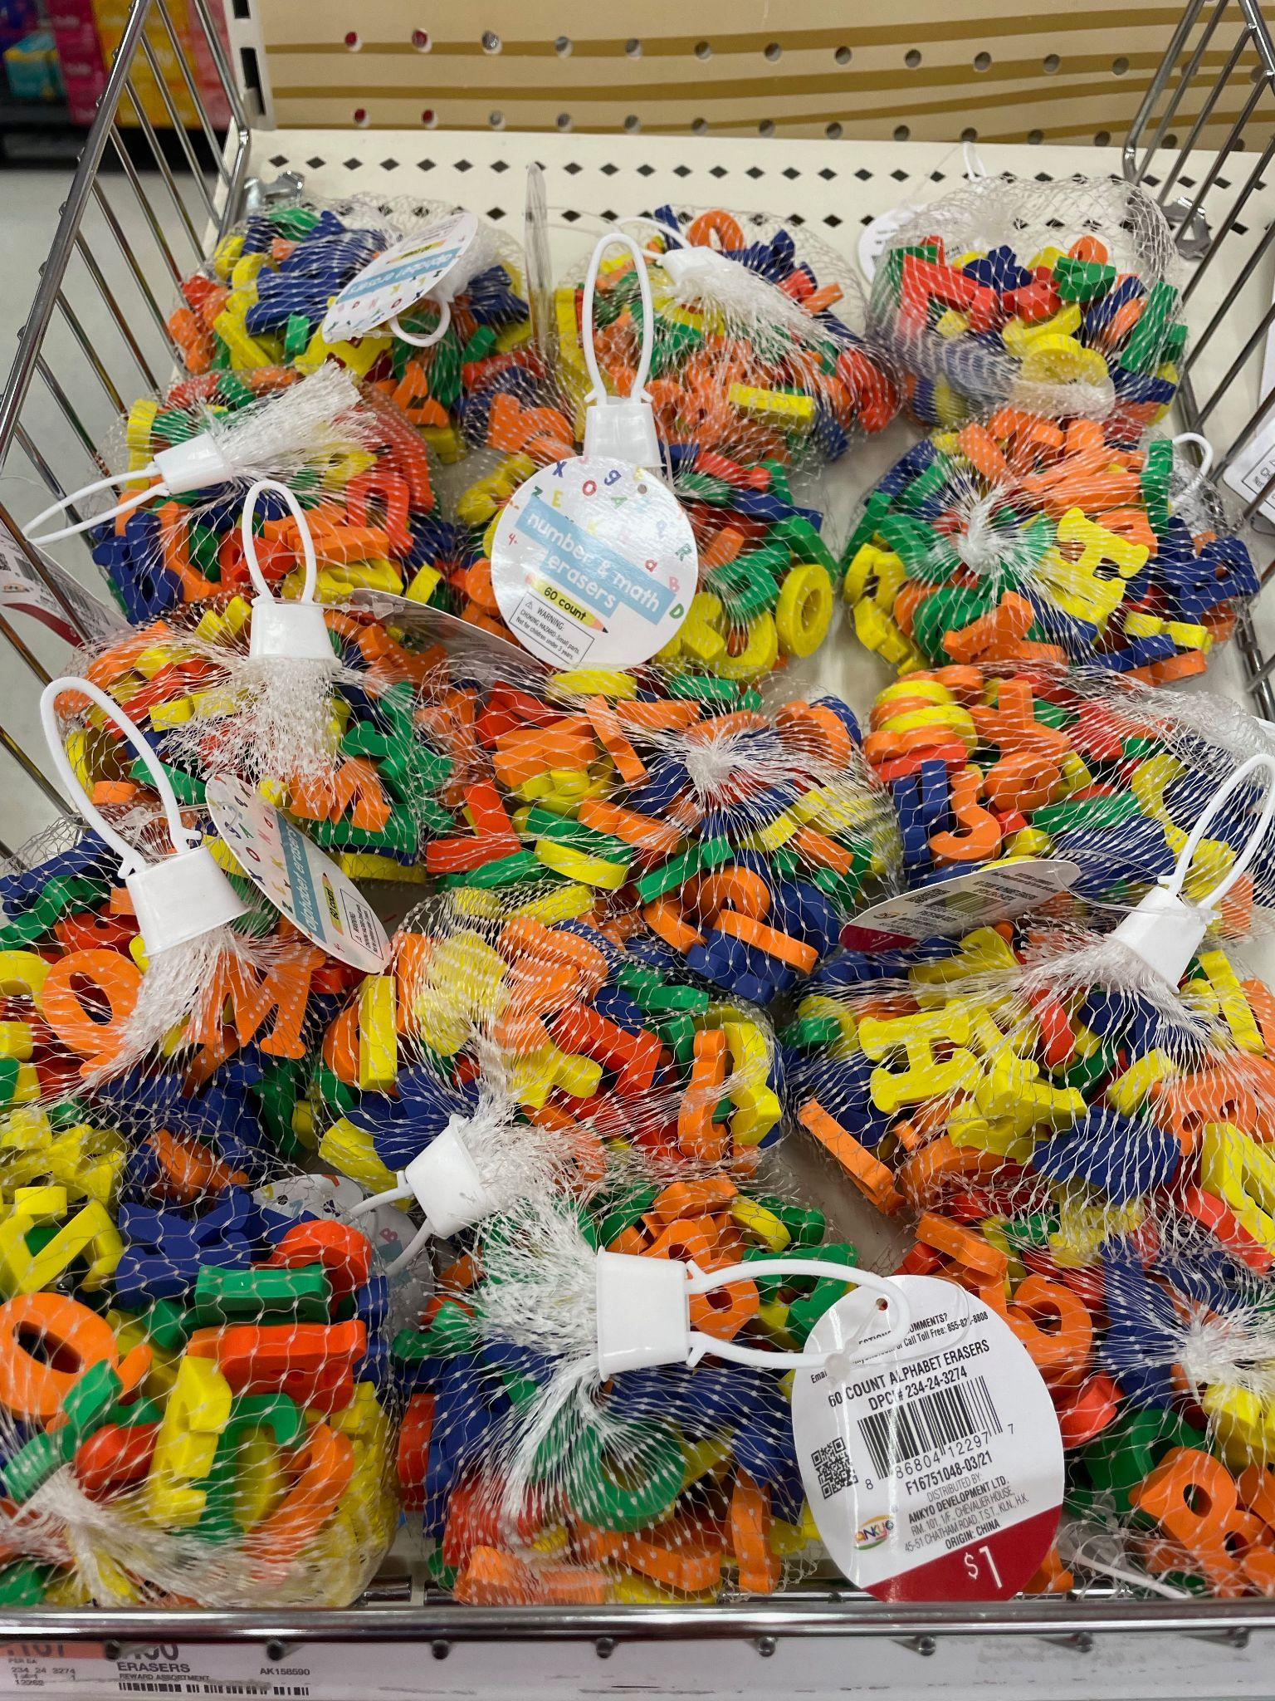
Look at all of these erasers!
Estimate how many erasers might be here.
How many bags are here?
5 rows of 3 bags
How many in each bag?
60 erasers in each bag
What strategies can we use to solve this problem?
3.OA.A3

Slide 16

How many orange pieces do we see?
How many WHOLE oranges might
that be?
How do we know?
3.G.A2
Notes:
Week of September 27, 2021

Slide 17
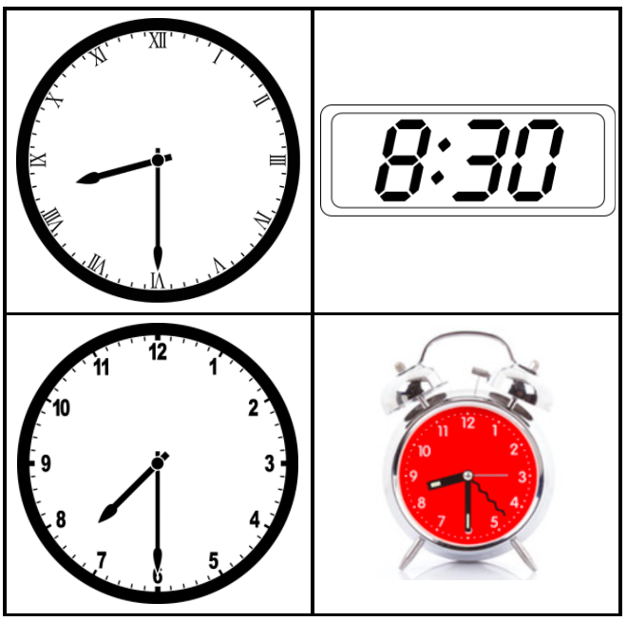
Which one doesn’t belong?
3.MD.A1

Slide 18
Sketch a shape
that is the SAME in one way
and
DIFFERENT in another way.
Describe this shape.
What shape is this?
3.G.A1

Slide 19
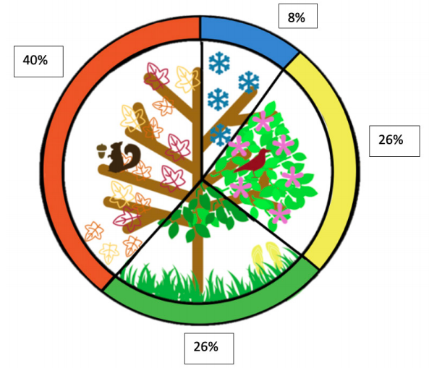
What is
going on
in this
Data Visualization?
YouCubed.org
3.MD.B
Notes:
This data is representing 1,005 adults in the United States in September 2015 who reported their favorite season. According to studyfinds.org many people pick Fall as their favorite season for a multitude of reasons, not just the weather. Over 50% of people in the U.S. like Fall due to the changing leaves while 41% enjoy the chill in the air. What other reasons might someone like Fall? What is your favorite season? What about this data surprises you?

Slide 20
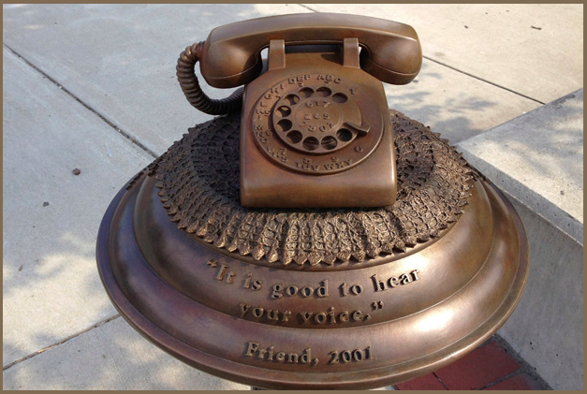
This huge bronze phone weighs close to 500 pounds!
What can we say about 500?
3.MD.A2

