Slide 1
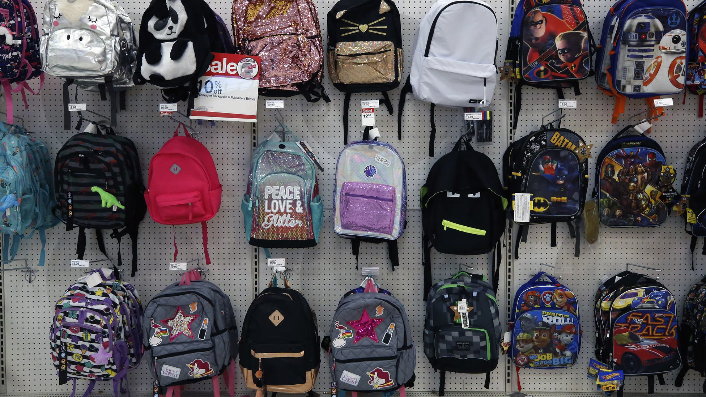
What can we say about these back- packs?
How many are there?
How can we count them?
How might we sort them?
2.OA.C4
Notes:
Week of September 1, 2021

Slide 2
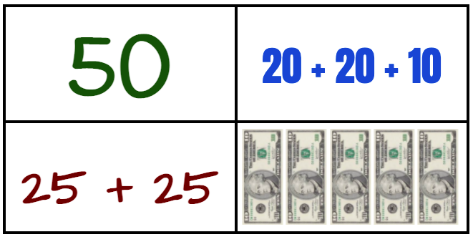
Which one doesn’t belong?
1.NBT.B8

Slide 3
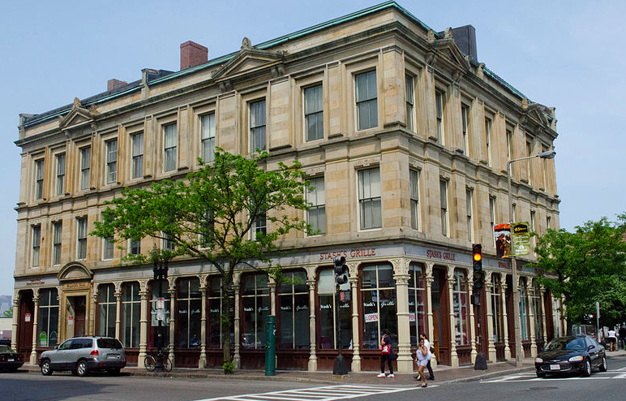
The Palladio Building has LOTS of windows!
Estimate how many windows might be here.
2.OA.C4

Slide 4
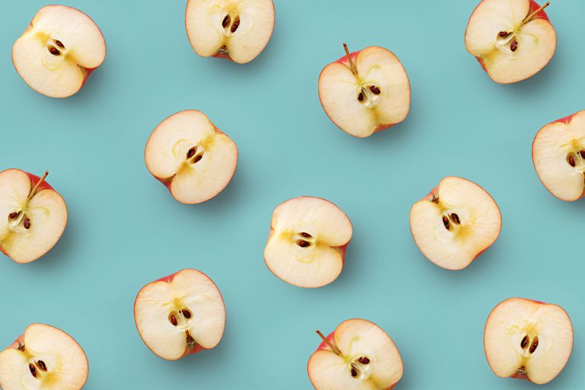
How many apples do we see?
Happy Rosh Hashanah!
2.G.A3
Notes:
Week of September 8, 2021

Slide 5
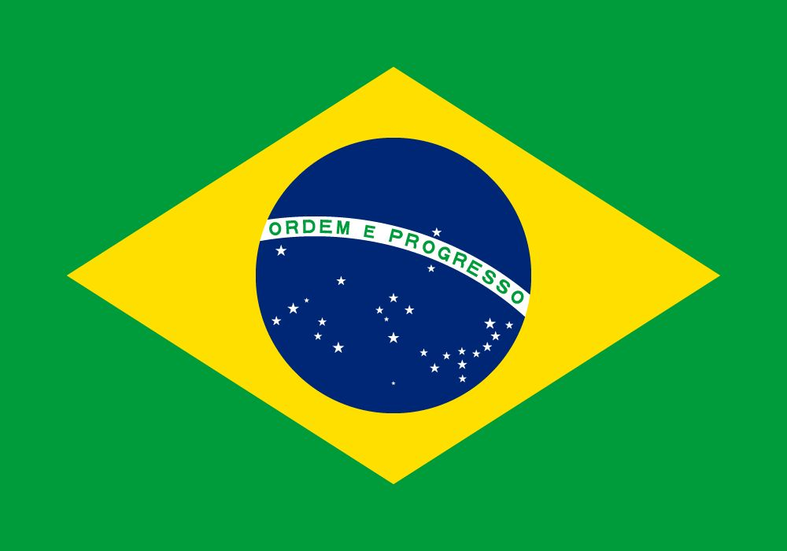
What shapes do we see in the flag of Brazil?
What do they have in common?
Can you draw a shape that is the SAME in one way and DIFFERENT in another?
Happy Independence Day in Brazil!
2.G.A1

Slide 6
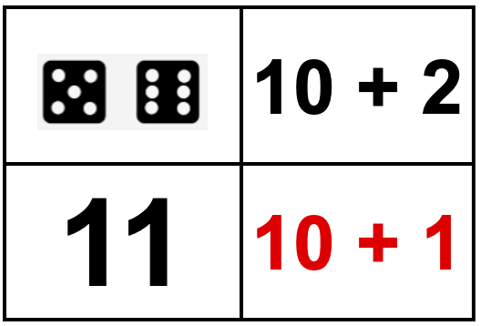
Which one doesn’t belong?
2.OA.B2

Slide 7
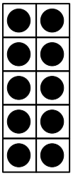
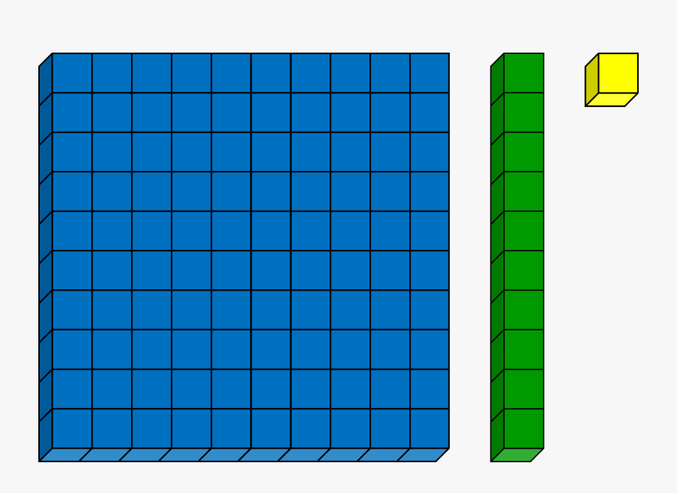
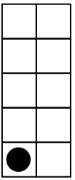
What is the SAME? What is DIFFERENT?
2.NBT.A1
Notes:
Week of September 13, 2021

Slide 8
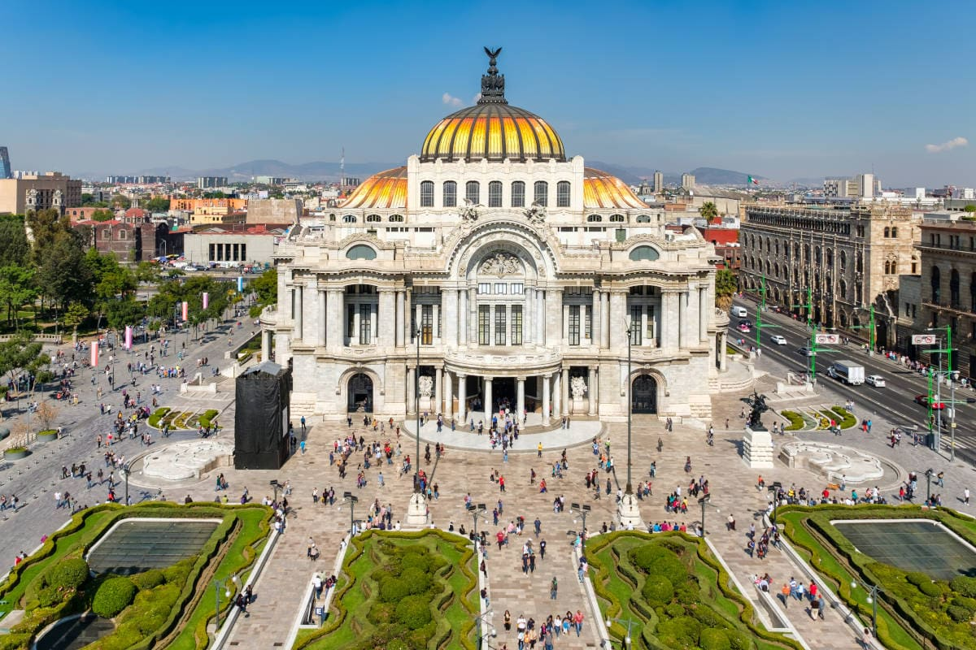
Describe some of the shapes you see in this photo of Mexico City.
What makes these shapes special?
Can we combine some shapes to make new shapes?
Happy Independence Day in Mexico!
2.G.A1

Slide 9
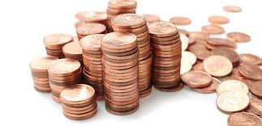
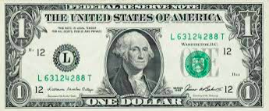
Would you rather have
107 pennies OR one dollar bill?
2.MD.C8

Slide 10
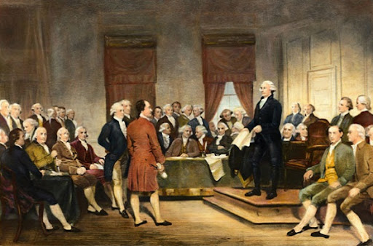
39 Delegates signed the Constitution on September 17, 1787.
How many ways can we get to the number 39?
Let’s write number sentences to match our mathematical thinking.
Happy Constitution Day!
2.NBT.C4
Notes:
SEPTEMBER 17, 2021

Slide 11
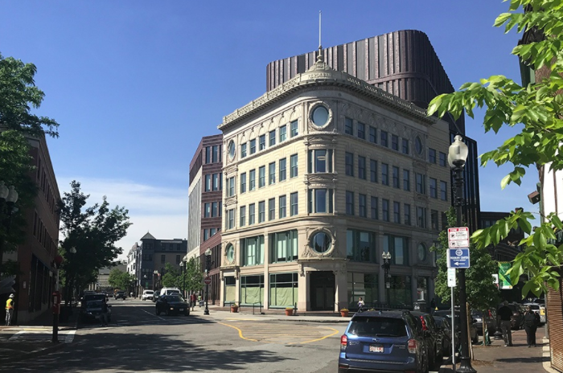
Where do we see rows and columns in this photo of Nubian Square?
How can we use rows and columns to figure out how many windows are here?
2.OA.C4
Notes:
Week of September 20, 2021

Slide 12
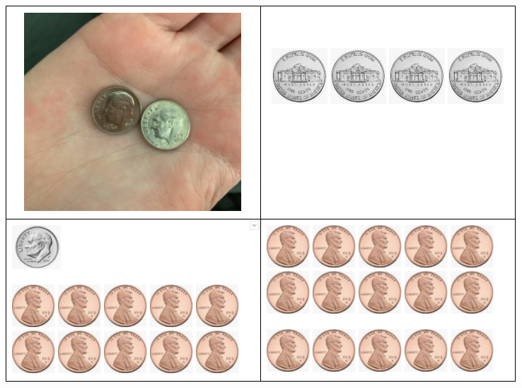
Which one doesn’t belong?
2.MD.C8

Slide 13
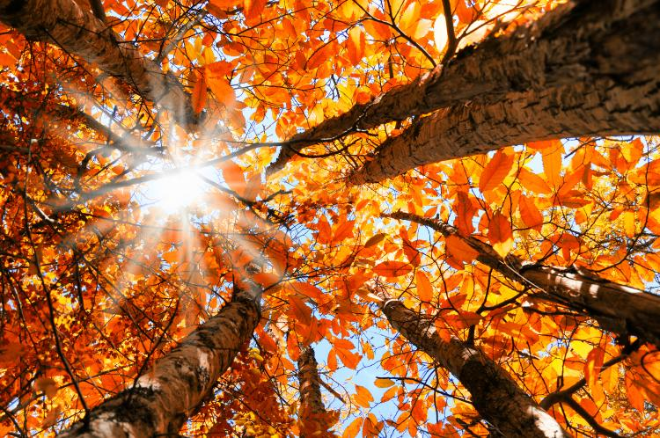
12 hours of day and
12 hours of night!
How many hours in one day?
How many hours in two days?
How about three days?
How many hours in one week?
Happy Autumnal Equinox! The first day of Fall!
2.MD.C7a

Slide 14
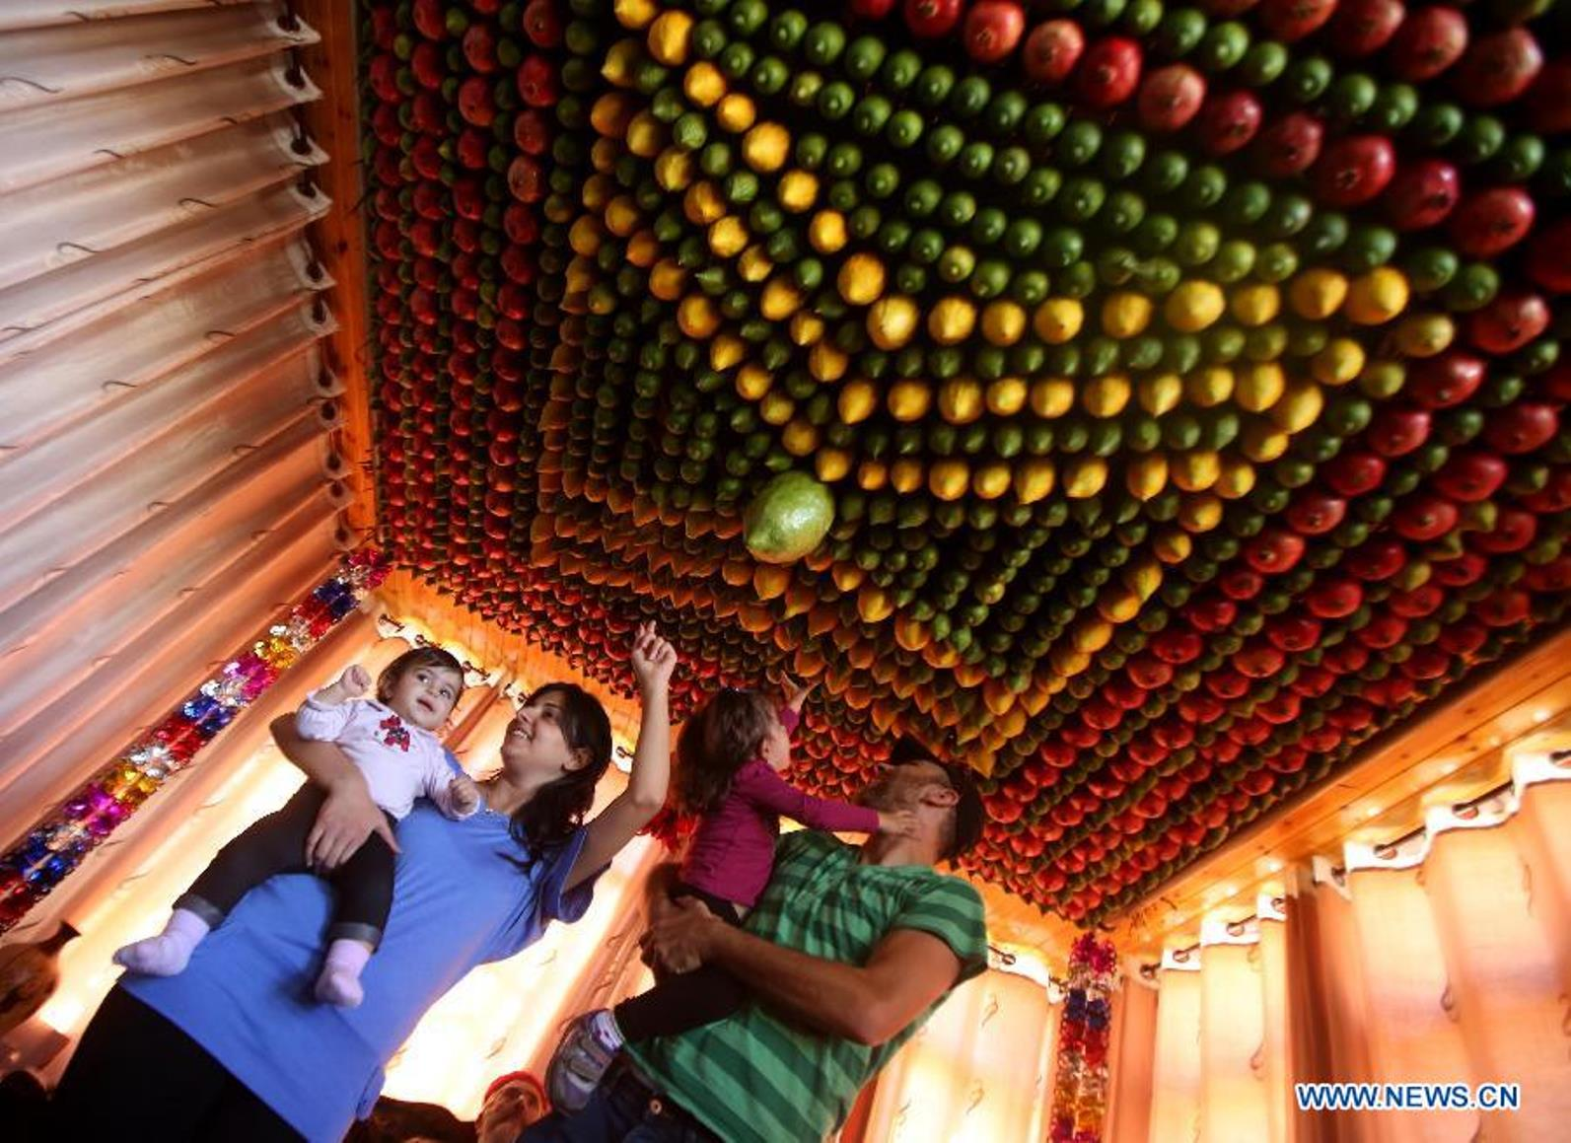
Look at the amazing shapes that make the roof of this Israeli Sukkah!
How do we see them?
How can we figure out how many pieces of fruit are here?
2.NBT.A2

Slide 15
What is the SAME? What is DIFFERENT?
2.G.A1

Slide 16
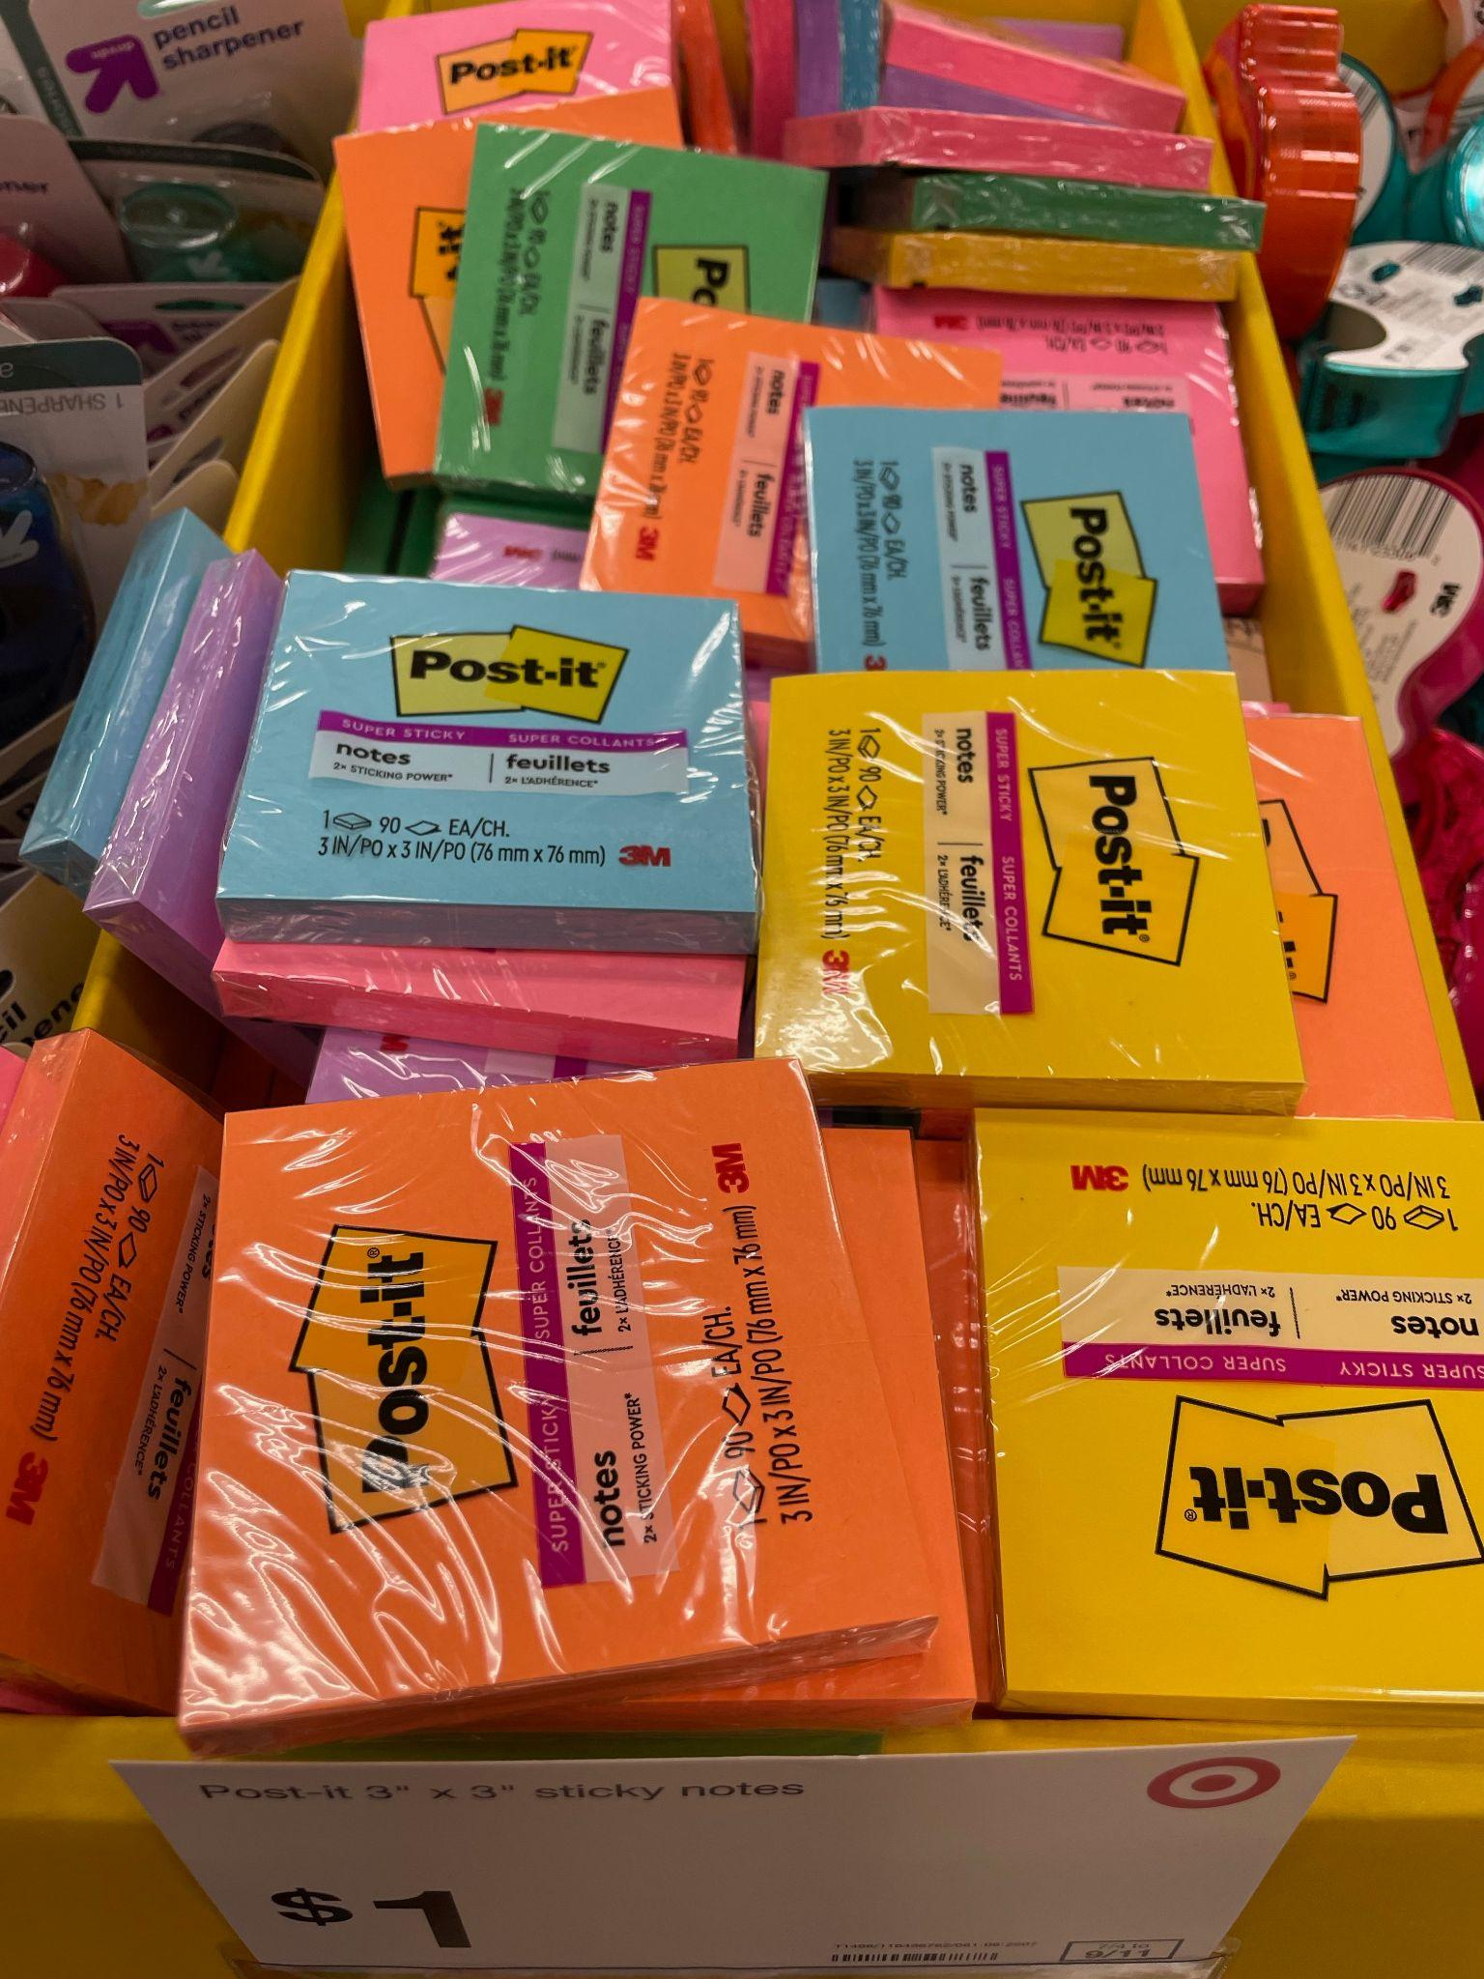
How many packs of Post-Its might be here?
How can we use what we know to make our best ESTIMATE?
If there are close to 100 in each pack, how many might there be altogether?
2.OA.A1
Notes:
Week of September 27, 2021

Slide 17
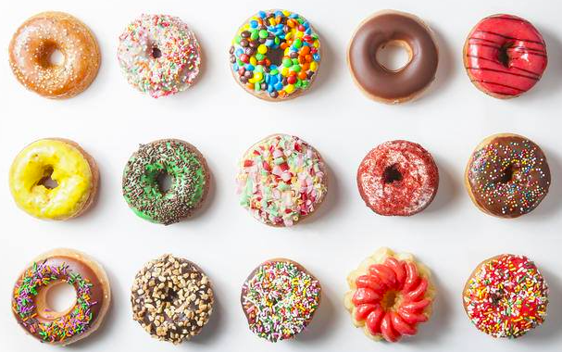
Yum! Donuts!
How many are hiding?
How many donuts are there altogether?
How do we know?
2.OA.C4

Slide 18
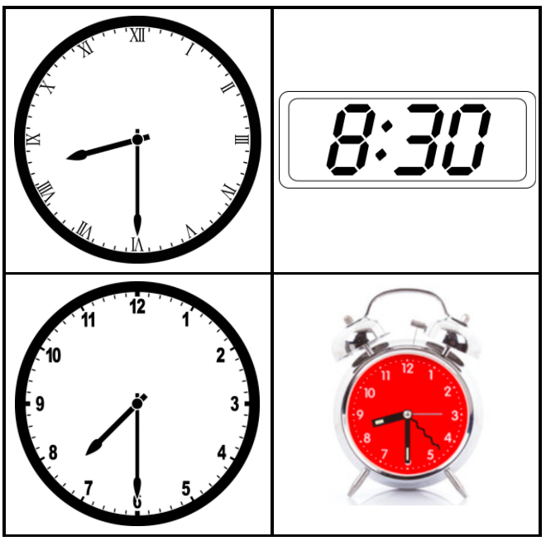
Which one doesn’t belong?
2.MD.C7

Slide 19
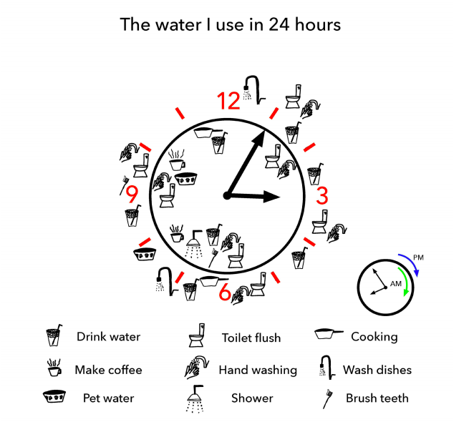
What is going on in this
DATA VISUALIZATION?
2.MD.D10
YouCubed .org

Slide 20

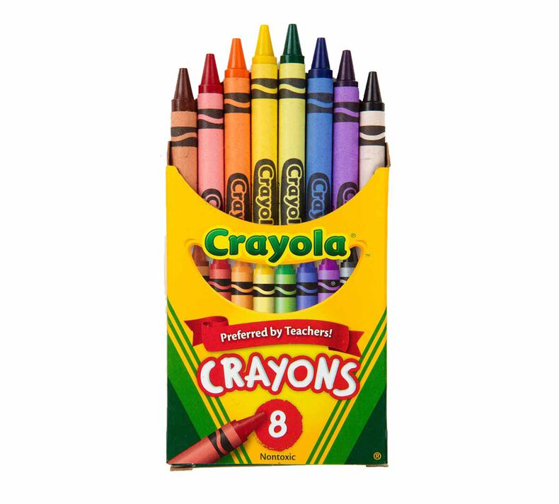
One crayon measures 3 inches.
If we measured this whole box of crayons, how many inches would that be?
2.NBT.B6

