Slide 1
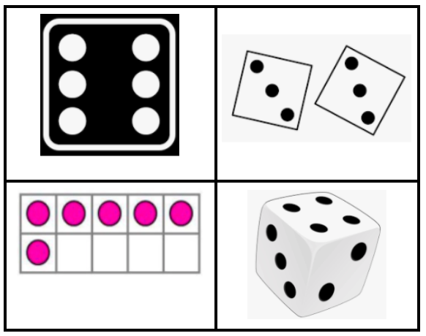
Which one doesn’t belong?
1.OA.C5
Notes:
Week of September 1, 2021

Slide 2
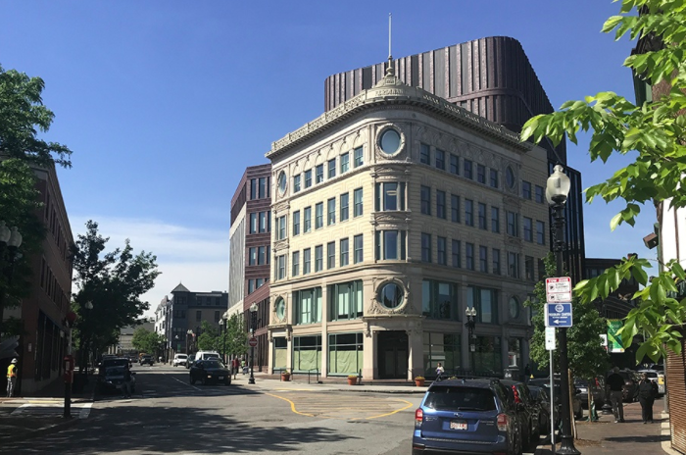
What shapes do we see in Nubian Square?
1.G.A1

Slide 3
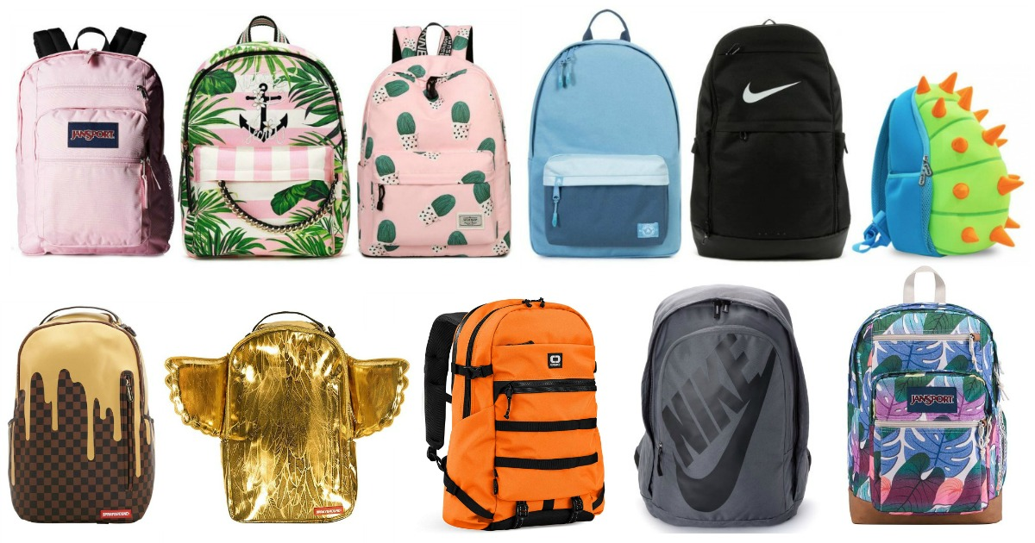
How many backpacks do we see here?
How can we count them? How might we sort them?
1.OA.C5

Slide 4
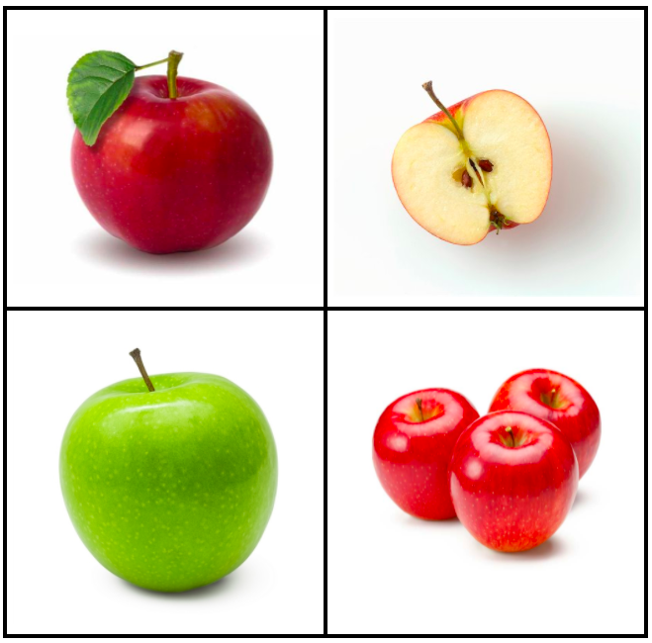
Which one doesn’t belong?
1.G.A1
Notes:
Week of September 8, 2021

Slide 5
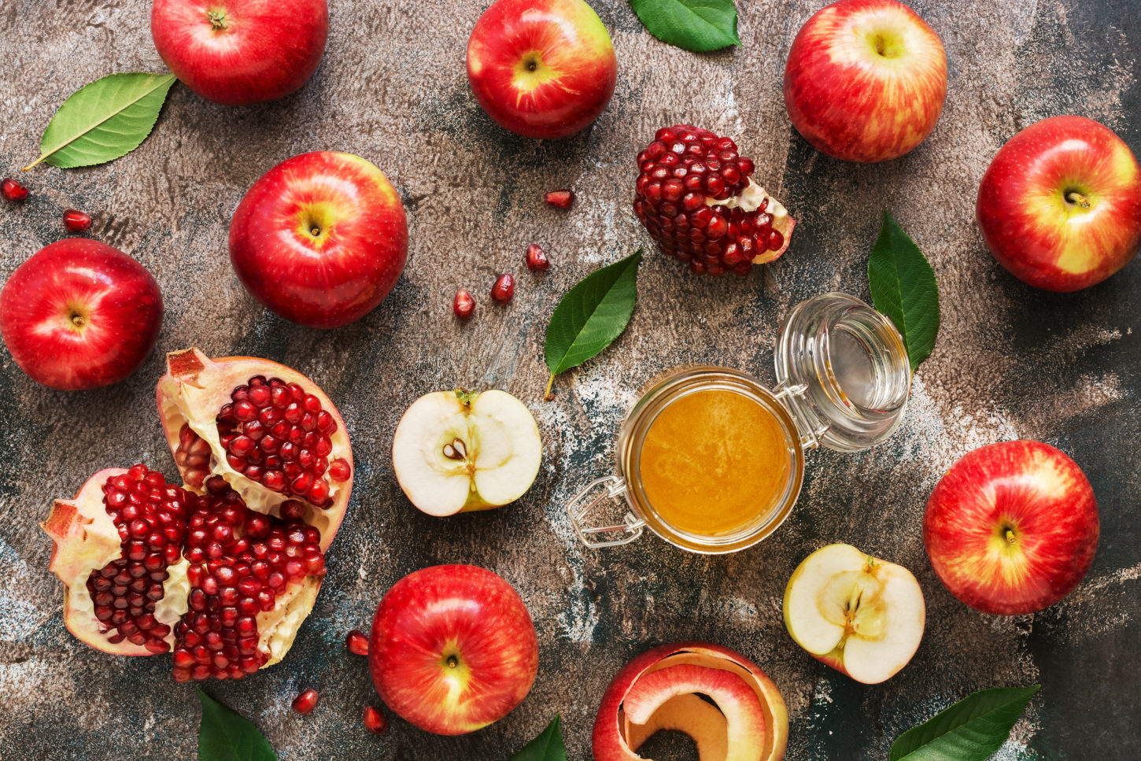
Happy Rosh Hashanah!
How many apples?
How many pomegranate seeds?
Can we estimate?
1.OA.C5

Slide 6
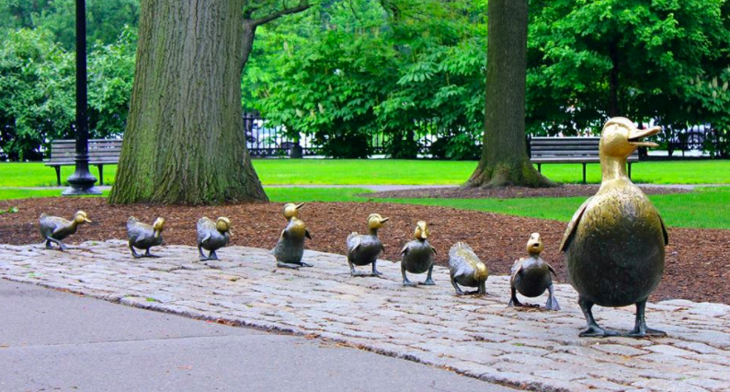
How many ducks?
How many would there be if another family of ducks came along?
1.OA.A1

Slide 7
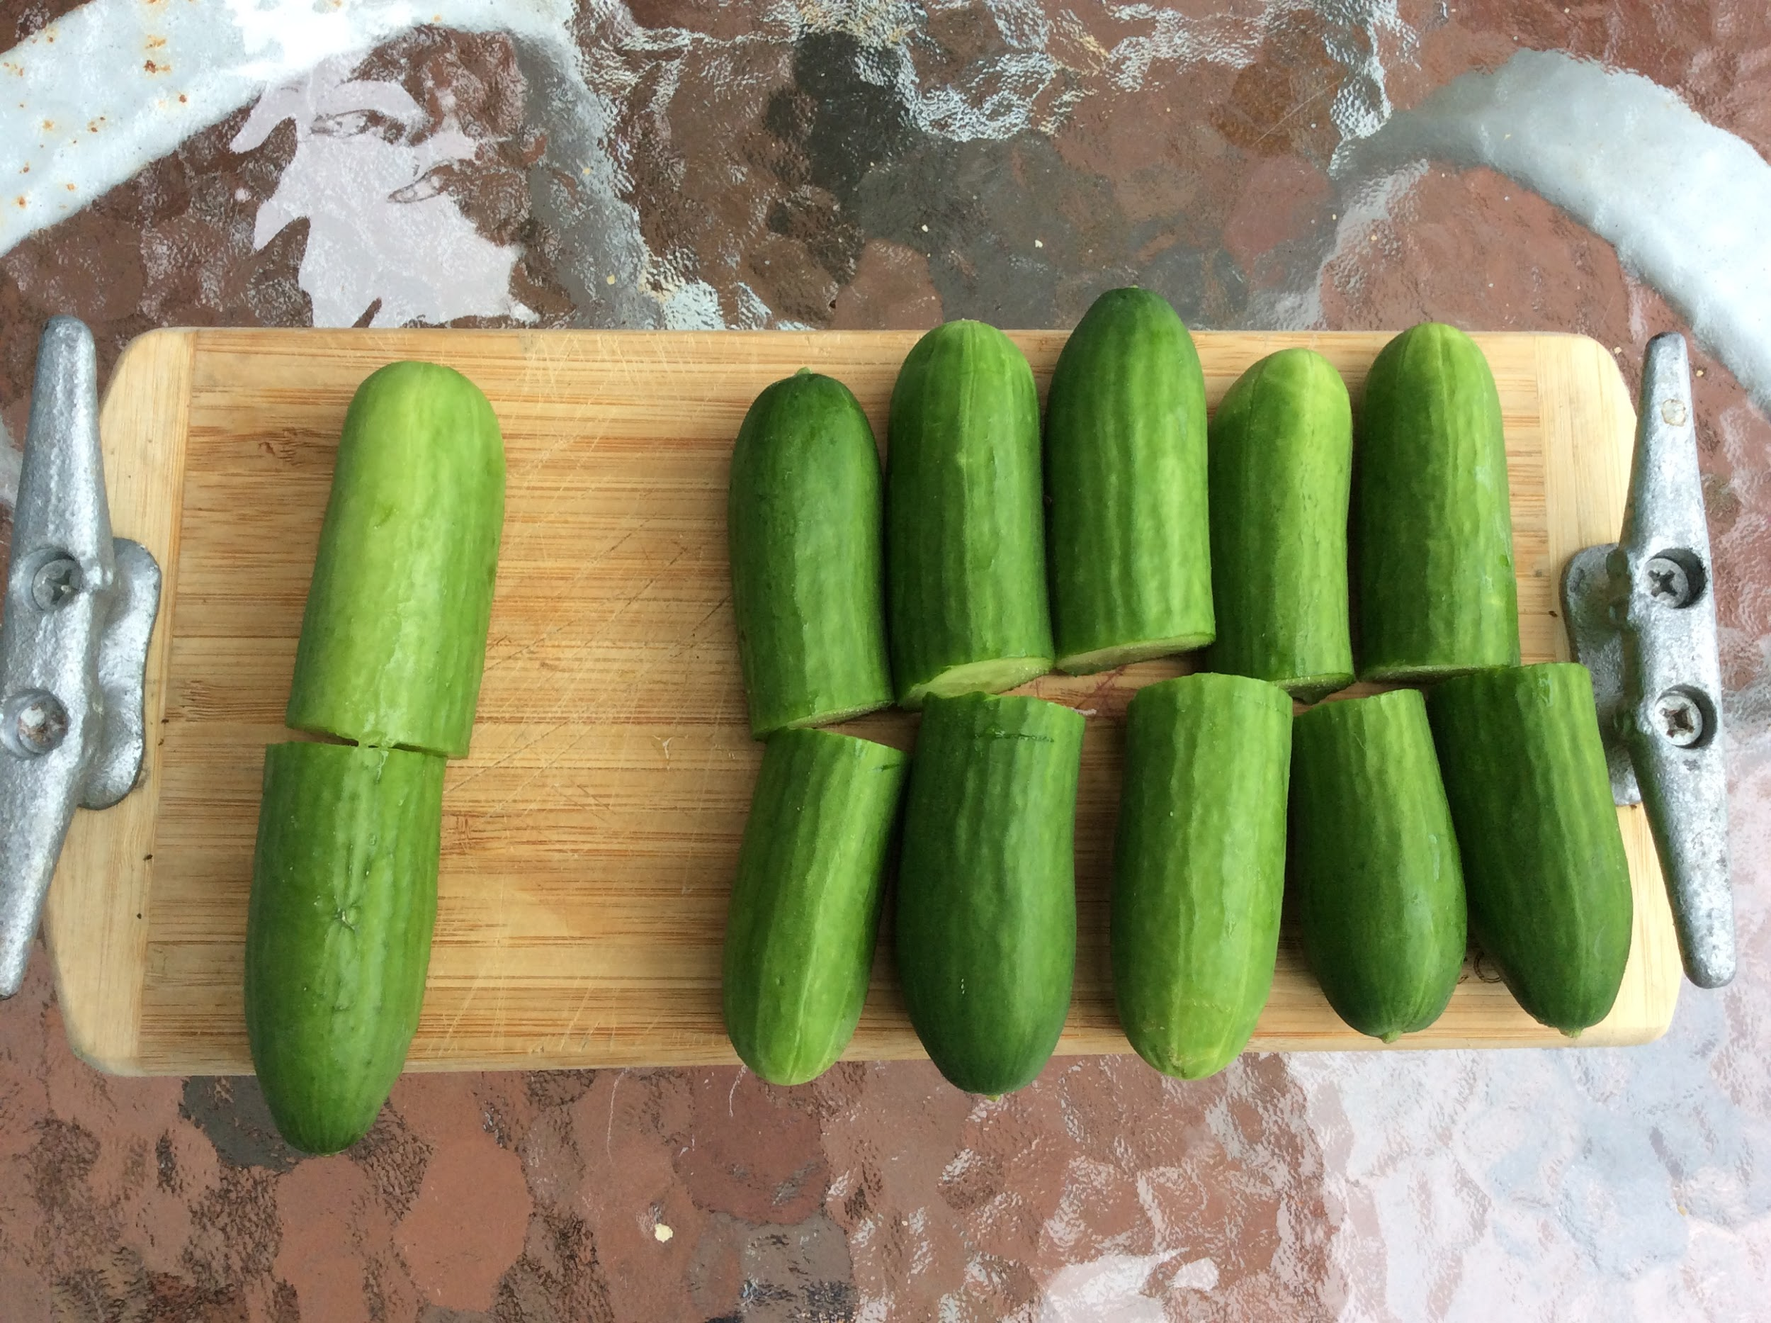
How many cucumbers do we see?
How do we see them?
Let’s write a number sentence to match the picture!
1.OA.B3
Notes:
Week of September 13, 2021

Slide 8
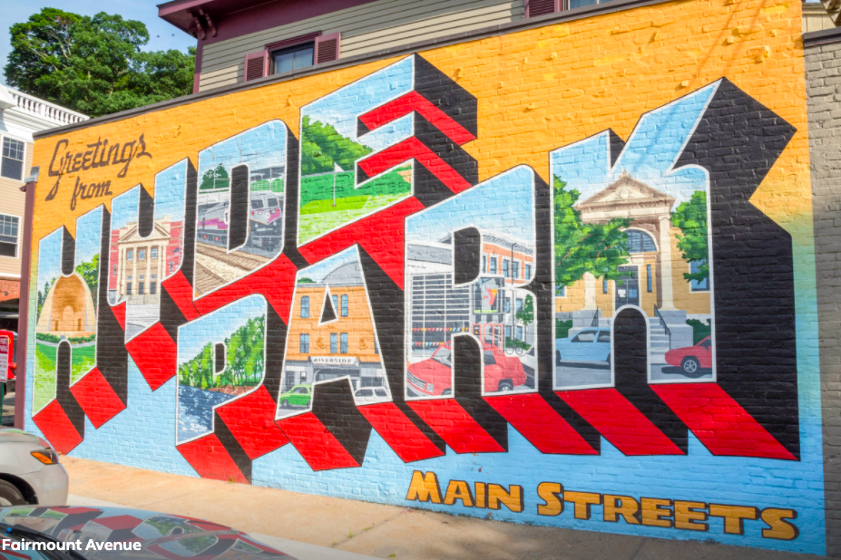
What shapes do we see in this mural?
1.G.A1

Slide 9
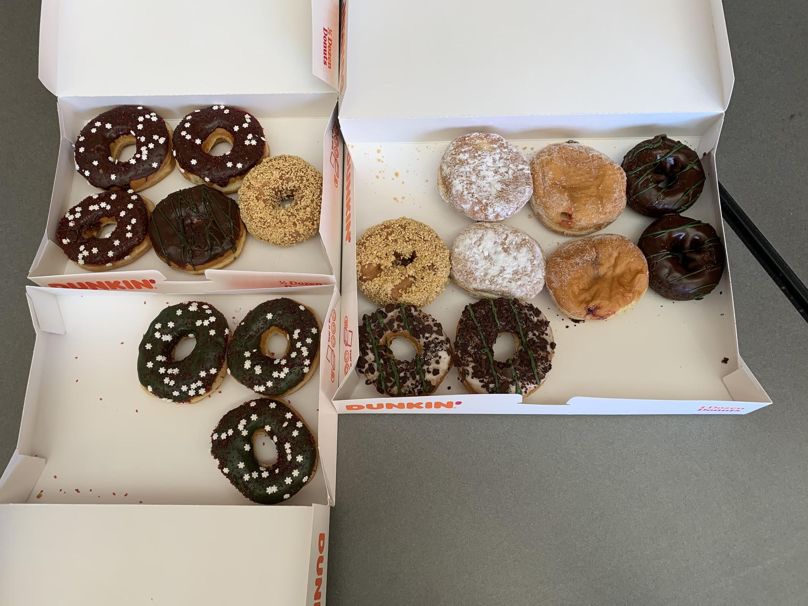
How many donuts?
How many different ways can we count them?
Let’s write some number sentences to match the photo!
1.OA.A2

Slide 10
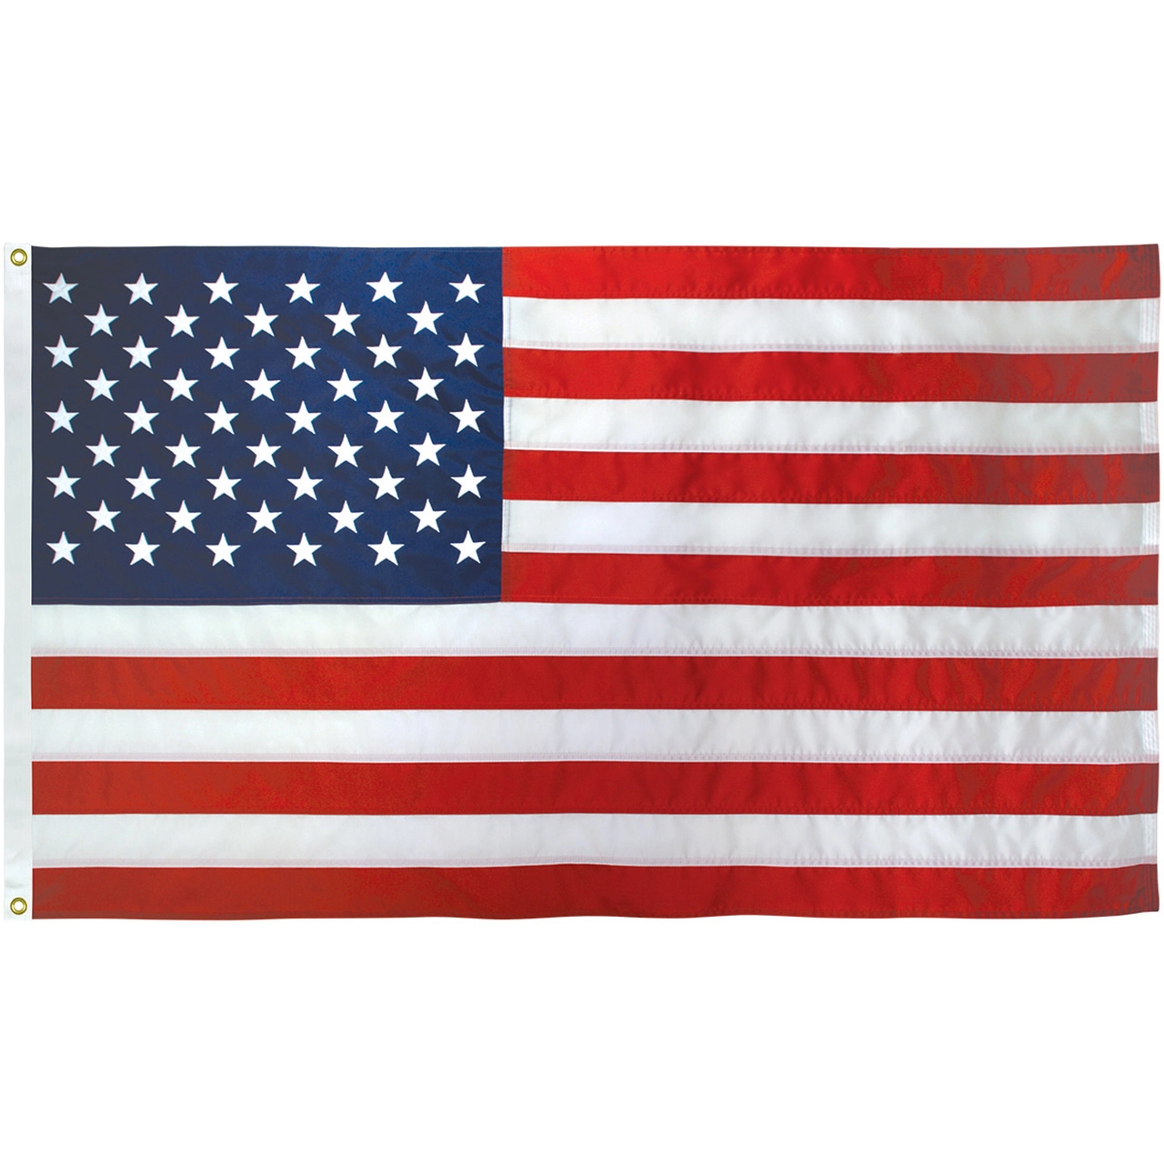
Happy Constitution Day!
Let’s describe the shapes we see in the American Flag!
How many stars?
How can we count them?
How many stripes?
How can we count them?
K.G.A1
Notes:
SEPTEMBER 17, 2021

Slide 11
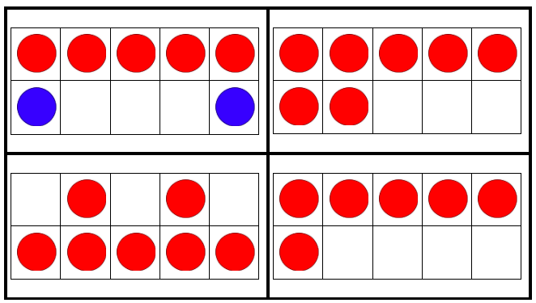
Which one doesn’t belong?
1.OA.C5
Notes:
Week of September 20, 2021

Slide 12
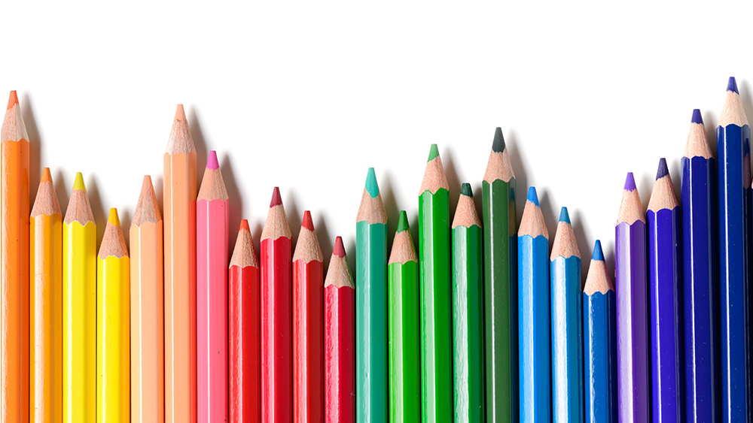
What can we say about these pencils?
How many are there?
How can we count them?
What do we see the MOST of?
What do we see the LEAST of?
1.NBT.A1

Slide 13
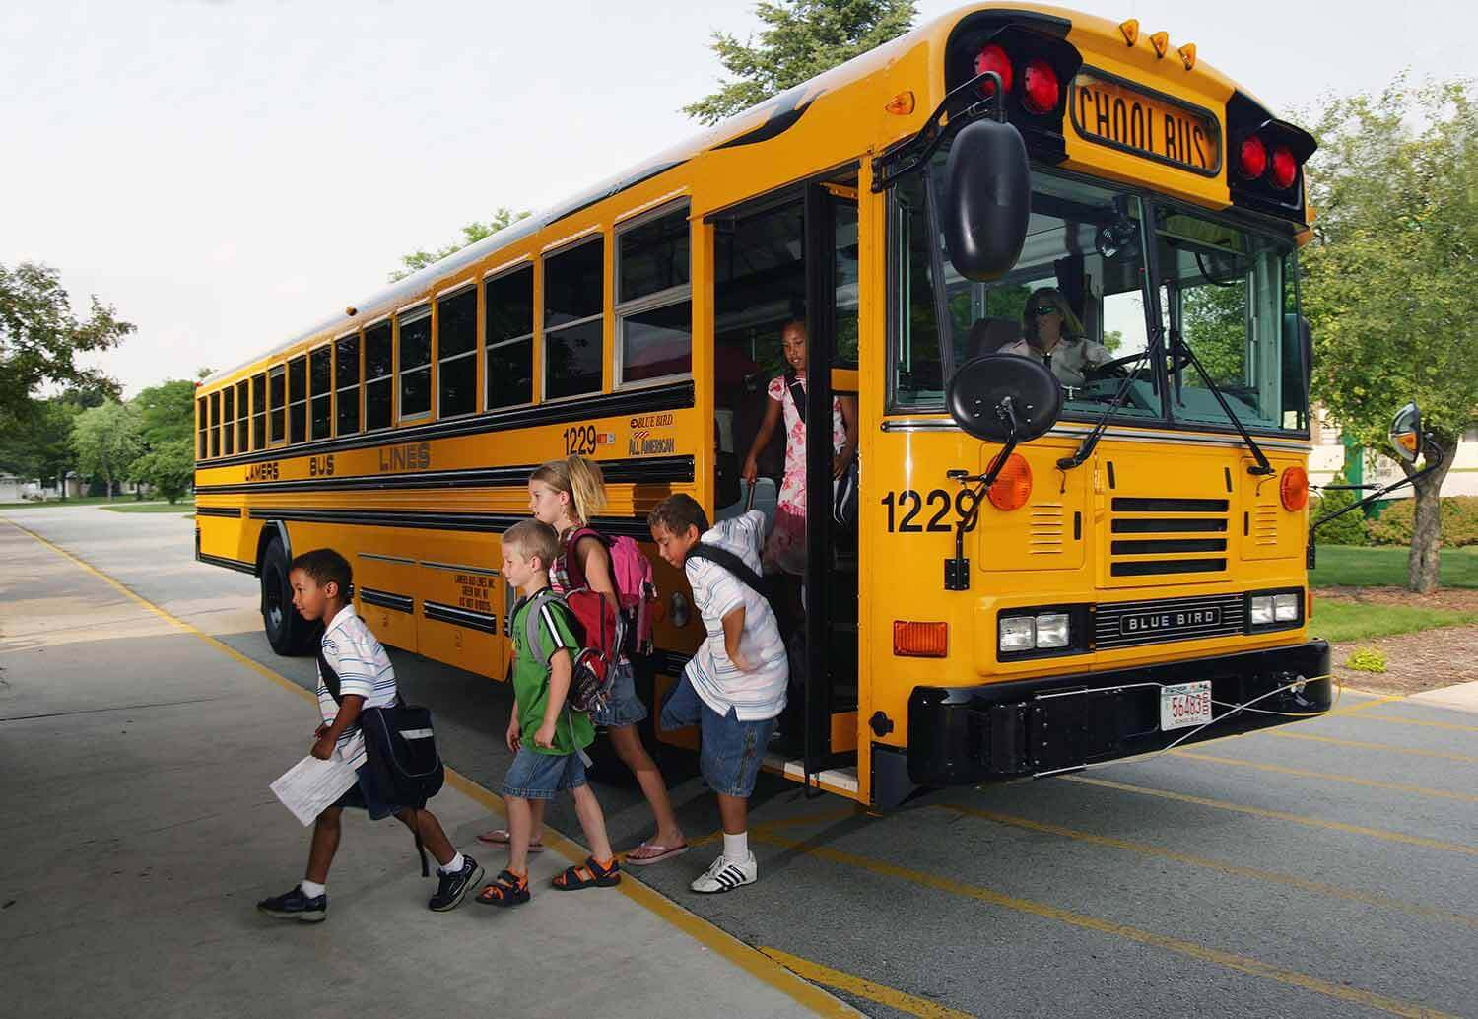
A school bus has 6 wheels.
How many wheels would 2 school busses have?
How about 3?
What about 10 busses?
1.OA.A1

Slide 14
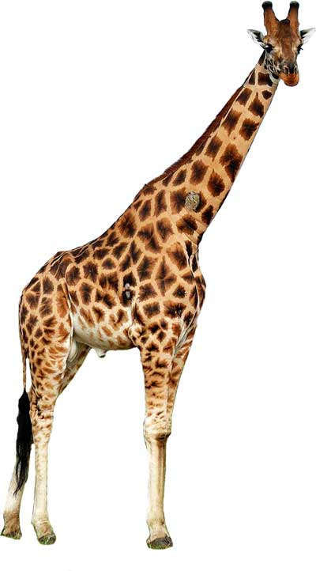
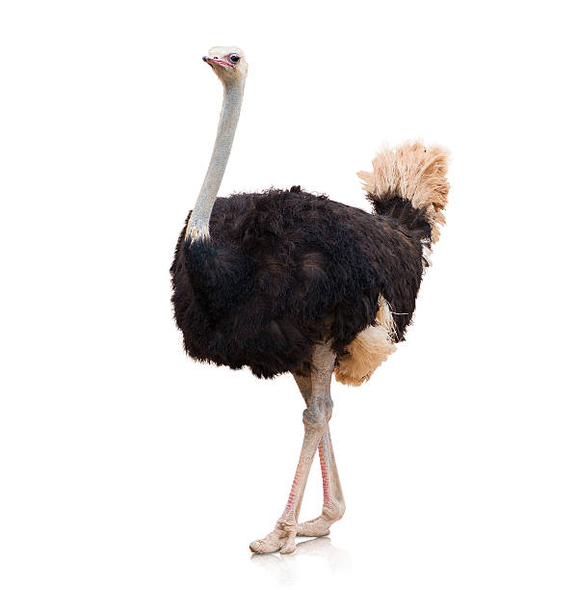
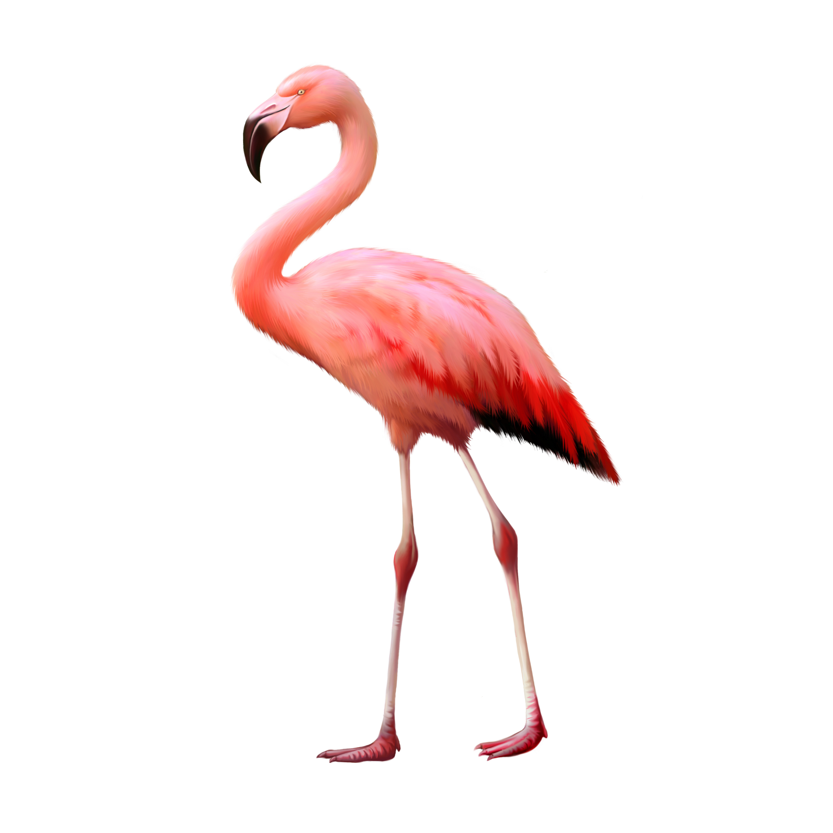
How can we COMPARE these animals?
1.MD.A1

Slide 15
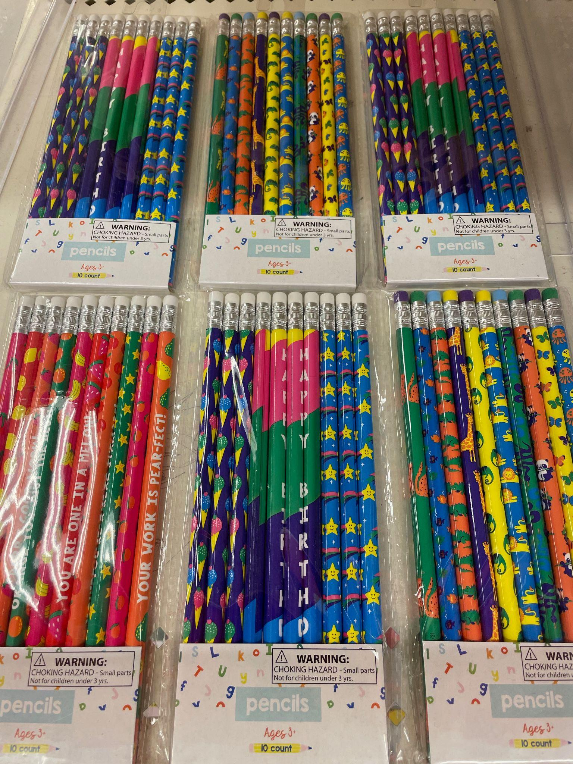
How many pencils are in each pack?
How many pencils are here altogether?
1.NBT.C5

Slide 16
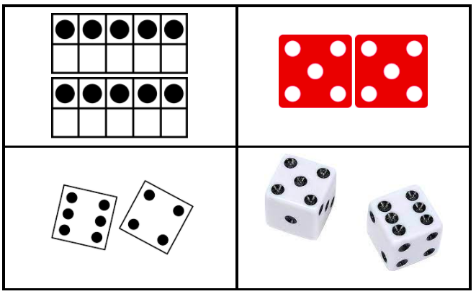
Which one doesn’t belong?
1.OA.C5
Notes:
Week of September 27, 2021

Slide 17
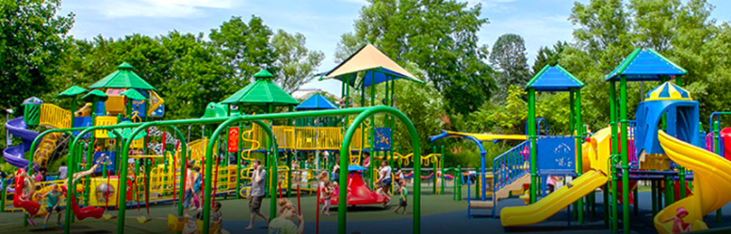
What shape do you see the MOST of in the playground at Franklin Park?
1.G.A1

Slide 18
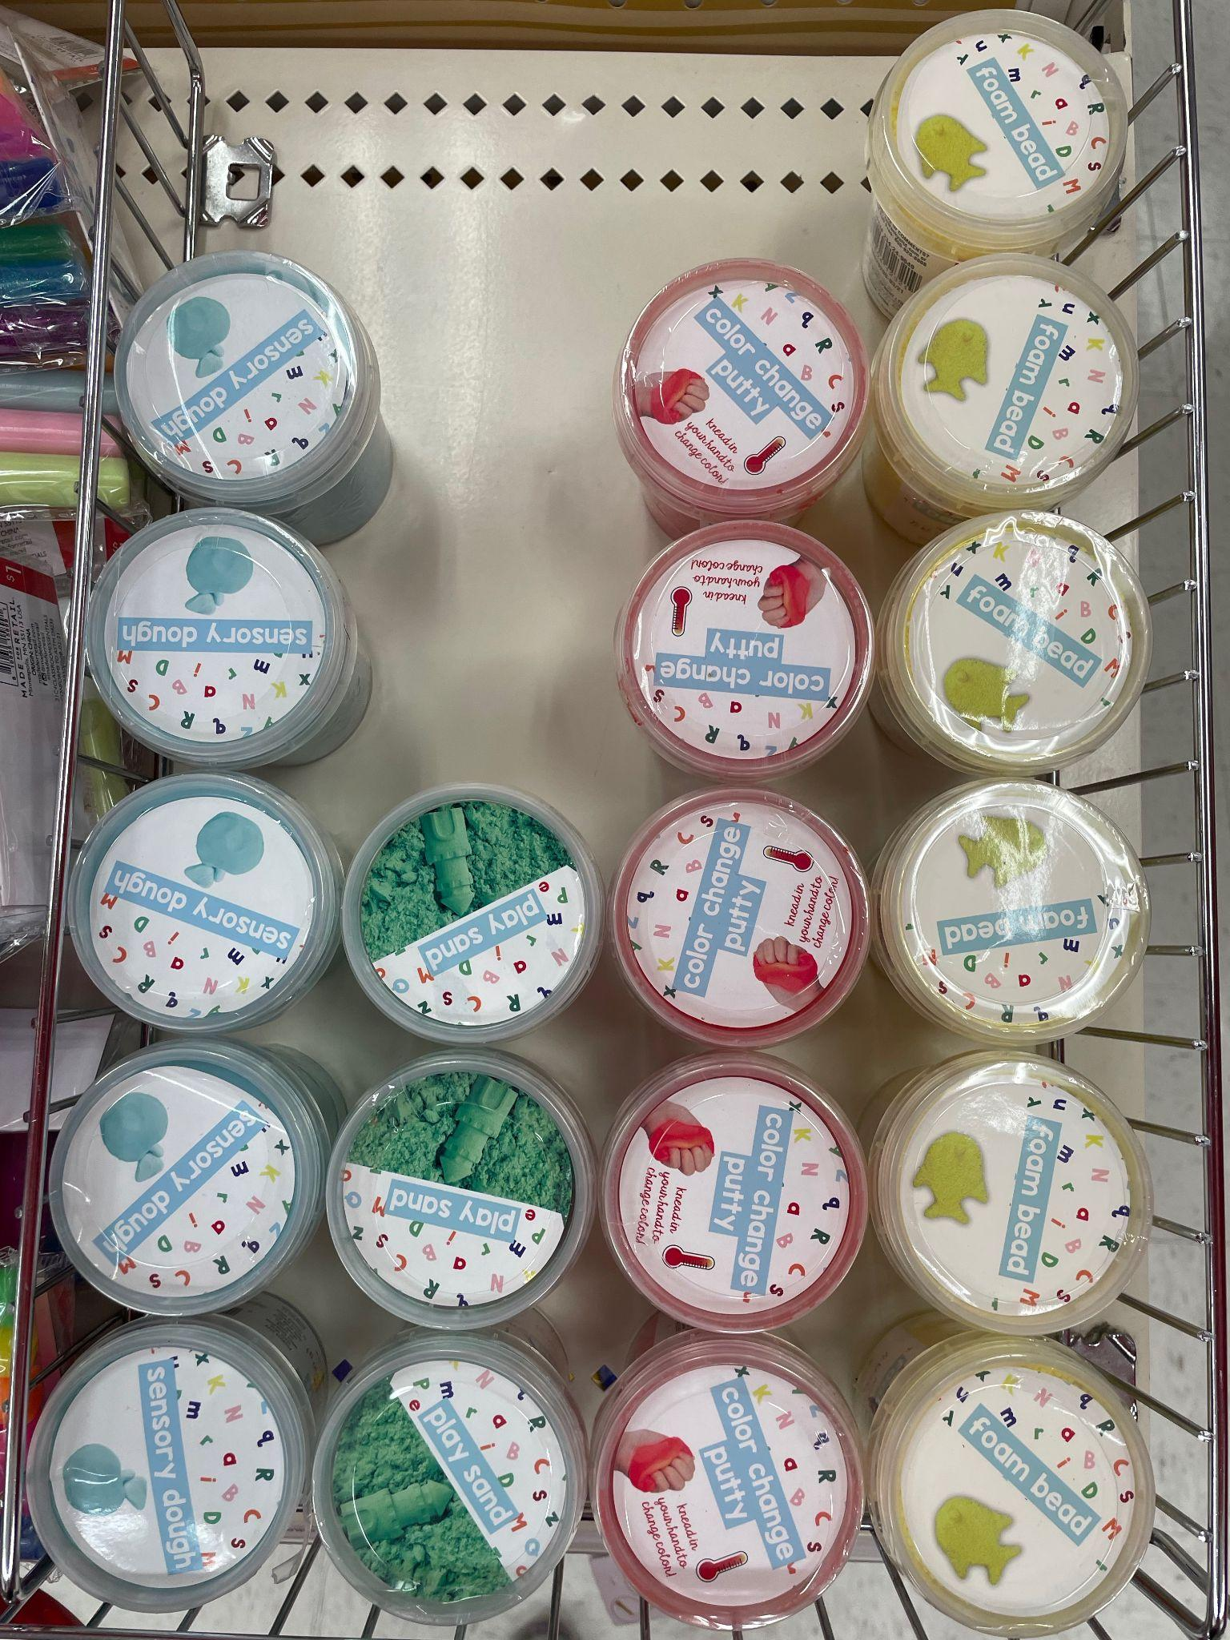
What can we say about this display of silly putty?
1.MD.C4

Slide 19
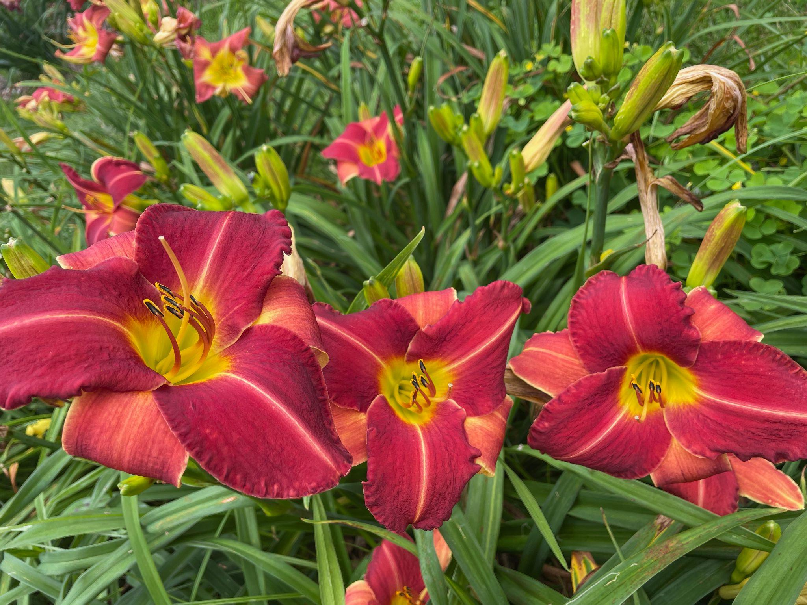
This is a lily garden in Mattapoisett.
How many lillies do we see?
How many more might there be that we don’t see?
1.NBT.A1

Slide 20

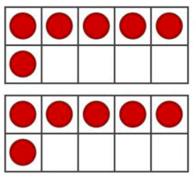

What’s the SAME? What is DIFFERENT?
1.NBT.B2

